Slide 1
IMPROVED AIR QUALITY MONITORING SYSTEM IN THE POST-HARVEST FACILITIES
<insert student name 1>
<insert student name 2>

Slide 2
Background
The primary role of post-harvest facilities is to store agricultural produce
An acceptable practice to reduce quality loss is to use mechanical aeration by fans
Aeration modifies temperature, humidity and atmospheric composition to it’s will

Slide 3
Problem STATEMENT
Post-harvest storage facilities lack controlled aeration mechanisms
Traditional aeration systems lack the aspect of control
Harvests end up too chilly or too dry
Amounting to post harvest loss

Slide 4
To design, test and implement a system that will improve storage harvest quality within a storage facility through aeration.
OBJECTIVES
Objective #1
To evaluate the hardware required to implement the system.
Objective #2
To acquire components and assemble a prototype of the system.
Objective #3
To test and analyze the performance of the system.

Slide 5
JUSTIFICATION
Cost feasibility of the system
Practicability of the system
Adoptability by the users
Required level of training

Slide 6
methodology
Consultancy/research?
Expert interviews
Simulation/Design?
Protues design suite
Programming?
Arduino IDE
Assembly/testing?
Single MVP

Slide 7
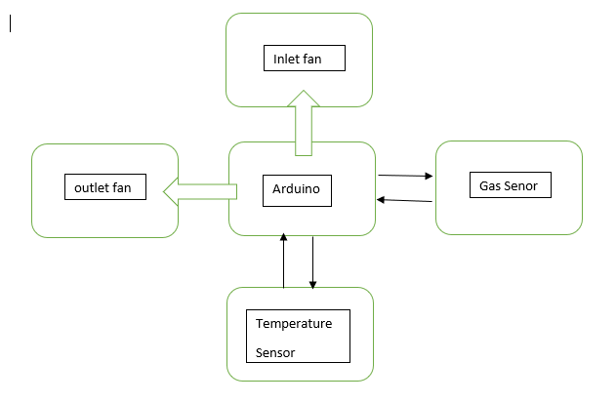
BLOCK DIAGRAM

Slide 8
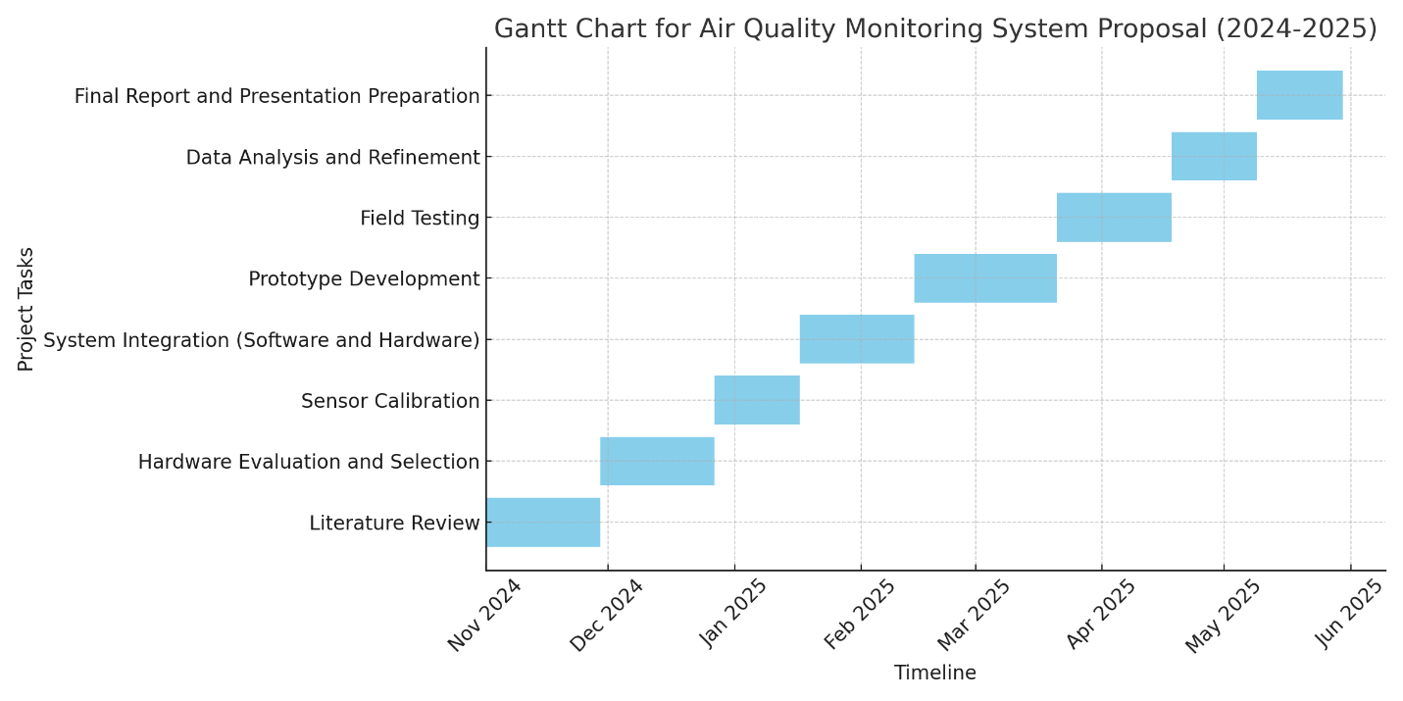
ACTIVITY PLAN

Slide 9
PROPOSED BUDGET
ITEM | PRICE (Shs)
MICROCONTROLLER UNIT | 55000
COMMUNICATION MODULE | 50000
TEMPERATURE SENSOR | 25000
HUMIDITY SENSOR | 25000
FANS (2) | 60000
POWER SUPPLY UNIT | 50000
CONSULTANCY | 100000
COMMUNICATION & TRANSPORT | 100000
TOTAL | 465000

Slide 10
THANK YOU

