Slide 1
Software Engineering
CS5002NP

Slide 2
Agendas
Unified Modeling Language
Different types of Unified Modeling Language
Use Case Diagram

Slide 3
Unified Modeling Language (UML)
A regulated modelling language that consists of several diagrams
Specify, construct, visualise, and document different aspects of software systems

Slide 4
Unified Modeling Language (UML)
Collection of best engineering practices that successfully model large and complex systems
Help project teams communicate, explore potential design, and validate the architecture design of the software

Slide 5
UML - Characteristics
Generalised Modeling Language
Different from programming language
Pictorial Language
Unlimited Application

Slide 6
UML - Types
Structural Diagram
Behavioural Diagram

Slide 7

Structural Diagram
Classes, objects, packages, physical nodes, components and interfaces

Slide 8
Structural Diagram
Depict the static structure of different elements
Used extensively in documenting the software architecture of a software system

Slide 9
Structural Diagram
Composite Structure Diagram
Deployment diagrams
Package diagram
Profile diagram
Class diagrams
Object diagram
Component diagrams

Slide 10

Behavioural Diagram

Slide 11
Behavioural Diagram
Depict the elements that are dependent on time and convey dynamic concepts
Resemble the verbs present in the English language and the relationships that connect them, conveying the passage of time

Slide 12
Behavioural Diagram
Activity diagram
Use case diagrams
State machine diagrams
Timing diagrams
Sequence diagrams
Collaboration diagrams
Interaction overview diagrams

Slide 13
Use Case Diagrams
Represent the details of a system and the person that uses it
Specify the expected behavior, not the exact method
Design a system from the end user’s perspective

Slide 14






Slide 15
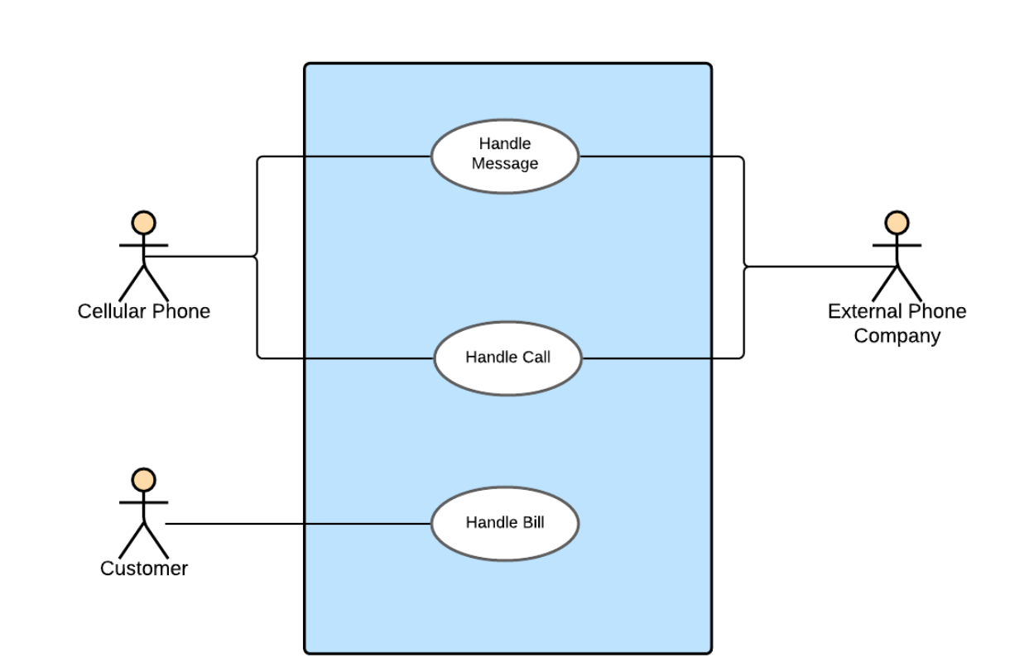
Use Case Diagrams - Notations

Slide 16
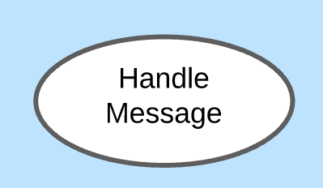
Use Case Diagrams - Notations
Use Case
System Functions/Processes
Verb + Noun

Slide 17
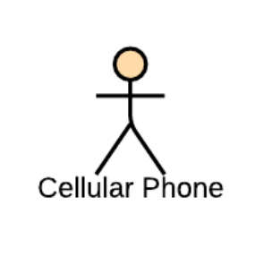
Use Case Diagrams - Notations
Actor
Interact with use case
Named by Noun
Plays a role in the business

Slide 18
Use Case Diagrams - Notations
Communication Link
Use to connect actors to use cases
Indicating that the actor and the use case communicate with one another using messages

Slide 19

Use Case Diagrams - Notations
Boundary
Entire System as defined in the required document
Use to enclose all the use cases

Slide 21
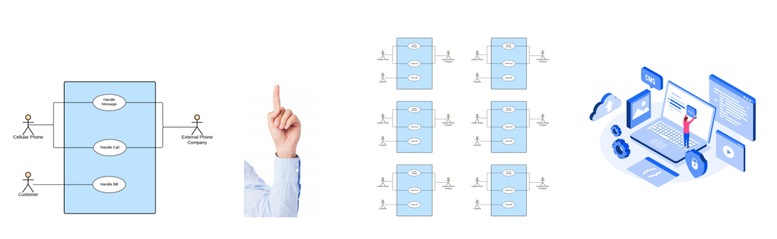

Slide 22
Use Case Diagrams - Relationships
Association
Generalization
Extends
Includes

Slide 23
Use Case Diagrams - Relationships
Association
Present in every use case diagram
An actor involved with a use case
Identified through a simple line or a line with arrows at both ends.

Slide 24
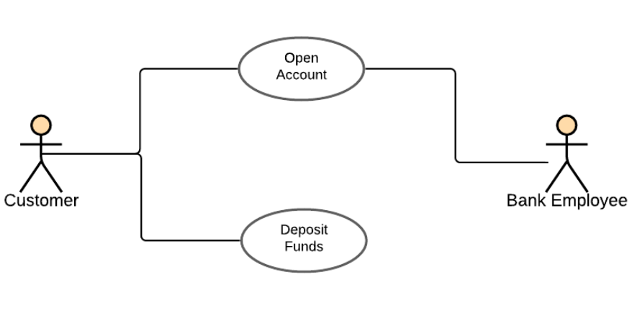

Slide 25
Use Case Diagrams - Relationships
Generalization
Parent-child relationship
Child is an enhancement of parent
Identified as a directed arrow with a triangle arrowhead
Can be further divided into
Generalization of an actor
Generalization of a use case

Slide 26
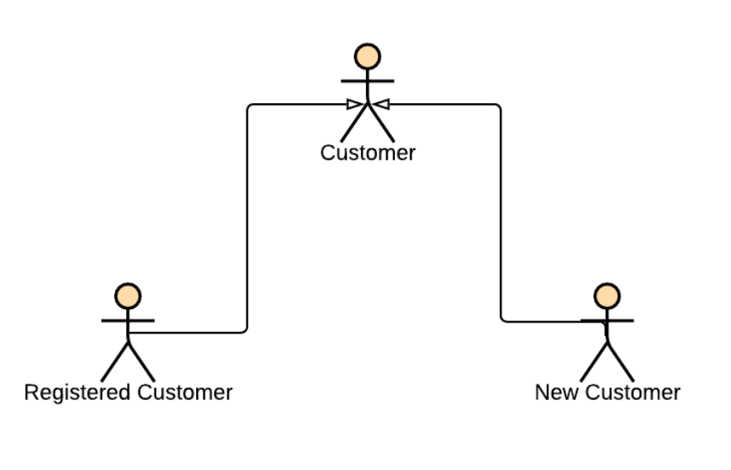
Use Case Diagrams - Relationships
Generalization of an Actor

Slide 27
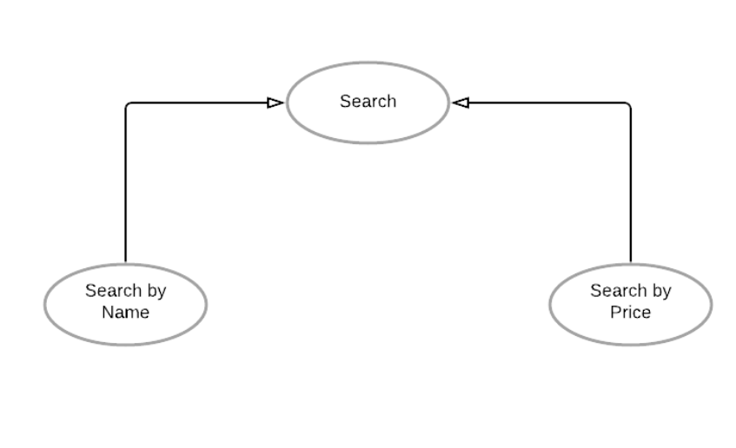
Use Case Diagrams - Relationships
Generalization of an Use Cases

Slide 28
Use Case Diagrams - Relationships
Extends
Shows optional functionality or system behavior
Presented in a use case diagram through a dotted arrow with the label extends

Slide 29
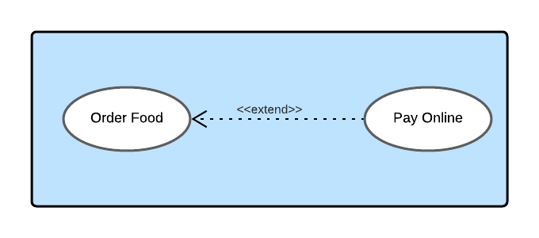
Use Case Diagrams - Relationships
Extends

Slide 30
Use Case Diagrams - Relationships
Includes
Adds additional functionality which is not specified in the base use case
Presented in a use case diagram through a dotted arrow with the label include

Slide 31
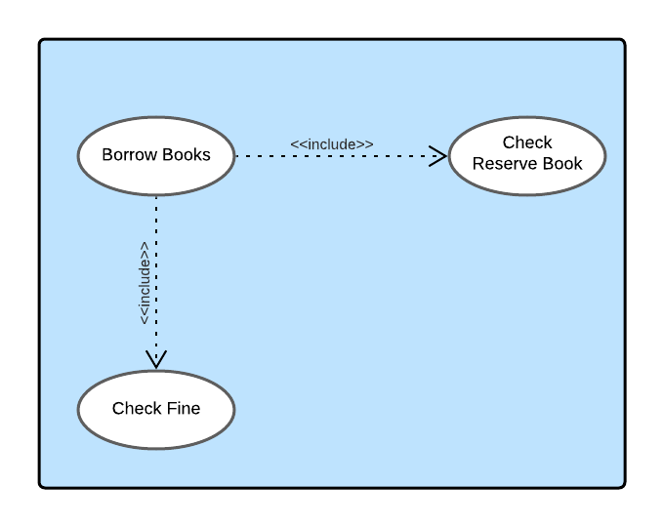
Use Case Diagrams - Relationships
Includes

Slide 32
THANK YOU!

