Slide 1
Lecture 1: Introduction
Dipendra Thapa
Dipendra.Thapa@icp.edu.np

Slide 2
Agenda
Introduction and overview of the module
Learning and teaching strategies
Assignment details and other administrative stuffs
Introduction to Computing

Slide 3
Overview of the module
Semester long module, 1 semester
Things to learn
Basics of Algorithms and algorithm design
Flowcharts & Pseudocode
Programming with Python

Slide 4
Assessments
This module is assessed by coursework
VIVA session will be held after submission where class performance will also be taken into account
LondonMet has collaboration policies, so plagiarism cases will be dealt very seriously
Assessments
Coursework (60%) – week 12 MCQ Exam (40%) – week 14

Slide 5
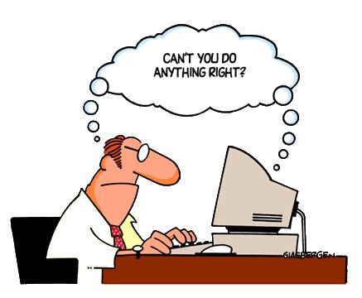
What is Computing?
A computer is an electronic programmable machine
A computer is very good at executing a preordered set of instructions with high speed and precision
Computing is the process of utilizing computer technology to solve problems and complete tasks

Slide 6
Terms and Terminology
Business Computing Level
Problem: Situation which prevents achieving our goals
Solution: New situation which satisfies our goals
Model: Informal (NL), graphic (UML) or formal (math) description of the transformation of a problem into a solution

Slide 7
Terms and Terminology
Information Technology Level
Data: Information used by a model in machine format
Algorithm: A set of steps defining how to find the solution
Program: A representation of an algorithm in machine form

Slide 8
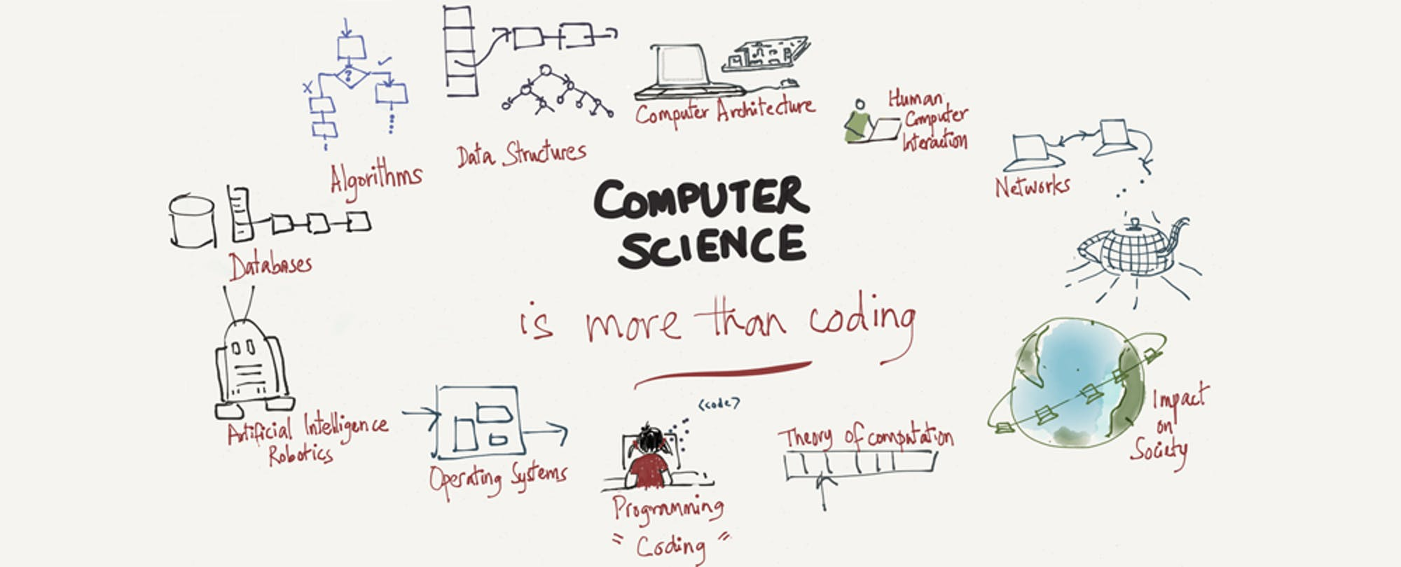
Computer Science is not the study of computers!
“Computers are to computer science what telescopes are to astronomy.” (E. Dijkstra)
So what is
Computer Science
then?

Slide 9
The recurrent themes in computer science
Computing technology effects:
Governments, economies, scientific research, communication, …
Seven “Big Ideas” that unite the study of computing into a scientific discipline:
Algorithms
Data
Abstraction
Programming
Networking
Creativity and Impact

Slide 10
Algorithms
A set of steps defining how to find the solution to a problem
A set of steps defining how to complete a particular task
An algorithm is basically a plan/blueprint to write a program
eg: an algorithm to add 2 numbers
Algorithms are written in steps, and can be further described using flowcharts and pseudocode

Slide 11
Data
Raw facts or figures that exist in a variety of forms, e.g. numbers or text on a piece of paper or bits and bytes stored in computer (0s and 1s)
Computers can represent and store any kind of data in digital format
Algorithms are used to process and transform data
They utilize massive storage capacities and processing power of computers

Slide 12
Data & Information
Information is created from data
Useful information is generated from data after processing it
There are massive amounts of data being generated everyday
That data needs to be processed in order to extract useful information
Data
Data
Data
Processing
Information

Slide 13
Abstraction
Abstraction: The distinction between the external appearance of an entity and the details of the entity’s internal composition.
Interface: A tool that allows the entity to be used without concern for its internal properties.
For example, you want to send an email to your friend that lives abroad. How do you do it?
You open your email account and then type your email. Your friend also needs to open his email account and then read it.
But do you know the processes involved? No. Because both you and your friend only see the outer interface. This is called abstraction.

Slide 14
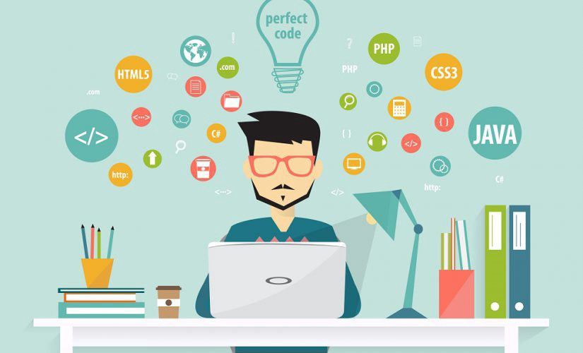
Programming
Programming is broadly referred to as:
Translating human intentions into executable algorithms
Abstractions in a programming language allows humans to reason and encode solutions to complex problems without knowing the details of the actual solution

Slide 15
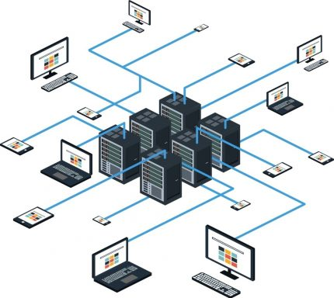
Networking
Profound impact in the way information is:
Stored
Retrieved
Shared
Used

Slide 16
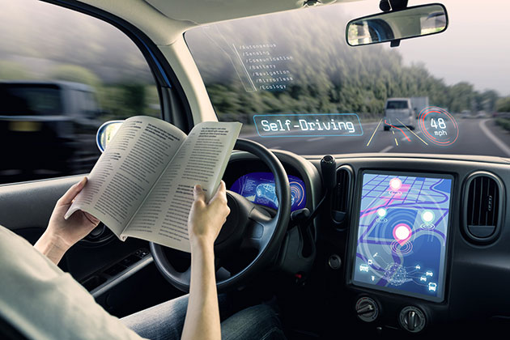

Creativity
Computer science is inherently creative
Discovering and applying algorithms to solve problems is an essential human activity
Basically making computers do our work to make our lives easier, eg: self-driving cars
Extends the forms of expression in many ways – i.e., digital art/media, collaborative working through online platforms, etc

Slide 17
Impact
Business and Technology
Social, ethical, legal impacts including:
Security concerns and cybercrime
Issues of software ownership and liabilities
Social impact of database technology
Consequences of robotics, Artificial Intelligence (AI) in general
Health impacts:
Addiction, Neurosis and Emotional life
Sighting and Hearing

Slide 18
Role of Algorithms
The study of algorithms was originally a subject in mathematics (numerical calculations, geometric drawings, alphabetical sorting, coding, encryption, etc.)
Examples of an early algorithm used in mathematics is the “Euclidean Algorithm”
The algorithms became the basis for problem solving in business (modeling) and technology (computer programming)
Gödel's Incompleteness Theorem: Some problems cannot be solved by algorithms (they need an intuition, guess, chance…)

Slide 19
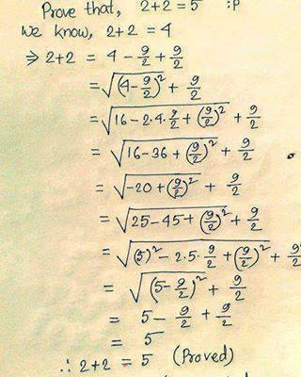
Gödel's Incompleteness Theorem
Using algorithms, we can prove things like 2+2=4 and 2+2≠5. But can an algorithm also prove things like 2+2=5?
There are other examples as well. Like earthquakes. We cannot predict if we will have an earthquake tomorrow can we?

Slide 20
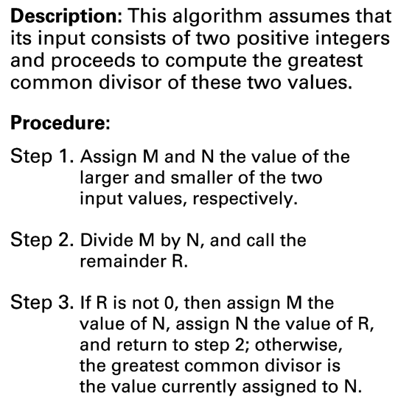
The Euclidean algorithm
An algorithm to find the greatest common divisor of two numbers

Slide 21
The Euclidean algorithm
Lets take two numbers: 12 and 9
12 = 1,2,3,4,6,12
9 = 1,3,9
M = 12 and N = 9 then R = 3
Again,
M = 9 and N = 3 then R = 0.
Thus, Greatest Common Divisor is 3.

Slide 22
End of Lecture 1

Slide 23
Thank you ! Any questions ?

