Slide 1
Lecture 2: Introduction to Python
Dipendra Thapa
Dipendra.Thapa@icp.edu.np
CS4051 Fundamentals of Computing

Slide 2
Agenda
Programming language and programming
Python basics
Python variables and data types
Basic math operations

Slide 3
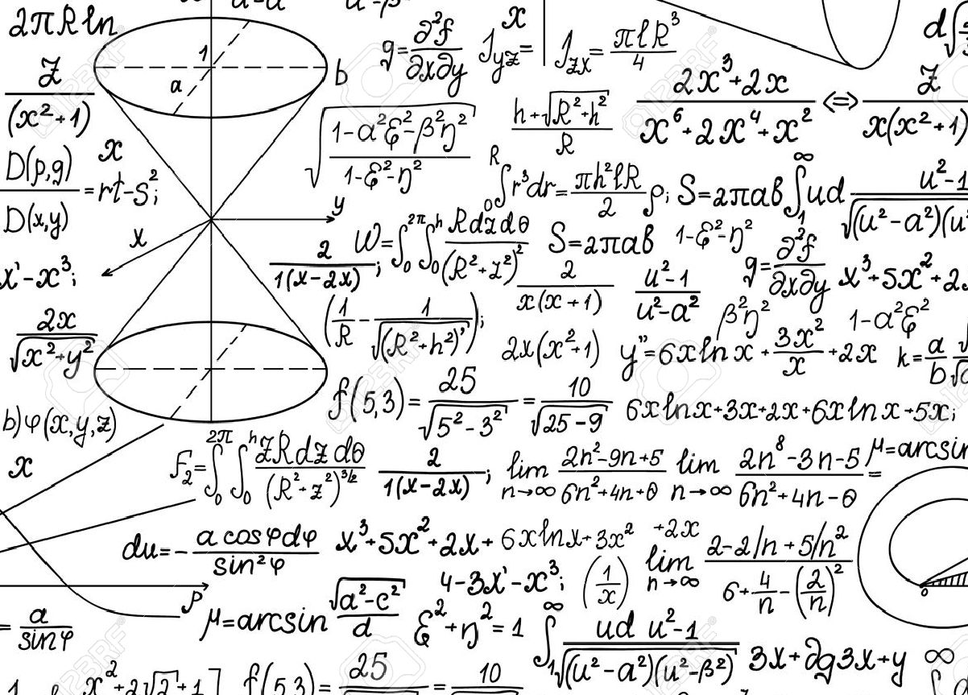
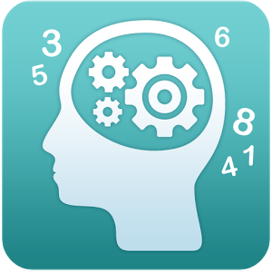
What is computation?
What does a program do?
Fundamentally,
performs calculations, a billion calculations per second
remembers results, 100s of gigabytes of data
What kind of calculations?
built-in to the language
ones that you define as a programmer
Computers only know what you tell them

Slide 4
Programming language and programming
A programming language is a computer system created to allow humans to precisely express algorithms using a higher level of abstraction without reference to the computer operations and the internal information representation
Programming languages shield users from details of the machine:
A single Python statement might map to one, tens, or hundreds of machine instructions
Basically a program is a set of instructions for the computer to perform/execute

Slide 5
The way of the program
A computer program is a sequence of steps to execute
Programs use flow control to specify when each step is executed, they use loops and conditionals
They have a means of determining when to stop

Slide 6
Advice for learning programming
Want to be good at programming? The only way is Practice! Practice and Practice !
You can’t passively absorb programming as a skill, you won’t learn programming without trying it out yourself
Don’t be afraid to try out commands and run programs, in the worst case you will just have to reset/restart the computer

Slide 7
Introduction to Python
A readable, dynamic, pleasant, flexible, fast and powerful language
Multi-purpose (General purposes, Scientific computing, Data Science, Artificial Intelligence, Web, etc.)
Supports multiple programming paradigms/styles (object-oriented, functional, procedural)
Interpreted Language
Focuses on readability and productivity, code blocks are separated using indentation (empty space at the beginning of a line) and not brackets
Large and comprehensive standard library (built in features)
Cross platform and strong community

Slide 8
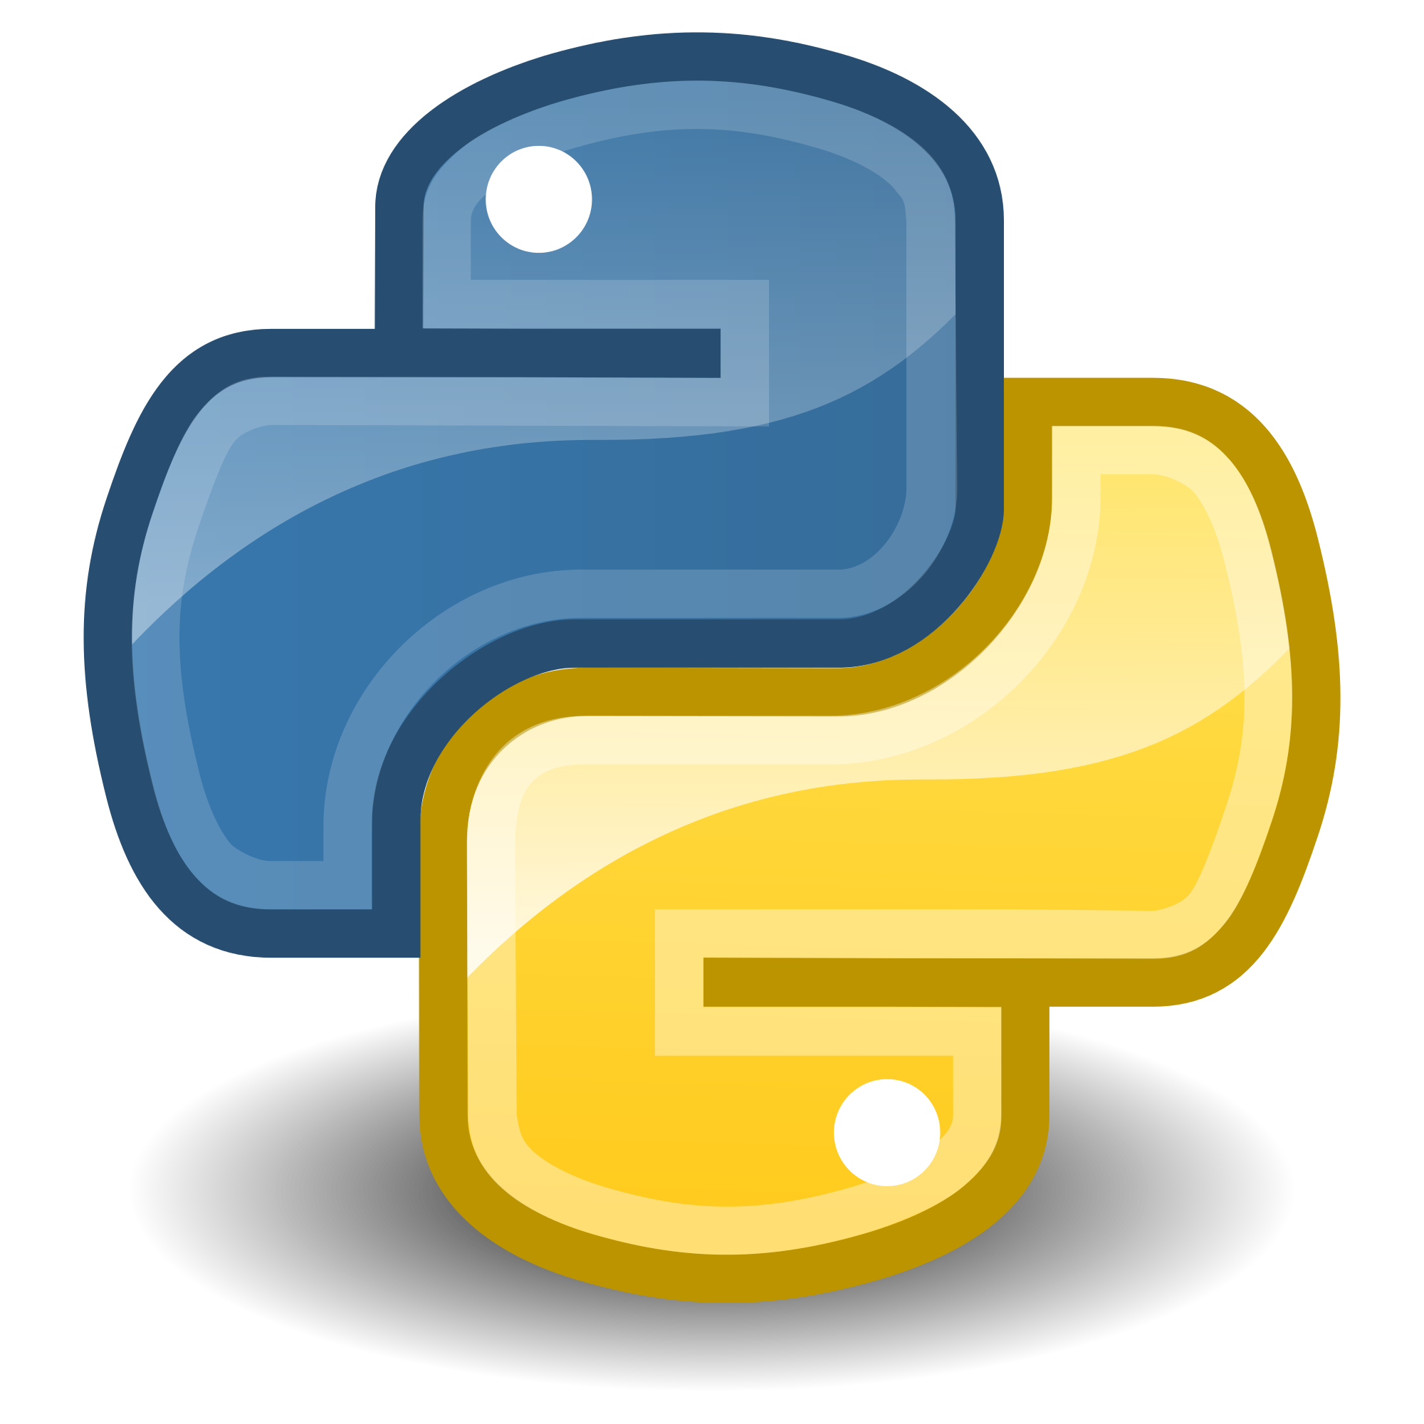
What we will be using?
We will be using python 3
Can be downloaded and easily installed link for download: www.python.org/downloads
We will be using IDLE as our default IDE (Integrated Development Environment)

Slide 9
Programming Paradigms
Programming paradigms are ways of structuring and organizing code
There exist many programming paradigms, popular ones are imperative/procedural and object oriented programming (OOP)
We will start with procedural programming and later in the course we will get to OOP

Slide 10
Procedural Programming
Characterized by sequential sets of linear commands where you write statements for the computer to execute
Code can be grouped into procedures and functions
Functions and procedures are a series of instructions that are performed on a given parameter or parameters. Functions return a value while procedures don’t.
Basic concepts are:
Sequence (execution moves forward one statement at a time)
Selection (if statements)
Iteration (loops)

Slide 11
Object Oriented Programming
Based on the concept of classes whose instances are called objects
Classes store data in form of attributes
Each class has its own methods which perform some operations
Useful in modeling real world entities
For example, think of a person class, a person has attributes such as name, address, height, weight, etc. A person can talk, walk and interact with another person, so those are the methods of the class

Slide 12
Compiled and Interpreted Languages
In compiled languages, source code is converted/compiled into machine code first and the program is run
Whereas in the case of interpreted languages, each line of code is translated into machine code and executed one at a time by the interpreter
When a python program is run, the python interpreter reads and executes each line of code one by one

Slide 13
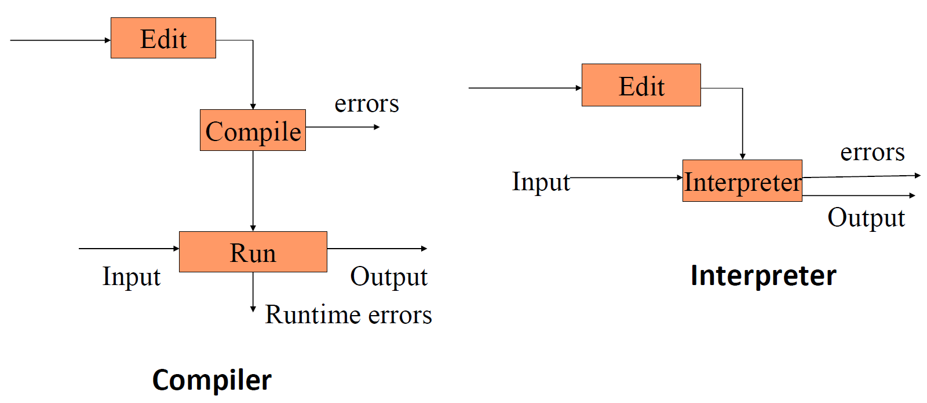
Compiled and Interpreted Languages

Slide 14
Python Data Types
int – represent integers, eg. 5
float – represent real numbers, eg. 2.12
bool – represent Boolean values True or False
str – represent characters, eg. “Hello World !!”
type() can be used to see the data type of a value
>>> type(1)
int

Slide 15
Type conversion
Convert the datatypes from one to another
float(3) converts integer 3 to float 3.0
int(3.4) truncates float 3.4 to integer 3
str(3) converts integer 3 to string ”3”

Slide 16
The “Hello World” program in python
The “Hello World” program in python is as simple as
print(“Hello World !!”)
The print function (inbuilt function) prints out “Hello World” in the above program
A function takes some parameters and does some operations on them, the job of the print function here is to output what’s given to it as parameters
Python files are saved with a .py extension

Slide 17
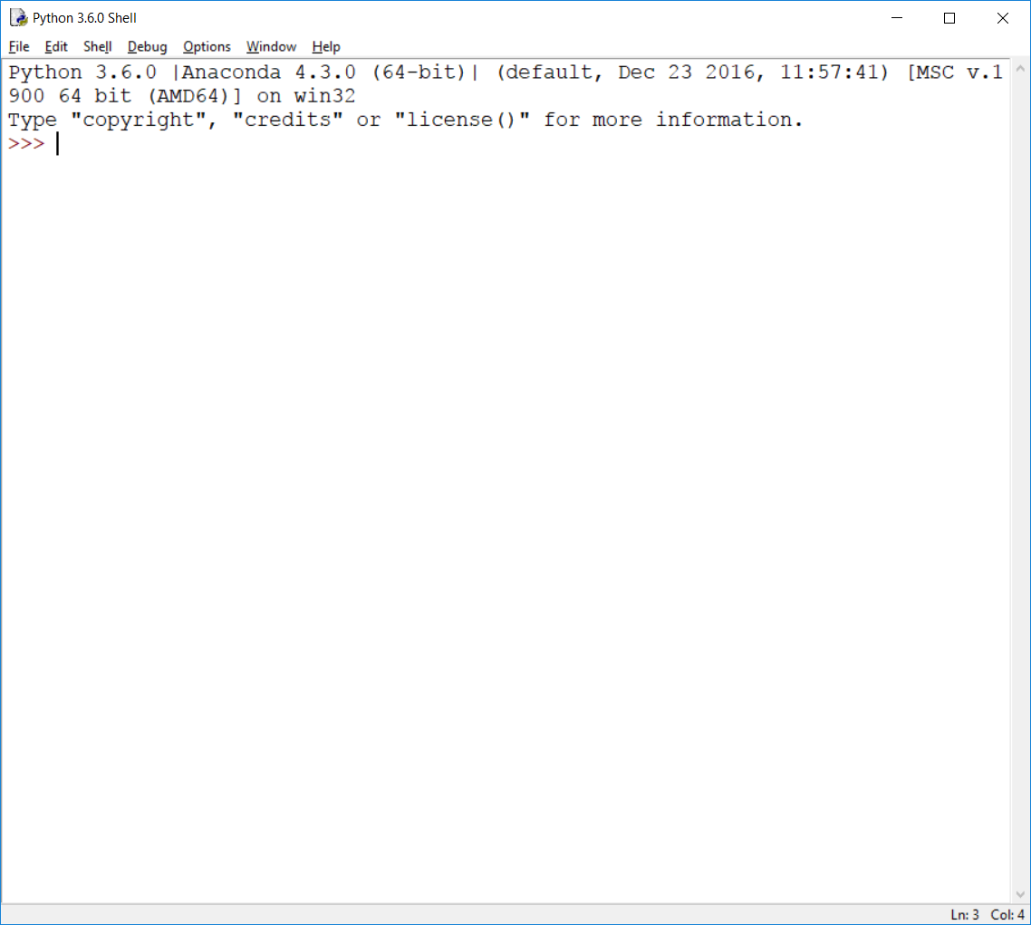
IDLE
This is the python shell, you can run commands here which will be executed by the python interpreter and the result will be printed out straight away

Slide 18
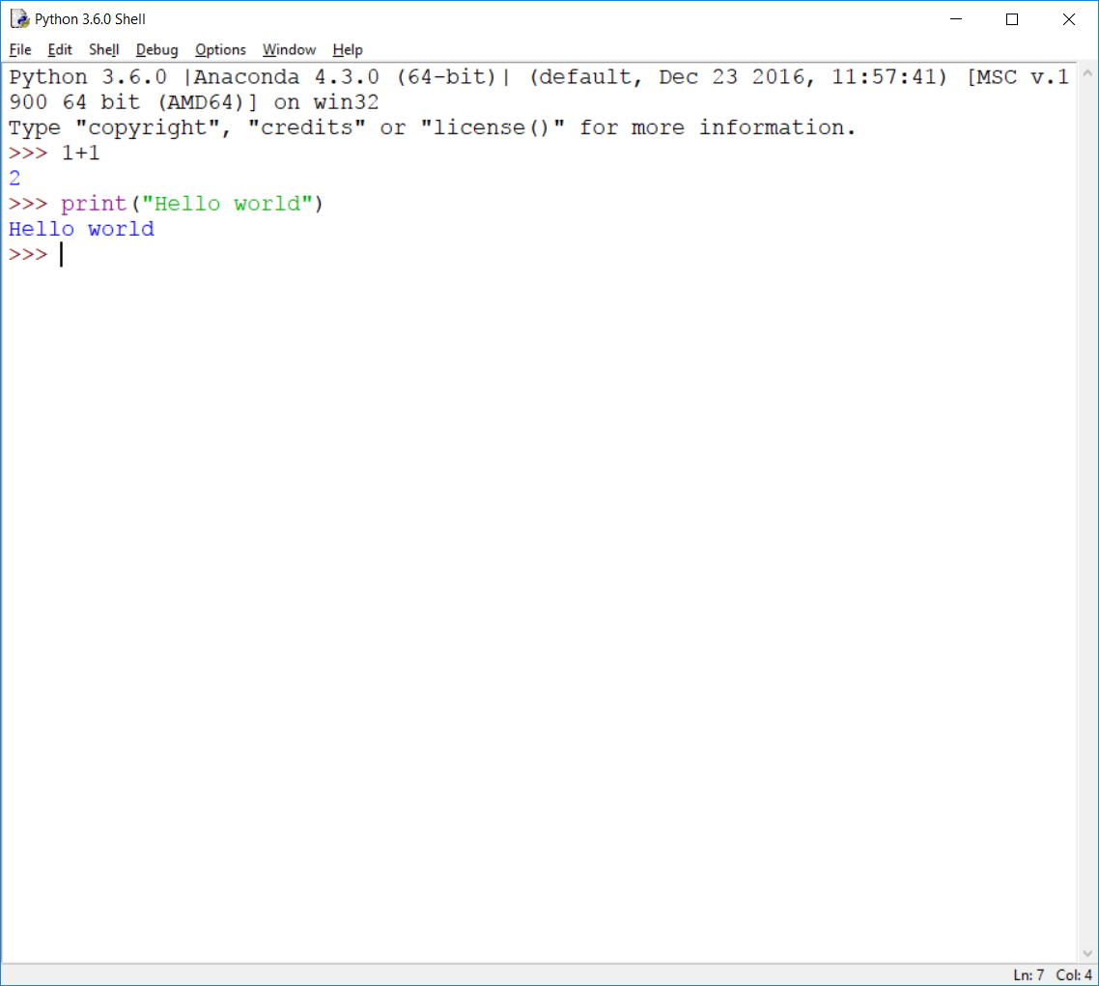
IDLE
You can run the hello world program in the shell

Slide 19
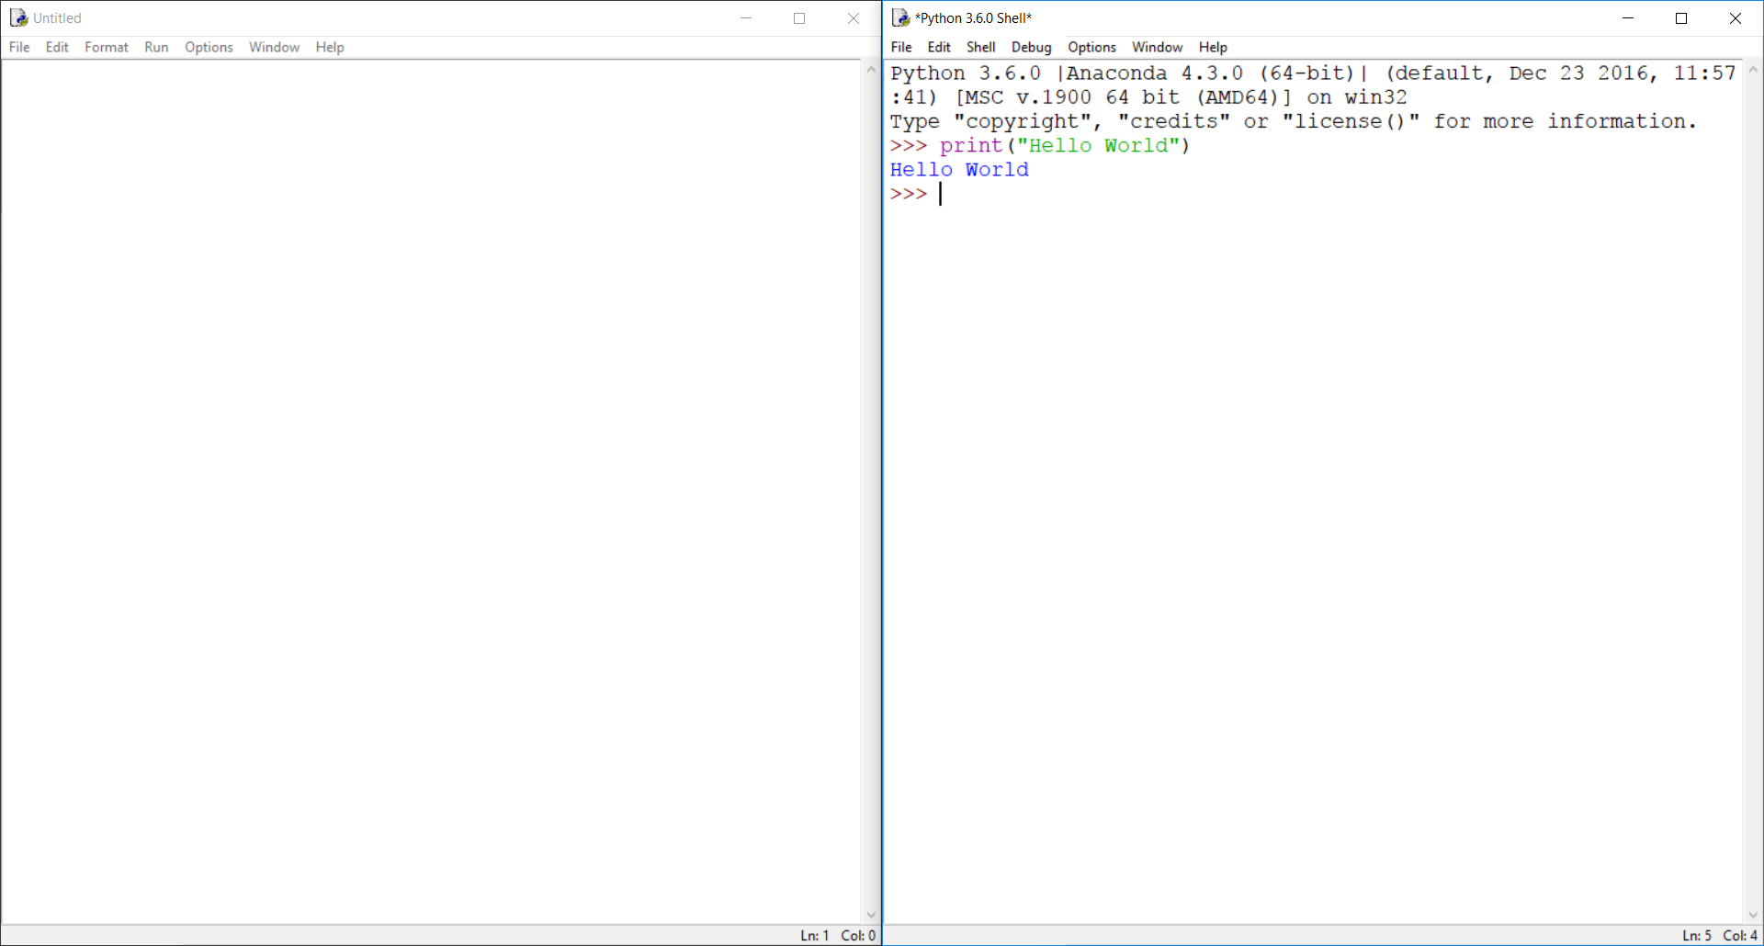
IDLE
Clicking on
File -> New File will open another window called the editor, it allows us to write programs and save them

Slide 20
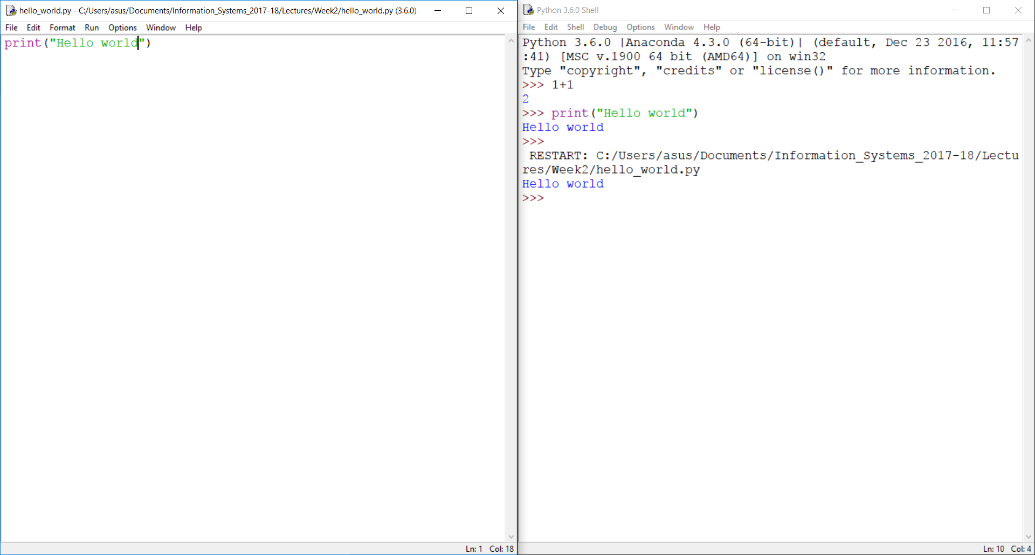
IDLE
The program can be run by clicking on
Run -> Run Module

Slide 21
Variables
In programs, variables are a place for storing data for further use
While declaring a variable in python you don’t need to specify a data type
You just declare a variable and assign it a value
Python automatically assigns the variable a suitable type during runtime
a = 1
b = “one”
c = 1.0

Slide 22
Strings
Strings can be declared in the following ways
a = “this is a string”
b = ‘this is also a string’
The “+” operator is used to concatenate (join) multiple strings
>>> print(“Good morning! ”+”The Weather is good today.”)
>>> Good morning! The Weather is good today.

Slide 23
Numbers
Integer numbers
a = 12
b = int(“20”)
Floating point numbers
pi = 3.1415
pi2 = float(“3.1415”)

Slide 24
Comments
Comments are useful to describe what your code is doing. During runtime the python interpreter just ignores them and does not treat them as code. Comments in python can be written in the following ways
a = 1 # this is a comment
print(a)
‘‘‘this is a multiline
comment’’’

Slide 25
Arithmetic operators
Arithmetic operators in python are as follows
Operator | Meaning
+ | Addition
- | Subtraction
/ | Division
* | Multiplication
% | Modulus - remainder of division
** | Exponent - raise a number to the power of another number

Slide 26
Arithmetic operators
a = 10 # 10
a += 1 # 11 (equivalent to a = a + 1)
a -= 1 # 10 (equivalent to a = a - 1)
b = a + 1 # 11
c = a – 1 # 9
d = a * 2 # 20
e = a / 2 # 5
f = a % 3 # 1
g = a ** 2 # 100

Slide 27
Taking input from the user
User input can be implemented using the input() function
name = input(“Enter your name: ”)
print(name)
>>Enter your name:
>>Enter your name: Alex
>>Alex
The default data type of the user input data is “str”, in order to perform math operations on that data, type conversion must be done

Slide 28
Errors in programs
Syntax errors – Errors in the grammar of the language
english:
“cat dog boy” – not syntactically valid
“cat hugs boy” – syntactically valid
programming languages
“hi”5 – not syntactically valid
3.2*5 – syntactically valid

Slide 29
Errors in programs
Runtime errors – No syntax errors but program can’t complete execution
english:
“He are hungry” – syntactically valid but not meaningful
programming languages
3.2*5 – syntactically valid
3.2+”hi” – syntactically valid but the computer can’t really add 3.2 and “hi”

Slide 30
Errors in programs
Logical errors – The program completes execution but delivers incorrect results
english:
“Flying planes can be dangerous”– can have multiple meaning
programming languages:
have only one meaning but may not be what the programmer intended

Slide 31

Calculating mathematical expressions
A simple program to calculate the area of a circle, $A=πr^{2}$
pi = 3.14
radius = 2
area = pi*(radius**2)
print(area)
>>>12.56

Slide 32
Calculating mathematical expressions
A simple program to calculate the area of a circle, $A=πr^{2}$
pi = 3.14
radius = 2
area = pi*(radius**2)
print(area)
>>>12.56

Slide 33
Calculating mathematical expressions
A simple program to calculate the area of a circle, $A=πr^{2}$
pi = 3.14
radius = 2
area = pi*(radius**2)
print(area)
>>>12.56
3.14
pi

Slide 34
Calculating mathematical expressions
A simple program to calculate the area of a circle, $A=πr^{2}$
pi = 3.14
radius = 2
area = pi*(radius**2)
print(area)
>>>12.56
3.14
pi
2
radius

Slide 35
Calculating mathematical expressions
A simple program to calculate the area of a circle, $A=πr^{2}$
pi = 3.14
radius = 2
area = pi*(radius**2)
print(area)
>>>12.56
3.14
pi
2
radius
12.56
area

Slide 36
End of Lecture 2

Slide 37
Thank you ! Any questions ?

