Slide 1
Lecture 6: Collection Data Types II
Dipendra Thapa
Dipendra.Thapa@icp.edu.np
CS4051 Fundamentals of Computing

Slide 2
Last couple of weeks
lists – mutable ordered collection of elements
tuples – immutable ordered collection of elements

Slide 3
Today
Other collection data types
dictionaries
sets
2-dimentional lists

Slide 4
Storing student info in lists
can store data in separate lists
names = [‘john’, ’sam’, ’anna’, ’ben’, ’jeff’]
maths = [88.0, 77.0, 67.0, 87.0, 90.0]
english = [86.0, 67.0, 65.0, 78.0, 80.0]
a separate list for each item
each list must have the same length
each index here refers to info of a different student

Slide 5
Update/Retrieve student info
must keep track of index
to update/retrieve data of a particular student, must use specific index
messy if lot of different info to keep track of as many lists must be maintained
must always use integers as index

Slide 6
An alternative - dictionaries
A dictionary is an unordered collection of key-value pairs with unique keys
Dictionaries are mutable, so items can be easily added/removed
Since dictionaries are unordered, there is no concept of order/position, a definite order is not guaranteed
Dictionaries are denoted using curly brackets {}

Slide 7
An alternative - dictionaries
A dictionary is an unordered collection of key-value pairs with unique keys
Dictionaries are mutable, so items can be easily added/removed
Since dictionaries are unordered, there is no concept of order/position, a definite order is not guaranteed
Dictionaries are denoted using curly brackets {}
p01= {'id': 1948, 'name': 'Cap', 'size': 3}
key1
value1
key2
value2
key3
value3

Slide 8
Lists vs Dictionaries
dictionaries allow a nice way to index items by using custom keys/index
List
Dictionary
0 | Element 1
1 | Element 2
2 | Element 3
3 | Element 4
… | …
Key 1 | Value 1
Key 2 | Value 2
Key 3 | Value 3
Key 4 | Value 4
… | …
index
element
custom index
element/value

Slide 9
Dictionary operations
maths = {‘john’: 88.0, ‘sam’: 77.0}
print(maths[‘john’]) # prints 88.0

Slide 10
Dictionary operations
maths = {‘john’: 88.0, ‘sam’: 77.0}
print(maths[‘john’]) # prints 88.0
maths[‘john’] = 90.0 # modifies value
print(maths[‘john’]) # prints 90.0

Slide 11
Dictionary operations
maths = {‘john’: 88.0, ‘sam’: 77.0}
print(maths[‘john’]) # prints 88.0
maths[‘john’] = 90.0 # modifies value
print(maths[‘john’]) # prints 90.0
maths[‘alan’] = 77.0 # adds key-value pair
# maths = {‘john’: 90.0, ‘sam’: 77.0, ‘alan’: 77.0}

Slide 12
Dictionary operations
maths = {‘john’: 88.0, ‘sam’: 77.0}
print(maths[‘john’]) # prints 88.0
maths[‘john’] = 90.0 # modifies value
print(maths[‘john’]) # prints 90.0
maths[‘alan’] = 77.0 # adds key-value pair
# maths = {‘john’: 90.0, ‘sam’: 77.0, ‘alan’: 77.0}
del(maths[‘sam’]) # delete pair with key ‘sam’
# maths = {‘john’: 90.0,‘alan’: 77.0}

Slide 13
Iteration in dictionaries
maths = {‘john’: 88.0, ‘sam’: 77.0}
for key, value in maths.items():
print(key, value)
>>>
john 88.0
sam 77.0

Slide 14
Iteration in dictionaries
maths = {‘john’: 88.0, ‘sam’: 77.0}
for key in maths.keys():
print(key)
>>>
john
sam

Slide 15
Iteration in dictionaries
maths = {‘john’: 88.0, ‘sam’: 77.0}
for value in maths.values():
print(value)
>>>
88.0
77.0

Slide 16
Dictionary keys and values
values
any type (immutable and mutable)
can be duplicates
dictionary values can be lists, and even dictionaries!
keys
must be unique
immutable type (int, string, float, bool)
d = {4: {1: 0, 3: 2}, ’const’:[3.14, 9.8, 2.7]}

Slide 17
Sets
A set is an unordered collection of elements
Sets are mutable, so we can easily add or remove items
But since they are unordered, there is no concept of index, any specific order is not guaranteed
Sets always contain unique items, adding duplicate items is safe but pointless
Sets are denoted by {}

Slide 18
Set operations
a
b
a = {1, 2, 3, 4}
b = {3, 4, 5, 6}
print(a.union(b)) # {1, 2, 3, 4, 5, 6}
print(a.intersection(b)) # {3, 4}
print(a.difference(b)) # {1, 2}
print(b.difference(a)) # {5, 6}
print(a.symmetric_difference(b)) # {1, 2, 5, 6}
print(len(a)) # 4
1
2
3
4
5
6

Slide 19
Set operations
s = {'p', 'i', 'e'}
print(s) # {'p', 'e', 'i'}

Slide 20
Set operations
s = {'p', 'i', 'e'}
print(s) # {'p', 'e', 'i'}
s.add(‘s’)
print(s) # {'p', 's', 'e', 'i'}

Slide 21
Set operations
s = {'p', 'i', 'e'}
print(s) # {'p', 'e', 'i'}
s.add(‘s’)
print(s) # {'p', 's', 'e', 'i'}
s.add(‘p’)
print(s) # {'p', 's', 'e', 'i'}

Slide 22
Set operations
s = {'p', 'i', 'e'}
print(s) # {'p', 'e', 'i'}
s.add(‘s’)
print(s) # {'p', 's', 'e', 'i'}
s.add(‘p’)
print(s) # {'p', 's', 'e', 'i'}
s.remove(‘s’)
print(s) # {'p', 'e', 'i'}

Slide 23
Iteration in sets
as sets have no indexes, cannot access elements by using indexes
can iterate through sets using a for each loop
a = {1, 2, 3, 4}
for item in a:
print(item)
>>>
1
2
3
4

Slide 24
Unique elements of a list
get the unique elements of a list by converting it to a set
l = [1, 1, 2, 3, 2, 3, 4, 4, 5, 6, 6]
print(set(l)) # {1, 2, 3, 4, 5, 6}
u_l = list(set(l))
print(u_l) # [1, 2, 3, 4, 5, 6]

Slide 25
2-dimensional lists
a 2D list is simply a list of lists
a list where each element is again a list
A = [[1, 2, 3], [4, 5, 6]] # A is a simple 2d list
B = [[11, 33], [22, 44, 66], [77]]
# B is also valid but not used often
think of 2D lists as matrices
[
]
1 2 3
4 5 6
A =

Slide 26
Indices in 2D lists
same as in 1D lists, but each element will have 2 indices in a 2D list
A = [[1,2,3],[4,5,6]]
print(A[0]) # prints [1, 2, 3]
print(A[1]) # prints [4, 5, 6]
print(A[2]) # gives error
0
1

Slide 27
Indices in 2D lists
same as in 1D lists, but each element will have 2 indices in a 2D list
A = [[1,2,3],[4,5,6]]
0
1
0 1 2
0 1 2

Slide 28
Indices in 2D lists
same as in 1D lists, but each element will have 2 indices in a 2D list
A = [[1,2,3],[4,5,6]]
[
horizontal rows
]
0
1
1 2 3
4 5 6
A =
vertical columns
0 1 2
0 1 2
[
indices
]
(0,0) (0,1) (0,2)
(1,0) (1,1) (1,2)
A =

Slide 29
Indices in 2D lists
same as in 1D lists, but each element will have 2 indices in a 2D list
A = [[1,2,3],[4,5,6]]
print(A[0][0]) # prints 1
print(A[1][2]) # prints 6
print(A[1][3]) # gives error
[
horizontal rows
]
0
1
1 2 3
4 5 6
A =
vertical columns
0 1 2
0 1 2
[
indices
]
(0,0) (0,1) (0,2)
(1,0) (1,1) (1,2)
A =

Slide 30
Iterating through 2D lists
[
]
1 2 3
4 5 6
A =
A = [[1,2,3],[4,5,6]]
for i in range(len(A)):
print(A[i])
for row in A:
print(row)
0
1
>>>
[1,2,3]
[4,5,6]

Slide 31
Iterating through 2D lists
since 2D list elements have 2 indices, to access them sequentially we need to generate 2 indices using 2 for loops (1 for loop nested inside of another for loop)
A = [[1,2,3],[4,5,6]]
for i in range(len(A)):
for j in range(len(A[i])):
print(A[i][j])
>>>
1
2
3
4
5
6

Slide 32
Iterating through 2D lists
[
]
[
]
A = [[1,2,3],[4,5,6]]
for i in range(len(A)):
for j in range(len(A[i])):
print(A[i][j])
1 2 3
4 5 6
indices
(0,0) (0,1) (0,2)
(1,0) (1,1) (1,2)
A =
A =
>>>
1
2
3
4
5
6

Slide 33
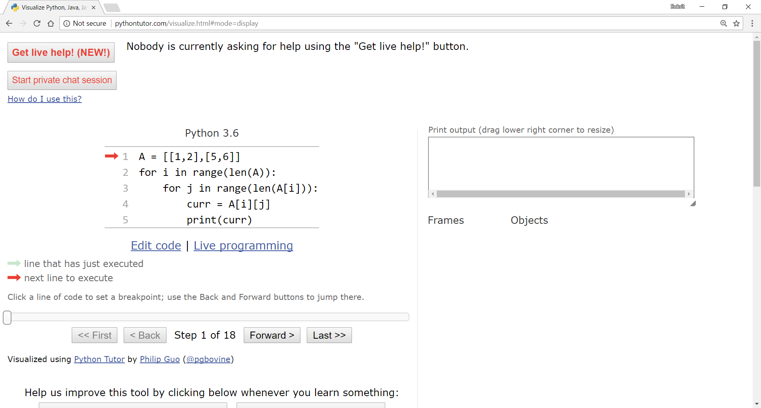
Visualizing iteration through 2D lists
[
]
1 2
5 6
A =
[
]
(0,0) (0,1)
(1,0) (1,1)

Slide 34
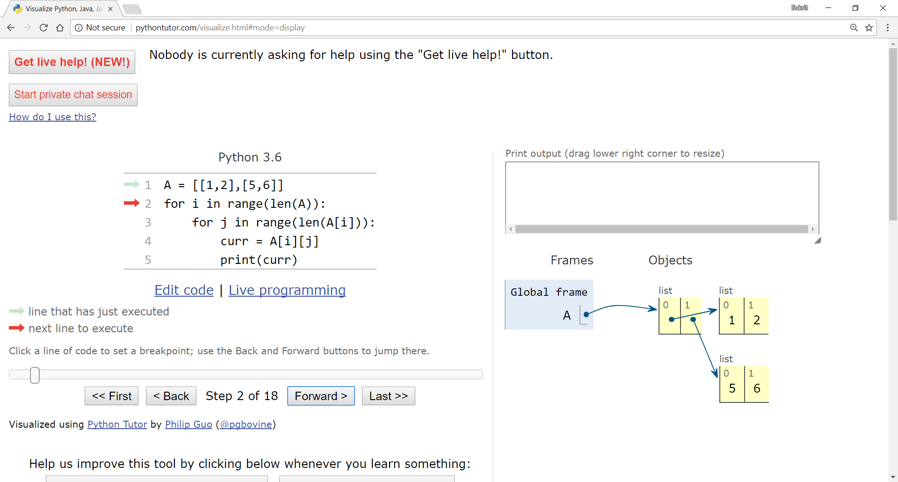
Visualizing iteration through 2D lists
[
]
1 2
5 6
A =
[
]
(0,0) (0,1)
(1,0) (1,1)

Slide 35
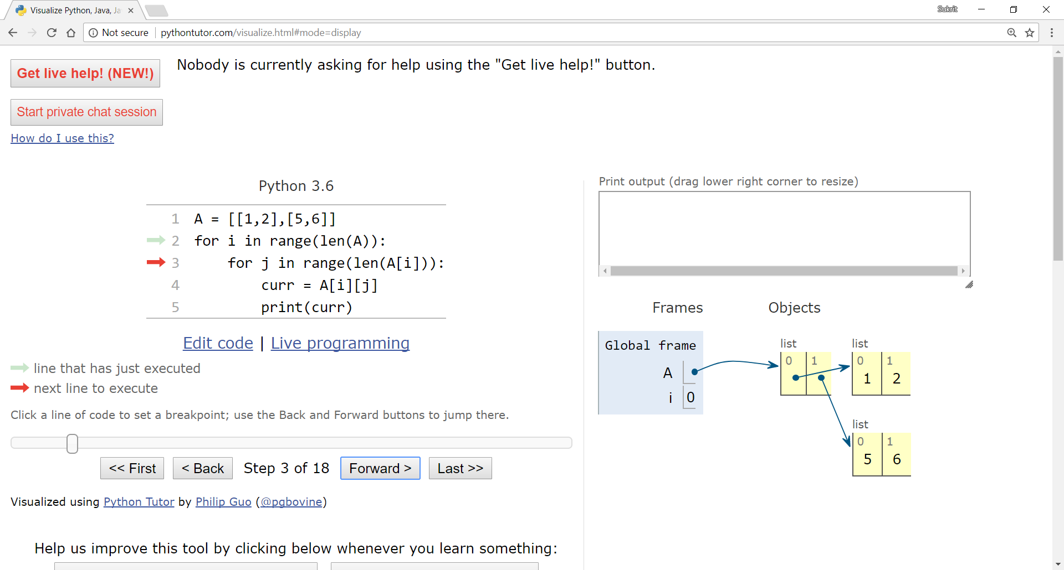
Visualizing iteration through 2D lists
[
]
1 2
5 6
A =
[
]
(0,0) (0,1)
(1,0) (1,1)

Slide 36
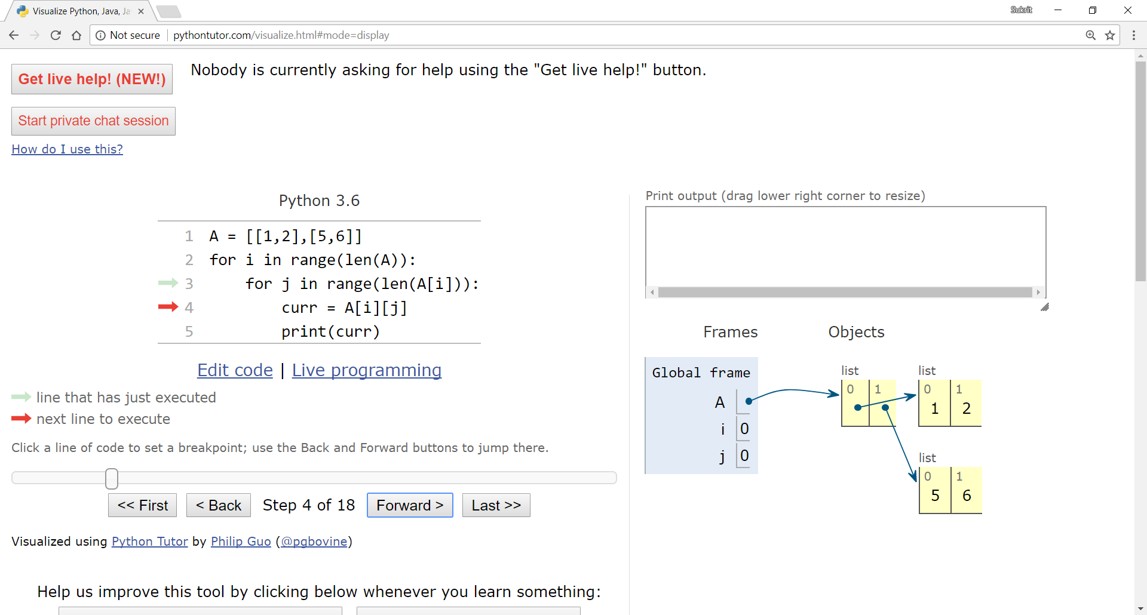
Visualizing iteration through 2D lists
[
]
1 2
5 6
A =
[
]
(0,0) (0,1)
(1,0) (1,1)

Slide 37
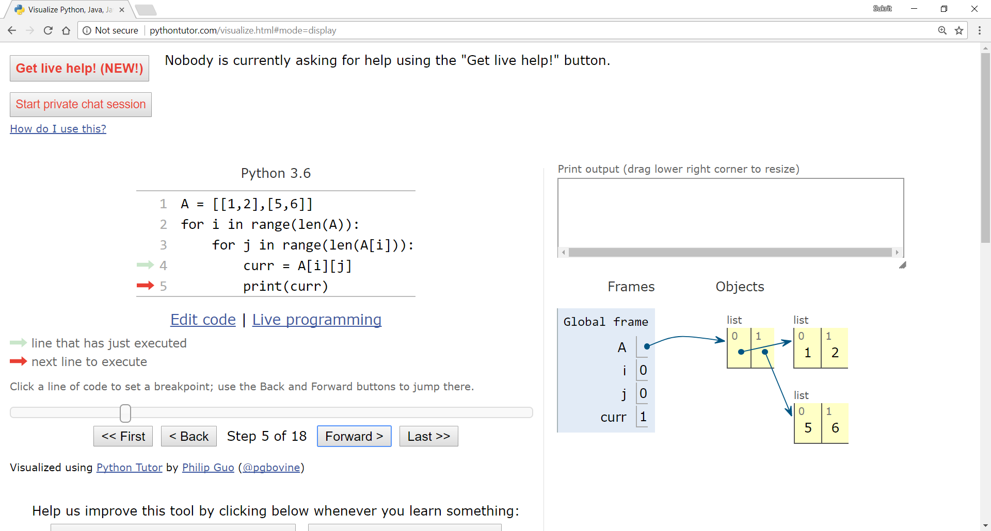
Visualizing iteration through 2D lists
[
]
1 2
5 6
A =
[
]
(0,0) (0,1)
(1,0) (1,1)

Slide 38
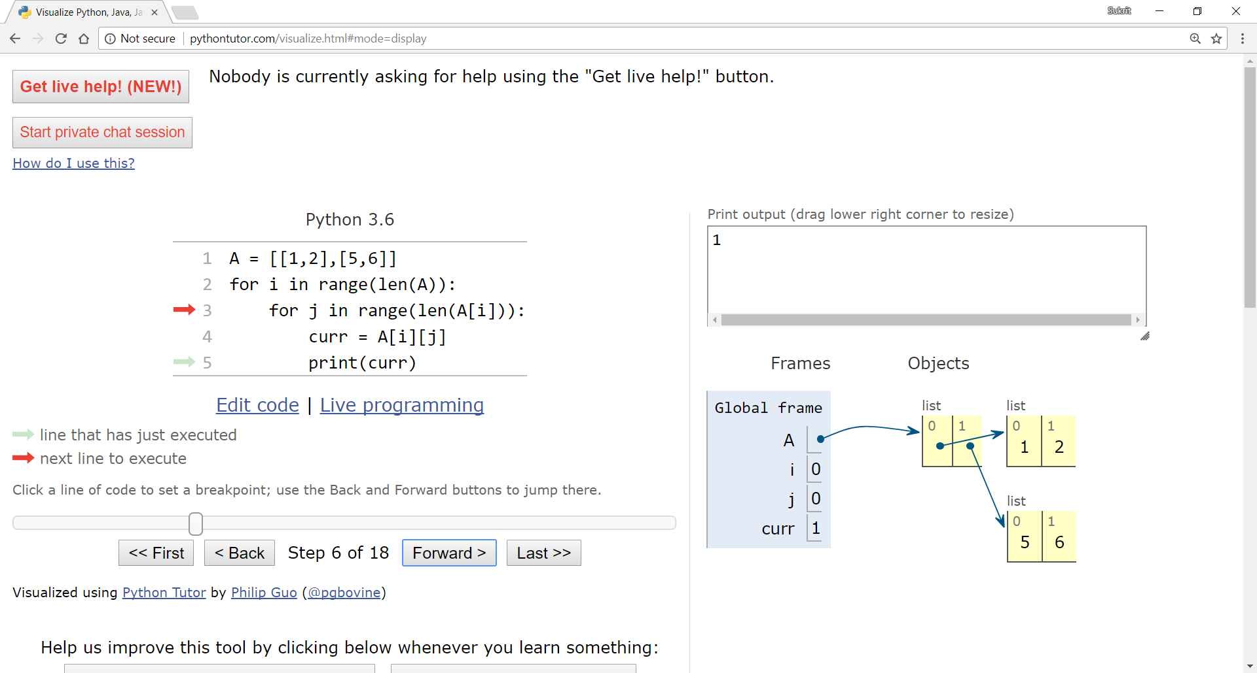
Visualizing iteration through 2D lists
[
]
1 2
5 6
A =
[
]
(0,0) (0,1)
(1,0) (1,1)

Slide 39
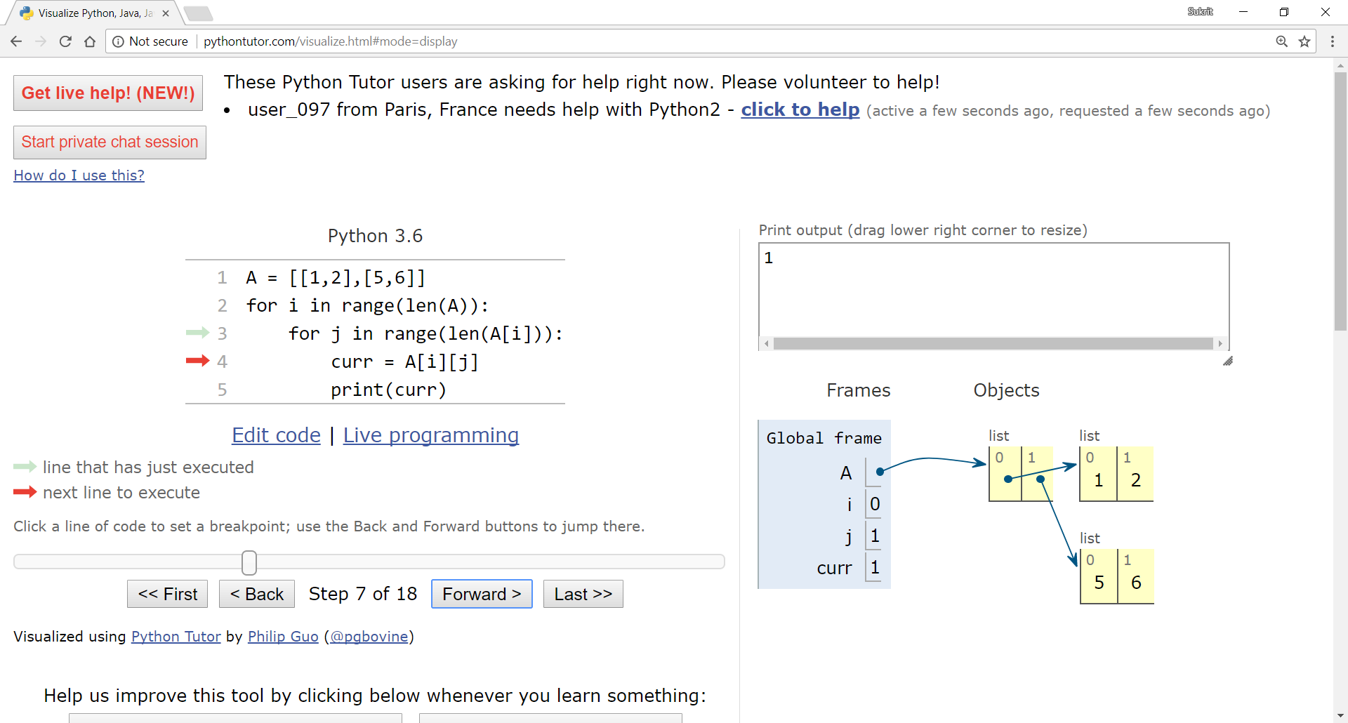
Visualizing iteration through 2D lists
[
]
1 2
5 6
A =
[
]
(0,0) (0,1)
(1,0) (1,1)

Slide 40
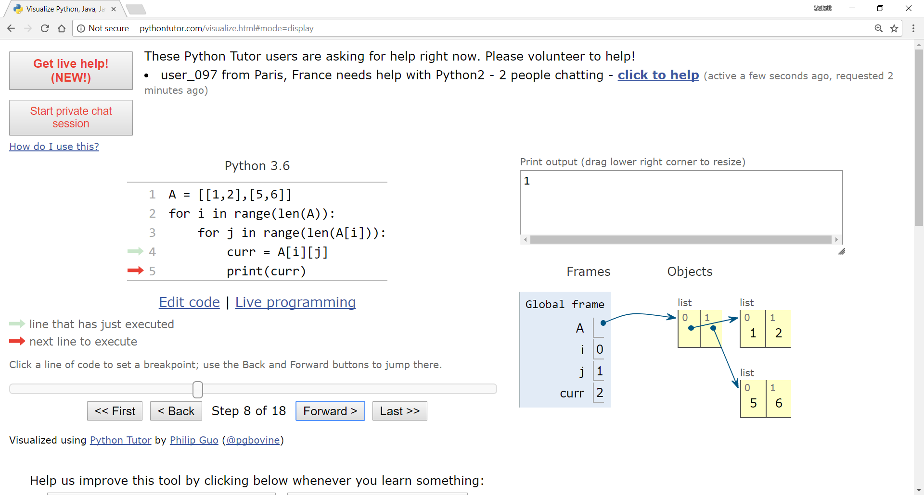
Visualizing iteration through 2D lists
[
]
1 2
5 6
A =
[
]
(0,0) (0,1)
(1,0) (1,1)

Slide 41
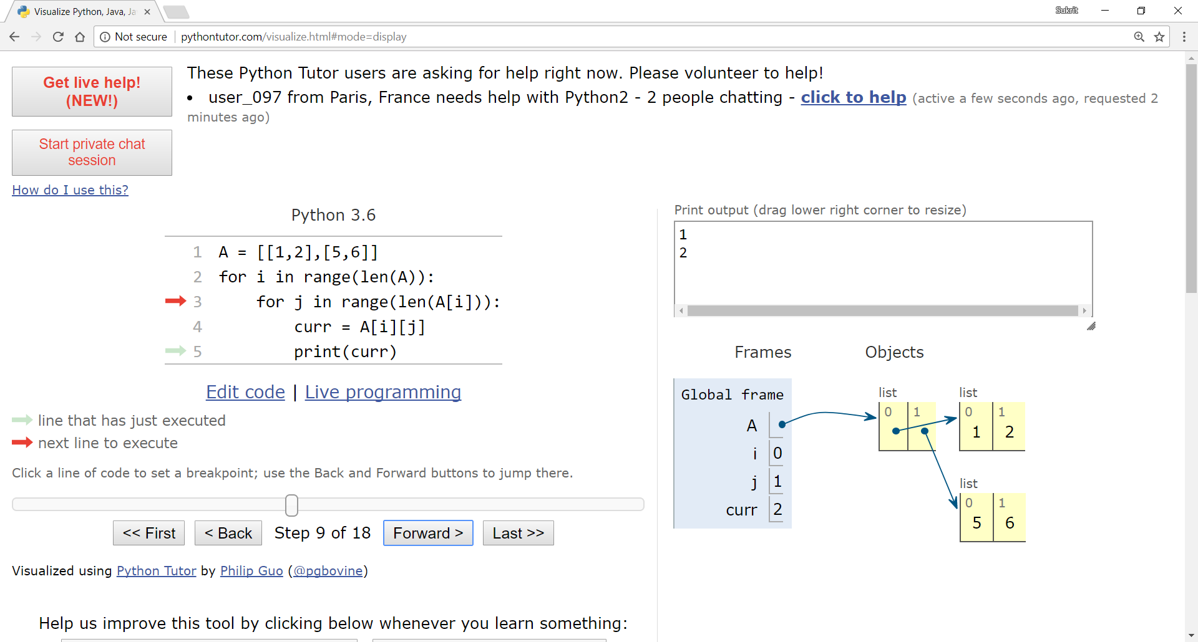
Visualizing iteration through 2D lists
[
]
1 2
5 6
A =
[
]
(0,0) (0,1)
(1,0) (1,1)

Slide 42
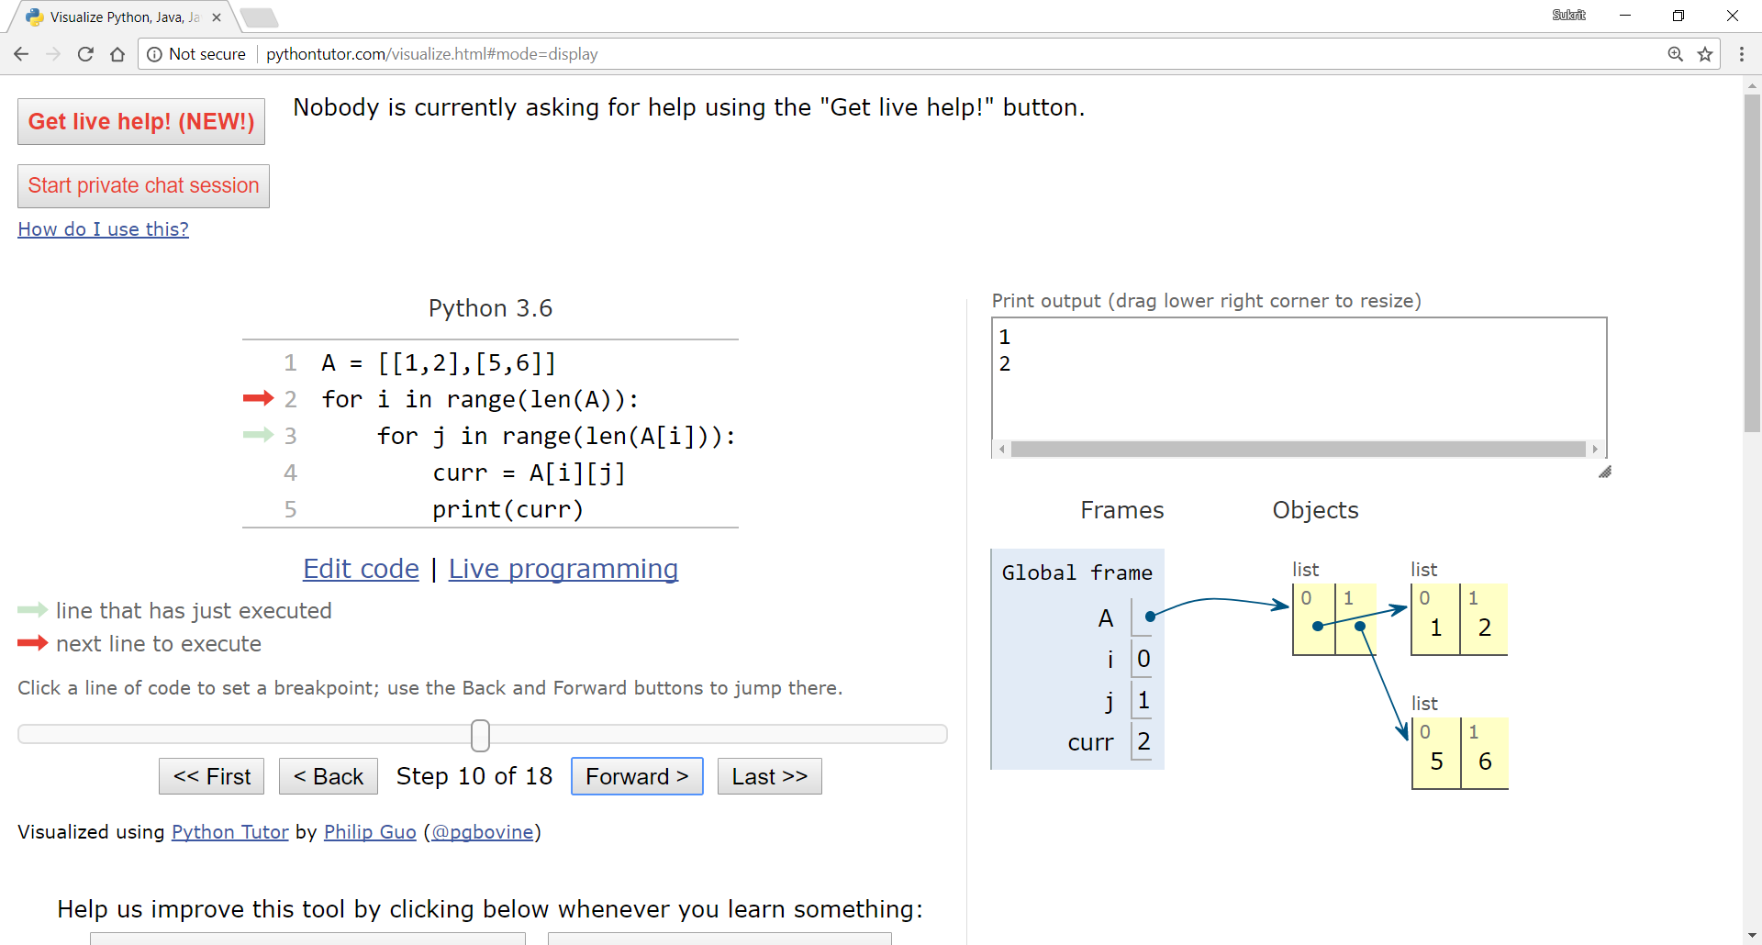
Visualizing iteration through 2D lists
[
]
1 2
5 6
A =
[
]
(0,0) (0,1)
(1,0) (1,1)

Slide 43
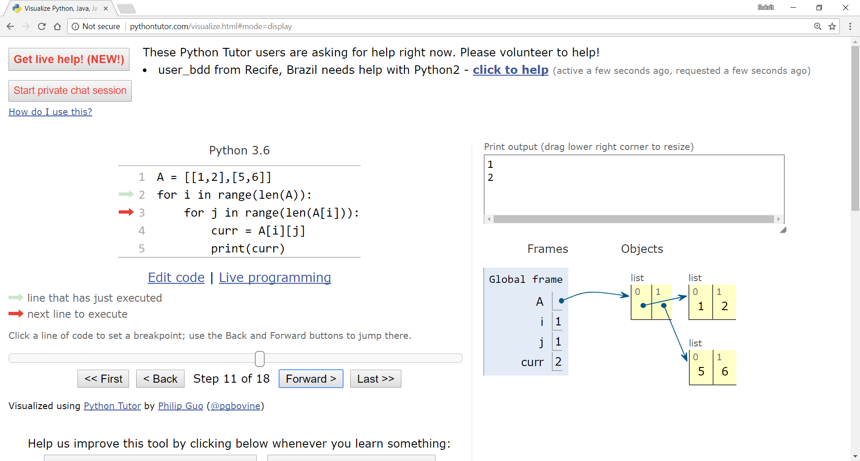
Visualizing iteration through 2D lists
[
]
1 2
5 6
A =
[
]
(0,0) (0,1)
(1,0) (1,1)

Slide 44
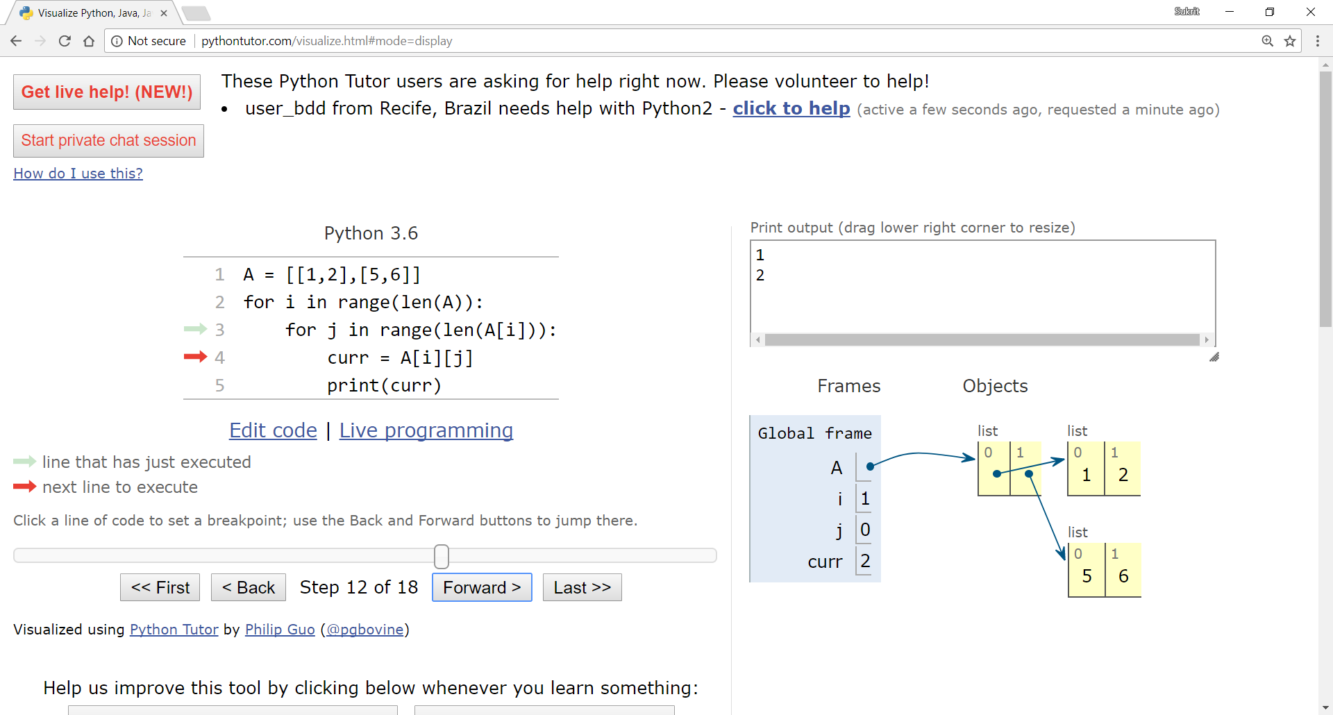
Visualizing iteration through 2D lists
[
]
1 2
5 6
A =
[
]
(0,0) (0,1)
(1,0) (1,1)

Slide 45

Visualizing iteration through 2D lists
[
]
1 2
5 6
A =
[
]
(0,0) (0,1)
(1,0) (1,1)

Slide 46

Visualizing iteration through 2D lists
[
]
1 2
5 6
A =
[
]
(0,0) (0,1)
(1,0) (1,1)

Slide 47

Visualizing iteration through 2D lists
[
]
1 2
5 6
A =
[
]
(0,0) (0,1)
(1,0) (1,1)

Slide 48

Visualizing iteration through 2D lists
[
]
1 2
5 6
A =
[
]
(0,0) (0,1)
(1,0) (1,1)

Slide 49
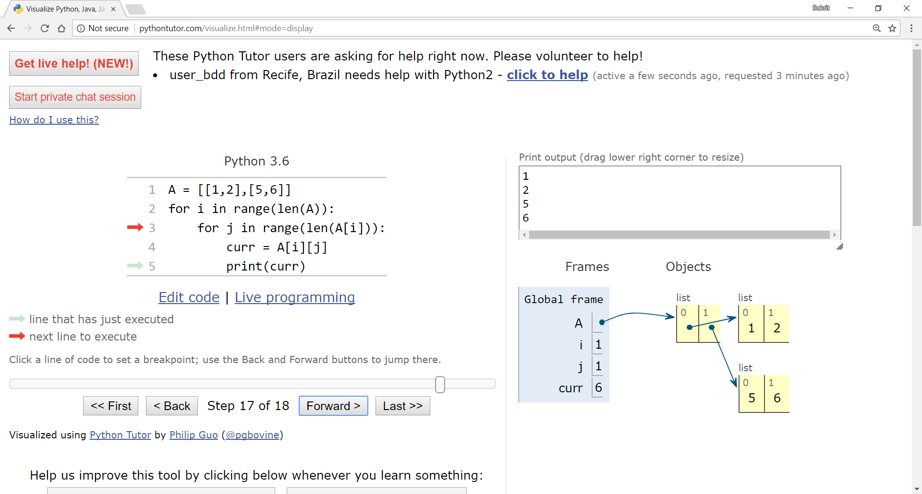
Visualizing iteration through 2D lists
[
]
1 2
5 6
A =
[
]
(0,0) (0,1)
(1,0) (1,1)

Slide 50
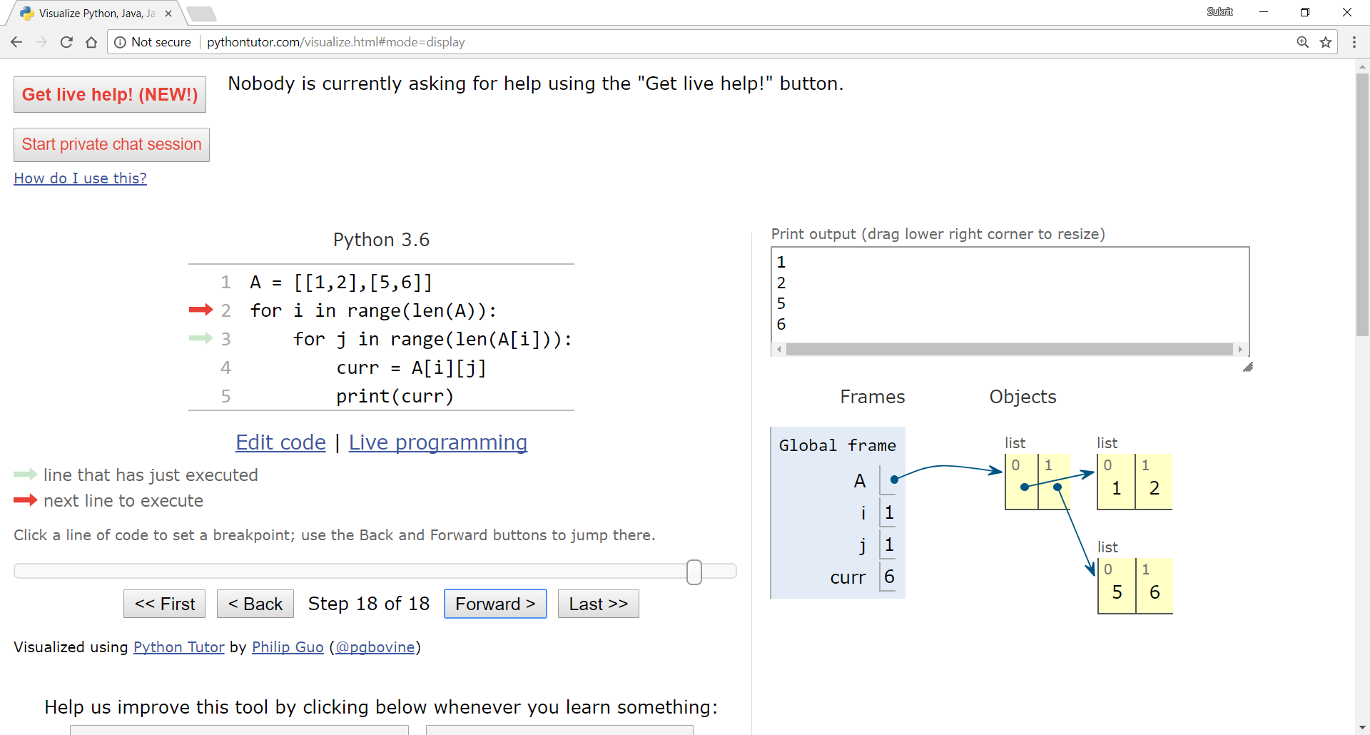
Visualizing iteration through 2D lists
[
]
1 2
5 6
A =
[
]
(0,0) (0,1)
(1,0) (1,1)

Slide 51
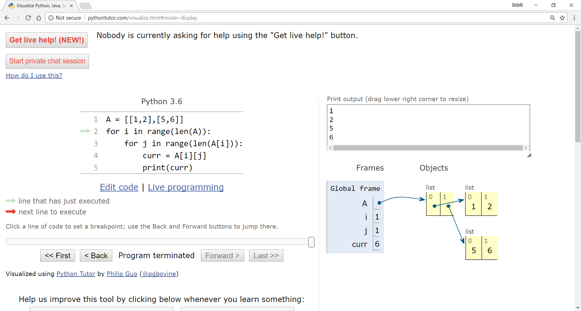
Visualizing iteration through 2D lists
[
]
1 2
5 6
A =
[
]
(0,0) (0,1)
(1,0) (1,1)

Slide 52
Iterating through 2D lists
[
]
Try it yourself:
visualize the execution of this code using pythontutor.com and try to understand what’s going on
A = [[1,2,3],[4,5,6]]
for row in A:
for element in row:
print(element)
1 2 3
4 5 6
A =
>>>
1
2
3
4
5
6

Slide 53
Uses of 2D lists
in real world tasks, data has to stored in form of rectangular tables consisting of cells
in python or in any other programming language, 2D lists can be used to imitate tables easily
think of a scenario where a python program needs to store the marks obtained by 5 students in 5 different subjects
using just variables like studentName_subjectName would be ridiculous and useless since it will be hard to work with that data
john_maths = 88
john_science = 78

Slide 54
Uses of 2D lists
notice that all lists have the same length and each index represents a particular student here
use lists !!
students = [‘john’, ’sam’, ’anna’, ’ben’, ’jeff’]
maths = [88.0, 77.0, 67.0, 87.0, 90.0]
english = [86.0, 67.0, 65.0, 78.0, 80.0]
physics = [76.0, 87.0, 67.0, 67.0, 79.0]
computer = [66.0, 67.0, 76.0, 77.0, 88.0]
nepali = [76.0, 56.0, 65.0, 57.0, 70.0]

Slide 55
Uses of 2D lists
the first list is the heading here, then in the remaining lists each index represents a particular information based on the heading
use 2D lists to imitate tables!!
result = [[‘name’, ’maths’, ’eng’, ’phy’, ’com’, ’nep’],
[‘john’, 88.0, 86.0, 76.0, 66.0, 76.0],
[‘sam’, 77.0, 67.0, 87.0, 67.0, 56.0],
[‘anna’, 67.0, 65.0, 67.0, 76.0, 65.0],
[‘ben’, 87.0, 78.0, 67.0, 77.0, 57.0],
[‘jeff’, 90.0, 80.0, 79.0, 88.0, 70.0]]
here using loops, you can compute things such as the average marks of the students, the average marks of the subjects, the highest/lowest marks

Slide 56
End of Lecture 6

Slide 57
Thank you ! Any questions ?

