Slide 1
Lecture 8:
Functions II
Dipendra Thapa
Dipendra.Thapa@icp.edu.np
CS4051 Fundamentals of Computing

Slide 2
Today
Modularity via functions
Working with text files
Testing and debugging

Slide 3
Defining functions
keyword
name
parameters
docstring, specifications of the function
def add_two(a,b):
”””takes 2 numbers and returns sum”””
sum_ = a + b
return sum_
body of the function
the functions adds the two numbers and returns the sum

Slide 4
Defining functions
def add_two(a,b):
”””takes 2 numbers and returns sum”””
sum_ = a + b
return sum_
print(add_two(1,4)) # prints out 5
print(add_two(10,2)) # prints out 12

Slide 5

Using functions as modules
def add(a,b):
return a+b
def subtract(a,b):
return a-b
def multiply(a,b):
return a*b
def divide(a,b):
return a/b
$$x=\left(a+b\right)\left(a−b\right)$$
$$a=5, b=9$$
calculate the value for x

Slide 6

Using functions as modules
def add(a,b):
return a+b
def subtract(a,b):
return a-b
def multiply(a,b):
return a*b
def divide(a,b):
return a/b
$$x=\left(a+b\right)\left(a−b\right)$$
$$a=5, b=9$$
calculate the value for x
first = add(5,9)

Slide 7

Using functions as modules
def add(a,b):
return a+b
def subtract(a,b):
return a-b
def multiply(a,b):
return a*b
def divide(a,b):
return a/b
$$x=\left(a+b\right)\left(a−b\right)$$
$$a=5, b=9$$
calculate the value for x
first = add(5,9)
second = subtract(5,9)

Slide 8
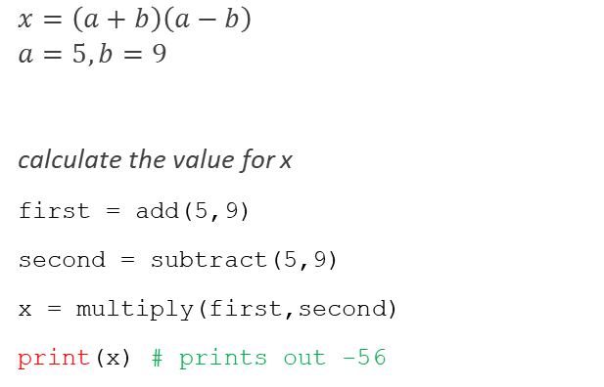
Using functions as modules
def add(a,b):
return a+b
def subtract(a,b):
return a-b
def multiply(a,b):
return a*b
def divide(a,b):
return a/b
$$x=\left(a+b\right)\left(a−b\right)$$
$$a=5, b=9$$
calculate the value for x
first = add(5,9)
second = subtract(5,9)
x = multiply(first,second)
print(x) # prints out -56

Slide 9
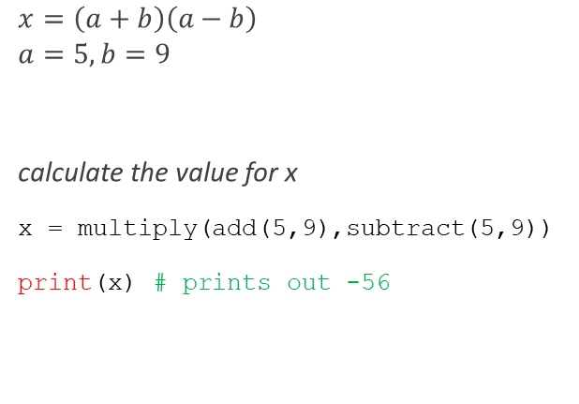
Using functions as modules
def add(a,b):
return a+b
def subtract(a,b):
return a-b
def multiply(a,b):
return a*b
def divide(a,b):
return a/b
$$x=\left(a+b\right)\left(a−b\right)$$
$$a=5, b=9$$
calculate the value for x
x = multiply(add(5,9),subtract(5,9))
print(x) # prints out -56

Slide 10

Using functions as modules
def add(a,b):
return a+b
def subtract(a,b):
return a-b
def multiply(a,b):
return a*b
def divide(a,b):
return a/b
$$x=\frac{\left(a+b\right)\left(a−b\right)}{2}$$
$$a=5, b=9$$
calculate the value for x

Slide 11

Using functions as modules
def add(a,b):
return a+b
def subtract(a,b):
return a-b
def multiply(a,b):
return a*b
def divide(a,b):
return a/b
$$x=\frac{\left(a+b\right)\left(a−b\right)}{2}$$
$$a=5, b=9$$
calculate the value for x
first = add(5,9)

Slide 12

Using functions as modules
def add(a,b):
return a+b
def subtract(a,b):
return a-b
def multiply(a,b):
return a*b
def divide(a,b):
return a/b
$$x=\frac{\left(a+b\right)\left(a−b\right)}{2}$$
$$a=5, b=9$$
calculate the value for x
first = add(5,9)
second = subtract(5,9)

Slide 13

Using functions as modules
def add(a,b):
return a+b
def subtract(a,b):
return a-b
def multiply(a,b):
return a*b
def divide(a,b):
return a/b
$$x=\frac{\left(a+b\right)\left(a−b\right)}{2}$$
$$a=5, b=9$$
calculate the value for x
first = add(5,9)
second = subtract(5,9)
third = multiply(first,second)

Slide 14

Using functions as modules
def add(a,b):
return a+b
def subtract(a,b):
return a-b
def multiply(a,b):
return a*b
def divide(a,b):
return a/b
$$x=\frac{\left(a+b\right)\left(a−b\right)}{2}$$
$$a=5, b=9$$
calculate the value for x
first = add(5,9)
second = subtract(5,9)
third = multiply(first,second)
x = divide(third,2)
print(x) # prints out -28

Slide 15
Working with text files
Python lets you read data from plain text files (.txt) and also write data to them
Data read from files are by default strings and only strings can be written back to files
While working with files, the file must be in the same folder as the python script/if not the full path to the file must be specified

Slide 16
Reading from a file
file1.txt
hello python
this is a file
file = open(“file1.txt”,“r”)

Slide 17
Reading from a file
file1.txt
hello python
this is a file
file = open(“file1.txt”,“r”)
open function to open file
filename
mode in which the file in being opened, “r” means reading mode
Notes:
Read – r
Write – w
Append – a
Create – x

Slide 18
Reading from a file
file1.txt
hello python
this is a file
file = open(“file1.txt”,“r”)
print(file.read())
open function to open file
filename
mode in which the file in being opened, “r” means reading mode
>>>
hello python
this is a file

Slide 19
Reading from a file
file1.txt
hello python
this is a file
file = open(“file1.txt”,“r”)
print(file.read())
open function to open file
filename
mode in which the file in being opened, “r” means reading mode
the read function reads the content of the file as a single string/ then the print function prints the content
>>>
hello python
this is a file

Slide 20
Reading from a file
file1.txt
hello python
this is a file
file = open(“file1.txt”,“r”)
print(file.read())
file.close()
filename
mode in which the file in being opened, “r” means reading mode
the read function reads the content of the file as a single string/ then the print function prints the content
>>>
hello python
this is a file
need to close the file at the end

Slide 21
Reading from a file
file1.txt
hello python
this is a file
file = open(“file1.txt”,“r”)
print(file.read())
file.close()
>>>
hello python
this is a file

Slide 22
Reading from a file
file1.txt
hello python
this is a file
file = open(“file1.txt”,“r”)
lines = file.readlines()
print(lines)
file.close()
>>>
['hello python\n', 'this is a file']

Slide 23
Reading from a file
file1.txt
hello python
this is a file
file = open(“file1.txt”,“r”)
lines = file.readlines()
print(lines)
file.close()
reads each line and puts it in a list
>>>
['hello python\n', 'this is a file']

Slide 24
Reading from a file
file1.txt
hello python
this is a file
file = open(“file1.txt”,“r”)
lines = file.readlines()
for line in lines:
print(line)
file.close()
reads each line and puts it in a list
>>>
hello python
this is a file

Slide 25
Writing to a file
file2.txt
file = open(“file2.txt”,“w”)
will create a new file, if file is already present will overwrite the file
mode is set to “w”, meaning writing mode

Slide 26
Writing to a file
file2.txt
012
file = open(“file2.txt”,“w”)
for i in range(3):
file.write(str(i))
will create a new file, if file is already present will overwrite the file
mode is set to “w”, meaning writing mode
write the current value of i to file using the write function, i is of int type so need to convert to str before writing to file

Slide 27
Writing to a file
file2.txt
012
file = open(“file2.txt”,“w”)
for i in range(3):
file.write(str(i))
file.close()
will create a new file, if file is already present will overwrite the file
mode is set to “w”, meaning writing mode
write the current value of i to file using the write function, i is of int type so need to convert to str before writing to file

Slide 28
Writing to a file
file2.txt
012
file = open(“file2.txt”,“w”)
for i in range(3):
file.write(str(i))
file.close()

Slide 29
Writing to a file
file2.txt
0
1
2
file = open(“file2.txt”,“w”)
for i in range(3):
file.write(str(i))
file.write(“\n”)
file.close()
will create a new file, if file is already present will overwrite the file
mode is set to “w”, meaning writing mode
write the current value of i to file using the write function, i is of int type so need to convert to str before writing to file
insert a line break which moves the cursor to the next line

Slide 30
Testing & Debugging
Testing
Compare input/output, check if desired output is achieved for some input value
Tells us if the program is working or not
“How can I break my program?”
Debugging
Study events leading up to an error
Process of finding out “Why is it not working?”
“How can I fix my program”

Slide 31
Testing & Debugging
set yourself up for easy testing and debugging
design your code in such a way that eases this part
break the program up into modules that can be tested and debugged individually, using functions we can achieve modularity
document each module/function
  what do you expect the input to be?
  what do you expect the output to be?
document your intensions/assumptions behind the code

Slide 32
Modularity via functions
Suppose you have to write a program that analyzes data stored in a text file
name, math, science, physics
john, 88, 76, 77
sam, 76, 88, 65
anna, 76, 56, 79
The program should calculate the average marks of each student and the topper of each subject

Slide 33
Modularity via functions
The task can be divided into the following sub tasks
you could write the whole program as a sequence of commands which executes one task after another
but it would be very messy and hard to keep track of
and testing/debugging the program would be very hard
read data from file
store that data efficiently using python’s collection data types
perform analysis on that data

Slide 34
Modularity via functions
you can decompose your program into modules by using functions
this would be easier to manage and debug
for instance, if the analysis part is not giving proper results, you know exactly where to look for bugs/errors
notice that each module is self-contained but they work together towards the same goal
read data from file
write code to read data only
store that data efficiently using python’s collection data types
write code to store data only
perform analysis on that data
write code to perform analysis only

Slide 35
Good programming
more code is not necessarily a good thing
measure good programmers by the amount of functionality in their code
messy code is hard to understand for other fellow programmers
and sometimes the programmer who wrote the program might find it hard to understand his/her code in the future

Slide 36
When are you ready to test?
ensure your code runs
  remove syntax errors, python interpreter can easily find this for you
have a set of expected results
  an input set
  for each input, the expected output

Slide 37
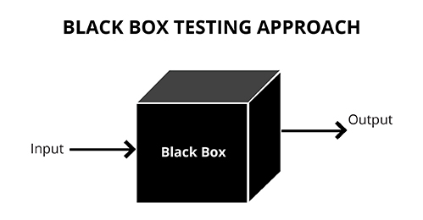
Black box testing
belongs to a class of testing called unit testing where each piece of program is validated, each function/module is tested separately
check if for a set of inputs you get the desired output without knowledge of the actual internal composition of the program
usually done by someone other than the implementer to avoid implementer bias

Slide 38
Testing example
Suppose you are testing a function created for adding 2 numbers
Test no. | 1
Action | Pass two numbers 2 and 3 as parameters to function add_two
Expected output | 5
Actual output | 5
Test result | Pass

Slide 39
Testing example
Test no. | 2
Action | Pass two numbers 2 and “s” as parameters to function add_two
Expected output | Error
Actual output | Error
Test result | Pass
Test no. | 3
Action | Pass two numbers 2 and 1 as parameters to function add_two
Expected output | 3
Actual output | 1
Test result | Fail

Slide 40
Debugging
goal is to have a bug-free program/fix the failed test cases
tools
  built in debugger in IDLE
  pythontutor.com
  print statement
  your brain (think and develop intuition)

Slide 41
Print statements
you can put multiple print statements throughout your code to see what’s going on and how the variable values are changing
l = [2,55,43,1]
s = 0
for i in range(len(l)):
print(l[i]) # print current element
s = s + l[i]
print(s) # print the updated sum
print(s) # print the final sum

Slide 42
Error messages
trying to access beyond the limits of a list
test = [1,2,3] then test[4] -> IndexError
trying to convert an inappropriate type
int(“hello”) -> TypeError
referencing a non-existent variable
a -> NameError

Slide 43
Error messages
mixing datatypes without proper type conversion
‘3’/4 -> TypeError
forgetting to close parenthesis, quotation, etc
a = int(input(“enter a num: ”)
print(a) -> SyntaxError

Slide 44
Testing & Debugging
DON’T
Write entire program
Test entire program
Debug entire program
DO
Write a function
Test the function
Debug the function
Integrate the functions together & test if the overall program works (remember how we calculated the value of the complex mathematical expression)

Slide 45
End of Lecture 8

Slide 46
Thank you !
Any questions ?

