Slide 1
Tutorial
Week 6

Slide 2

Job Application
Build your personal brand
Resume writing
Cover letter writing
Job search
Research on companies
Apply for job
Follow-up

Slide 3
Job Application
Build your personal brand
LinkedIn profile
Job portal profile
Portfolio development

Slide 4




Job Application
Resume writing/ Cover letter writing
Job fairs or Reach out to your network for referrals
Job search
Find the right/relevant job
Job search sites
https://www.linkedin.com/jobs/
https://merojob.com
https://www.kumarijob.com
https://www.ramrojob.com
https://www.jobsnepal.com
https://www.glassdoor.com
https://www.upwork.com/

Slide 5
Job Application
Research on companies
News
Official website
Ask your network

Slide 6
Apply for job
Application: Resume/Cover letter
Outfit
Get there early for interview
Know who is interviewing you
Confidence / Body language
Identify your strength instead of focusing on weaknesses
Practice and prepare
Apply to companies you'd like to work for even if they don't have a current job opening.

Slide 7
Job application email template
Dear [Hiring Manager’s Name],
I recently saw your job posting for the [Job Title] position on [where you saw it]. Based on the information you provided, I am quite interested in this position. Upon review of my application materials, I hope that you can see why I would be a good fit for this job.
[Two paragraphs that detail your previous job experience. Explain how it directly relates to the role you’re applying to.]
My resume is attached to the email. Thank you for taking the time to look through my application materials. If you have any questions about the information I included, please reach out. I look forward to hearing from you.
Sincerely,
[Your Name]
[Your Contact Information]
| 7

Slide 8
Job Application
Follow-up
Sending a brief follow-up email a few days after submitting your application is a good idea to ensure that the business received it.
You can also use this opportunity to reinforce your interest in the position.

Slide 9
In-demand jobs and skills
Machine Learning
Artificial Intelligence
Data Analytics
Cloud Computing
Blockchain
Cyber Security
Video Production
Search Engine Optimization (SEO)
Product Management
Sales leadership
Mobile app development
People management
User experience design
Digital journalism
Animation

Slide 10
Few Tips
Expand your skills
Showcase trainings and certifications
Don’t immediately take salary into consideration (entry-level)
Expand your network

Slide 11
Email Writing

Slide 12
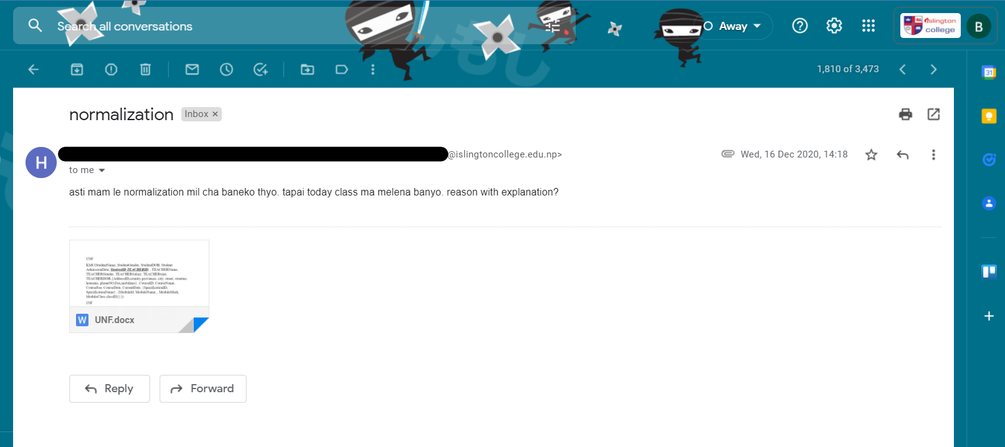
Examples
// kindly go to 'INSERT > Header & Footer' to change these options.
March 25, 2022
| 12

Slide 13
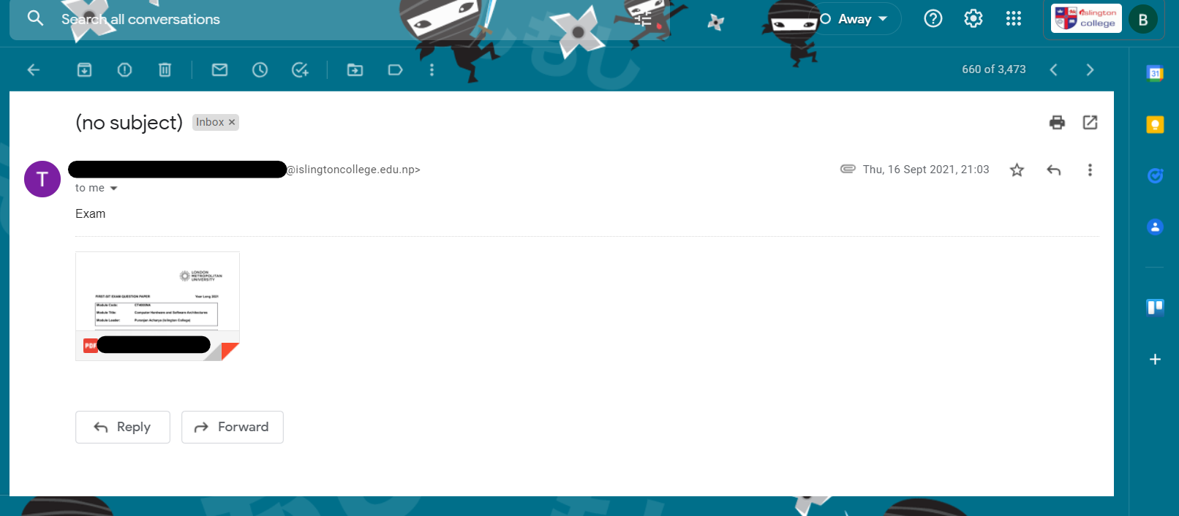
Examples
// kindly go to 'INSERT > Header & Footer' to change these options.
March 25, 2022
| 13

Slide 14
Email Writing
Widely used forms of communication
Essential part of professional communication
| 14
| 14

Slide 15
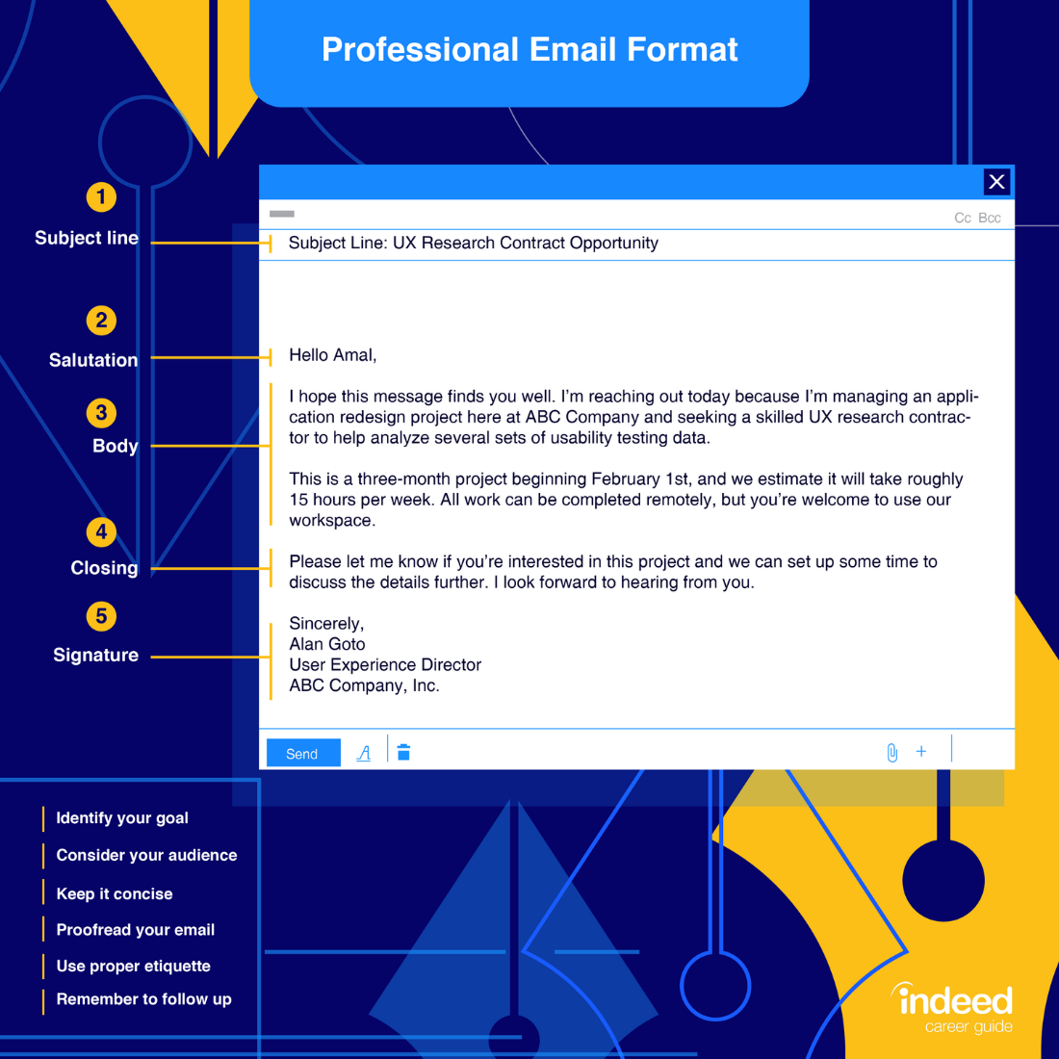
Email Writing Format
Subject Line
Greetings/Salutation
Email Body
Closing
Signature
| 15

Slide 16
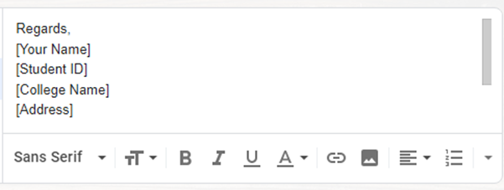
Adding Signature
1.Open Gmail, in the top right, click Settings. See all settings.
2.Go to “Signature” option
3.Create “Signature”
4.Save Changes
| 16
| 16

Slide 17
Email Writing Tips
Optimize subject line
Proofread(read and mark any errors) before sending
Double check to ensure you have attachments you may have referenced in your email body
Keep your email clear & concise
Be formal when appropriate

Slide 18
Job application for Teaching assistant (Islington college)
Teaching Assistant Job Responsibilities
Work under the supervision of a teacher or instructor.
Watch and supervises students. Gives students additional attention and instruction.
Be present and engaged during class sessions. Supports teacher’s lessons by reviewing material with students.
Enforces school and class rules to help teach students appropriate behavior.
Teaching Assistant Qualifications/ Skills:
Communication skills, Time management skills, Organizational skills and Decision making skills
Proficiency in the subject areas taught for level 4 modules
Analyzing information
Education Requirements:
Bachelors running

Slide 19
TASK
Write a job application email to Islington College for the job vacancy given below:
IT Support Specialist
Islington College
Full-time – Entry level
Job Location: Kathmandu, Nepal
Job Specification
Education level: Bachelor
Required Skills
Extensive knowledge of the inner workings of computer networks
Knowledge of a variety of hardware as well as software, programming languages, and operation systems.
Excellent communication skills and English language ability
Job Description
Installing and configuring computer hardware operating systems and applications.
Monitoring and maintaining computer systems and networks.
Responding in a timely manner to service issues and requests.
Troubleshoot system and network problems, diagnosing and solving hardware or software faults.

Slide 20
Thank you

