Slide 1
CS5054 ADVANCED PROGRAMMING
AND
TECHNOLOGIES
Week 1 - Tutorial Project Setup
Saroj Kumar Yadav

Slide 2

Required Software's
Eclipse IDE
- Desktop IDEs. The Eclipse IDE is famous for our Java Integrated Development Environment

Slide 3
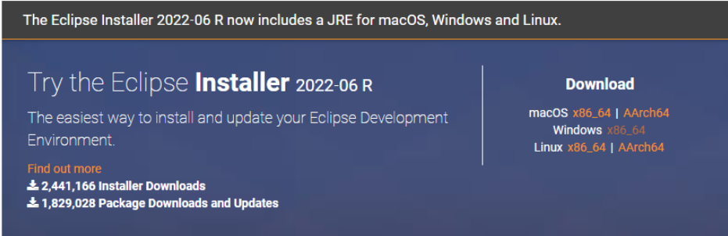
Download guide
Follow the provided link to download the eclipse IDE
https://www.eclipse.org/downloads/packages/release/2022-06/r
Click on the respective OS to download the IDE.

Slide 4
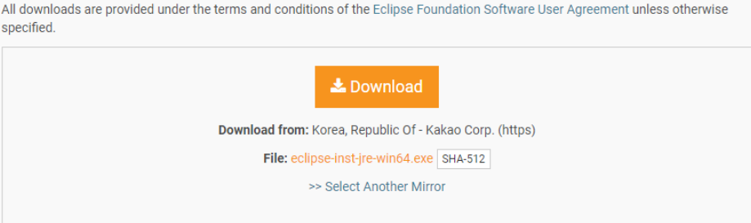
Download guide
Click on download button

Slide 5
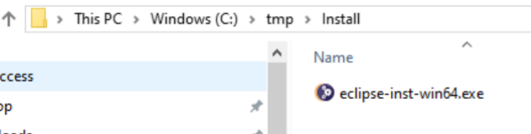
Installation guide
- Run the installation file

Slide 6
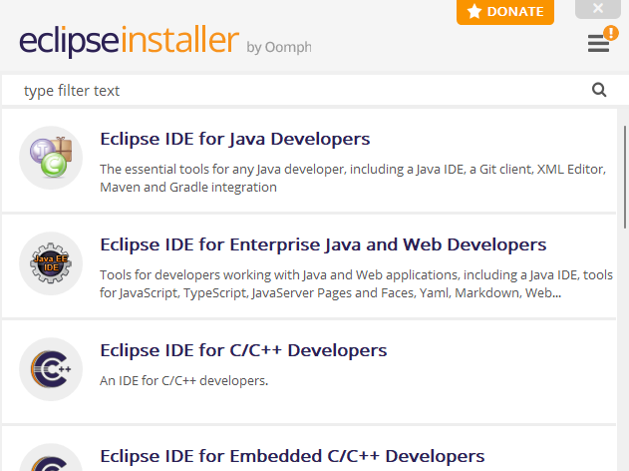
Installation guide
- Select Eclipse IDE for Enterprise Java and Web Developers

Slide 7
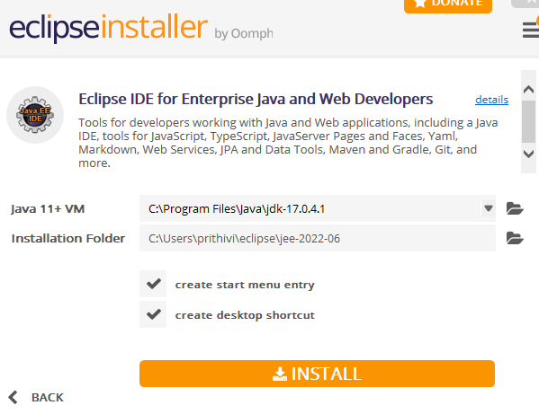
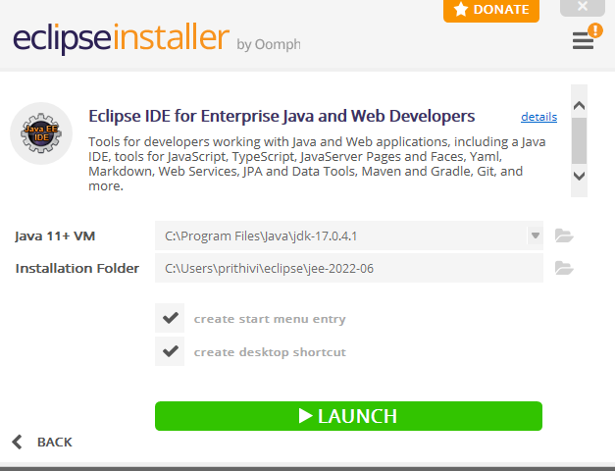
Installation guide
- Click on the install button

Slide 8
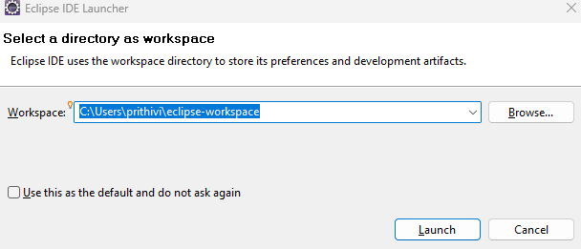
Installation guide
- Select your desired workspace

Slide 9
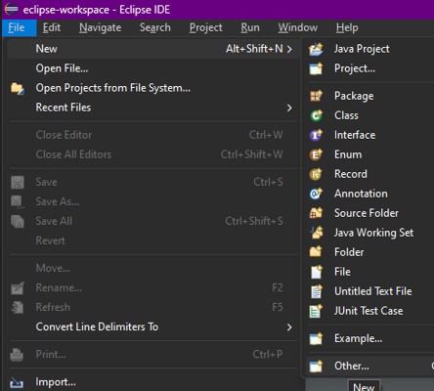
Project Setup
Web > Dynamic Web Project

Slide 10
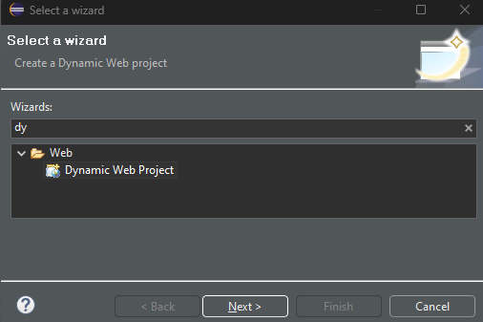
Project Setup
Web > Dynamic Web Project

Slide 11
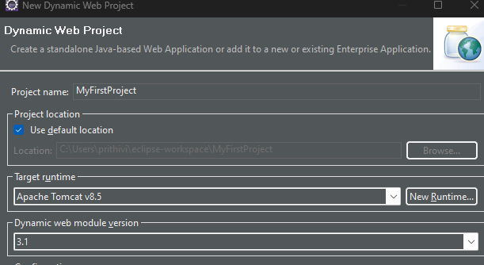
Project Setup
Project name and runtime server

Slide 12
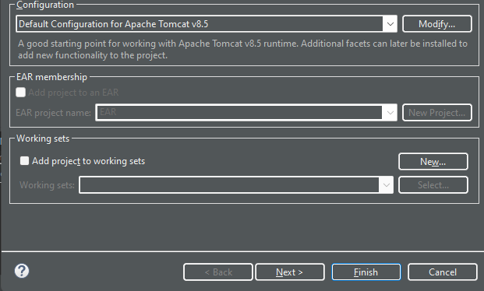
Project Setup
Click next

Slide 13
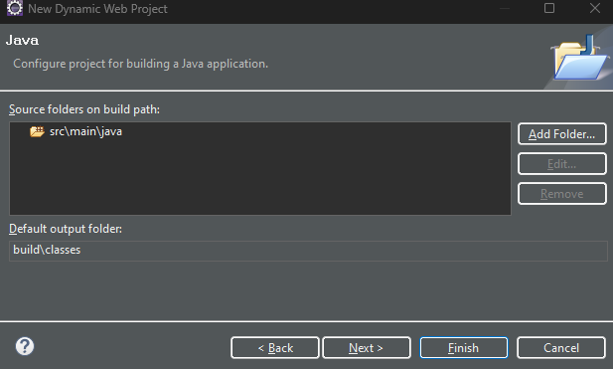
Project Setup
Click Next

Slide 14
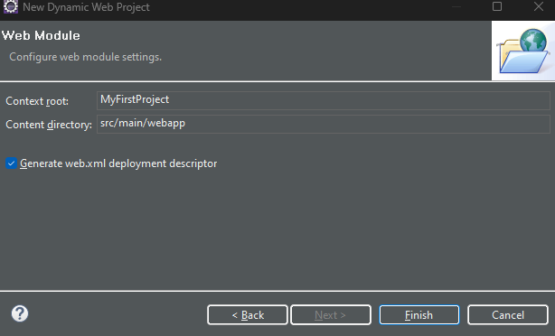
Project Setup
Check Generate web.xml
Then click finish

Slide 15
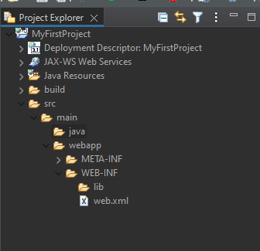
Project Setup
Project Folder

Slide 16
Xampp
Go the link to download Xampp. Then install it.
Download XAMPP (apachefriends.org)

Slide 17
Any Questions?

Slide 18
Thank You

