Slide 1
CS5054 ADVANCED PROGRAMMING
AND
TECHNOLOGIES
Week 3 - Lecture More about Servlet
Sandip Adhikari

Slide 2
Learning Objectives
Understand SendRedirect
Understand RequestDispacher
Understand ServletConfig
Understand ServletContext

Slide 3

Previous Week
Servlet
- a component of JEE framework used for web development.

Slide 4
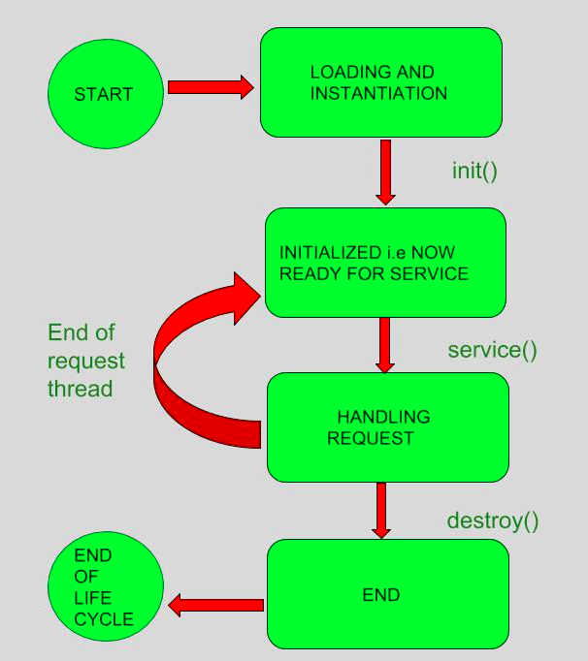
Previous Week
Life cycle of Servlets

Slide 5
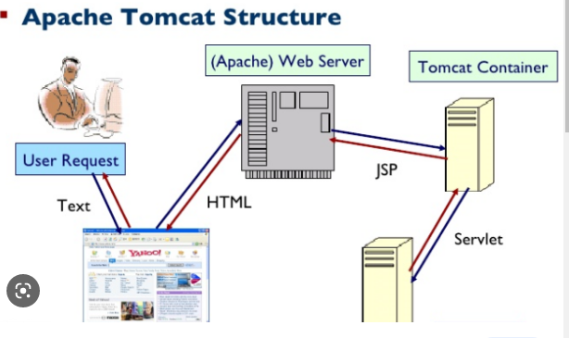
Previous Week
Container

Slide 6
Previous Week
HttpServlet class methods
1. doGet()
2. doPost()

Slide 7
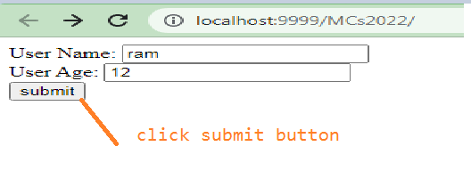
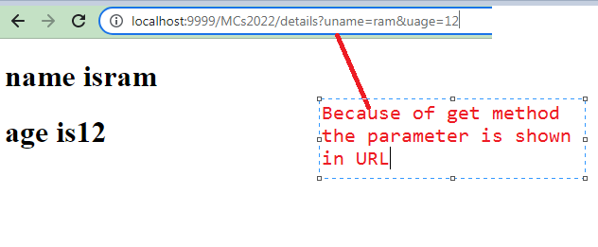
Previous Week
Learned to implement Servlet and JDBC connectivity.

Slide 8
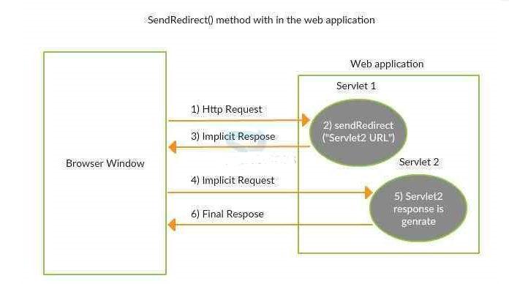
Send Redirect Method
The browser submits a request, which the servlet accepts, processes, and then produces a response for the browser.

Slide 9
Send Redirect Method
Redirecting the response to that resource is necessary if, while processing the request, we need to contact another servlet from a different server.

Slide 10
Send Redirect Method
Java servlets offer the sendRedirect() function in the javax.servlet.http package's HttpServletResponse interface to accomplish this.
Notes:
Let's have a look at some real-world instances to help our understanding.
Example 1: There are a ton of internet shops available to us today where we can buy products. The browser will redirect to the appropriate online payment page once we have chosen the item, are ready to make the buy, and click on pay. A new URL is displayed in the browser as a result of the shopping website's answer, which takes the user to the payment page.
Example 2: In some online education applications, we must redirect the response to the appropriate URL if we wish to include a google search operation or a link to another website for more information on the topic.

Slide 11

Send Redirect Method
public interface HttpServletResponse extends ServletResponse
HttpServletResponse Interface
The ServletResponse interface is extended by the HttpServletResponse interface to include features tailored to HTTP requests and responses.
It offers ways to access cookies and HTTP headers.

Slide 12
Send Redirect Method
public interface HttpServletResponse extends ServletResponse
Method – sendRedirect()
sends the response to a different resource, either within or outside the server
can redirect the requested resource to a Servlet, HTML page, or JSP page that is either on the same server or not.
It accepts relative as well as absolute URL

Slide 13
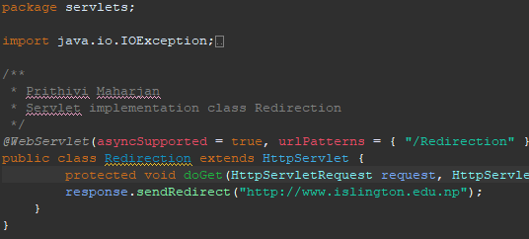
Send Redirect Explanation

Slide 14
Request Dispatcher Interface
The RequestDispatcher is an Interface that falls under package javax.servlet.
With this interface we receive an object in servlet after receiving the request.
With the RequestDispatcher object we dispatch a request to other resources which include (servlet, HTML file, or JSP file).

Slide 15
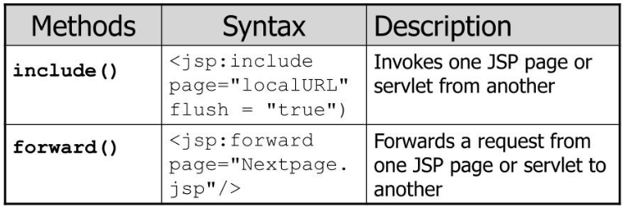
Request Dispatcher Interface
This interface has following two methods:

Slide 16
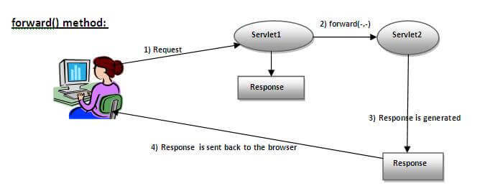
Forward Method
As you see in the above figure, response of second servlet is sent to the client. Response of the first servlet is not displayed to the user

Slide 17
Forward Method
As you see in the above figure, response of second servlet is sent to the client. Response of the first servlet is not displayed to the user

Slide 18
Forward Method
Programming:

Slide 19
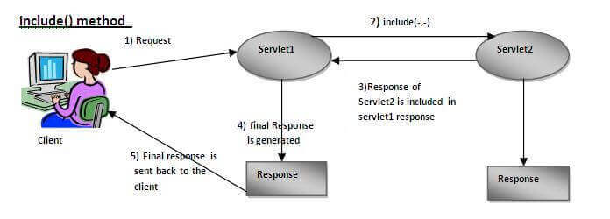
Include Method
As you can see in the above figure, response of second servlet is included in the response of the first servlet that is being sent to the client

Slide 20
Include Method
Programming:

Slide 21
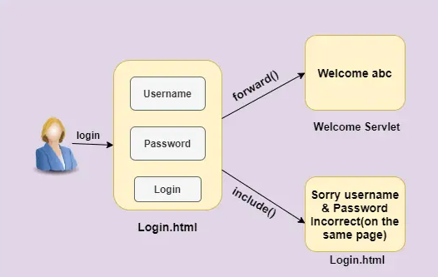
How both method are implemented

Slide 22
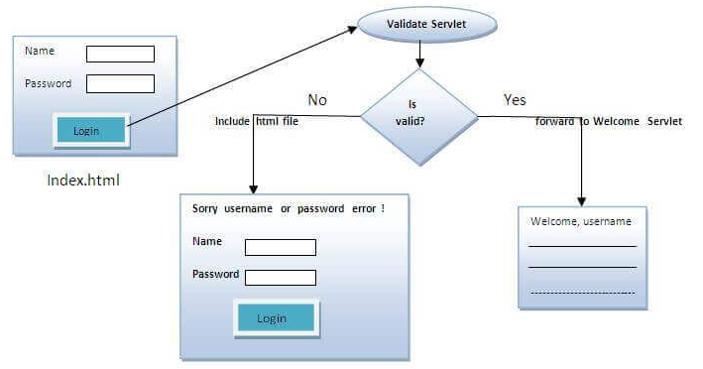
How both method are implemented

Slide 23
Difference
SendRedirect | RequestDispatcher
This is the HttpServlerResponse object's method. | HttpServletRequest can access this object.
Request is forwarded to the client (Browser), who will then handle the new URL. | The request will be forwarded by the servlet internally to another servlet or jsp page.
The end user can view the page to which the url is forwarded. | The end user is unaware of which page is internally handled.
In a Nutshell, client-side processing. | In a nutshell, server-side processing is completed.

Slide 24
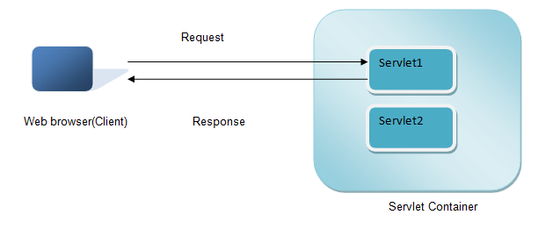
Servlet Config
Servlet Container creates ServletConfig object for each Servlet during initialization, to pass information to the Servlet. This object can be used to get configuration information such as parameter name and values from deployment descriptor file (web.xml).

Slide 25
Servlet Config Interface - Methods
Methods | Use case
public String getInitParameter(String name) | Returns the value of given parameter as String, or null if the given parameter doesn’t exist in web.xml.
public Enumeration getInitParameterNames() | Returns an enumeration of all the parameter names.
public String getServletName() | Returns the name of the servlet instance.
public ServletContext getServletContext() | Returns an object of ServletContext

Slide 26
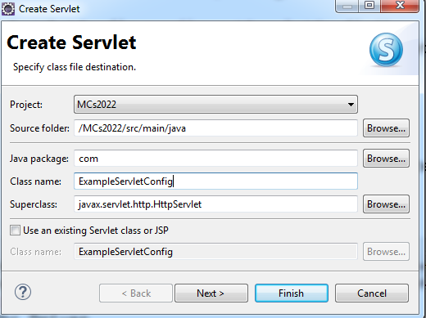
Servlet Config with Example
Creating a Servlet named as ExampleServletConfig and click Next

Slide 27
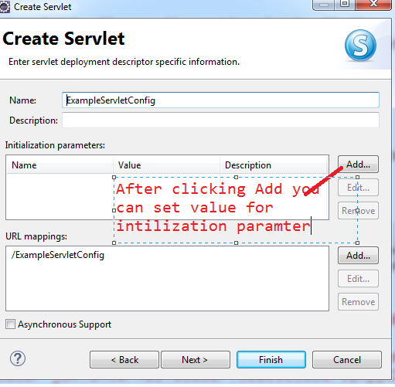
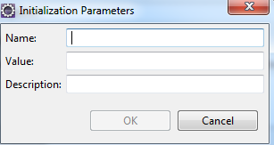
setting param value for ServletConfig
After clicking add button we can set name and value for initialization Parameter and Click Finish

Slide 28
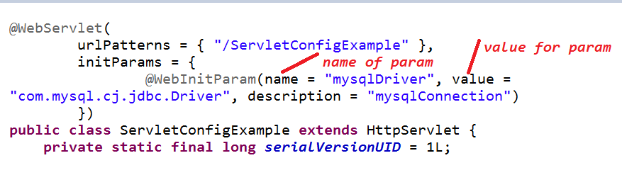
Continue..
After giving the name and value for param

Slide 29
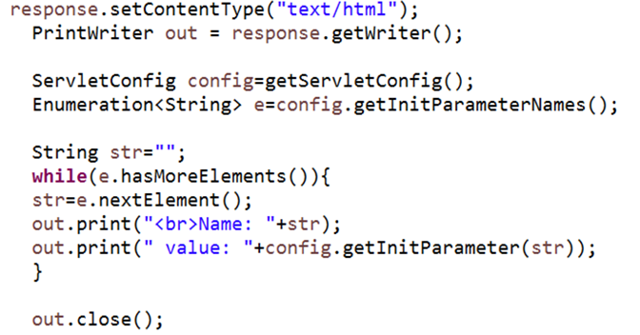
Continue..
Inside doGet method

Slide 30
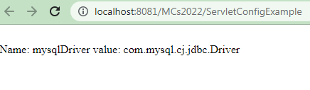
Output of this program

Slide 31
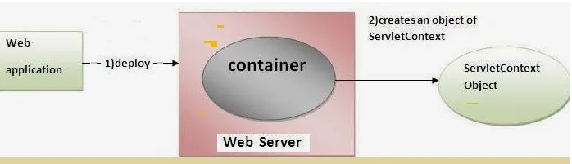
How to get the object of Servlet Context
ServletContext app = getServletContext();
ServletContext app = getServletConfig().getServletContext();

Slide 32
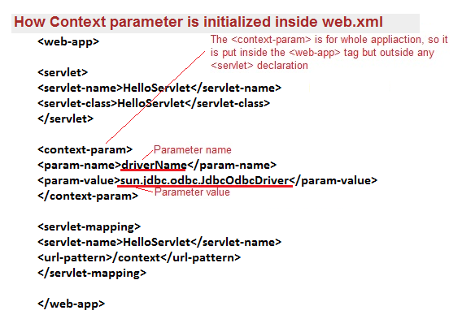
Example
In web.xml

Slide 33
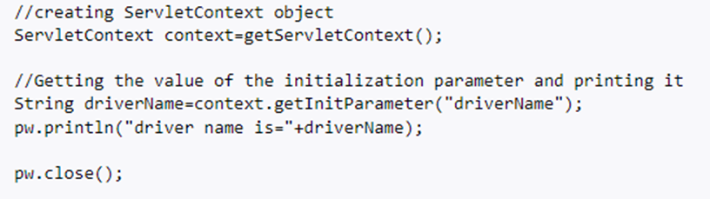
Example cont..
Inside doGet method

Slide 34
Summary
We understand the concept of SendRedirect method with the demonstration illustration.
We learned how we can implement the RequestDispacher in web application
We also understood how ServletConfig works and how we can implement it.
We also learned how we can use the ServletContext.

Slide 35
Any Questions?

Slide 36
Thank You

