Slide 1
CS5054 ADVANCED PROGRAMMING
AND
TECHNOLOGIES
Week 0 - Lecture
Introduction to the Module

Slide 2
Agenda
Describe the module
Explain the learning outcomes
Know about weekly learning materials
Understand the assessments
Identify the core readings

Slide 3
Learning Outcomes
S.N | LO Description | LO.No.
1 | Know and understand a range of programming concepts, techniques, class libraries and tools which are used to build sizable programs. | LO1
2 | Demonstrate a practical understanding of common data structures and apply collection classes APIs to implement data structures in their programs. | LO2
3 | Appreciate key features, advantages and drawbacks of current IDEs, and demonstrate practical skills in using an IDE to develop programs of their own using third party components, application frameworks such as visual GUI builder, data persistence. | LO3

Slide 4
Learning Outcomes
S.N | LO Description | LO.No.
4 | Understand and be familiar with the principles of object-oriented programming in real development scenarios. | LO4
5 | Evaluate, select and use suitable platforms and technologies for program assignments and case studies. | LO5

Slide 5

Learning Outcomes - 1
Know and understand a range of programming concepts, techniques, class libraries and tools which are used to build sizable programs.

Slide 6
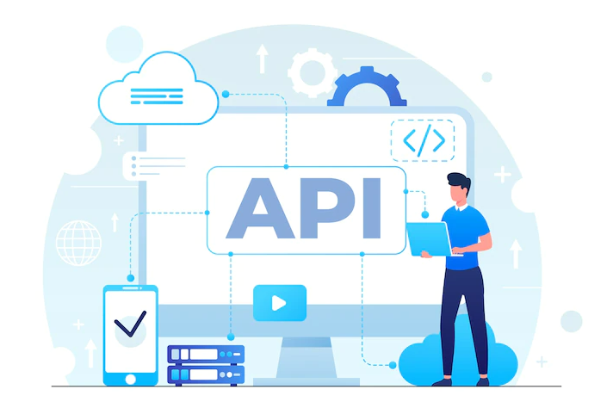
Learning Outcomes - 2
Demonstrate a practical understanding of common data structures and apply collection classes APIs to implement data structures in their programs.

Slide 7

Learning Outcomes - 3
Appreciate key features, advantages and drawbacks of current IDEs, and demonstrate practical skills in using an IDE to develop programs of their own using third party components, application frameworks such as visual GUI builder, data persistence.

Slide 8

Learning Outcomes - 4
Understand and be familiar with the principles of object-oriented programming in real development scenarios.

Slide 9

Learning Outcomes - 5
Evaluate, select and use suitable platforms and technologies for program assignments and case studies.

Slide 10

What we will learn in this module?

Slide 11

Dynamic Web Application Development

Slide 12
Weekly Learning Materials

Slide 13
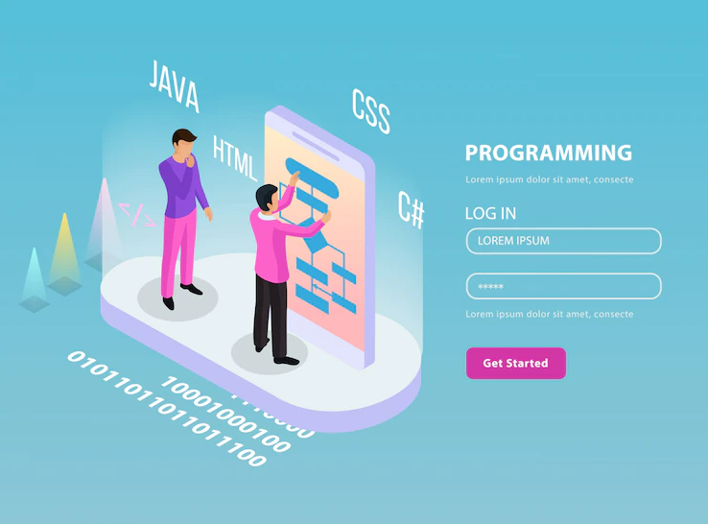
Weekly learning materials
Week 0 - Introduction to Mobile Application

Slide 14

Weekly learning materials
Week 1 - Web-pages and its type

Slide 15

Weekly learning materials
Week 2 - Introduction to Servlets

Slide 16
Weekly learning materials
Week 3 - More about servlets

Slide 17

Weekly learning materials
Week 4 - Introduction to JSP

Slide 18
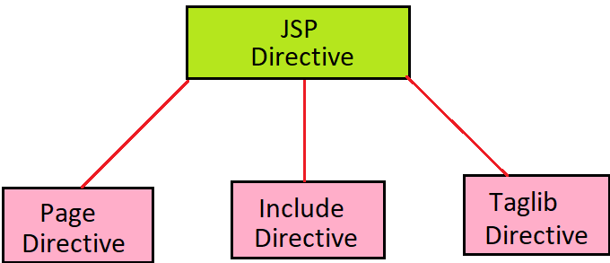
Weekly learning materials
Week 5 - Introduction to JSP directives

Slide 19
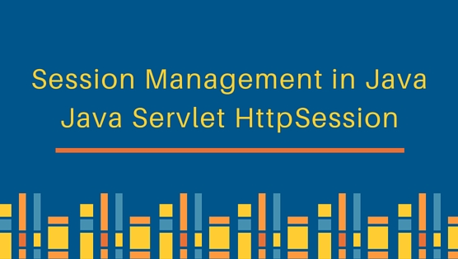

Weekly learning materials
Week 6 - State management of JSP

Slide 20
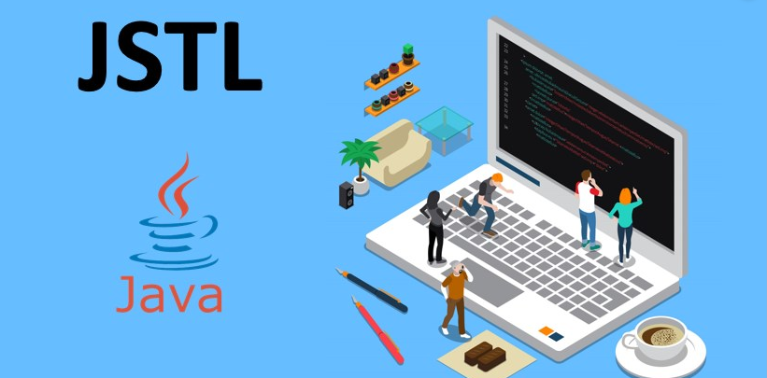
Weekly learning materials
Week 7 - Introduction to JSTL & Coursework

Slide 21
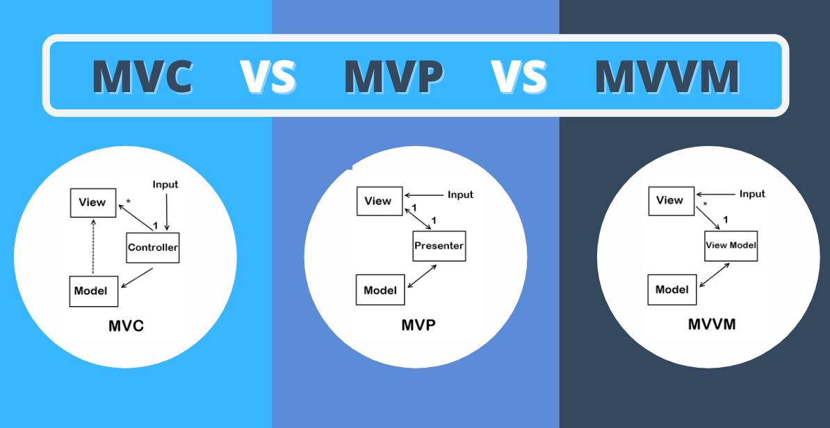
Weekly learning materials
Week 8 - MVC, MVP and MVVM

Slide 22

Weekly learning materials
Week 9 - Database: Create & View Operations

Slide 23

Weekly learning materials
Week 10 - Database: Update & Delete Operations

Slide 24

Weekly learning materials
Week 11 - Revision and coursework feedback

Slide 25
Assessments
1. Coursework
2. Examination
Coursework description
Coursework Topic | Ecommerce
Weightage | 50%
Release date | Week 7
Submission date | Week 12

Slide 26
Core readings
Head First Java 2e (A Brain Friendly Guide) by Kathy Sierra & Bert Bates
Dynamic Web Application Development Using XML and Java by David Parsons, Parsons
Servlet & JSP: A Tutorial (A Tutorial series) by Budi Kurniawan
Murach's Java Servlets and JSP (2nd Edition) by Andrea Steelman, Joel Murach

Slide 27
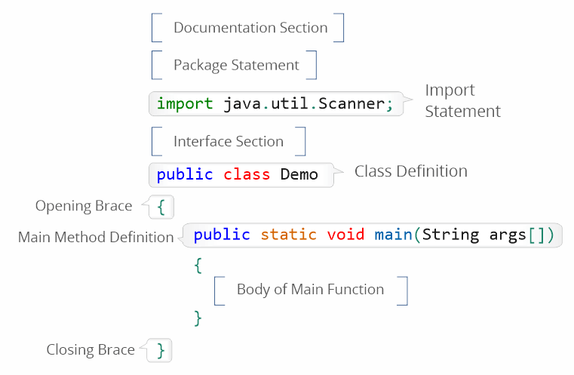
Tutorial
Java Basics

Slide 28

Workshop
Java Basic: Questions

Slide 29
Summary
We learned different section about the module like learning outcomes, weekly learning materials, assessments and core readings
We understood about the core learning outcomes
Our weekly learning materials which is based on Web development
Talk about different assessments of the module
We can also follow the core readings to enhance our knowledge on JSP and Servlet.

Slide 30
Thank You

