Slide 1
CS5054 ADVANCED PROGRAMMING
AND
TECHNOLOGIES
Week 0 - Tutorial
Introduction to the Module
Prithivi Maharjan

Slide 2
Agenda
Recalling learning outcomes
Recalling module content
Explain module assessments
Revision on Java Basics

Slide 3
Module Content
Weeks | Topics
Week 0 | Introduction to Mobile Application
Week 1 | Web-Pages and its type
Week 2 | Introduction to Servlets
Week 3 | More about Servlets
Week 4 | Introduction to JSP
Week 5 | Introduction to JSP directives
Week 6 | State management in JSP

Slide 4
Module Content
Weeks | Topics
Week 7 | Introduction to JSTL & Coursework
Week 8 | MVC, MVP & MVVM
Week 9 | Database: Create & View Operations
Week 10 | Database: Update & De;eteOperations
Week 11 | Revision and coursework feedback

Slide 5
Assessments
1. Coursework
2. Examination
Coursework description
Coursework Topic | Ecommerce
Weightage | 50%
Release date | Week 7
Submission date | Week 12

Slide 6
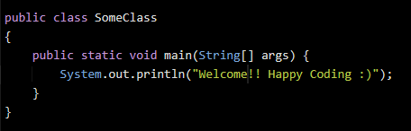
Java Basics
Class and main method

Slide 7
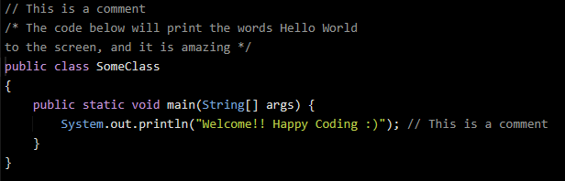
Java Basics
Comments

Slide 8
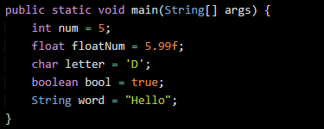
Java Basics
Variables

Slide 9

Java Basics
Final variable

Slide 10
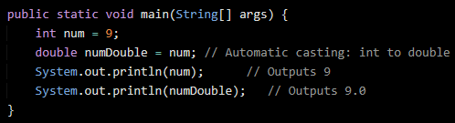
Java Basics
Typecasting: Automatic casting

Slide 11
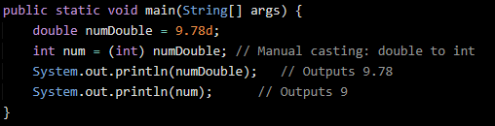
Java Basics
Typecasting: Manual casting

Slide 12
Java Basics
Operators
Arithmetic | + | - | * | / | % | + + | - -
Assignment | = | += | -= | *= | /= | %=
Comparison | == | != | > | < | >= | <=
Logical | && | || | !

Slide 13
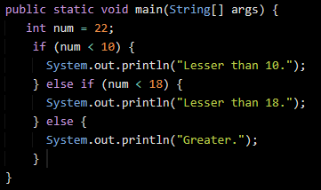
Java Basics
if, else if and else

Slide 14
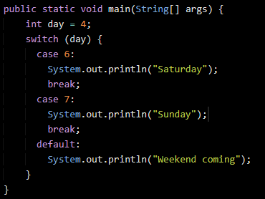
Java Basics
Switch case

Slide 15
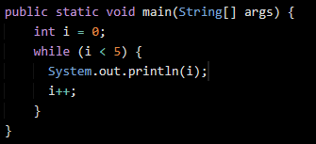
Java Basics
While Loop

Slide 16
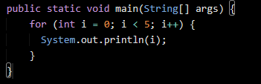
Java Basics
For Loop

Slide 17
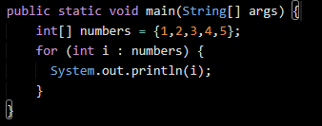
Java Basics
For Each Loop

Slide 18
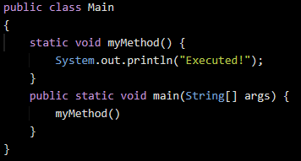
Java Basics
Methods

Slide 19
Summary
We learned the weekly module content in depth from which we can understand what sort of content we will be learning in each week
We talk about our various assessments and its weightage.
We revised the basics of Java

Slide 20
Any Questions?

Slide 21
Thank You

