Slide 1
CS5054 ADVANCED PROGRAMMING
AND
TECHNOLOGIES
Week 1 - Lecture
Web pages and its type

Slide 2
Learning Objectives
Understand the basics of Web-page
Know about different types of Web-page
Describe about GET and POST Request

Slide 3

Web Page
A Web-page is a document that is commonly, written in HTML, JSP or other languages.

Slide 4
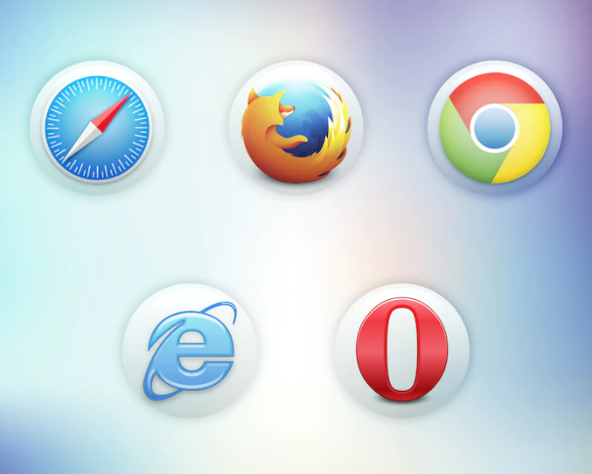
Web Page
They are viewed in browsers such as google chrome, Mozilla Firefox and so on.

Slide 5

Now, we understood the basics, but how do we access a web page in a browser?

Slide 6
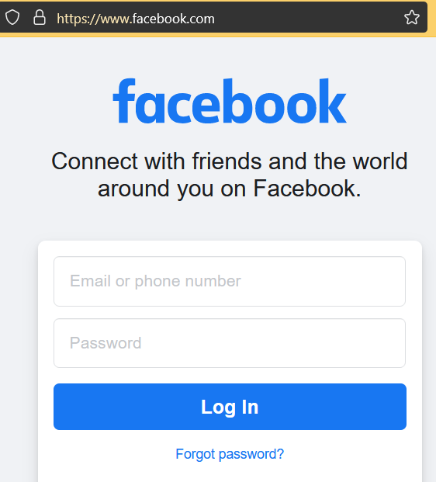
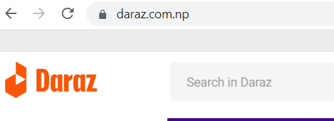
Accessing Web Page
To access a web page, we type the name of the website, with .com (.com.np) at the end
(In some cases, it can also contains country as well along with .com)

Slide 7
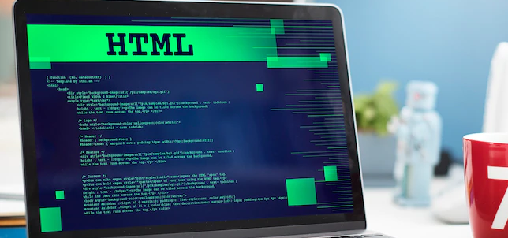
Web Pages
A web page is a document (hypertext) that a website provides on the web browser for display in front of a site visitor.
Many web pages link together on a website, and they may contain audio, images, videos, and so on

Slide 8
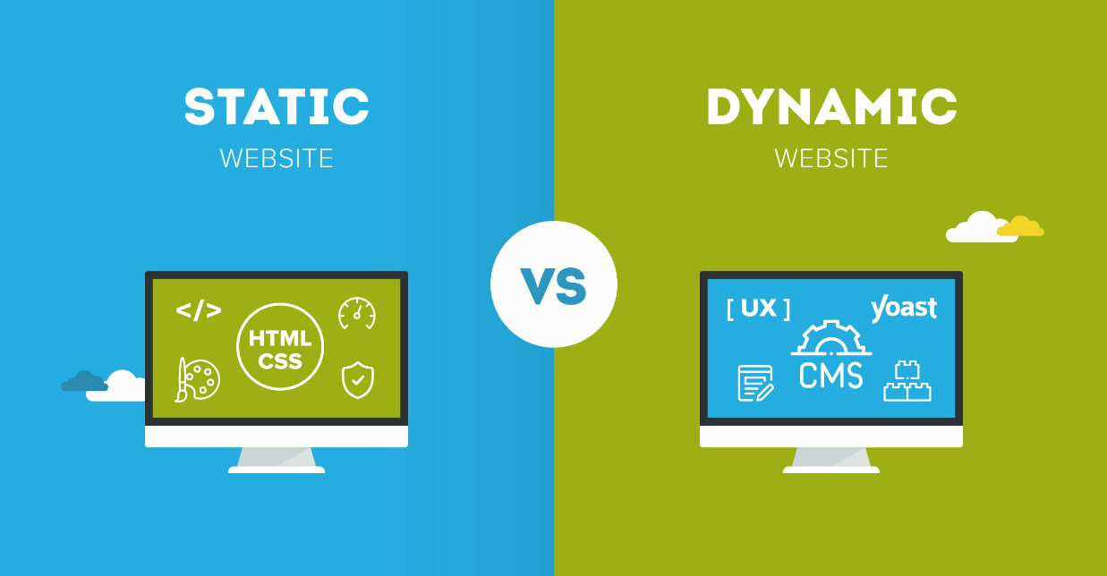
Types of Web Pages
There are two types of Web Pages
Static Webpage
Dynamic Webpage

Slide 9
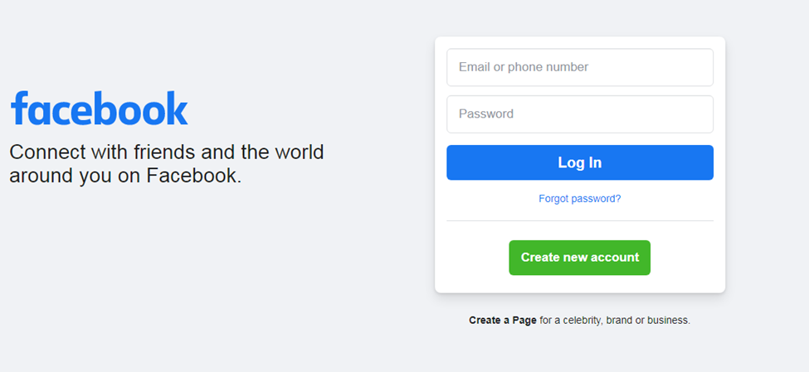

Static Web Page
You might have noticed this login page. You have also made the similar login page in module: Introduction to Information Systems.
What do all these login pages share in common?

Slide 10
Static Web Page
All of them have a username and password and also fields for entering username and password.
Since, all the users when they login into Facebook, they use the same login page.
This is an example of Static Web Page.

Slide 11

Static Web Page
Simple web pages - written in languages like JavaScript, HTML, CSS, and so on, and stored in a web server.

Slide 12
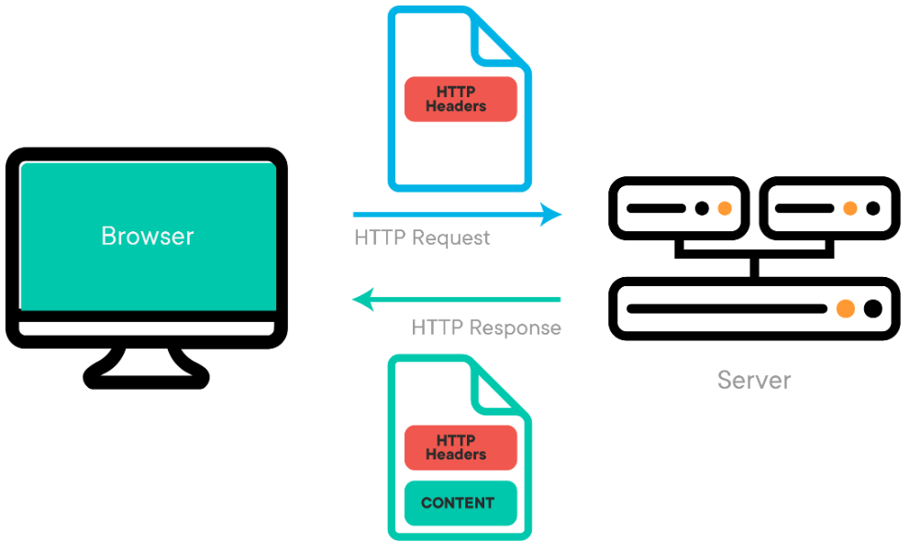
Static Web Page
In the case of static web pages, as soon as a server receives a request for a page, it immediately sends a response to the client with zero additional processing.

Slide 13
Static Web Page
The server locates this page, adds the HTTP headers, then immediately replies with an HTTP response. This way, you can view these web pages through a web browser

Slide 14
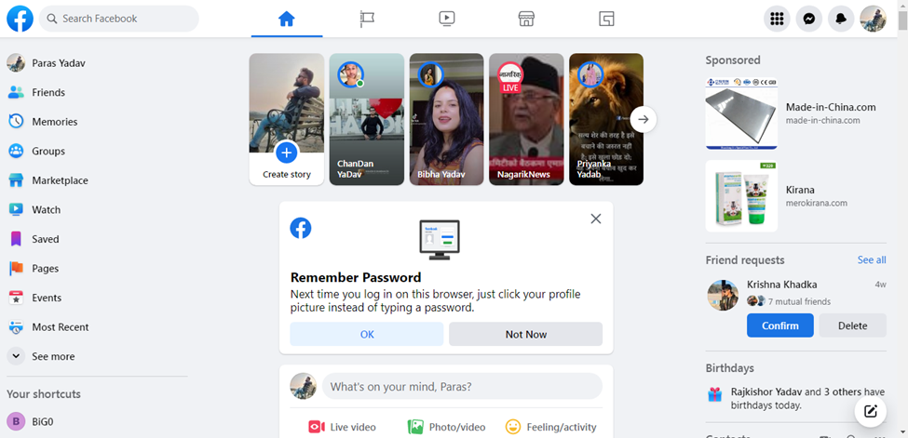
Dynamic Web Page
When we login into Facebook, we see a similar interface.
This interface is different for different users.
This is an example of dynamic web page.

Slide 15
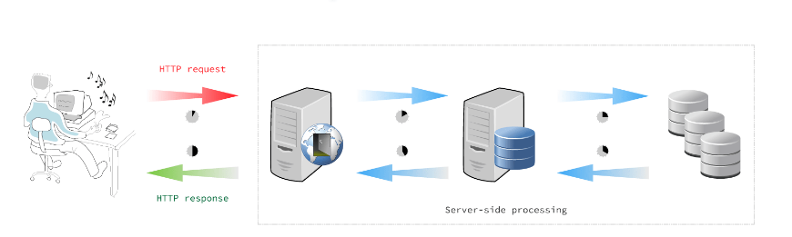
Dynamic Web Page
Dynamic websites are those that generate web pages in real-time. Web scripting code, such as PHP or ASP, is used on these pages.
The web server parses the code, and the generated HTML is transmitted to the client's browser when a client requests a dynamic page.

Slide 16
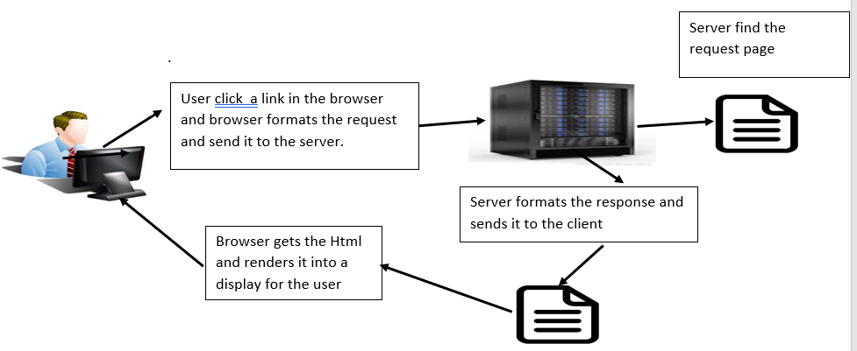
Client Server Model
A web client lets the the user request something on the server and shows the user the result of the request
A web server takes a client request and gives something back to the client.

Slide 17
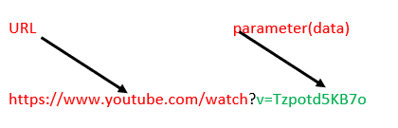
Get Request
It is the simplest HTTP method and its main job is to ask the server to get a resource and send it back to the user.
In this type of request, The total amount of character in a GET is really limited
The data you send with a Get is appended to the URL up in a browser bar,so whatever we send a get request, the information is exposed .
NOTE: Better not put a password or some sensitive data as part of a Get

Slide 18
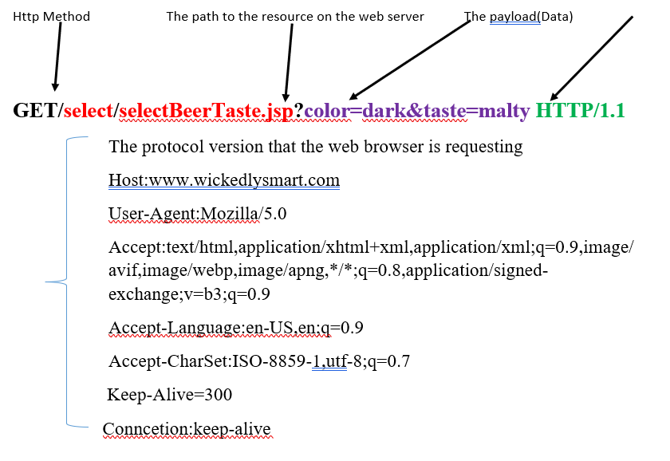
Anatomy of an HTTP GET Request

Slide 19
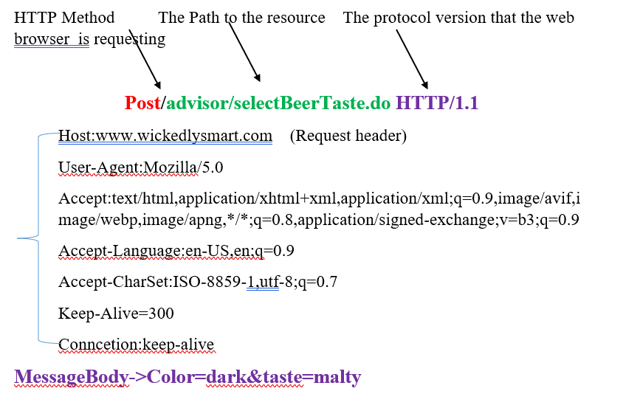
Anatomy of an HTTP POST Request
They are designed to be used by the browser to make complex request on the server.
Example: If a user has just completed a long form the application might want all of the form’s data to be added to the database. The data to be send to the server is known as message body or payload.

Slide 20
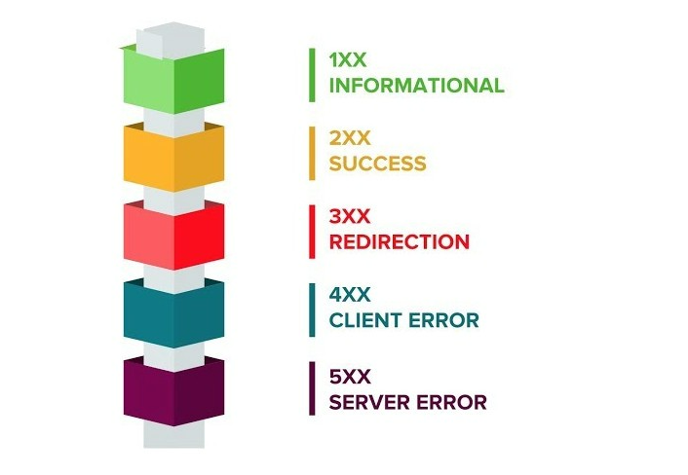
HTTP response status codes
Informational responses (100 – 199)
Successful responses (200 – 299)
Redirection messages (300 – 399)
Client error responses (400 – 499)
Server error responses (500 – 599)

Slide 21
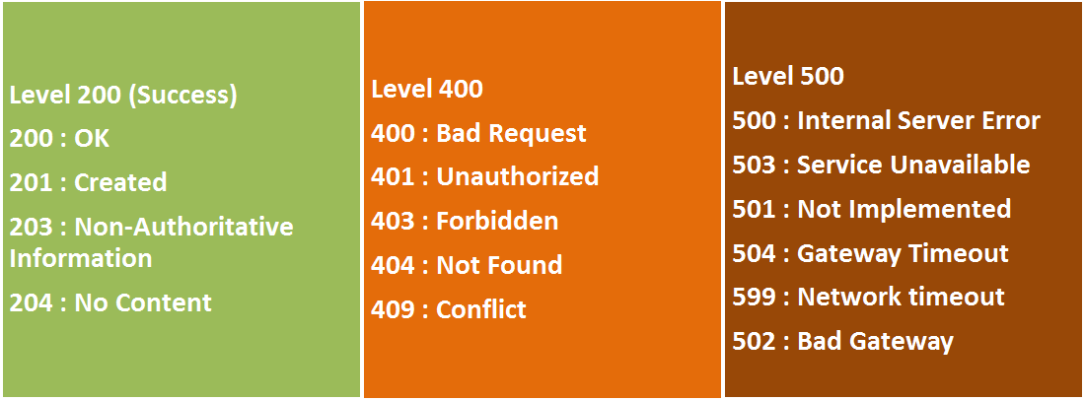
HTTP response status codes

Slide 22
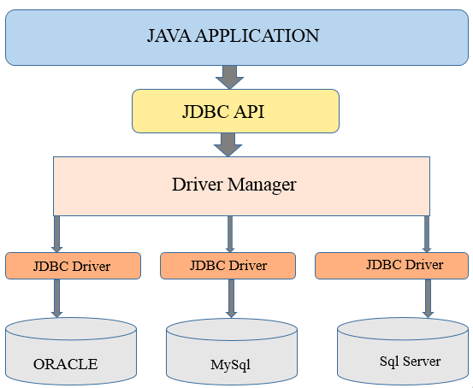
MySql Database Connectivity

Slide 23
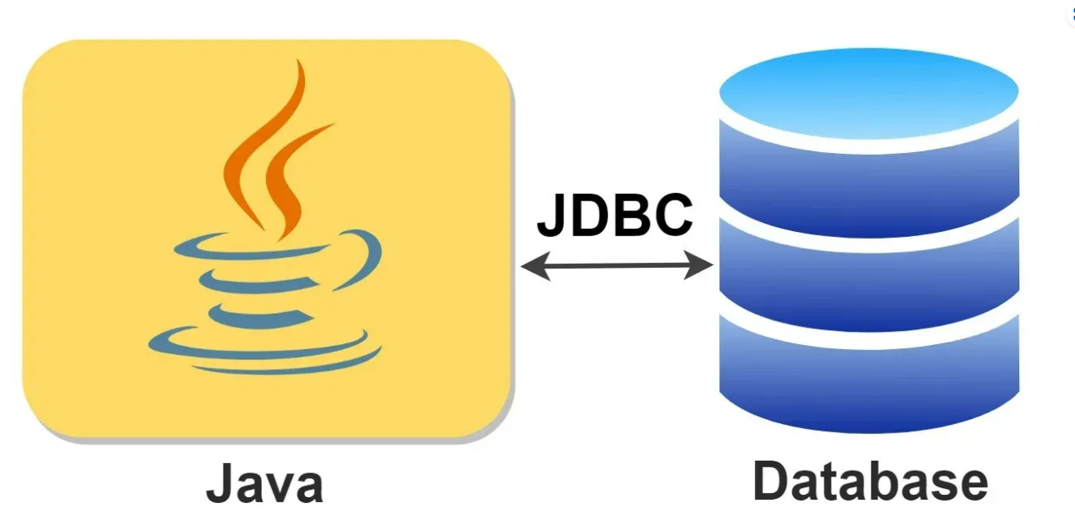
Tutorial
Java Database Connectivity (JDBC)

Slide 24


Workshop
Project Setup

Slide 25
Any Questions?

Slide 26
Thank You

