Slide 1
CS5054 ADVANCED PROGRAMMING
AND
TECHNOLOGIES
Week 1 - Tutorial Web-Pages and Its Types
Saroj Kumar Yadav

Slide 2
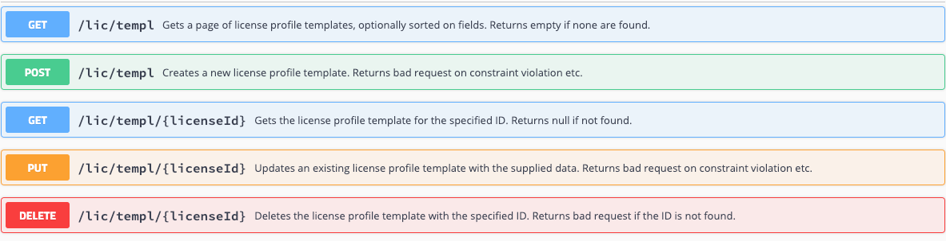
HTTP Methods

Slide 3
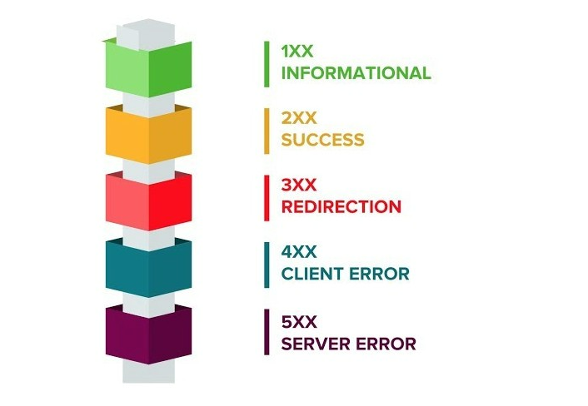
HTTP response status codes
Informational responses (100 – 199)
Successful responses (200 – 299)
Redirection messages (300 – 399)
Client error responses (400 – 499)
Server error responses (500 – 599)

Slide 4
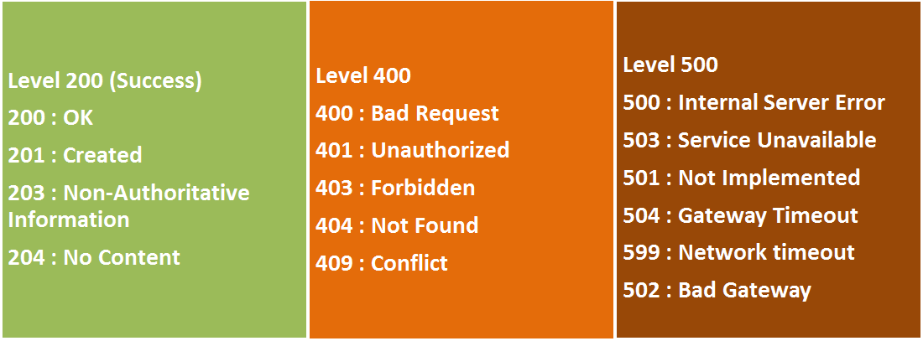
HTTP response status codes

Slide 5
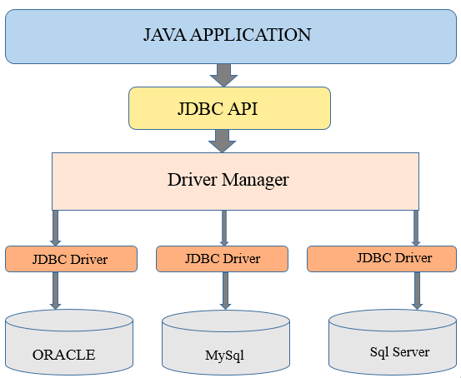
MySql Database Connectivity

Slide 6
Step for Database Connectivity with MySQL
Driver class: The driver class for the MySQL database is com.mysql.jdbc.Driver
Connection URL: The connection URL for the MySQL database is jdbc:mysql://localhost:3306/demo where
jdbc is the API,
MySQL is the database,
local host is the server name on which MySQL is running,
3306 is the port number and demo is the database name
Username: The default username for the MySQL database is root.
Password: It is the password given by the user at the time of installing the MySQL database.

Slide 7
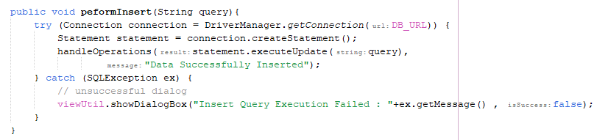
Java Database Connectivity (JDBC)
Insert Query

Slide 8
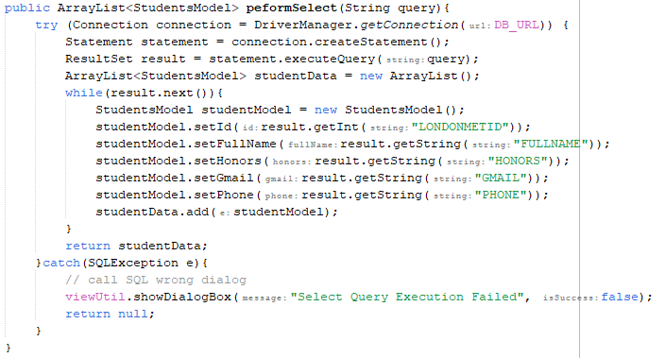
Java Database Connectivity (JDBC)
Select Query

Slide 9
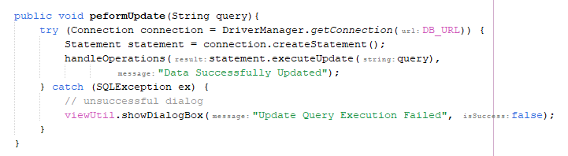
Java Database Connectivity (JDBC)
Update Query

Slide 10
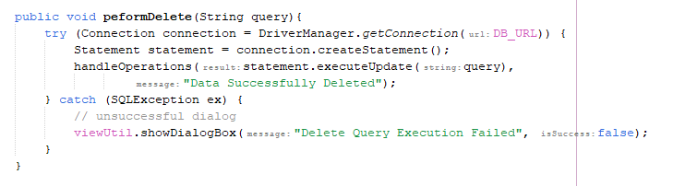
Java Database Connectivity (JDBC)
Delete Query

Slide 11

Required Software's
Xampp
- free and open-source cross-platform web server solution

Slide 12

Required Software's
Eclipse IDE
- Desktop IDEs. The Eclipse IDE is famous for our Java Integrated Development Environment

Slide 13
Any Questions?

Slide 14
Thank You

