Slide 1
CS5054 ADVANCED PROGRAMMING
AND
TECHNOLOGIES
Week 2 - Lecture Introduction to Servlets
Prithivi Maharjan

Slide 2
Learning Objectives
Understand the basics of Servlets
Know about life cycle of Servlets
Understand containers
Demonstrate how servlet works

Slide 3

In previous week
Web pages

Slide 4
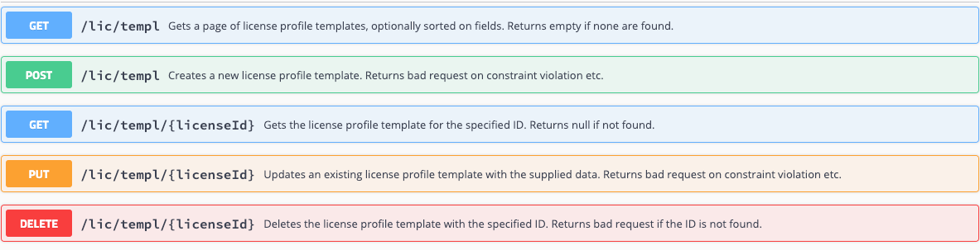
In previous week
HTTP methods

Slide 5
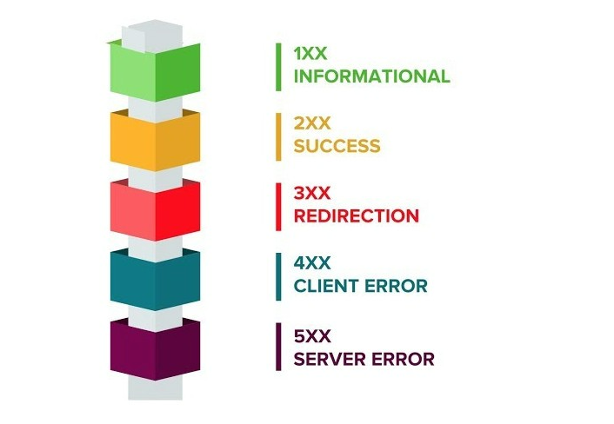
In previous week
HTTP response status codes

Slide 6
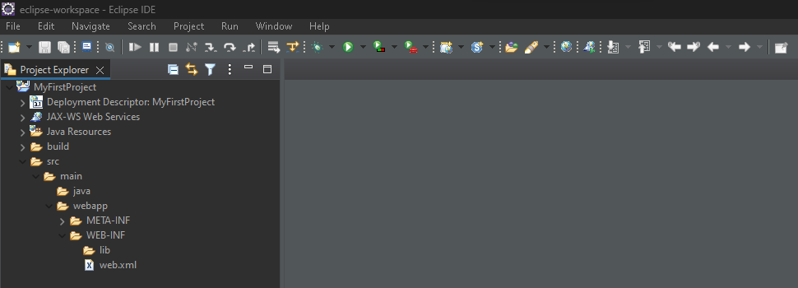
In previous week
Installation and project setup in eclipse IDE

Slide 7

Servlet
Servlets are a component of JEE framework used for web development. (JEE = Java Enterprise Edition)
They are basically Java programs that run inside the boundaries of a container.
In short, they are responsible for accepting a request, processing it, and sending a response back.

Slide 8
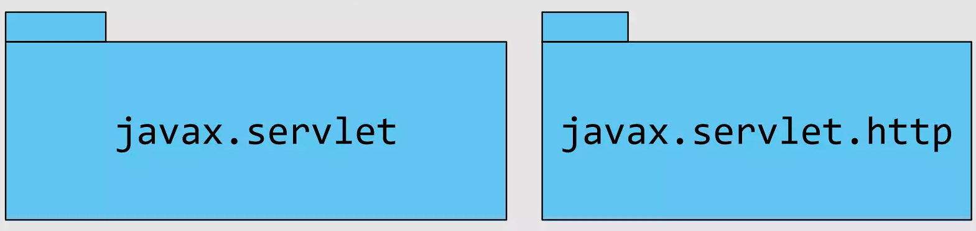
Servlet
A Servlet consists of Servlet API (API = Application Programming Interface)
The Servlet API consists of two important packages that encapsulates all the important classes and interface, namely :

Slide 9
Advantages of Servlets
BETTER PERFORMANCE
Servlets have better performance because it causes a thread for each request.
PORTABILITY
Servlets are portable because it uses Java programming language.
ROBUST
Servlets are robust because JVM manages Servlet. Hence, we do not need to worry about the memory leak, garbage collection.
SECURE
Servlets are secure because it uses Java programming language
(As discussed in Year 1, we know JAVA IS SECURE PROGRAMMING LANGUAGE.)

Slide 10
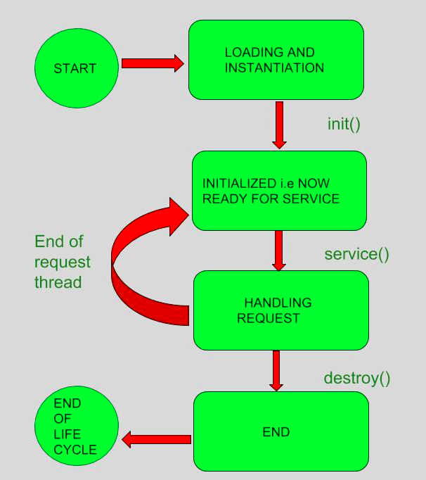
Life Cycle of Servlets
The life cycle of servlets consists of:
Load Servlet Class
Create an instance of Servlet
Call init() method
Call service() method
Call destroy() method

Slide 11
init() method
The init() method is also called only once.
This method is used to initialize the servlet.
The container initializes the Servlet object by invoking the Servlet.init(ServletConfig) method which accepts ServletConfig object reference as parameter.

Slide 12
service() method
The service() method is called each time when request for servlet is received.
If the servlet is not initialized, the same above steps are followed, and then the service() method is called.
If the servlet is initialized, it calls the service() method.

Slide 13

destroy() method
The destroy() method is called at the end.
When a servlet container decides to destroy the Servlet, the following operations are carried out:
All the threads currently running in the service method of the Servlet instance to complete their jobs and get released.
After currently running threads have completed their jobs, the Servlet container calls the destroy() method on the Servlet instance.

Slide 14

Need of Container
Servlet doesn’t have a main method.
They are under the control of another java application called a container.

Slide 15
Need of Container
Servlets must initially be registered before being used so that a container, whether JEE-based or Spring-based, can take them up at startup.
A servlet is initially created by the container by invoking its init() function.

Slide 16
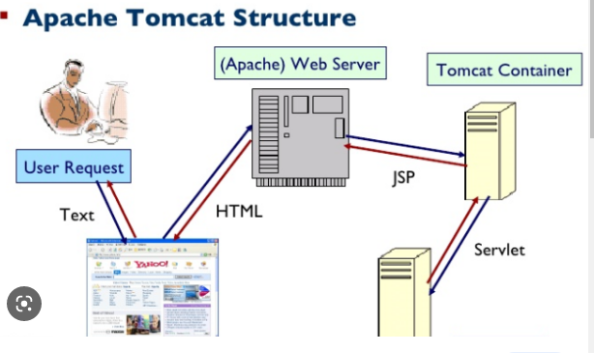
Need of Container
When a web server gets a request for servlet, the server hands the request to the container in which the servlet is deployed.

Slide 17
Need of Container
Its the container that gives the servlet - the Http request and response (Container that calls the servlet ‘s method ( doPost() and doGet() ).

Slide 18
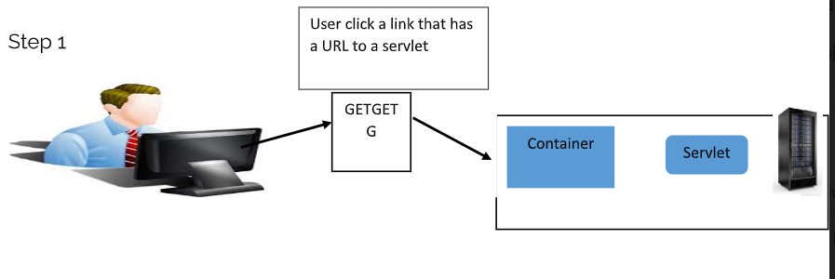
How Servlet Works?
Step 1: User click a link that has a URL to a servlet
GET

Slide 19
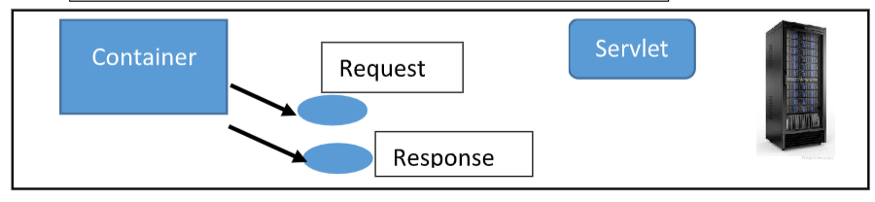
How Servlet Works?
Step 2: The container sees that the request is for the servlet
So that container creates two objects:
1) HttpservletResponse 2) HttpservletRequest

Slide 20
How Servlet Works?
Step 3: The container finds the correct servlet based on the URL in the request, creates or allocates a thread for that request, and passes the request and response object to the servlet thread.
Container
Servlet
Request
Response
Thread

Slide 21
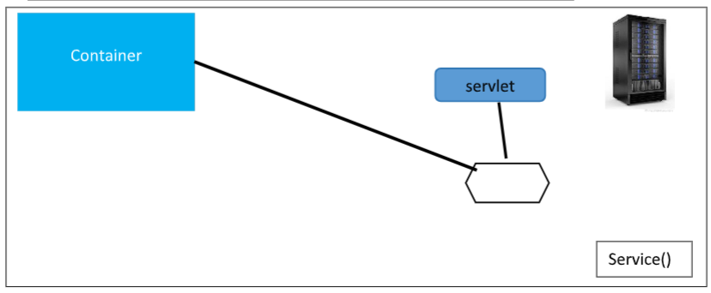
How Servlet Works?
Step 4: The container invokes the Servlet’s method. Depending on the type of request, the service method calls either the doGet() or doPost() method.
For this example we will assume the request was an HTTP GET
Request
Response

Slide 22
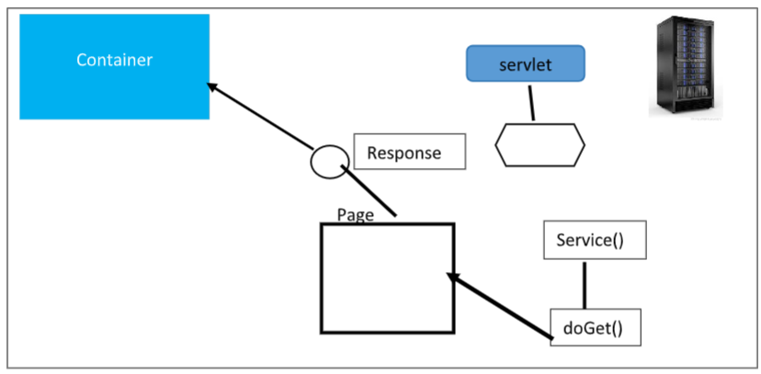
How Servlet Works?
Step 5: The doGet() method generates the required data which is the response object for the page.

Slide 23
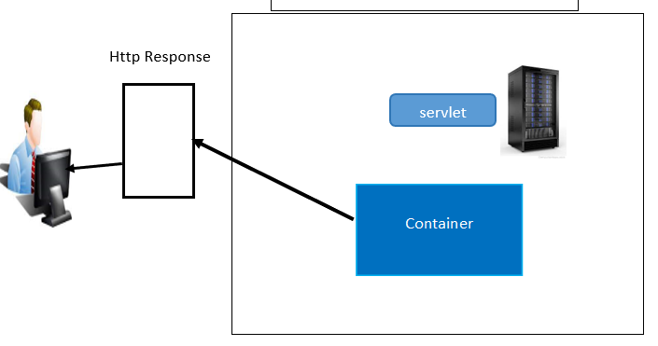
How Servlet Works?
Step 6: The thread completes, the container converts the response object into HTTP Response and send back into the client.
No thread
Delete the request and response object

Slide 24
Servlet
The Servlet API consists of two important

Slide 25
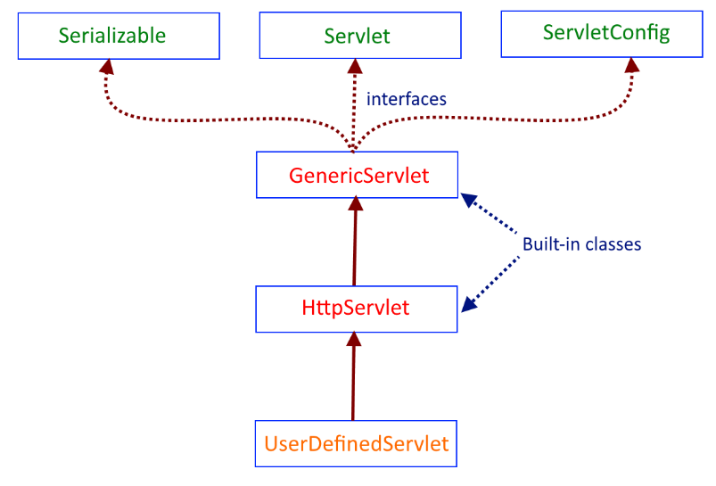
Http Servlet Class
Abstract class provided by ‘javax.servlet.http.HttpServlet’

Slide 26
Http Servlet Class Methods
1. doGet()
Used to handle server side GET request
2. doPost()
Used to handle server side POST request

Slide 27
Http Servlet Class Methods
3. doPut()
Used to handle server side PUT request
4. doDelete()
Used to handle server side DELETE request

Slide 28
Http Servlet Class Methods
5. doHead()
6. doOptions()
7. doTrace()
8. service()

Slide 29
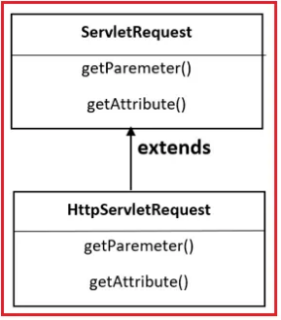
Servlet Request Interface
When a client sends a request to the web server, the servlet container creates ServletRequest & ServletResponse objects and passes them as an argument to the servlet’s service() method.
The request object provides the access to the request information such as header and body information of request data.

Slide 30
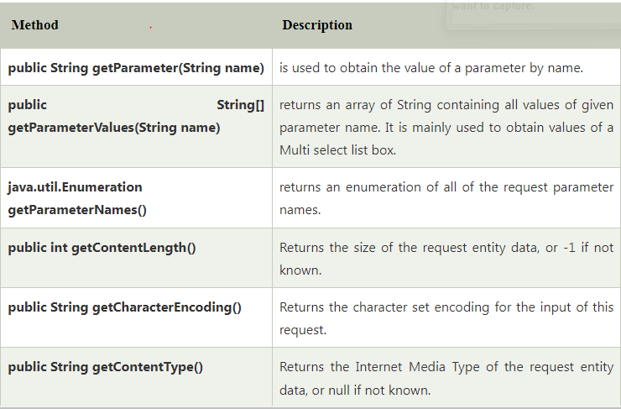
Explanation of Request Interface Method

Slide 31
Tutorial
Create a new servlet in our project.

Slide 32
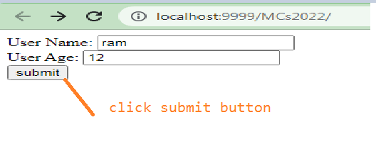
Tutorial

Slide 33
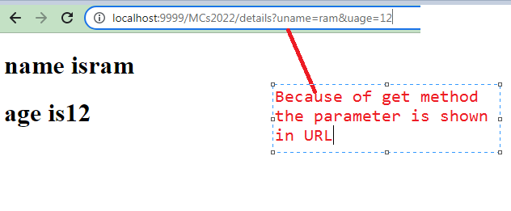
Tutorial

Slide 34
Workshop
Dynamic web application – Servlet task

Slide 35
Summary
We understood the concepts of servlets
We gained the knowledge of lifecycle of servlets
We observed the architecture workflow of servlets
We learned the importance of container in servlets
We understood the information of HttpServlet class and methods

Slide 36
Any Questions?

Slide 37
Thank You

