Slide 1
CS5054 ADVANCED PROGRAMMING
AND
TECHNOLOGIES
Week 2 Introduction to Servlets
Prithivi Maharjan

Slide 2
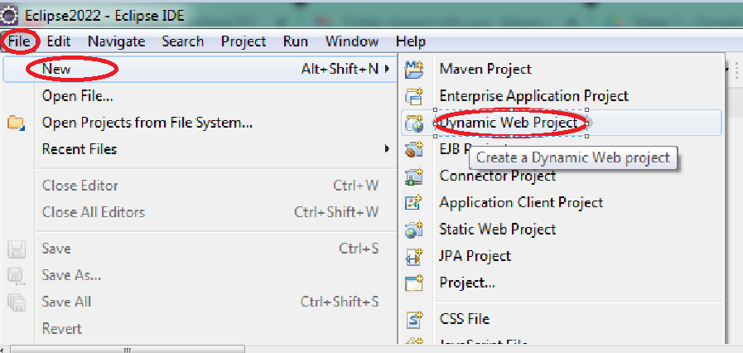
Creating Dynamic Project
Step 1: Open Eclipse IDE, Select File -> New -> Dynamic Web Project

Slide 3
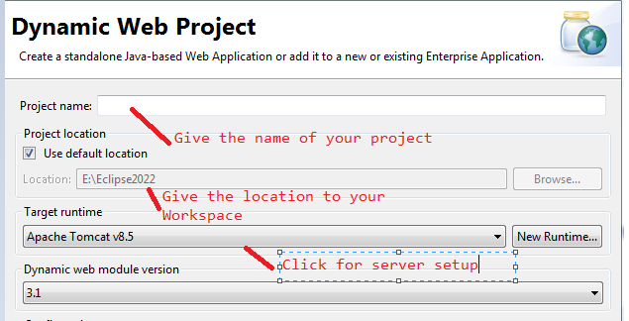
Creating Dynamic Project
Step 2: Give the name to your project. Click New Runtime to setup the server for the project

Slide 4
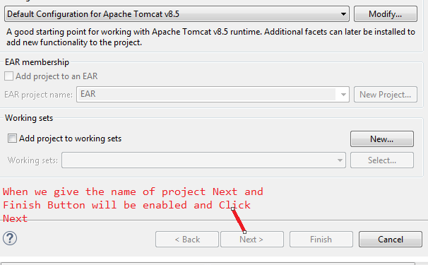
Creating Dynamic Project
Continue…

Slide 5
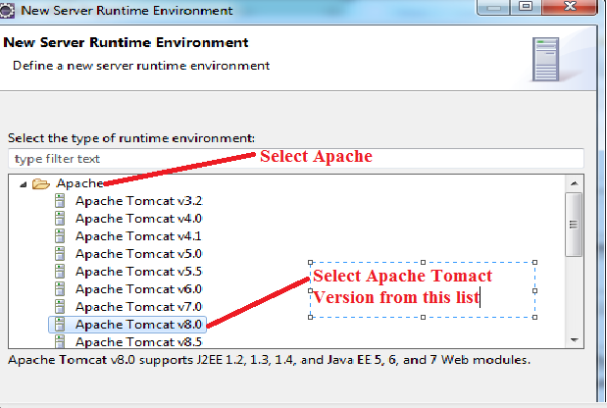
Creating Dynamic Project
Step 3: Select Apache and Select Apache Tomcat Version and Click Next

Slide 6
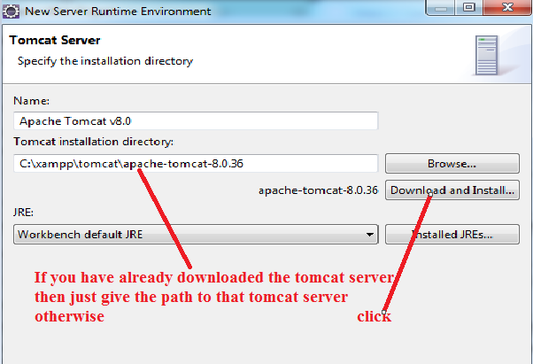
Creating Dynamic Project
Step 4: Click the Download and Install button if you have not downloaded the Tomcat server. Then click Finish after download is complete

Slide 7
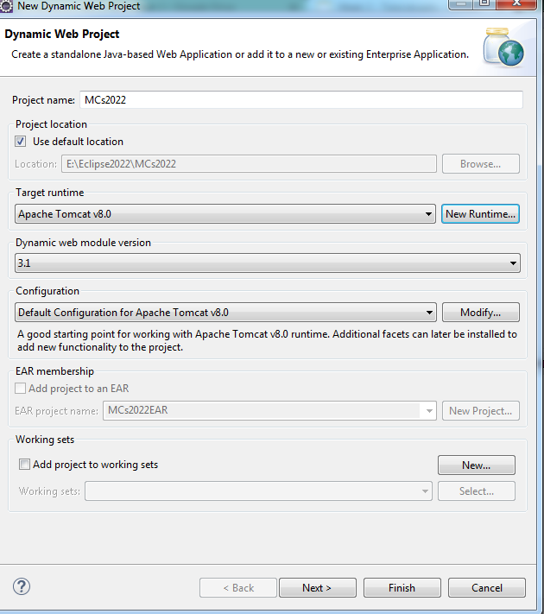
Creating Dynamic Project
Step 5: After Server setup we will return with this window and then click Next

Slide 8
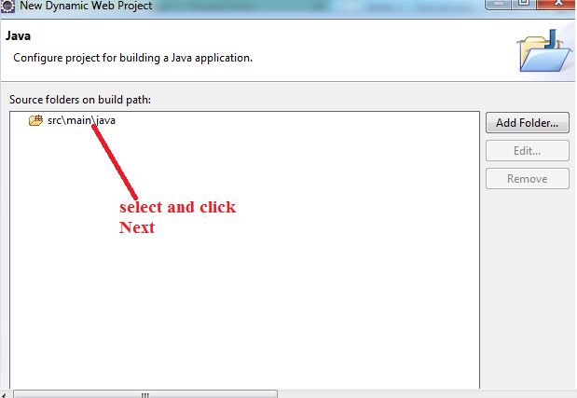
Creating Dynamic Project
Step 6: Select src\main\java and click Next

Slide 9
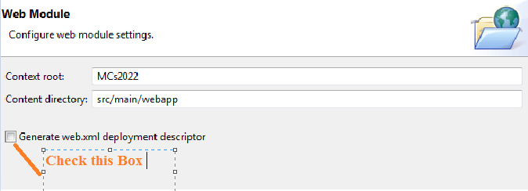
Creating Dynamic Project
Step 7: Check the “Generate web.xml deployment descriptor” so that we don’t have to write servlet mapping manually and Click Finish
C

Slide 10
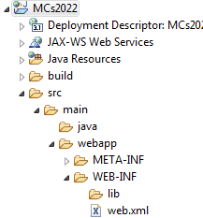
Creating Dynamic Project
Project folder after successful creation of dynamic project.

Slide 11
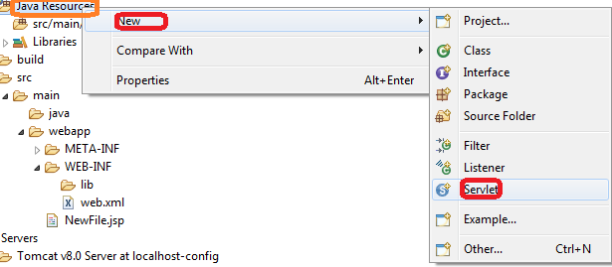
Creating Servlet
Step 1:
Select-> Java Resource Right Click on Java Resource Select ->New and then select Servlet

Slide 12
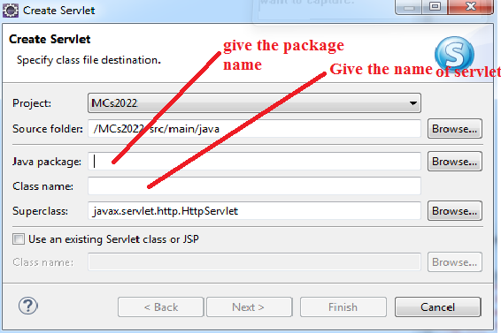
Creating Servlet
Step 2:
Select/Give the required package name and also give the Servlet name and Click Next

Slide 13
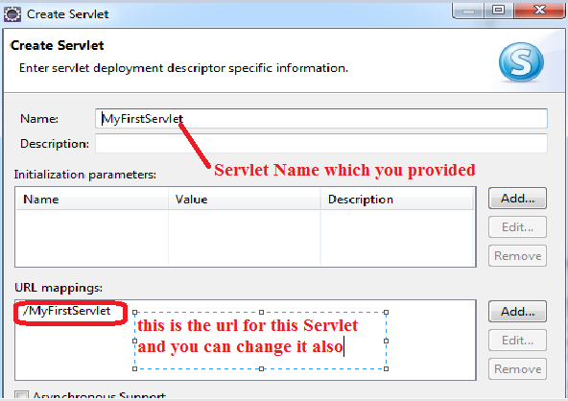

Creating Servlet
Step 3: Check the Asynchronous support and Click Next

Slide 14
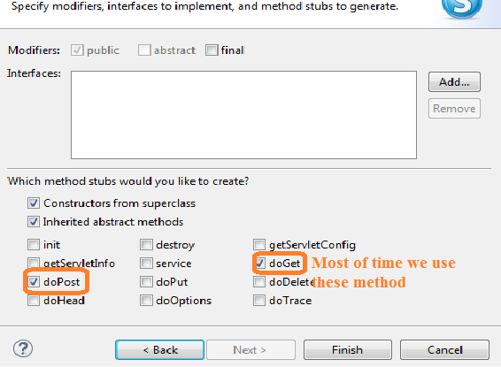
Creating Servlet
Step 4: Select these method and Click Finish. Setting up your Servlet is ready now

Slide 15

Creating Servlet
Step 5: Write the following code inside your doGet() method

Slide 16
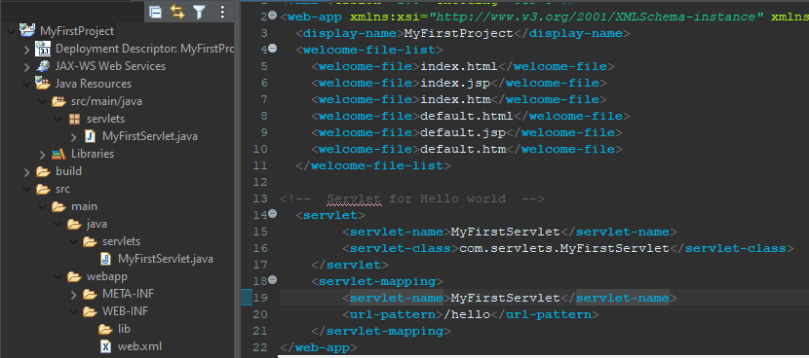
Creating Servlet
Step 5: In web.xml file add the code shown in the figure

Slide 17
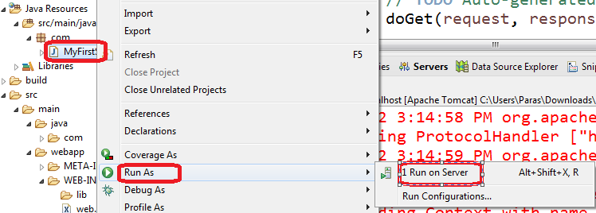
Run the Servlet

Slide 18
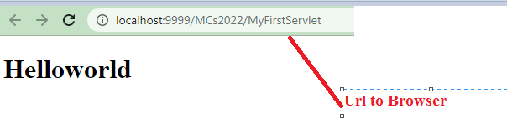
HelloWorld in browser

Slide 19
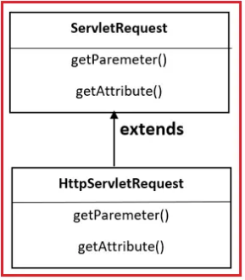
Servlet Request Interface
When a client sends a request to the web server, the servlet container creates ServletRequest & ServletResponse objects and passes them as an argument to the servlet’s service() method.
The request object provides the access to the request information such as header and body information of request data.

Slide 20
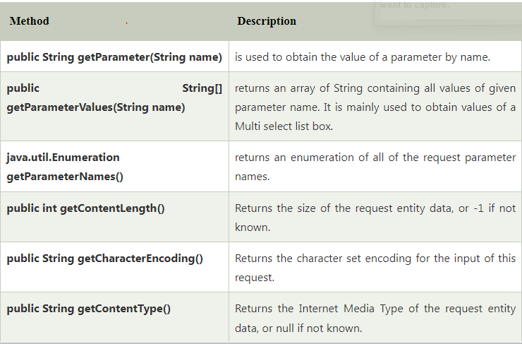
Explanation of Request Interface Method

Slide 21
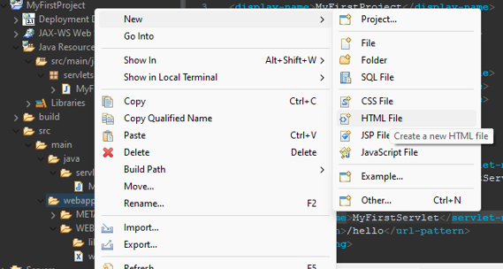
ServletRequest getParameter()
Create a new register.html file inside webapp folder

Slide 22
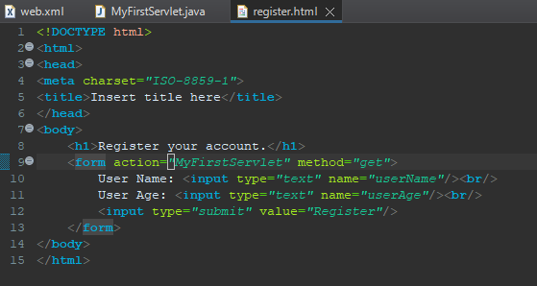
ServletRequest getParameter()
Add the following code inside register.html code

Slide 23
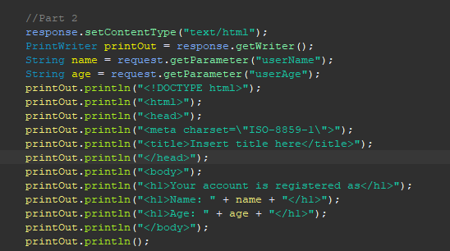
continue…
MyFirstServlet.java
Add following codes inside doGet() method.

Slide 24
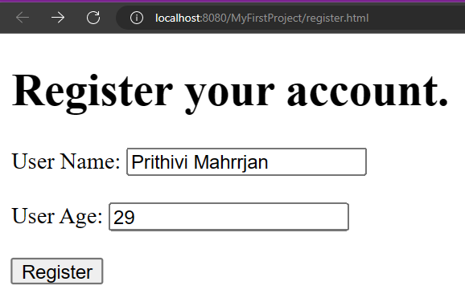
Output

Slide 25
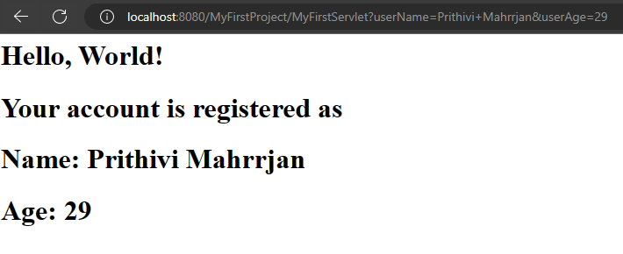
Output

Slide 26

Post Method
Replace get with post text inside method.

Slide 27
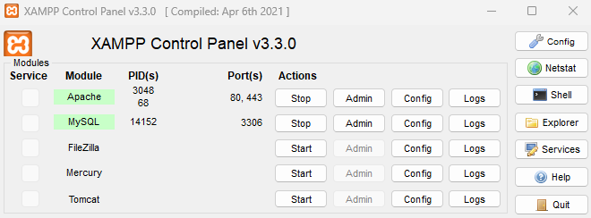
Setting up database
Then we need to create a new database and table in XAMPP server.
Start Apache and MySQL server
Then click on Admin of MySQL server
Then we need to create a new database and table in XAMPP server.
Start Apache and MySQL server
Then click on Admin of MySQL server

Slide 28
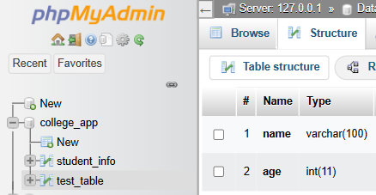
Setting up database
Create a new database “college_app”. Create a table “text_table”.
The table should contain 2 column name and age as shown in figure.

Slide 29
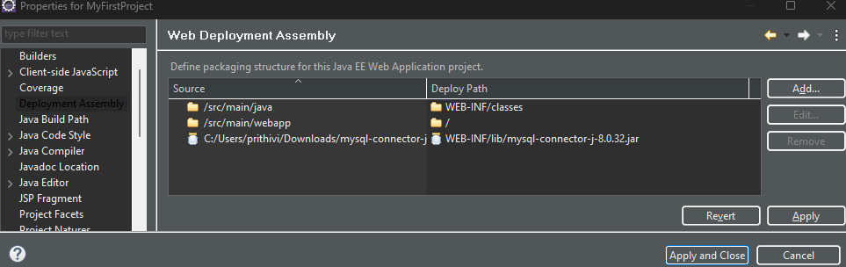
Setting up MySQL in Eclipse
Right click on the project then select properties
Select Deployment Assembly then click on Add button

Slide 30
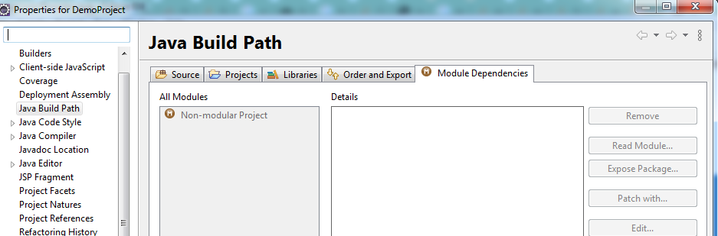
Setting up MySQL in Eclipse
Right click on the project then select properties
Select Deployment Assembly then click on Add button

Slide 31
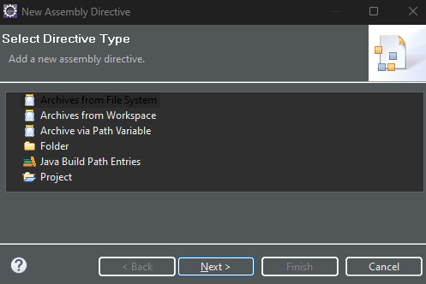
Setting up MySQL in Eclipse
Select Archives From File System.
Then click Next

Slide 32
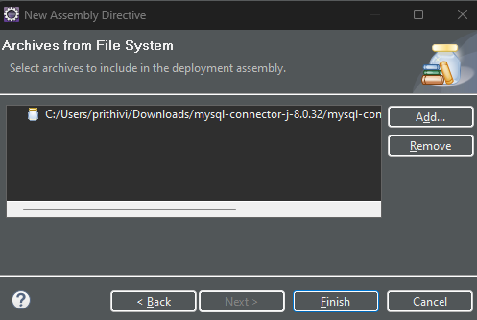
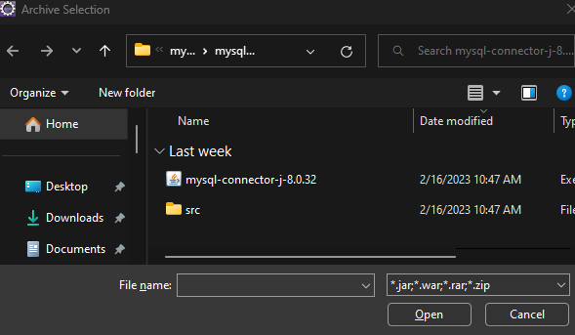
Setting up MySQL in Eclipse
Click on Add button. Then select MySQL connecter. Then click on Finish

Slide 33
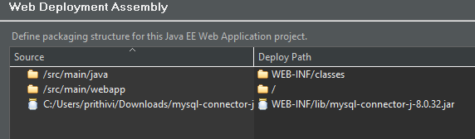
Setting up MySQL in Eclipse
Then you can see MySQL connecter in your web deployment assembly

Slide 34
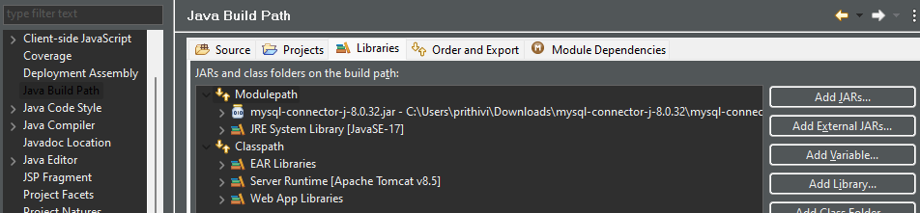
Setting up MySQL in Eclipse
Select Java Build Path. Select Modulepath. Click on Add JARs.

Slide 35
Setting up MySQL in Eclipse
In Java Build Path make sure that MySQL connector is shown in Module path.
If not shown then select Modulepath. Click on Add JARs. Then add the jar file like we have done in our previous slides.
In Java Build Path make sure that MySQL connector is shown in Module path.
If not shown then select Modulepath. Click on Add JARs. Then add the jar file like we have done in our previous slides.

Slide 36
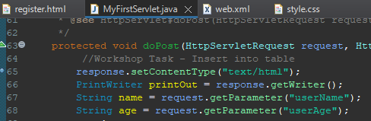
Database Connectivity with Servlet
Add the following code in doPost() method of your servlet.

Slide 37
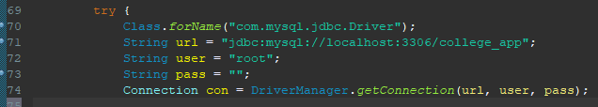
Database Connectivity with Servlet
Then add the code to configure connection to database.

Slide 38
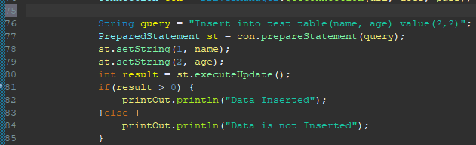
Database Connectivity with Servlet
After the connection add the following code to run the query and get response from the database

Slide 39
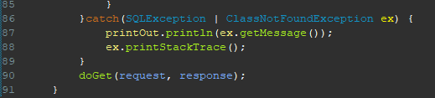
Database Connectivity with Servlet
Finally in catch method, catch the exception thrown and print them in the browser

Slide 40
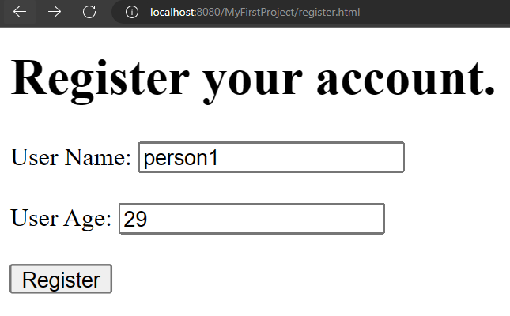
Output

Slide 41
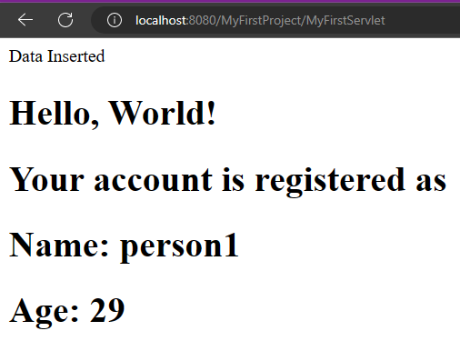
Output

Slide 42
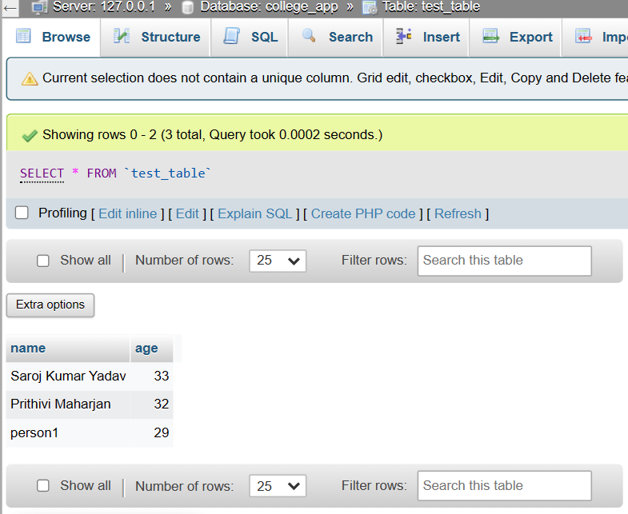
Output

Slide 43
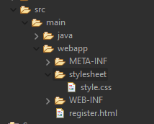
Adding CSS
Create new folder: Project Folder -> webapp -> stylesheet
Create new CSS file: stylesheet-> style.css

Slide 44
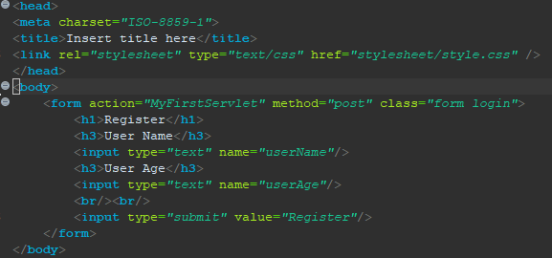
Adding CSS
To include CSS in HTML we can use link tag inside head

Slide 45
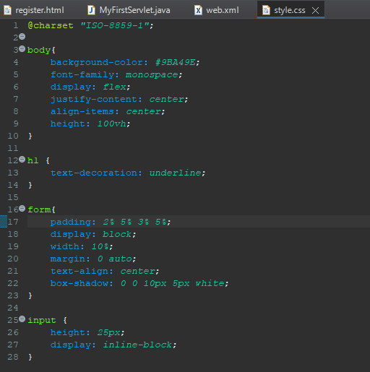
Adding CSS
CSS codes

Slide 46
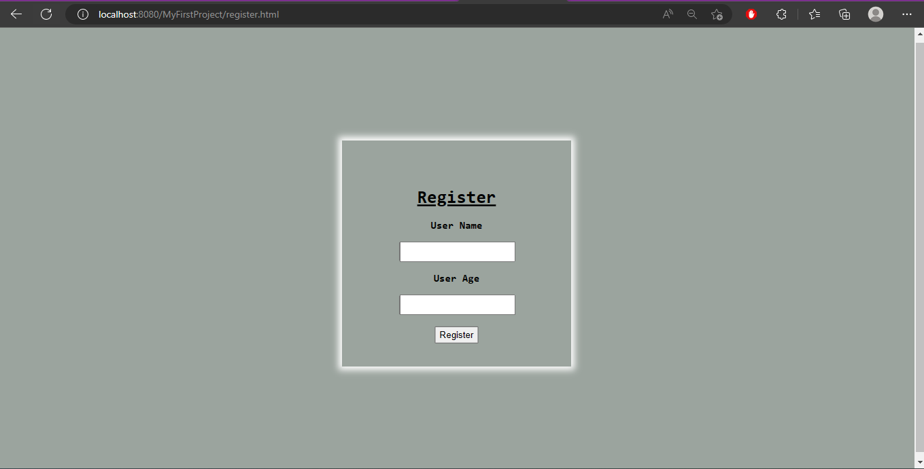
Output

Slide 47
Thank You

