Slide 1
CS5054 ADVANCED PROGRAMMING
AND
TECHNOLOGIES
Week 4 - Lecture Introduction to JSP
Prithivi Maharjan

Slide 2
Agenda
Understand the basics of JSP
Know about life cycle of JSP
Understand different tags in JSP
Demonstrate about JSP Implicit Objects

Slide 3
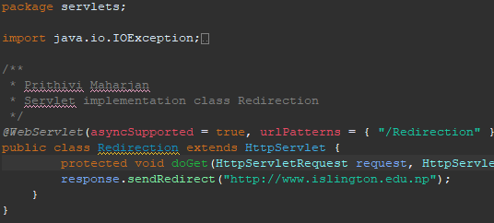
Previous Week
Send Redirect Method

Slide 4
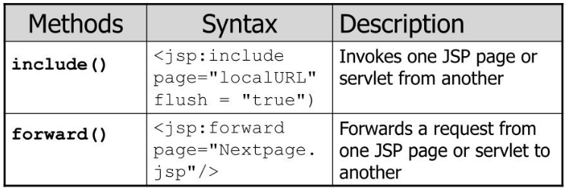
Previous Week
Request Dispatcher

Slide 5

JSP
JSP stands for Java Server Pages

Slide 6
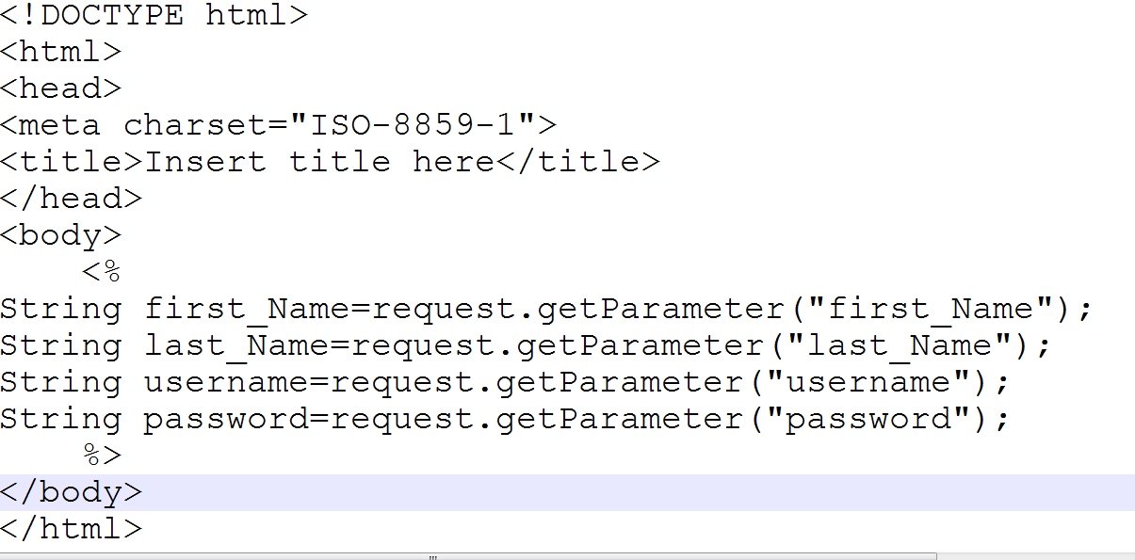
Java Server Pages
Java Server Page is a web development technology that supports dynamic content. This allows programmer to use specific jsp tags to insert java code inside html.

Slide 7

Advantages of JSP
Enhances the performance and scalability of web pages

Slide 8

Advantages of JSP
JSP Enables the separation of content generation from content presentation. Which makes it more flexible

Slide 9
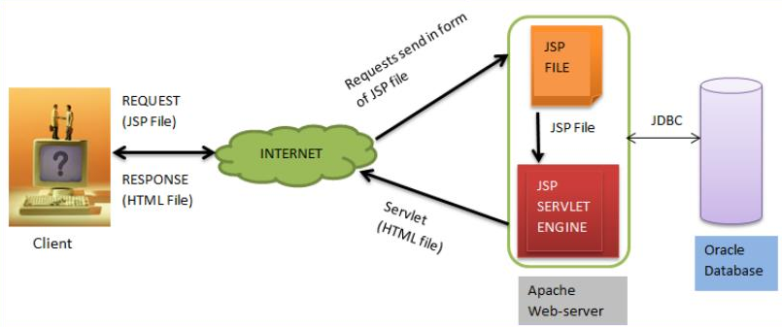
Advantages of JSP
There is automatic deployment of a JSP, recompilation is done automatically when changes are made to JSP pages

Slide 10
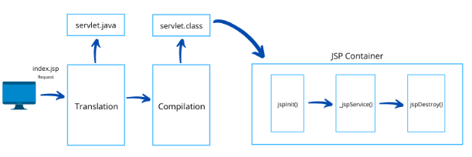
Life cycle of JSP
JSP passes through the following phases:
Translation of JSP page
Compilation of JSP page
Class loading
Instantiation
Initialization
Request Processing
Destruction

Slide 11
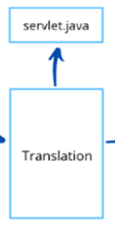
JSP Translation Phase
Web browser sends an HTTP request to the webserver when a user navigates to a JSP page.
Checks if duplicate JSP contains
JSP servlet engine converts JSP page into servlet content (.java extension) which is called translation process.
Web container automatically converts JSP page into .java extension.

Slide 12
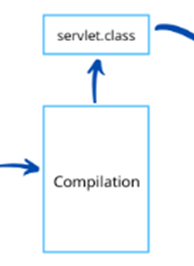
JSP Compilation Phase
If JSP page was not compiled beforetime then JSP engine compiles the page.
In this phase, .java extension file will be compiled into .class extension file.

Slide 13
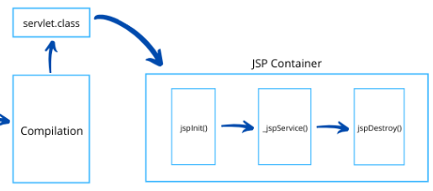
JSP Class Loading Phase
At this stage, the .class file gets loaded to the container.

Slide 14
JSP Initialization Phase
After compilation container invokes jspInit() method.

Slide 15
JSP Request Processing Phase
After the initialization of servlet instances, a new thread gets created.
All the interactions necessary to process requests occur at this stage.
Thus, container invokes _jspService() method.
This method contains two parameters:
HTTPServletRequest req
HTTPServletResponse res

Slide 16
JSP Destroy Phase
For the cleanup jspDestroy() method gets invoked.
This cleanup means that the JSP page after processing gets removed from the container.

Slide 17
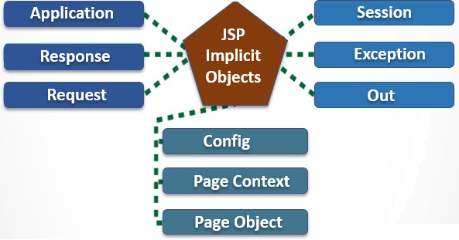
JSP Implicit Objects
Implicit objects are a set of Java objects made available to developers on each page by the JSP Container.
We can invoke them directly - without explicit declaration.

Slide 18
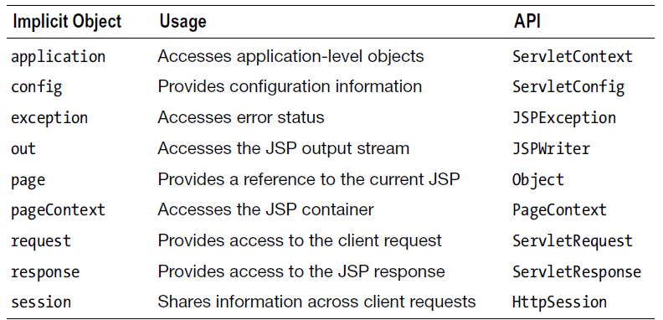
JSP Implicit Objects

Slide 19
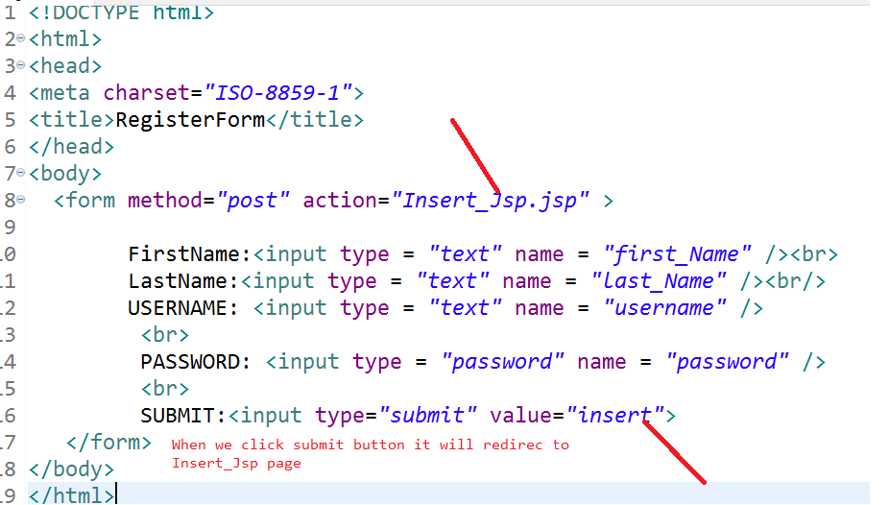
Example of request implicit object

Slide 20
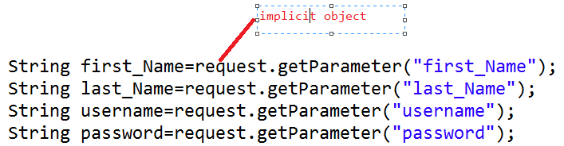
Implicit objects
Request implicit object
Out implicit object
out.println(first_Name);
Response implicit object
response.sendRedirect(“http://www.google.com”);

Slide 21
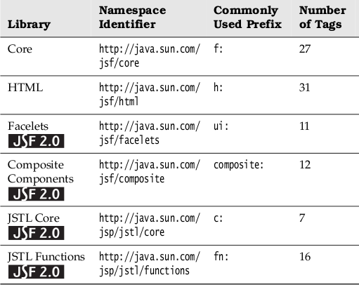
JSF Tag Libraries

Slide 22
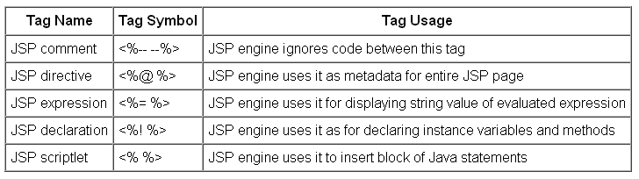
Tags in JSP

Slide 23

Comment Tag
It includes text that has been added for information but that should be ignored.

Slide 24
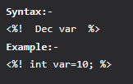
Declaration Tag
Used to declare variables

Slide 25

Java Scriplets Tag
Allows us to add Java codes

Slide 26
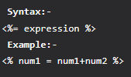
JSP Expression Tag
It performs evaluation and turns the expression into a string.

Slide 27

JSP Action Tag
Used to get rid of Scriptlet code in your JSP code
JSP Scriptlets are no longer used or taken into consideration.

Slide 28
JSP Action Tag
Tag | Description
jsp:forward | is used to send the request and response to additional resources.
jsp:include | is used to incorporate a different resource.
jsp:body | is used to define an XML element's dynamically specified body.
jsp:setProperty | is used to set a property's value in a bean object.
jsp:getProperty | is used to print the value of the bean's property.
jsp:useBean | is used to locate or create bean objects.
jsp:attribute | is used to define the properties of an XML element that is dynamically defined.

Slide 29
Jsp:forward
Jsp:forward action tag is used to forward the request to another resource it may be jsp, html or another resource
Syntax:
<jsp:forward page=“relativeURL | <%=expression %>”> text </jsp:forward>
Example:
<jsp:forward page="home.html"> Home </jsp:forward>

Slide 30
Jsp:include
Jsp:include action tag is used to include the content of another resource it may be jsp, html or servlet. It includes the resource at request time.
Syntax:
<jsp:forward page=“relativeURL | <%=expression %>”> text <jsp:include>
Example:
<jsp:include page="Register.html"> Register </jsp:include>

Slide 31
Summary
We understood the basics of JSP.
We learned how the life cycle of JSP works.
We identified the different tags that are used in JSP.
We learned the JSP Implicit Objects and observed its syntax.

Slide 32
Any Questions?

Slide 33
Thank You

