Slide 1
CS5054 ADVANCED PROGRAMMING
AND
TECHNOLOGIES
Example on JSP
Saroj Kumar Yadav

Slide 2
Tutorial Task
Tutorial Task
Create Homepage with two hyperlink as Signup and View .
Create Register Form for Signup
Retrieve all the value from form to JSP File
Database Connectivity in JSP File
Insert and View through JSP file

Slide 3
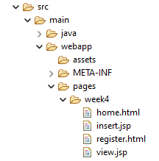
Home.html
Inside webapp>pages create a new folder week4
Inside week4 folder create 4 new files
home.html page
register.html page
insert.jsp page
view.jsp page

Slide 4
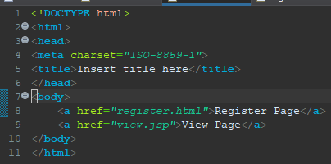
Home.html
Inside home.html page create 2 new anchor tag as shown in figure
Inside home.html page create 2 new anchor tag as shown in figure

Slide 5
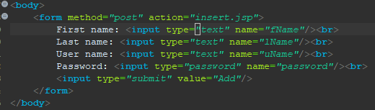
Register.html
Inside register.html page, create a form containing following information

Slide 6

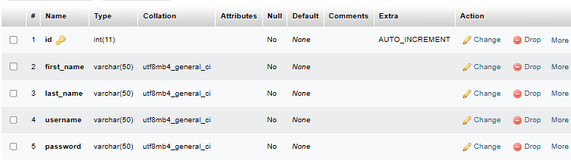
Database Table Structure
Create a new database name college_app
Inside college_app DB create a new table named register
The register table should contain the following columns.

Slide 7
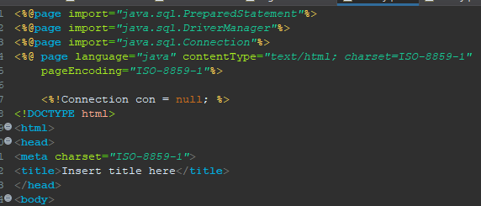
Insert.jsp
Inside the insert.jsp page import the required classes and create a variable with Connection datatype and null value

Slide 8
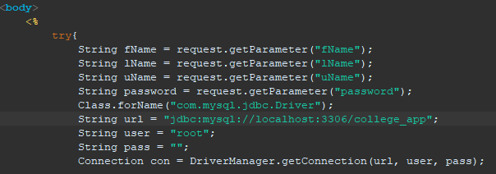
Insert.jsp continue…
Now we will add the Java code to insert the data into database.
Inside body tag add the following code.

Slide 9
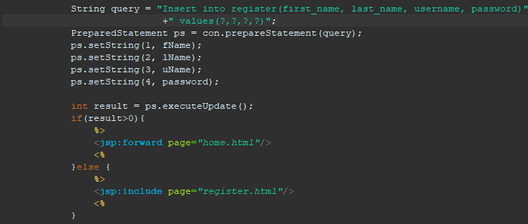
Insert.jsp continue…

Slide 10
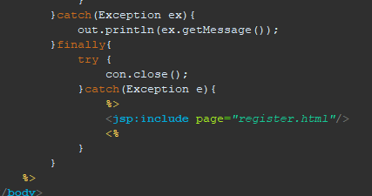
Insert.jsp continue…

Slide 11
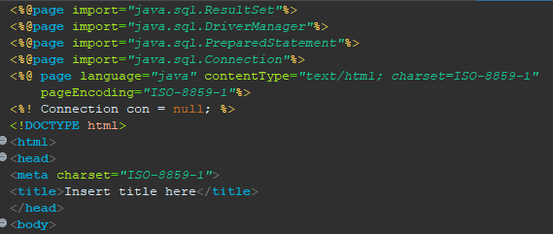
View.jsp
Then we will add the Java code to select all the the data from the database.
Inside body tag add the following code.

Slide 12
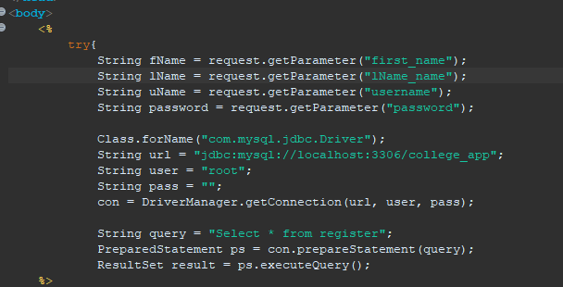
View.jsp continue…

Slide 13
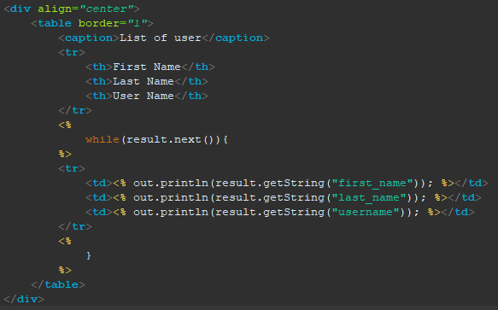
View.jsp continue…

Slide 14
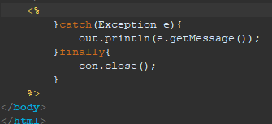
View.jsp continue…

Slide 15
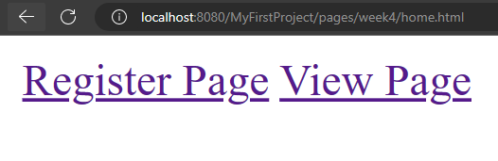
Output

Slide 16
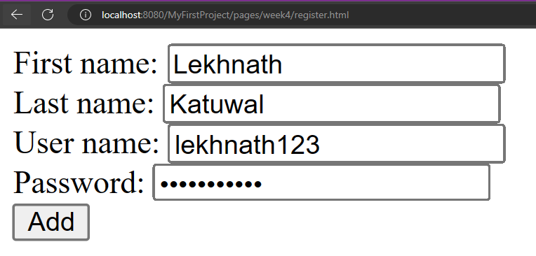
Output

Slide 17
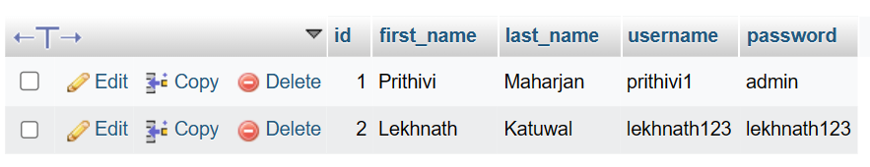
Output
Refresh your phpMyAdmin server. You can see your new inserted data.

Slide 18
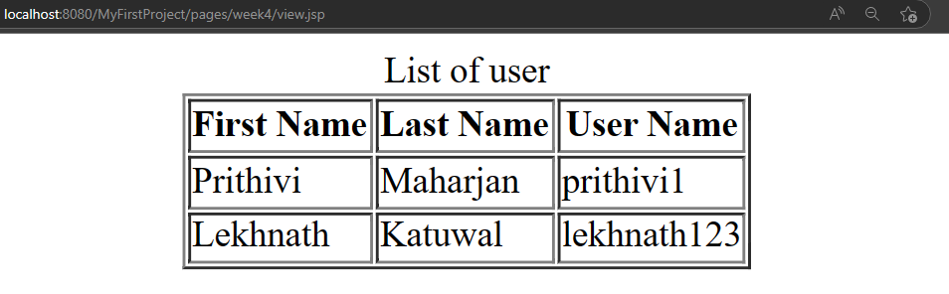
Output

Slide 19
Thank You

