Slide 1
CS5054 ADVANCED PROGRAMMING
AND
TECHNOLOGIES
Week 5 - Lecture Introduction to JSP Directives
ADVANCED PROGRAMMING AND TECHNOLOGIES

Slide 2
Agenda
Define JSP directives
Interpret include directive
Discuss taglib directive
Explain JavaBean class and jsp:useBean action tag
Discuss jsp:setProperty and jsp:getProperty action tags

Slide 3

JSP Directives
JSP directives are messages that tell the JSP web server how to convert a JSP page into a servlet.
Directives in JSPs are instruction from JSPs to JSP Engine.

Slide 4
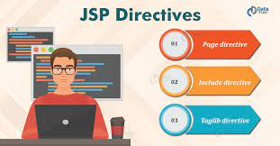
JSP Directives
There are three types of directives and they are page directive, include directive and taglib directive.

Slide 5
Page Directive
It provides attributes that get applied to entire JSP page.
Like imported packages, classes, interfaces and so on.
Synatx is
<%@ page attribute="value" %>

Slide 6
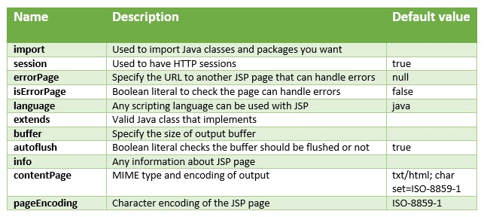
Page Directive
The attribute of page directive are given below

Slide 7
Attribute example of Page Directives
Language attribute
It defines the programming language (underlying language) being used in the page.
Syntax of language:
<%@ page language="value" %>
Example
<%@ page language="java" %>
Note: the code in expression tags would be compiled using java compiler

Slide 8
Attribute example of Page Directives
Import Attribute
This attribute is most used attribute in page directive attributes.It is used to tell the container to import other java classes, interfaces, enums, etc. while generating servlet code.
It is similar to import statements in java classes, interfaces
Syntax of import:
<%@ page import="value" %>
Example is
<%@page import="java.sql.Connection"%>

Slide 9
Attribute example of Page Directives
ContentType Attribute
It defines the character encoding scheme i.e. it is used to set the content type and the character set of the response
The default type of contentType is “text/html; charset=ISO-8859-1”.
Syntax of the contentType:
<%@ page contentType="value" %>
Example
<%@ page language="java" contentType="text/html; charset=ISO-8859-1"%>

Slide 10
Attribute example of Page Directives
Session Attribute
JSP page creates session by default.
Sometimes we don’t need a session to be created in JSP, and hence, we can set this attribute to false in that case.
The default value of the session attribute is true, and the session is created.
When it is set to false, then we can indicate the compiler to not create the session by default
Syntax is: <%@ page session="true/false"%>
Example:
<%@ page language="java" contentType="text/html; charset=ISO-8859-1" session="false"%>

Slide 11
Attribute example of Page Directives
Error Attribute
This attribute is used to set the error page for the JSP page if JSP throws an exception and then it redirects to the exception page.
Syntax is
<%@ page errorPage="value" %>
Example is
<%@ page language="java" contentType="text/html;" pageEncoding="ISO-8859-1" errorPage="errorHandler.jsp"%>

Slide 12
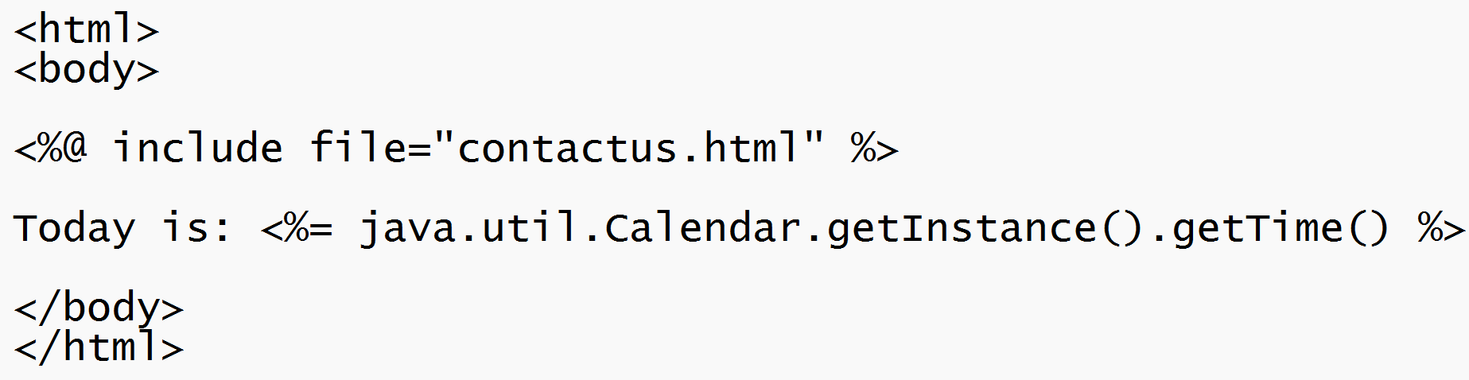
JSP include directive
The include directive is used to include the content of any resource, whether it's a jsp, html, or text file.
Syntax:
<%@ include file="resourceName" %>

Slide 13
JSP Taglib directive
The JavaServer Pages API allows you to define custom JSP tags that look like HTML or XML tags and a tag library is a set of user-defined tags that implement custom behavior.
The taglib directive declares that your JSP page uses a set of custom tags, identifies the location of the library, and provides a means for identifying the custom tags in your JSP page.
Syntax of JSP Taglib directive: <%@ taglib uri="xyz" prefix="xyz"%>

Slide 14
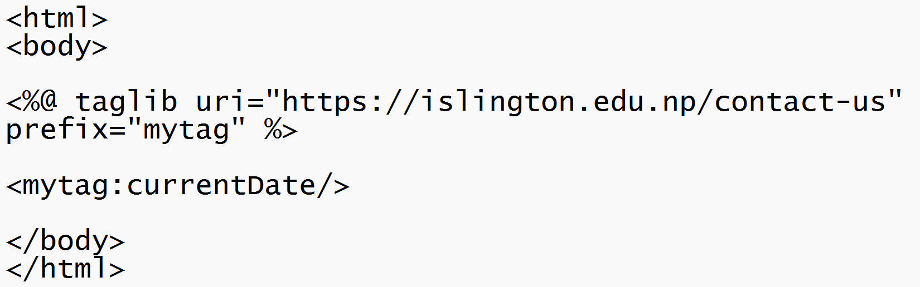
JSP Taglib directive - Example

Slide 15
JSP Action Tags
The action tags are used to control page flow and to implement Java Beans.
JavaBeans are classes provided by java that combine many objects into a single entity which is also known as the bean
There are various sorts of Standard Action Tags.

Slide 16
JSP: useBean
The jsp useBean action tag is used to locate or instantiate a bean class.
If bean object of the Bean class is already created, it doesn’t create the bean depending on the scope. But if object of bean is not created, it instantiates the bean.
JavaBeans are classes provided by java that combine many objects into a single entity which is also known as the bean.

Slide 17
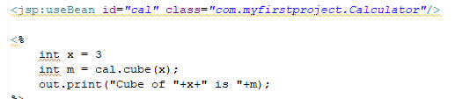
JSP: useBean
Syntax
<jsp:useBean id= "instanceName" scope= "page | request | session | application" class= "packageName.className" type= "packageName.className"
beanName="packageName.className | <%= expression >" >
</jsp:useBean>

Slide 18
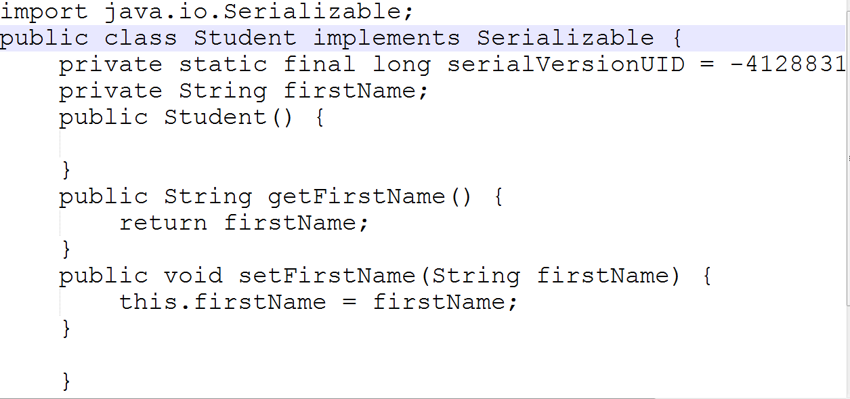
What is Bean Class?
Class having no argument constructor
Having setter and getter method
Must implements Serializable

Slide 19
JSP: setProperty
The jsp:setProperty in JSP is used to set the bean's property.
Before we can set the property, we must first specify a bean in our java classes
Syntax is
<jsp:setProperty name="xyz" property="xyz" value="xyz"/>
jsp:setProperty and jsp:getProperty tags - javatpoint

Slide 20
JSP: getProperty
The getProperty action tag is used to retrieve a property's value, transform it to a string, and then insert it into the output.
Syntax is
<jsp:useBean id="myName" ... />
...
<jsp:getProperty name="myName" property="someProperty" .../>
jsp:setProperty and jsp:getProperty tags - javatpoint

Slide 21
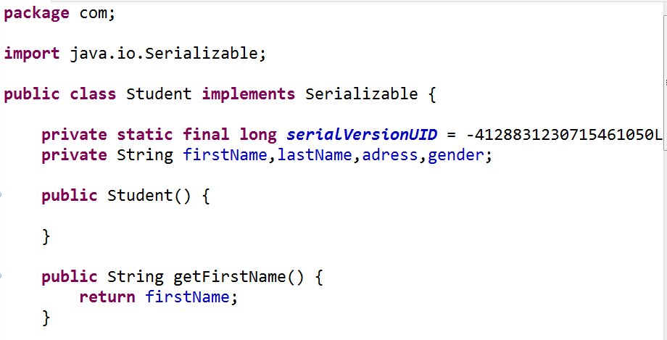
Tutorial
How to create and use a bean class
Use of different tag.

Slide 22

Workshop

Slide 23
Summary
We understood the JSP directives
We learned about the taglib directive
We observed the use case of JavaBean class and jsp:useBean action tag
We also learned to use jsp:setProperty and jsp:getProperty action tags

Slide 24
Any Questions?

Slide 25
Thank You

