Slide 1
CS5054 ADVANCED PROGRAMMING
AND
TECHNOLOGIES
Week 5 Introduction to JSP Directives

Slide 2
Agenda
Create a java Bean class named as Student.java
Create a StudentRegister.html file
Create a class named DataBaseConnectivity
Create a Register.jsp

Slide 3
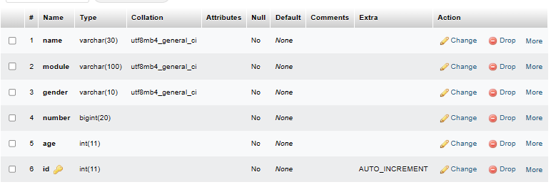
Creating table
Create a new table inside our database with following columns. Id should be primary key and auto increment.

Slide 4
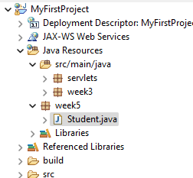
Creating a Java Bean Class (Student.java)
Create a new package named week 5.
Inside week 5 package create a normal class named Student

Slide 5
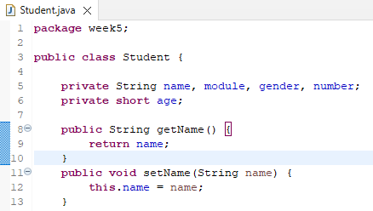
Creating a Java Bean Class (Student.java)
Inside Student.java file create variables (shown in the image)
Getter and setter method for name is created. Similarly, create getter and setter method for all variable.

Slide 6
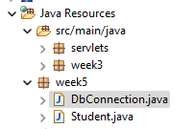
Creating a Java Bean Class (Student.java)
Create a new java file in week5 package named DbConnection.

Slide 7
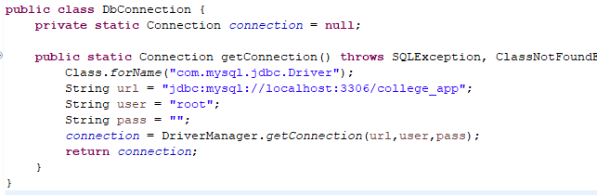
DbConnection.java file
This java file should check the connectivity and return the connection status.
This java file should check the connectivity and return the connection status.

Slide 8
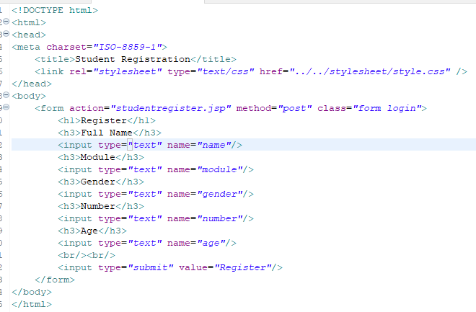
StudentRegister.html file
When we click submit button it will redirect to studentregister.jsp file
All the required data are requested by the form which are to be inserted in our table later.

Slide 9
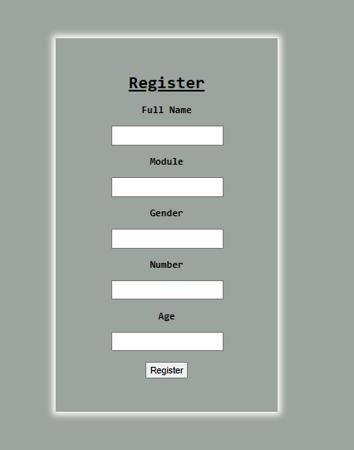
StudentRegister.html file
Give your own CSS to design this page

Slide 10
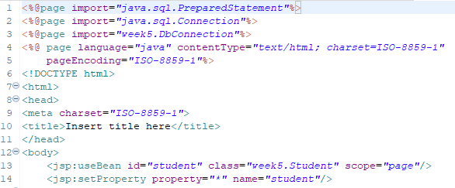
Register.jsp
We will now add the SQL insert query using register.jsp

Slide 11
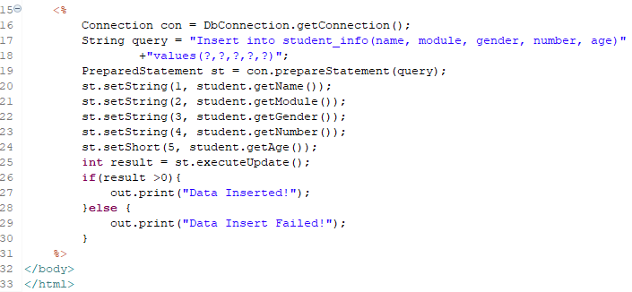
Register.jsp

Slide 12
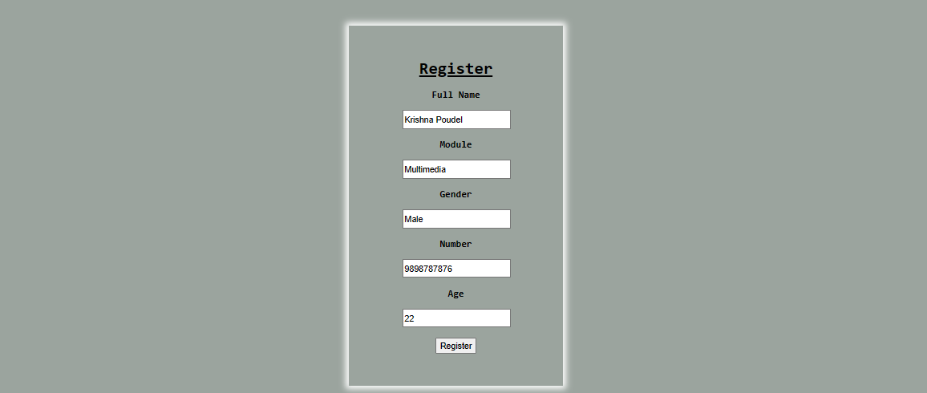
Output

Slide 13
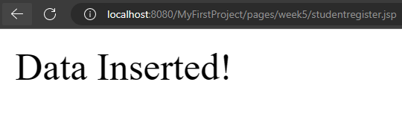
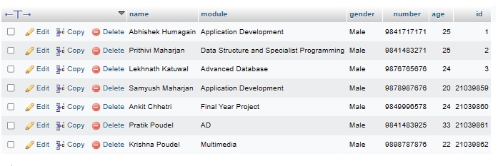
Output

Slide 14
Thank You

