Slide 1
CS5054 ADVANCED PROGRAMMING
AND
TECHNOLOGIES
Week 6 - Lecture State Management in JSP
ADVANCED PROGRAMMING AND TECHNOLOGIES
Prithivi Maharjan

Slide 2
Learning Objectives
Introduction to state management
Introduction to Servlet Filter
Interpret Servlet Filter Methods
Discuss Session and Cookies

Slide 3
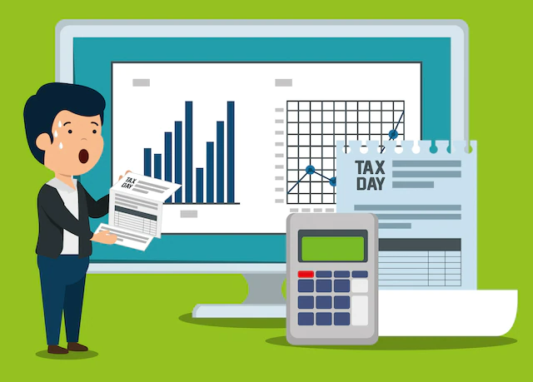
State Management
To determine the state of application at any one time, statement management is used.

Slide 4
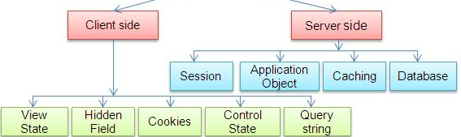
State Management
State management is the process of retaining information of an application's inputs across several linked data flows between applications that helps to create a more dynamic and personalized application.

Slide 5
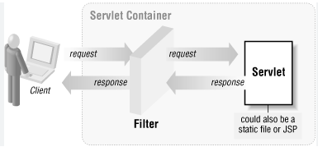
Servlet Filters
Introduced in servlet 2.3 version
Managed by Container
Follows the similar lifecycle like Servlets’ lifecycle.

Slide 6
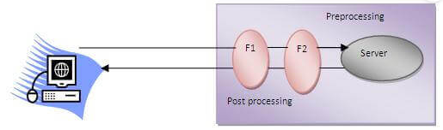
Servlet Filters
Filters are used to pre-process the request and post process the response.
Preprocessing involves authentication, logging, authorization, change request information.
Post processing involves encrypting response compressing response

Slide 7
Servlet Filter API
There are three interfaces of Servlet API:
Filter Interface
FilterChain Interface
FilterConfig Interface

Slide 8
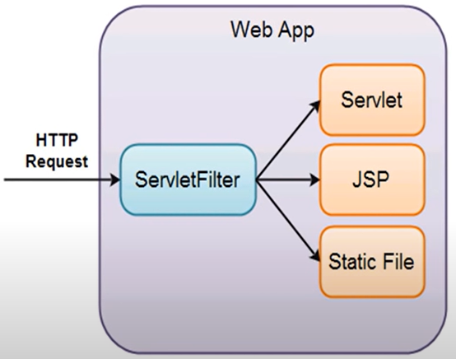
Servlet Filter Interface
Intercepts the client request and do some pre-processing.

Slide 9
Servlet Filter Interface
Implementing Filter Interface

Slide 10
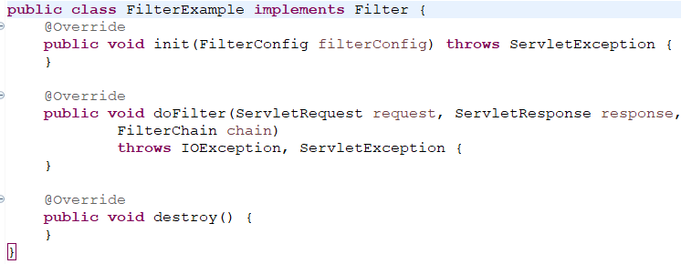
Servlet Filter Interface
Methods of filter Interface
Notes:
void init (FilterConfig filterConfig): It is called by the web container to indicate to a filter that it is being placed into service
void doFilter (ServletRequest request, ServletResponse response. FilterChain chain): It is called by the container each time a request/response pair is passed through the chain due to a client request for a resource at the end of the chain
void destroy(): It is called by the web container to indicate to a filter that it is being taken out of service.

Slide 11
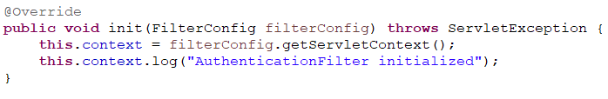
Servlet FilterConfig Interface
A filter configuration object used by a servlet container to pass information to a filter during initialization.
Saving the servlet context in initialization method

Slide 12
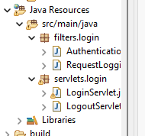
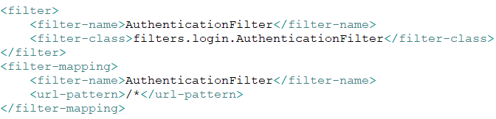
Servlet FilterConfig Interface
Adding filters (.java files) in web.xml in application context level
Invokes AuthenticationFilter each time when page reloads.

Slide 13

Servlet FilterChain Interface
A FilterChain is an object provided by the servlet container to the developer.
Filters use the FilterChain to invoke the next filter in the chain, or if the calling filter is the last filter in the chain, to invoke the resource at the end of the chain.

Slide 14
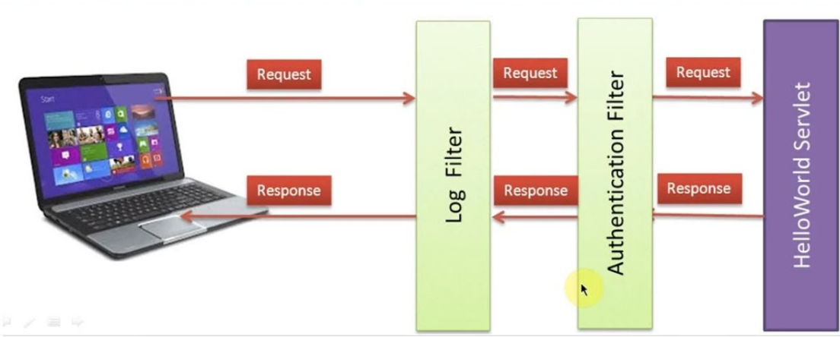
Servlet FilterChain Interface

Slide 15
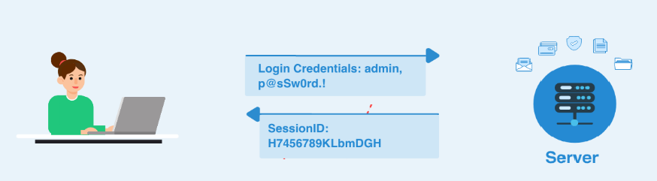
Session Tracking
A mechanism by which online businesses could personalize users’ browsing experiences, tailoring content to individual users.
Personalization enables businesses to communicate effectively with their customers and also helps users locate desired products and services.

Slide 16

Session
Example
Creating new session

Slide 17
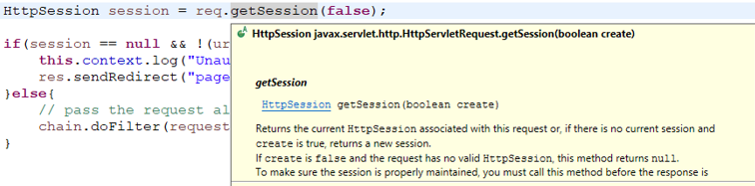
Session
Example
Checking if session is available or not

Slide 18
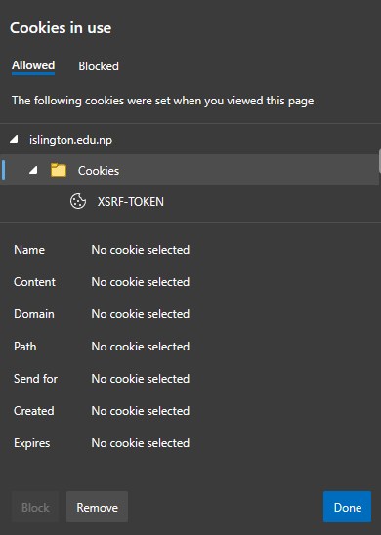
Cookies
Cookies provide a tool for personalizing web pages.
A cookie is a piece of data stored by web browsers in a small text file on the user’s computer.
A cookie maintains information about the client during and between browser sessions.

Slide 19
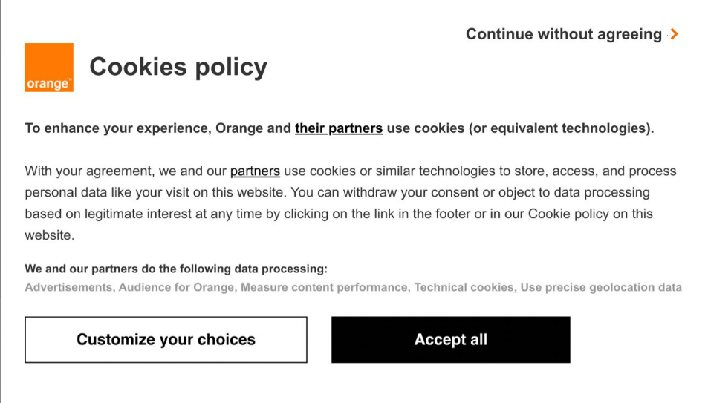
Cookies
The first time a user visits the website, the user’s computer might receive a cookie from the server; this cookie is then reactivated each time the user revisits that site.
The collected information is intended to be an anonymous record containing data that is used to personalize the user’s future visits to the site.

Slide 20

Cookie
Example
Creating Cookie

Slide 21
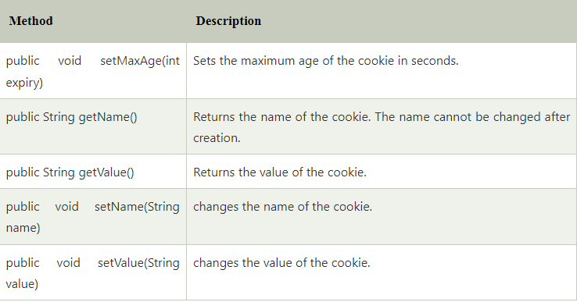
Useful Servlet Cookies Method

Slide 22
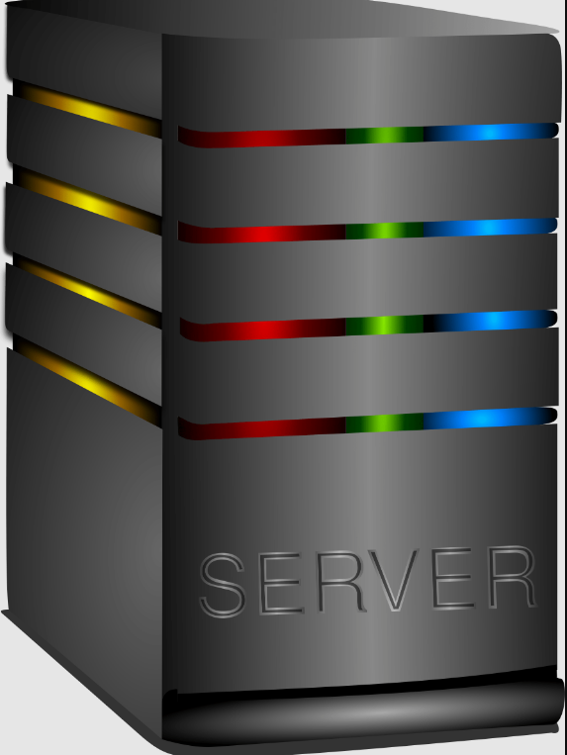
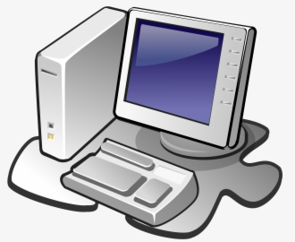


Workflow
Login Request
Create a session
Store userId &
required info
Servlet

Slide 23
Workflow
Logout Request
Delete the session
Clear data
Servlet

Slide 24

Workflow
Opens any page
Required Page
True
False
Check if session exits
Login Page
Servlet Filter

Slide 25
Summary
We understood the concept of state management
We learned about Servlet Filter and its different Servlet Filter Methods
We also understood about the Session and Cookies

Slide 26
Thank You

