Slide 1
CS5054 ADVANCED PROGRAMMING
AND
TECHNOLOGIES
Week 6 State Management in JSP
ADVANCED PROGRAMMING AND TECHNOLOGIES
Prithivi Maharjan

Slide 2
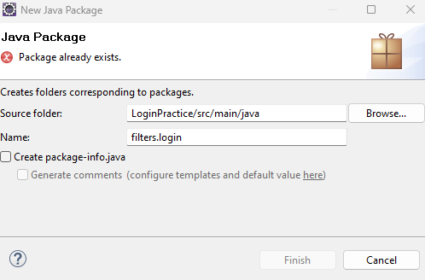

Setup the project
Create a new project named “LoginPractice”.
Inside Java recourses create packages as shown in picture
Dot (.) represents login package lies inside filters package

Slide 3
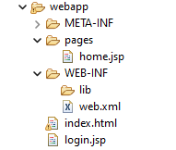
Setup the project
Make sure web.xml is present inside WEB-INF folder.
Create index.html page, login.jsp page inside webapp folder.
Create a new folder named “pages” inside webapp folder
Create home.jsp file inside pages folder

Slide 4
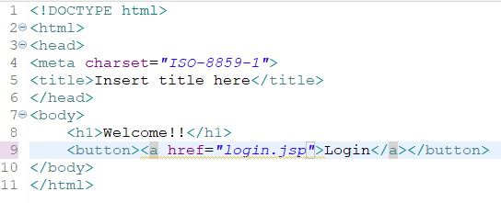
Index.html
Greets the user.
Contains navigation button to login.jsp

Slide 5
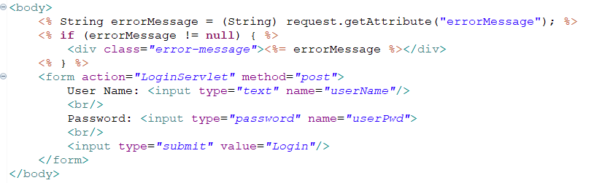
Login.jsp
Checks if the request have error message or not and prints accordingly
Create a form which navigates to LoginServlet

Slide 6
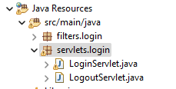
Servlets.login
Create new servlets named LoginServlet.java and LogoutServlet.java

Slide 7
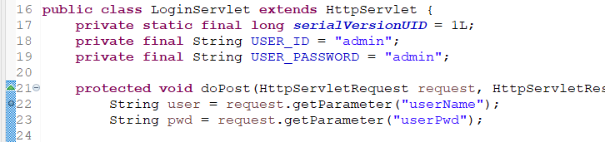
LoginServlet.java
Create two final variable USER_ID & USER_PASSWORD
You can delete doGet method, we do not need it.
Inside doPost get the login information sent from login.jsp file.

Slide 8
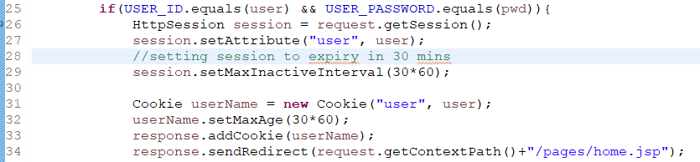
LoginServlet.java
After login information is captured.
We will check whether the login id and password matches our final variable or not.
If it matches we will create a new session and add user info into cookie.
Then we redirect to homepage.

Slide 9
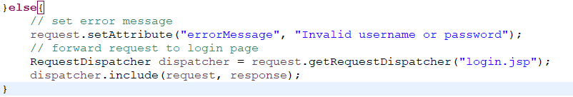
LoginServlet.java
If user id or password is incorrect.
We set the error message attribute
Then use requestDispatcher include method to get login.jsp file.

Slide 10
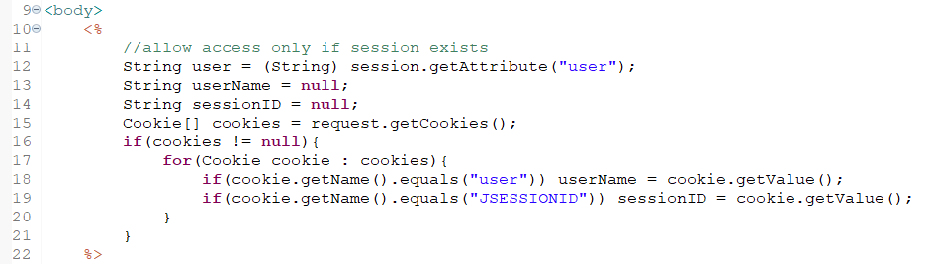
Home.jsp
If login successful and session is not expired, we will retrieve the user information and display it in our home page
The following code retrieves the username and sessionid stored in the cookie

Slide 11
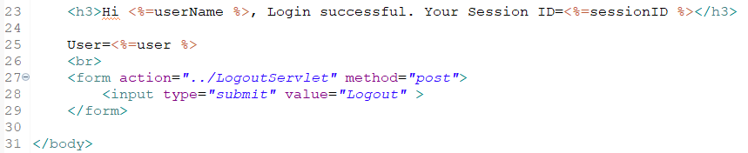
Home.jsp
Then we will use the invoked user name to welcome the user.
At last we can see a form, we will use this form to logout the current session.

Slide 12
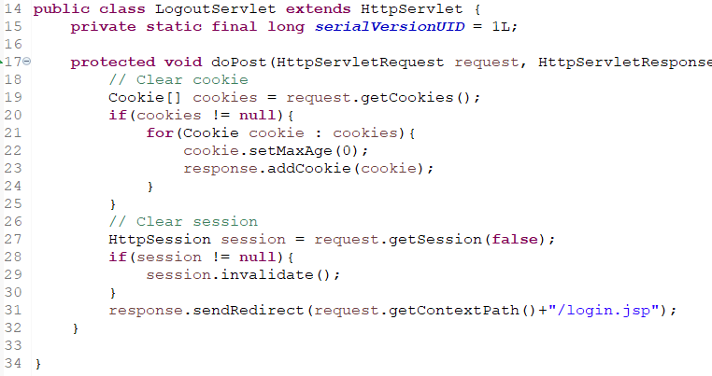
LogoutServlet.java
When logout button is clicked we need to logout from out current session and clear all cookies.
The shown code helps us to get the current cookie and session info.
Then we will clear the cookie and session.
And redirect to login.jsp file

Slide 13
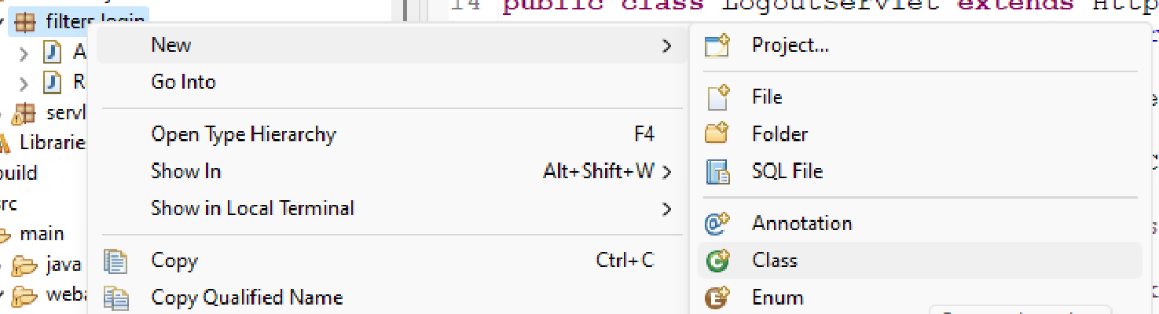

Filter Interface
To check and authenticate the login properly when each page loads we need to use the Filter Interface.
Inside filter.login package create two new java file (not a servlet file)
AuthenticationFilter.java
RequestLogginFilter.java

Slide 14
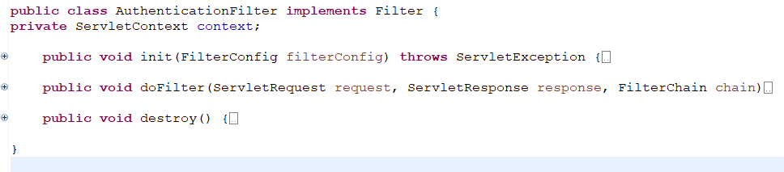
AuthenticationFilter.java
We will manually implement the Filter interface.
Then override its three methods which is must. (You can use suggestion to override methods automatically)

Slide 15
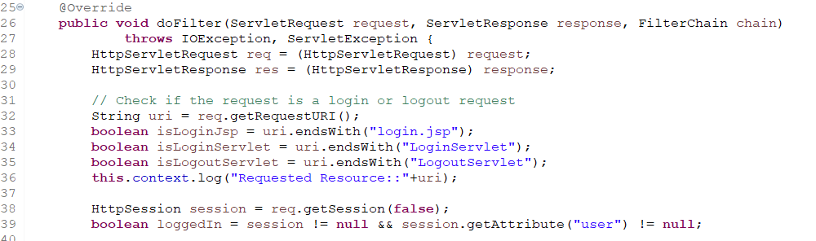
AuthenticationFilter.java
Inside doFilter method we will fetch the current url passed to check if the request is login or logout
Then we will fetch the current session using req.getSession(false). You can hover on this method to understand why we passed false as a parameter.

Slide 16
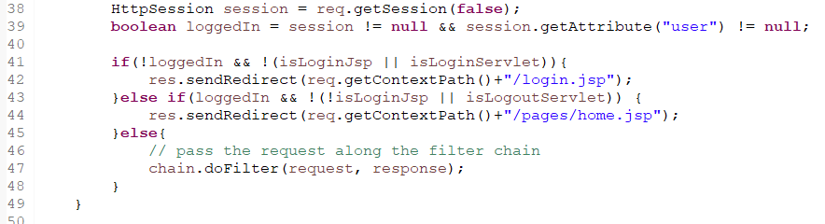
AuthenticationFilter.java
If the session is not created we redirect it to login.jsp
Else if session is found we redirect it to home.jsp
Else we pass the request and response along the filter chain

Slide 17
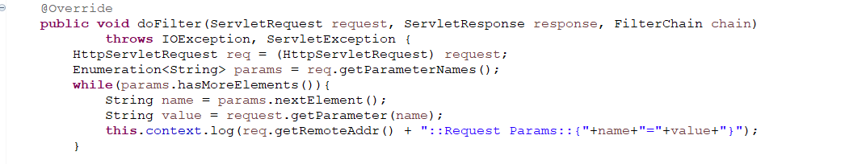
RequestLogginFilter.java
Similarly we will implement filter and override its 3 methods in this file too.
Then inside doFilter method we will fetch the context filter names

Slide 18
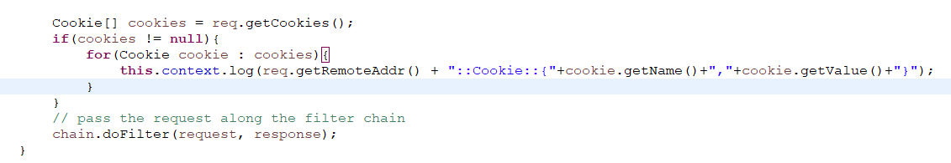
RequestLogginFilter.java
After that we will get the current cookie. If cookie exists we will print the information that cookie holds. Then we invoke FilterChain doFilter method
To understand filterchain go through this link and embedded link:
java - What is chain.doFilter doing in Filter.doFilter method? - Stack Overflow

Slide 19
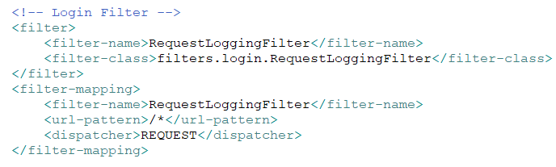
Web.xml
Then in web.xml file add the context level filter configuration file
Filter configuration for RequestLoggingFilter.java

Slide 20
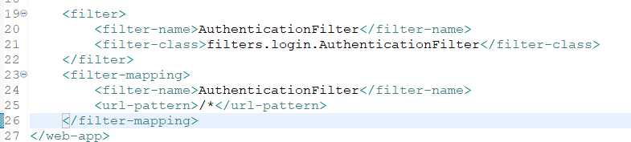
Web.xml
Then in web.xml file add the context level filter configuration file
Filter configuration for AuthenticationFilter.java

Slide 21
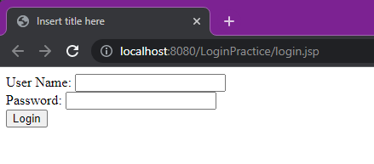
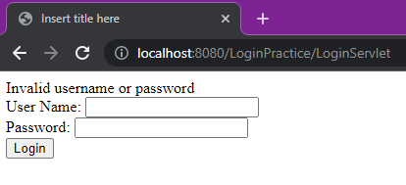
Output
Now run your project
Even if your welcome file is index.html, due to session login.jsp file is opening (image 1).
Then we can pass incorrect information it shows the error message that we programmed before (image 2).
Image 1
Image 2

Slide 22
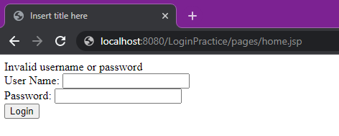
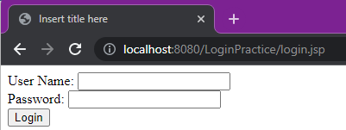
Output
If we change url to home.jsp page without login and press enter (image 1)
It will redirect us to login page (image 2)
Image 1
Image 2

Slide 23
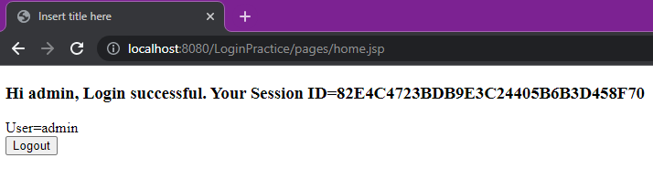
Output
If we login with proper credential then it will redirect us to home page

Slide 24
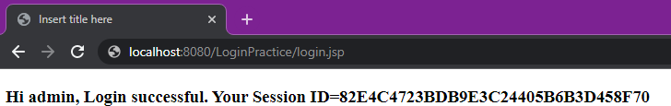
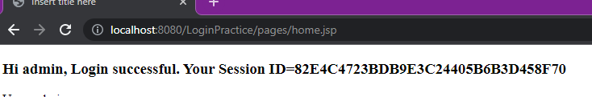
Output
If we change url to login.jsp page and press enter when user is currently logged in (image 1)
It will redirect us to home page

Slide 25
Thank You

