Slide 1
CS5054 ADVANCED PROGRAMMING
AND
TECHNOLOGIES
Week 7 Introduction to JSTL
ADVANCED PROGRAMMING AND TECHNOLOGIES
Prithivi Maharjan

Slide 2
Agenda
Define Java Server Pages Standard Tag Library (JSTL)
Demonstrate installation of JSTL library
Interpret core tags
Discuss formatting tags

Slide 3

JavaServer Pages Standard Tag Library (JSTL)
Collection of useful JSP tags
Encapsulates core functionality, common to many JSP applications

Slide 4
JavaServer Pages Standard Tag Library (JSTL)
Support for structural task like iteration and conditionals, tags for manipulating XML documents and SQL tags.
Also provides a framework for integrating the existing custom tags with the JSTL tags.

Slide 5
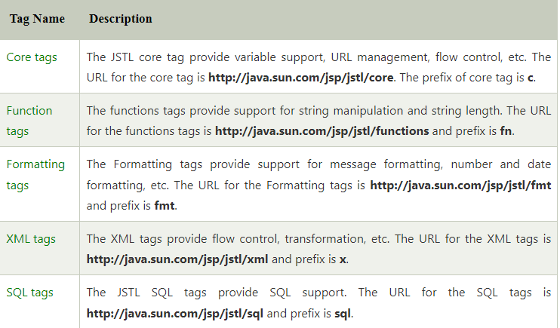
Types of Tag

Slide 6
Core Tag Library
In JSP, the core tags are the most commonly used tags. These tags are used for iteration, conditional logic, URL forward, redirect and so on.
Most commonly used tags.
Include core tag library in your project
<%@ taglib prefix = "c" uri = "http://java.sun.com/jsp/jstl/core" %>

Slide 7
Core Tag Library
Tags | Description
<c:import> | Accepts URL and exposes its contents to page
<c:out> | Used to print the message in page
<c:remove> | Removes scoped variable
<c:if> | Conditional tag, evaluate if given condition is true or false
<c:forEach> | Iteration tag, accepts different collection types.
<c:redirect> | Redirects to a new URL.

Slide 8
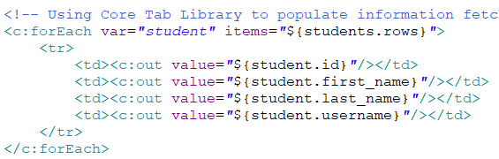
Core Tag Library
Example using forEach tag

Slide 9
Formatting Tag Library
The JSTL formatting tags are used to format and display text, the date, the time, and numbers.
Include formatting tag library in your project
<%@ taglib prefix = "fmt" uri = "http://java.sun.com/jsp/jstl/fmt" %>

Slide 10
Formatting Tag Library
Tags | Description
<fmt:formatNumber> | Render numerical value with specific format
<fmt:parseNumber> | Parses a number, currency, or percentage represented in a string.
<fmt:formatDate> | Uses the pattern provided to format a date and/or a time.
<fmt:parseDate> | Parses a date or time from a string representation.
<fmt:timeZone> | Provide the time zone information for any nested time formatting or parsing operations in its body.

Slide 11
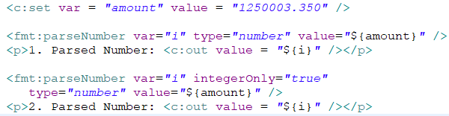
Formatting Tag Library
Example using parseNumber tag

Slide 12
Structured Query Language (SQL) Tag Library
Structured Query Language allows you to interact with databases (Oracle, MySQL, Microsoft SQL Server).
Can be used to manipulate databases i.e., creating, updating and deleting data.
Include SQL tag library in your project
<%@ taglib prefix = "sql" uri = "http://java.sun.com/jsp/jstl/sql" %>

Slide 13
SQL Tag Library
Tags | Description
<sql:setDataSource> | creates a basic DataSource that should only be used for prototyping.
<sql:query> | carries out the SQL statement specified in its body or via the sql attribute.
<sql:update> | runs the SQL update specified in the body of the statement or by using the sql attribute.
<sql:dateParam> | Sets the provided java.util.Date value for a parameter in a SQL statement.
<sql:transaction> | provides shared Connections with nested database action components that are configured to run all statements as a single transaction.

Slide 14
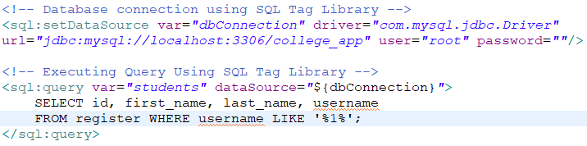
SQL Tag Library
Example using setDataSource and query tag

Slide 15
JSTL Functions
Contains various standard functions.
Common functions are string manipulation.
Include JSTL functions in your project
<%@ taglib prefix = "fn" uri = "http://java.sun.com/jsp/jstl/functions" %>

Slide 16
JSTL Functions
Tags | Description
fn:contains() | Checks if string holds any value passed in this function
fn:endsWith() | Checks if string ends with any value passed in this function
fn:length() | Returns the total number of characters in a string
fn:startsWith() | Checks if string starts with any value passed in this function
fn:toLowerCase() | Converts all the string in lowercase (small alphabets)
fn:toUpperCase() | Converts all the string in uppercase (capital alphabets)

Slide 17

SQL Tag Library
Example using setDataSource and query tag

Slide 18
Any Questions?

Slide 19
Thank You

