Slide 1
CS5054 ADVANCED PROGRAMMING
AND
TECHNOLOGIES
Week 7
JSTL Tag Library
ADVANCED PROGRAMMING AND TECHNOLOGIES
Prithivi Maharjan

Slide 2
Learning Objectives
Using JSLT tag view the Data from Database

Slide 3

Important jar for JSTL
First of all we need to download taglibs-standard-impl-1.2.5.jar file and taglibs-standard-spec-1.2.5.jar file
Then like we have added mysql-connector jar file add these 2 jar file in your project.

Slide 4
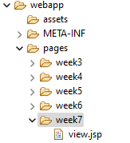
View.jsp file
Create view.jsp file inside webapp> pages> week7

Slide 5
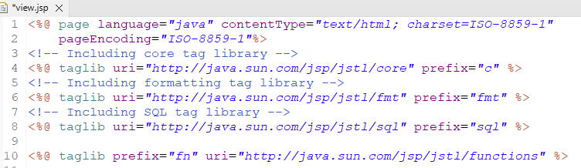
View.jsp file
To use JSTL tages we need to use directive tag taglib to add JSTL core, formatter, sql and functions.

Slide 6
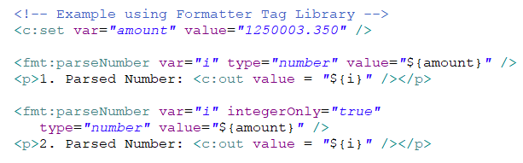
View.jsp file
Add these code inside body tag.
We use core tag set tag to declare a variable named amount.
Then we used Formatter parseNumber tag to convert number respectively.

Slide 7
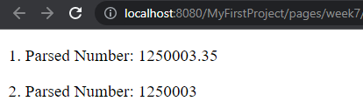
Output

Slide 8

View.jsp file
You can also add these code inside body tag.
Here we used JSTL core set tag to create a variable.
Then in second variable we used JSTL function to replace the first name of first variable.

Slide 9
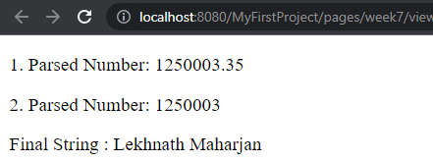
Output

Slide 10
View.jsp (DB Connection)
Step 1
Database Connection using JSTL SQL tag
Use of setDataSource tag to open a connection

Slide 11
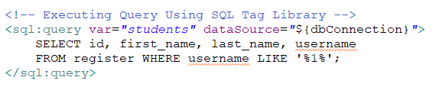
View.jsp (DB Connection)
Step 2
JSTL SQL tag – Executing Query in created database connection
Use of query tag to open a connection

Slide 12
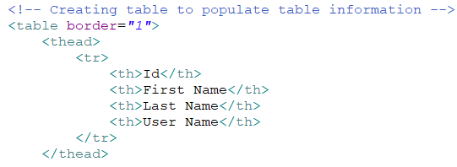
View.jsp (DB Connection)
Step 3
JSTL SQL tag – Creating table to show selected data from database
Creating table Headers first.

Slide 13
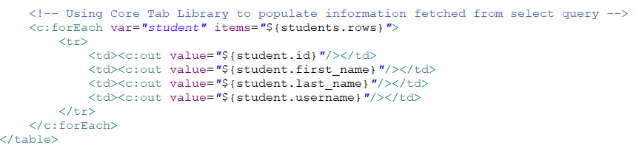
View.jsp (DB Connection)
Step 4
JSTL SQL tag – Creating table to show selected data from database
Creating table row data using core tag foreach tag.

Slide 14
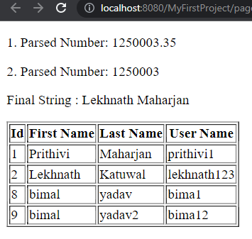
Output

