Slide 1
CS5054 ADVANCED PROGRAMMING
AND
TECHNOLOGIES
Week 8
Design Patterns (MVC & MVP)
ADVANCED PROGRAMMING AND TECHNOLOGIES
Prithivi Maharjan

Slide 2
Agenda
Understanding Model-View-Controller
Understanding Model-View-Presenter
ADVANCED PROGRAMMING AND TECHNOLOGIES

Slide 3

In previous week
Learned about Java Server Pages Tag Library
ADVANCED PROGRAMMING AND TECHNOLOGIES

Slide 4
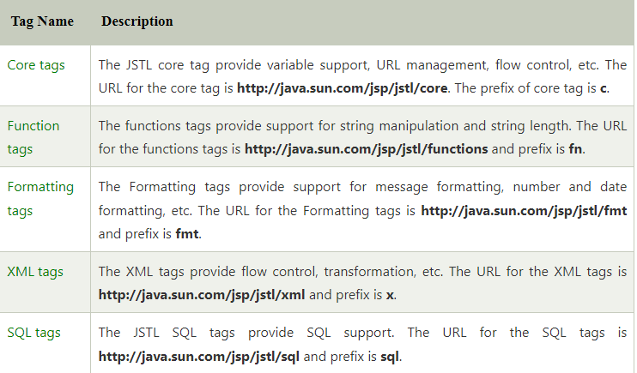
In previous week
Learned about types of tag library
ADVANCED PROGRAMMING AND TECHNOLOGIES

Slide 5
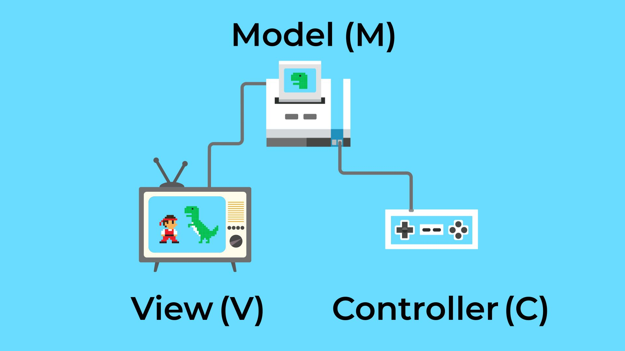
Model-View-Controller
In short MVC, is the design pattern for system development.
ADVANCED PROGRAMMING AND TECHNOLOGIES

Slide 6
Model
Data are kept in a model component.
ADVANCED PROGRAMMING AND TECHNOLOGIES

Slide 7
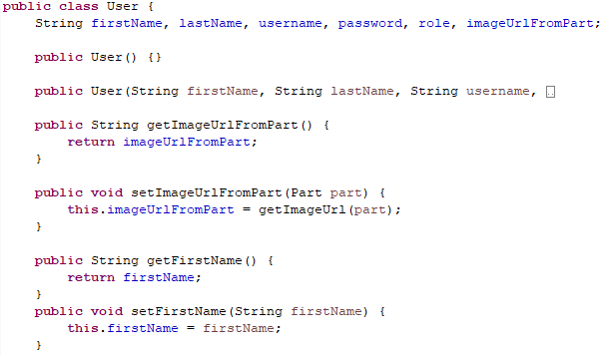

Model
Model classes are created in model package
ADVANCED PROGRAMMING AND TECHNOLOGIES

Slide 8
View
View describes how data is shown in the program.
ADVANCED PROGRAMMING AND TECHNOLOGIES

Slide 9
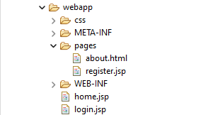
View
Managing view in our project
ADVANCED PROGRAMMING AND TECHNOLOGIES

Slide 10
Controller
The controller interprets user input, changing the model and display according to the data it gathers.
Responsible to handle business logics.
ADVANCED PROGRAMMING AND TECHNOLOGIES

Slide 11
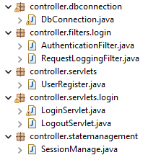
Controller
Managing controller package in our project
ADVANCED PROGRAMMING AND TECHNOLOGIES

Slide 12
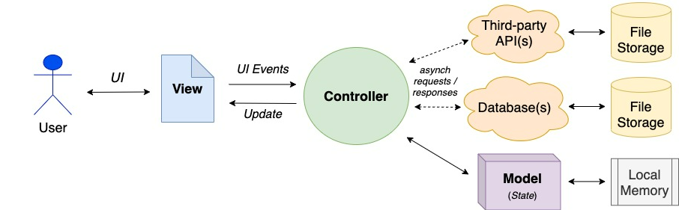
Model-View-Controller
ADVANCED PROGRAMMING AND TECHNOLOGIES

Slide 13
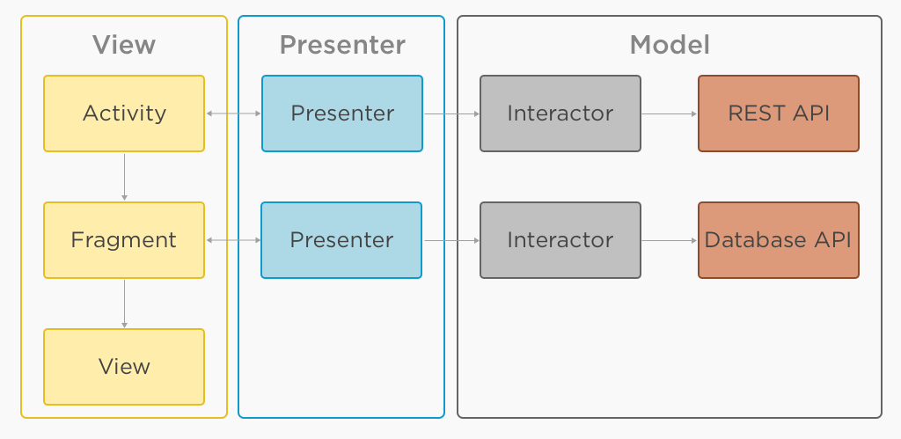
Model-View-Presenter
ADVANCED PROGRAMMING AND TECHNOLOGIES

Slide 14
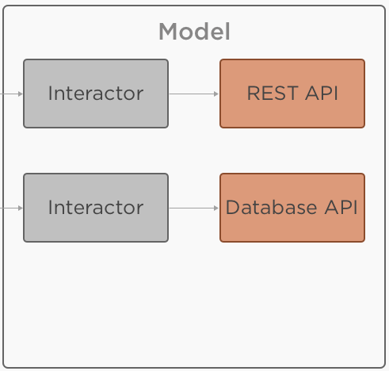
Model-View-Presenter
Data access layer like a database API or REST API often fills the role of a model.
Responsible to handle the business logic and database communication.
ADVANCED PROGRAMMING AND TECHNOLOGIES

Slide 15
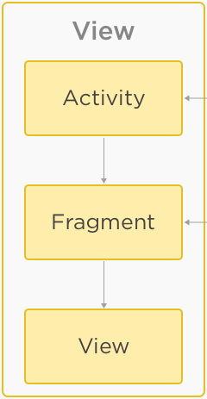
Model-View-Presenter
Provides the visualization of the data.
Notifies the presenter according to the user action.
ADVANCED PROGRAMMING AND TECHNOLOGIES

Slide 16
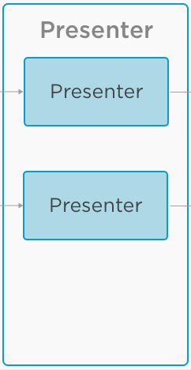
Model-View-Presenter
Responsible to load data from model.
Applies UI logic which decides what to send data to Model.
Takes action according to the users’ action.
ADVANCED PROGRAMMING AND TECHNOLOGIES

Slide 17
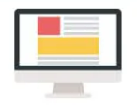
Difference between MVP & MVC
MVP | MVC
The user is shown the output with the help of the presenter. Only the model has a really close connection to the view. | The controller serves as a link between the view and model layers, giving the application's user interface.
ADVANCED PROGRAMMING AND TECHNOLOGIES

Slide 18

Difference between MVP & MVC
MVP | MVC
Business logic & other logics are present only in model layer where the data is present | Business logic & UI are separate, hence testing is done easily on the layers as separate.
ADVANCED PROGRAMMING AND TECHNOLOGIES

Slide 19
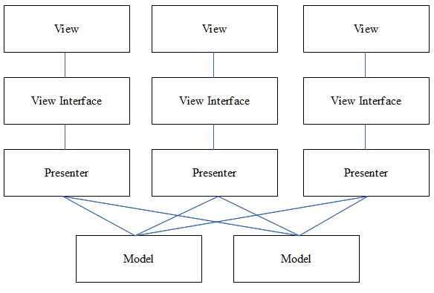
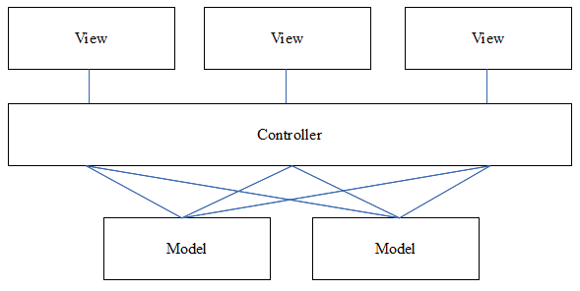
Difference between MVP & MVC
MVP | MVC
ADVANCED PROGRAMMING AND TECHNOLOGIES

Slide 20
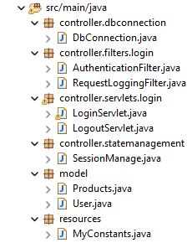
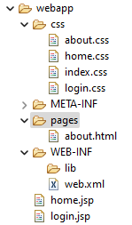
MVC in eclipse project
ADVANCED PROGRAMMING AND TECHNOLOGIES

Slide 21
Summary
We studied about the MVC and MVP system architecture.
We learned the entire process of MVC and MVP.
We understood the difference between MVC and MVP.
ADVANCED PROGRAMMING AND TECHNOLOGIES

Slide 22
Thank You
ADVANCED PROGRAMMING AND TECHNOLOGIES

