Slide 1
CS5054 ADVANCED PROGRAMMING
AND
TECHNOLOGIES
Week 8
Design Patterns (MVC & MVP)

Slide 2
Agenda
Full login implementation following MVC Architecture which includes
Servlet
Servlet Filter
JSP
Session
Cookies
Custom Constants
ADVANCED PROGRAMMING AND TECHNOLOGIES

Slide 3
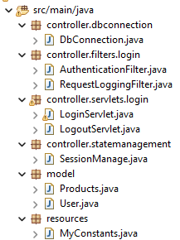
MVC Architecture
This is how our java file looks like at the end of this tutorial
ADVANCED PROGRAMMING AND TECHNOLOGIES

Slide 4
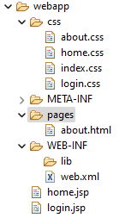
MVC Architecture
This is how our webapp folder looks like at the end of this tutorial
You can download the required CSS and JSP file from MstNepal
ADVANCED PROGRAMMING AND TECHNOLOGIES

Slide 5
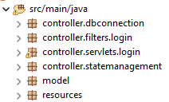
Managing Packages
Lets start by creating packages to manage java file in MVC architecture.
Create the listed packages in your project
ADVANCED PROGRAMMING AND TECHNOLOGIES

Slide 6
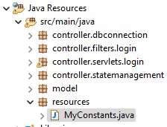
MyConstants.java
Inside resources package create a new file named MyConstants.java
ADVANCED PROGRAMMING AND TECHNOLOGIES

Slide 7
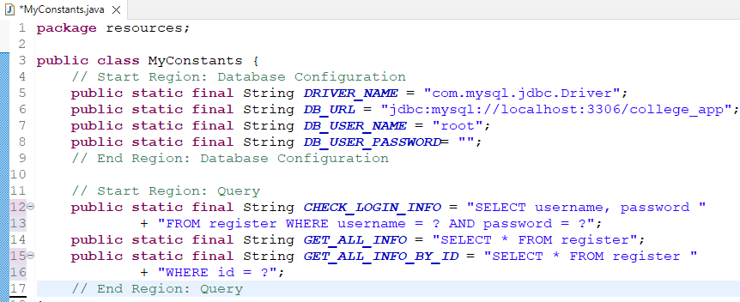
MyConstants.java
Constants file contains all the static final variables that we will use in our project.
ADVANCED PROGRAMMING AND TECHNOLOGIES

Slide 8
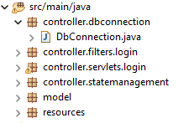
DbConnection.java
Now we will create DbConnection.java file inside controller.dbconnection package
In this file we will write all the codes that are required to communicate with XAMPP MySQL database
ADVANCED PROGRAMMING AND TECHNOLOGIES

Slide 9
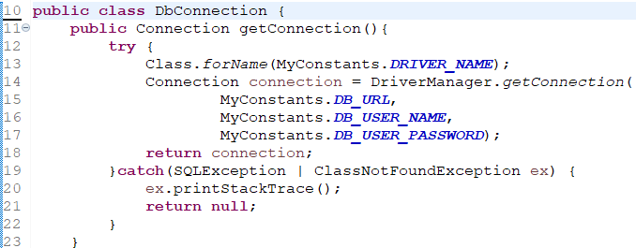
DbConnection.java
Like we have done before we will create a getConnection method that will return Connection. Notice that we have used final variables that we created in MyConstants.java
ADVANCED PROGRAMMING AND TECHNOLOGIES

Slide 10
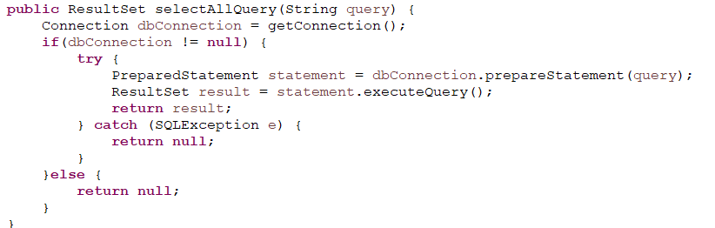
DbConnection.java
Only for reference: We can also add other methods like selectAllQuery below in this file.
This function retrieves the entire data of the table according to the query.
Do remember that each Db query should be handled from this file.
ADVANCED PROGRAMMING AND TECHNOLOGIES

Slide 11
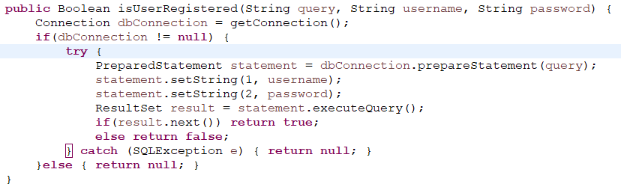
DbConnection.java
We will be implementing Login system completely. So, we need to add this isUserRegistered method in this file.
We will use this method when logging in, to check if user is registered or not.
ADVANCED PROGRAMMING AND TECHNOLOGIES

Slide 12
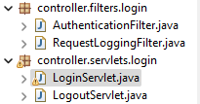
MyConstants.java
Inside controller.filters.login package you can copy your week 6 AuthenticationFilter.java and RequestLoggingFilter.java file
Similarly, inside controller.servlets.login package you can copy your week 6 LoginServlet.java and LogoutServlet.java file
ADVANCED PROGRAMMING AND TECHNOLOGIES

Slide 13
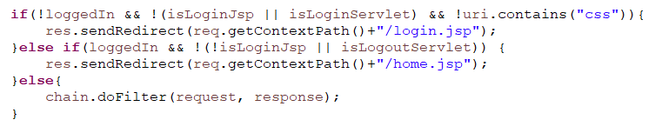
AuthenticationFilter.java
You can use week 6 java file here.
Comparing to week 6 we have changed few codes in this file.
We checked extra condition in if condition (!uri.contains(“css”)).
CSS file is loading .JSP/HTML while doFilter() method is invoked. To fix this and load CSS in our .JSP/HTML we need to check this condition.
ADVANCED PROGRAMMING AND TECHNOLOGIES

Slide 14
RequestLoggingFilter.java
We can use week6 requestloggingfilter.java file here too.
No changes made in this file. You can just copy and paste it.
ADVANCED PROGRAMMING AND TECHNOLOGIES

Slide 15
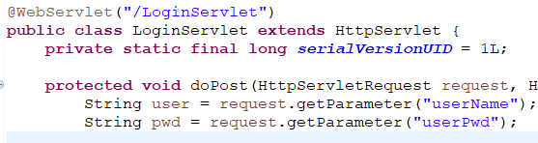
LoginServlet.java
As you can see we have deleted the global variable USER_ID and USER_PASSWORD.
ADVANCED PROGRAMMING AND TECHNOLOGIES

Slide 16
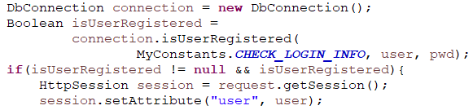
LoginServlet.java
In week 6, we checked if the username and password is “admin” or not.
Now we will change this code and check if the username and password lies under our database table or not.
To check, we have used the DbConnection class’ method named isUserRegistered that we have created in slide 11.
ADVANCED PROGRAMMING AND TECHNOLOGIES

Slide 17
LogoutServlet.java
We can use week6 logoutServlet.java file here too.
No changes made in this file. You can just copy and paste it.
ADVANCED PROGRAMMING AND TECHNOLOGIES

Slide 18

Web.xml
You can set the landing page file name in welcome-file-list, welcome-file tag.
In my case I have set up home.jsp as our landing page.
ADVANCED PROGRAMMING AND TECHNOLOGIES

Slide 19
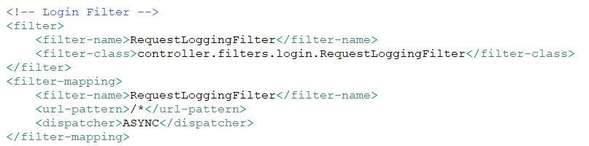
Web.xml
Like we have done in week 6 you need to ad the filter and filter-mapping in your web.xml file for RequestLoggingFilter.
Do confirm that your filter-class path is valid
ADVANCED PROGRAMMING AND TECHNOLOGIES

Slide 20
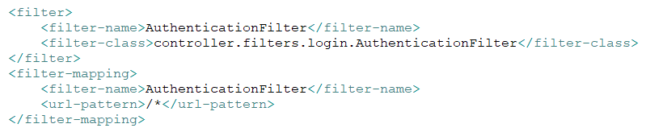
Web.xml
Similarly we also need to create the filter and filter mapping for AuthenticationFilter.
ADVANCED PROGRAMMING AND TECHNOLOGIES

Slide 21
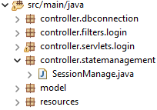
SessionManage.java
Inside controller.statemanagement package create a new file called SessionManage.java file.
ADVANCED PROGRAMMING AND TECHNOLOGIES

Slide 22
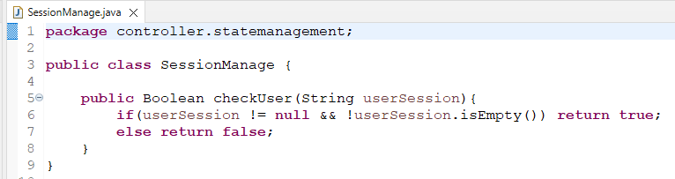
SessionManage.java
Then add a method as shown below.
This method checks if session exists or not according to the userSession parameter.
We will use this method when we need to check if session exists or not.
ADVANCED PROGRAMMING AND TECHNOLOGIES

Slide 23

Model Package
This is just an example. We can create different model classes in our model package.
For now we are working on login feature. We will ignore this slide.
Do not create any file in model package for now.
ADVANCED PROGRAMMING AND TECHNOLOGIES

Slide 24
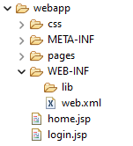
Design Part
As shown in figure create new folders inside webapp
CSS
Contains all the CSS file of each page i.e., home.css, login.css about.css, profile.css and so on.
Pages
Contains other pages like about, profile, contact and so on
Then inside webapp create 2 new jsp file named home and login.
ADVANCED PROGRAMMING AND TECHNOLOGIES

Slide 25

Login.jsp
We can link css with this format.
The code ${pageContext.request.contextPath} retrieves the root directory path. Then we can point to /css/login.css. In short this is absolute path.
So, no matter form which location this file is loaded, it can link to CSS with the help of absolute path
ADVANCED PROGRAMMING AND TECHNOLOGIES

Slide 26
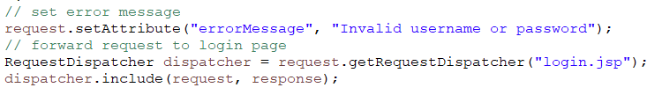
Login.jsp
Inside LoginServlet.java we have redirected to login.jsp file if there is any problem in login credential.
We have attached an errorMessage attribute to this redirection.
ADVANCED PROGRAMMING AND TECHNOLOGIES

Slide 27
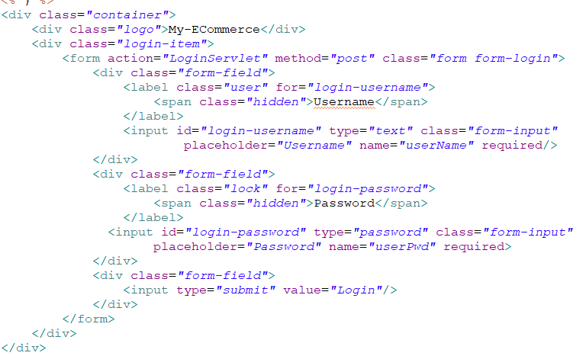
Login.jsp
Then we will add the login form which navigates to LoginServlet with post method when login submit button is clicked.
LoginServlet is created in slide number 14. As we have done code in this servlet:
When credentials are incorrect it will navigate us to login page where we can show error messages to user.
If credentials are correct it will redirect us to home page
ADVANCED PROGRAMMING AND TECHNOLOGIES

Slide 28
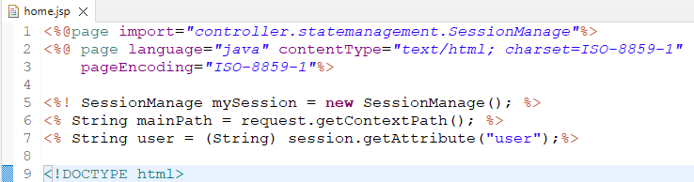
home.jsp
First we create a new object of SessionManage globally.
Then store the mainPath to globally.
And fetched the current session user attribute globally.
ADVANCED PROGRAMMING AND TECHNOLOGIES

Slide 29
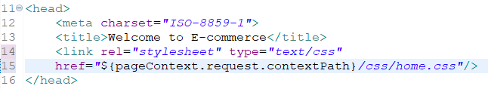
home.jsp
Give a suitable title name.
When linking CSS file, we have given the absolute path. Here you can reuse the mainPath that we have created in our previous slide.
ADVANCED PROGRAMMING AND TECHNOLOGIES

Slide 30
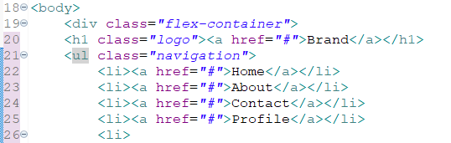
home.jsp
Then create a navigation bar as per your required pages name.
ADVANCED PROGRAMMING AND TECHNOLOGIES

Slide 31
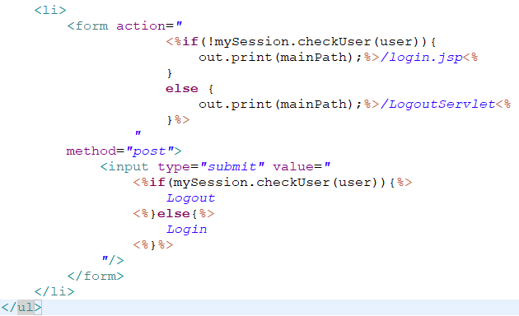
home.jsp
For the last navigation item we have added the login/logout button.
Inside <li> tag we created a form which consists only input type submit.
If the user is logged in (or the session of user is found), it will display logout text in button then redirects it to LogoutServlet.
Else the user is not logged in (or the session of user is not found), it will display login text in button which will redirect to Login.jsp page.
ADVANCED PROGRAMMING AND TECHNOLOGIES

Slide 32
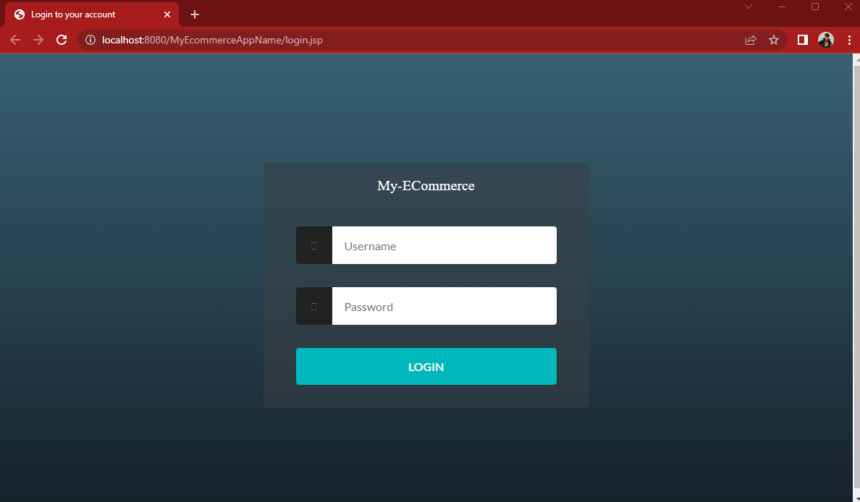
Output
When system is initially started it will not found any ongoing session and redirects to login.jsp instead of home.jsp page.
Even if we change the url, it should redirect us to login.jsp page
ADVANCED PROGRAMMING AND TECHNOLOGIES

Slide 33
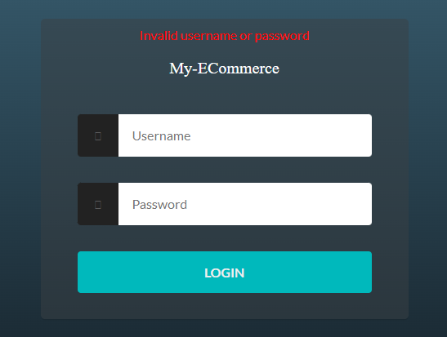
Output
If the username or password is incorrect it should show the error message.
ADVANCED PROGRAMMING AND TECHNOLOGIES

Slide 34
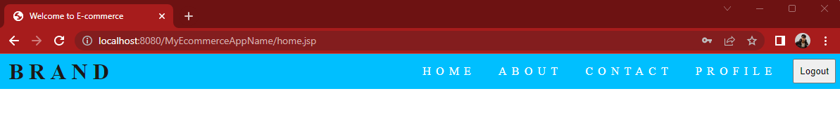
Output
If username and password is matched in database. It should redirect us to home page.
Try changing our URL to login.jsp. It should redirect us to home.jsp.
Try changing our URL to any other pages except logout. It should navigate to that page.
Remember that our button is named as “Logout”
The logout button should redirect us to LogoutServlet will should redirect us to login page.
You can download the required CSS and JSP file from MstNepal
ADVANCED PROGRAMMING AND TECHNOLOGIES

Slide 35
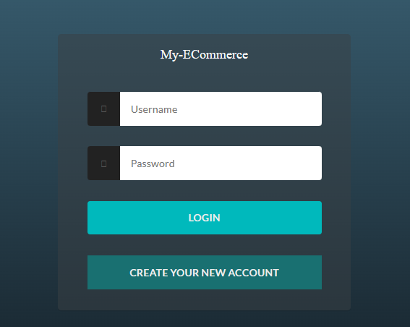
User Registration
We have added a new button named “Create your new account”.
On click it will redirect us to register.jsp
ADVANCED PROGRAMMING AND TECHNOLOGIES

Slide 36
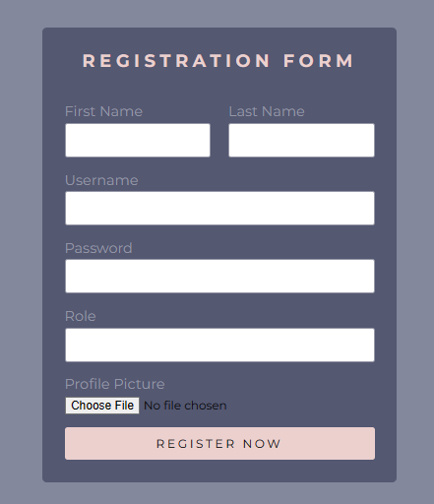
Configuration
To upload the image from html form, first we will configure where to upload the images.
ADVANCED PROGRAMMING AND TECHNOLOGIES

Slide 37
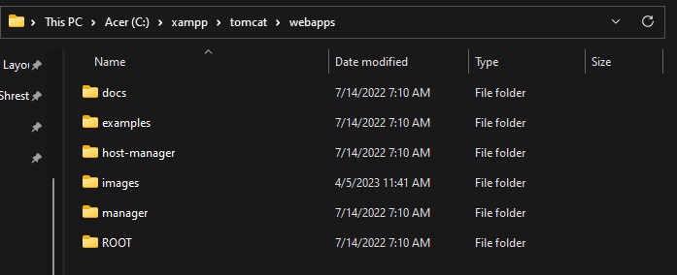
Configuration
Navigate to your xampp installed folder. Then go to tomcat/webapps and create a new folder named images.
ADVANCED PROGRAMMING AND TECHNOLOGIES

Slide 38
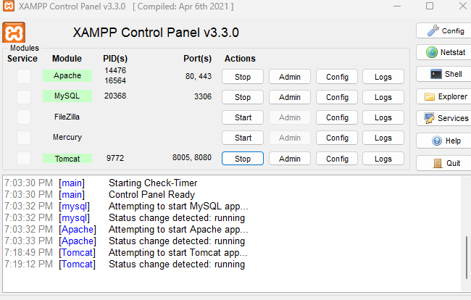
Configuration
Then we can use XAMPP application tomcat server to upload the image in created folder
To use it we need to start the Tomcat server. If there is any port issue we need to change its port number.
ADVANCED PROGRAMMING AND TECHNOLOGIES

Slide 39

User Model
Inside model package, create a new java file named User.java
ADVANCED PROGRAMMING AND TECHNOLOGIES

Slide 40
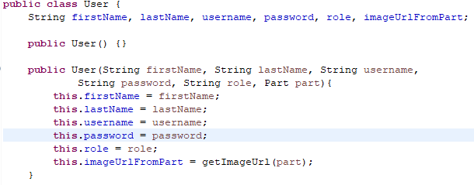
User Model
In this way we can add the information into variable from constructor too.
ADVANCED PROGRAMMING AND TECHNOLOGIES

Slide 41
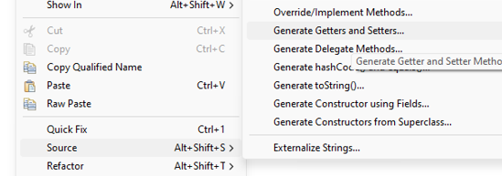
User Model
To auto import the getter and setter methods right click anywhere in the user model class.
Then go to Source>Generate Getters and Setters
ADVANCED PROGRAMMING AND TECHNOLOGIES

Slide 42
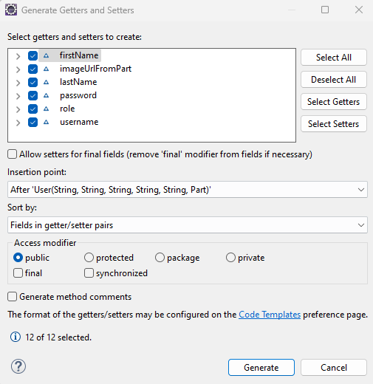
User Model
Then select all the variables that you want to create getter and setter methods.
After selecting click on generate.
ADVANCED PROGRAMMING AND TECHNOLOGIES

Slide 43
User Model
In MyConstants.java file we have added 2 new static variable.
IMAGE_DIR holds the string value which navigates where to upload image.
IMAGE_DIR_SAVE_PATH sets the absolute path to IMAGE_DIR.
Now we will use these path to upload image inside webapps/images folder
ADVANCED PROGRAMMING AND TECHNOLOGIES

Slide 44
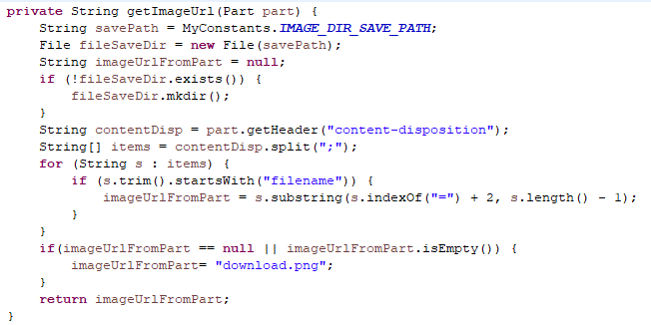
User Model
Inside user model class, create a new method as shown in image.
This method creates a new folder in server for images if IMAGE_DIR_SAVE_PATH does not exists.
If the parameter path is not null or empty, it will return us the image whole path till destination.
If the parameter path is null or empty, it will set download.png as a default image for every user.
ADVANCED PROGRAMMING AND TECHNOLOGIES

Slide 45
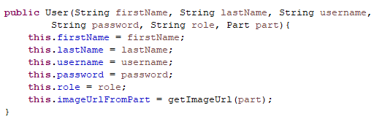
User Model
If you have not noticed yet, you can see inside constructor we have used getImageUrl(part) to get the default/full path of the image.
ADVANCED PROGRAMMING AND TECHNOLOGIES

Slide 46

User Model
Lastly, go to the image url setter method and update its data.
In parameter accept part and use the getImageUrl method that we have created in this file to get the full path.
ADVANCED PROGRAMMING AND TECHNOLOGIES

Slide 47
User Registration
Create a new registration file inside webapp>pages>register.jsp and give your own design
This registration form accepts firstname, lastname, username, password, role and profile picture as per the requirements.
You can download the required CSS and JSP file from MstNepal
ADVANCED PROGRAMMING AND TECHNOLOGIES

Slide 48
User Registration
Inside the form tag of register.jsp give the path to UserRegister servlet, method type post and enctype as shown below.
We will use multipart to upload our image. The image file can be selected from “input type file”
You can download the required CSS and JSP file from MstNepal
ADVANCED PROGRAMMING AND TECHNOLOGIES

Slide 49

User Registration
Create a new servlet file named UserServlet with url pattern “UserServlet” and asyncSupported = true.
We need MultipartConfig annotation as shown below to upload image in our server.
ADVANCED PROGRAMMING AND TECHNOLOGIES

Slide 50
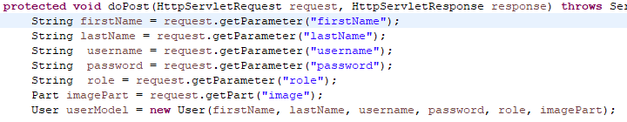
User Registration
Inside doPost method we will retrieve all the data sent from the register.jsp form.
Notice that we need to store the image in Part object/class.
Then we will add all the information into userModel.
ADVANCED PROGRAMMING AND TECHNOLOGIES

Slide 51
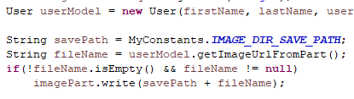
User Registration
Below the userModel code, we will add the code to upload the image in our server path if the filename is not empty or not null.
As we have programmed in user model class, if the user have not uploaded the image in the form then it will return the default image path in filename variable.
ADVANCED PROGRAMMING AND TECHNOLOGIES

Slide 52
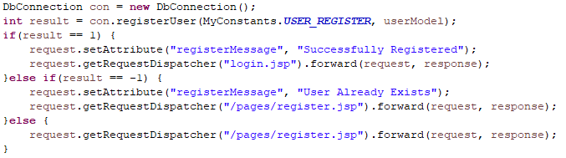
User Registration
Then we will upload the user information using registerUser method and check whether the user is already existed or there is something working or our user is successfully registered.
According to the return type of registerUser method we will navigate it to login or ron same register page
ADVANCED PROGRAMMING AND TECHNOLOGIES

Slide 53
User Registration
Then we will upload the user information using registerUser method and check whether the user is already existed or there is something working or our user is successfully registered.
According to the return type of registerUser method we will navigate it to login or ron same register page.
DbConnection file is also provided in MstNepal. Do observe and understand what registerUser method is programmed for.
ADVANCED PROGRAMMING AND TECHNOLOGIES

Slide 54

Password Encrption
Download the Password Encryption zipped file provided in week 8 folder (My Second Teacher)
Then copy it inside the model package.
Do understand what is AES encryption and its code provided in this file.
ADVANCED PROGRAMMING AND TECHNOLOGIES

Slide 55
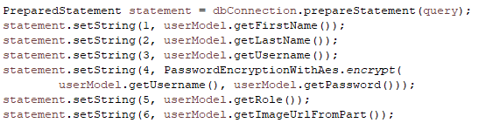
Password Encrption
We can use the encrypt method when registering the user to encrypt the password so that no one can see the users’ password. Even in database.
ADVANCED PROGRAMMING AND TECHNOLOGIES

Slide 56
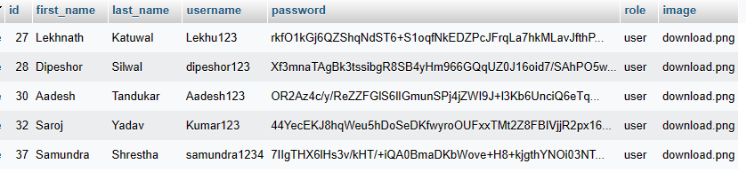
Password Encrption
You can see in our MySql database the password is encrypted.
We can see also the role and image file name uploaded in the database.
ADVANCED PROGRAMMING AND TECHNOLOGIES

Slide 57

Password Encrption
We can use its decrypt method to decrypt the password when logging into the website to check if the password matches or not.
You can look upon provided DbConnection file’ isUserRegistered method to find this code.
ADVANCED PROGRAMMING AND TECHNOLOGIES

Slide 58
Thank You

