Slide 1
GPS Difference when compared to iPhone
 | iPhone GPS | Arduino GPS Module (Beitian BN-280) | Difference
Latitude | 30.606082 | 30.604097 | 0.006486%
Longitude | -96.349300 | -96.347002 | 0.002385%
Youtube Link of demonstration: https://youtube.com/shorts/npSka5icJEc?feature=share

Slide 2
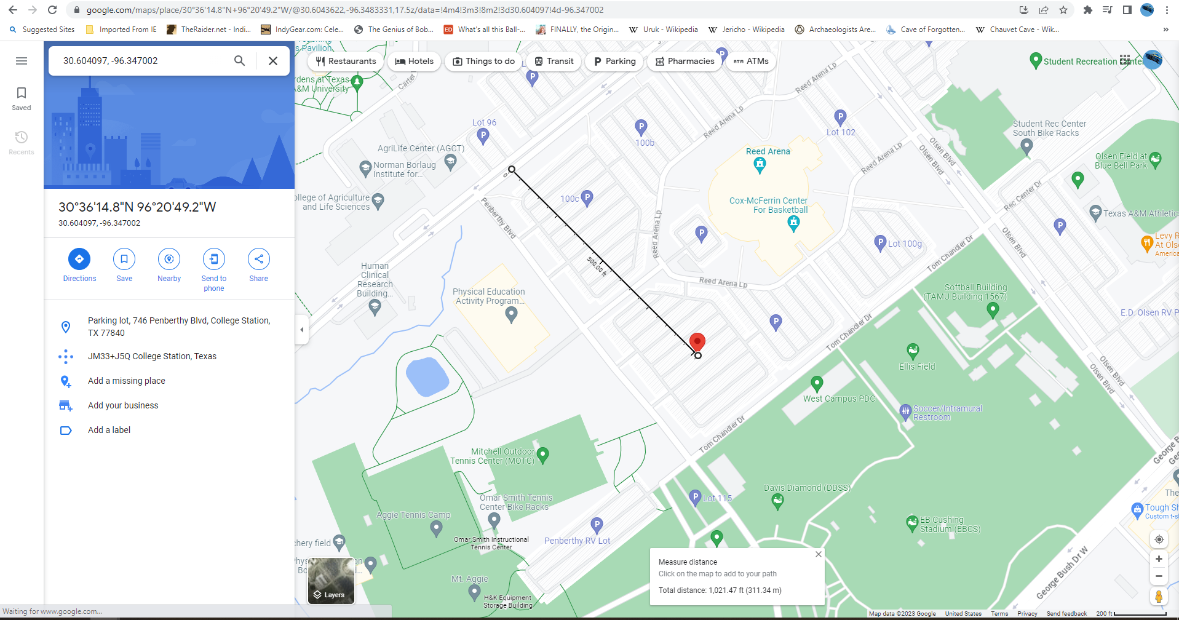
Red Point is the Beitian BN-280
White dot is the iPhone GPS Point
The iPhone had a much larger error than expected when compared to the GPS location.
The Beitian BN-280 data sheet claims a 2m error, with 98% of the time it will plot within one meter.

Slide 3
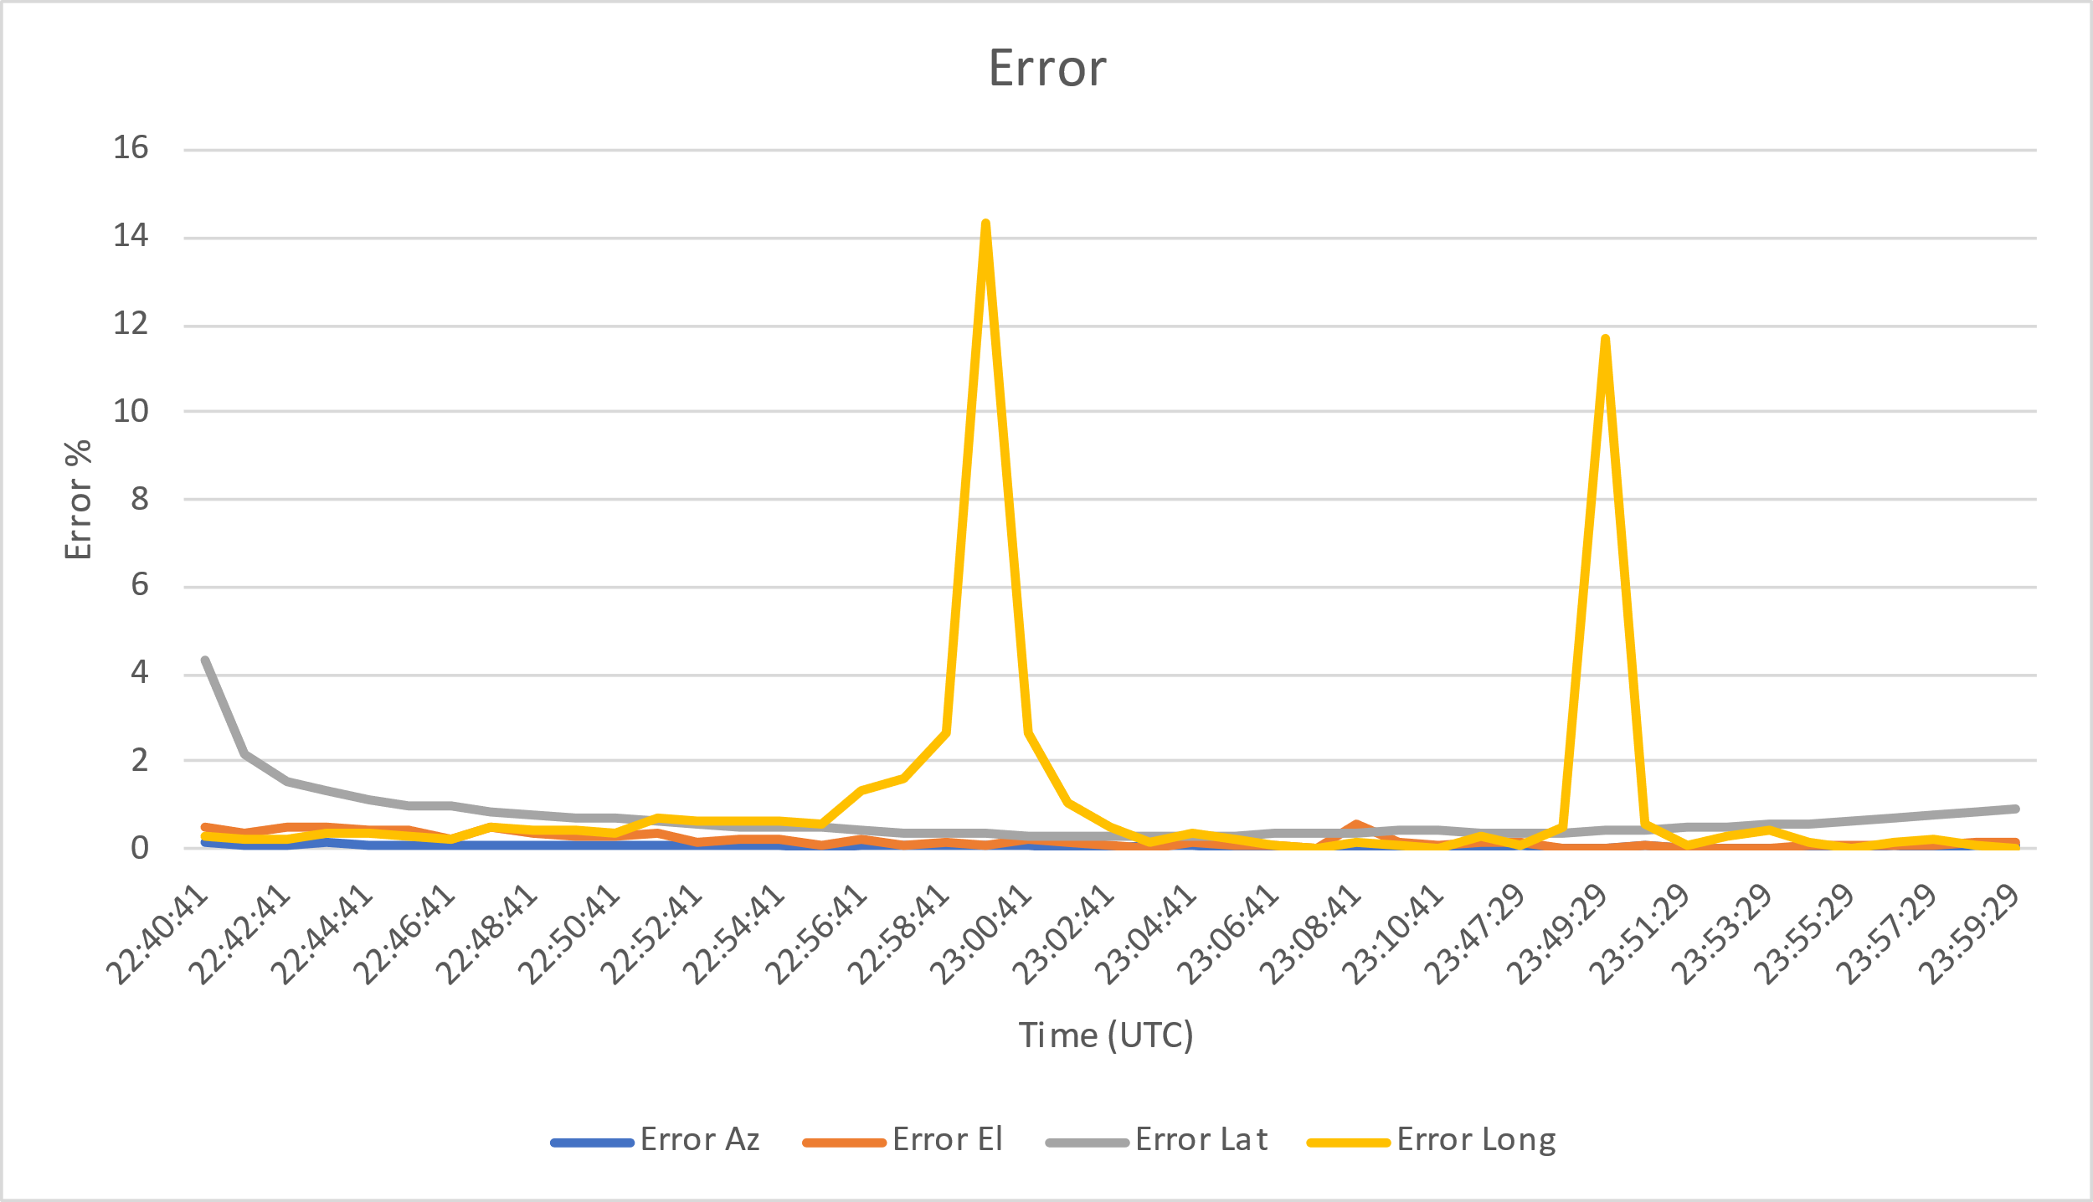
Satellite Prediction Error
Every time the error percentage jumps to a large error the satellite is passing over the equator.
 | Azimuth | Elevation | Latitude | Longitude
Average | 0.046360632 | 0.119257029 | 0.457584611 | 1.298389929

Slide 4
Time (UTC) | Pred Lat | Pred Long | Azimuth Pred | El Pred | Az Calc | El Calc | ISS Lat | ISS Long | Error Az | Error El | Error Lat | Error Long
22:59:41 | -49.646 | 0.5312 | 133.68 | -57.45 | 133.6 | -57.5 | -49.82 | 0.62 | 0.05988 | 0.086957 | 0.349257 | 14.32258
23:49:29 | -47.0173 | -0.4768 | 131.1 | -56.7 | 131.1 | -56.7 | -47.21 | -0.54 | 0 | 0 | 0.408176 | 11.7037
Despite the large error in the longitude, the azimuth and elevation error was still below the threshold needed to communicate with the satellite.

