Slide 1
Game Theory
Prepared by MO-88 group student
Rustamkhujaeva Komilakhon

Slide 2
01
The basics of Game Theory
Get general information about Game Theory.
Game Theory Definitions.
Game Theory Models.
02
Solving Games
Essence of the Game, “Stone Paper and Scissors” Game.
Finding optimal solution for the Game, Examples.
03
Importance of Game Theory
Why is the game theory important?
Role of Game Theory in Business, Statistics and Life.
Agenda

Slide 3
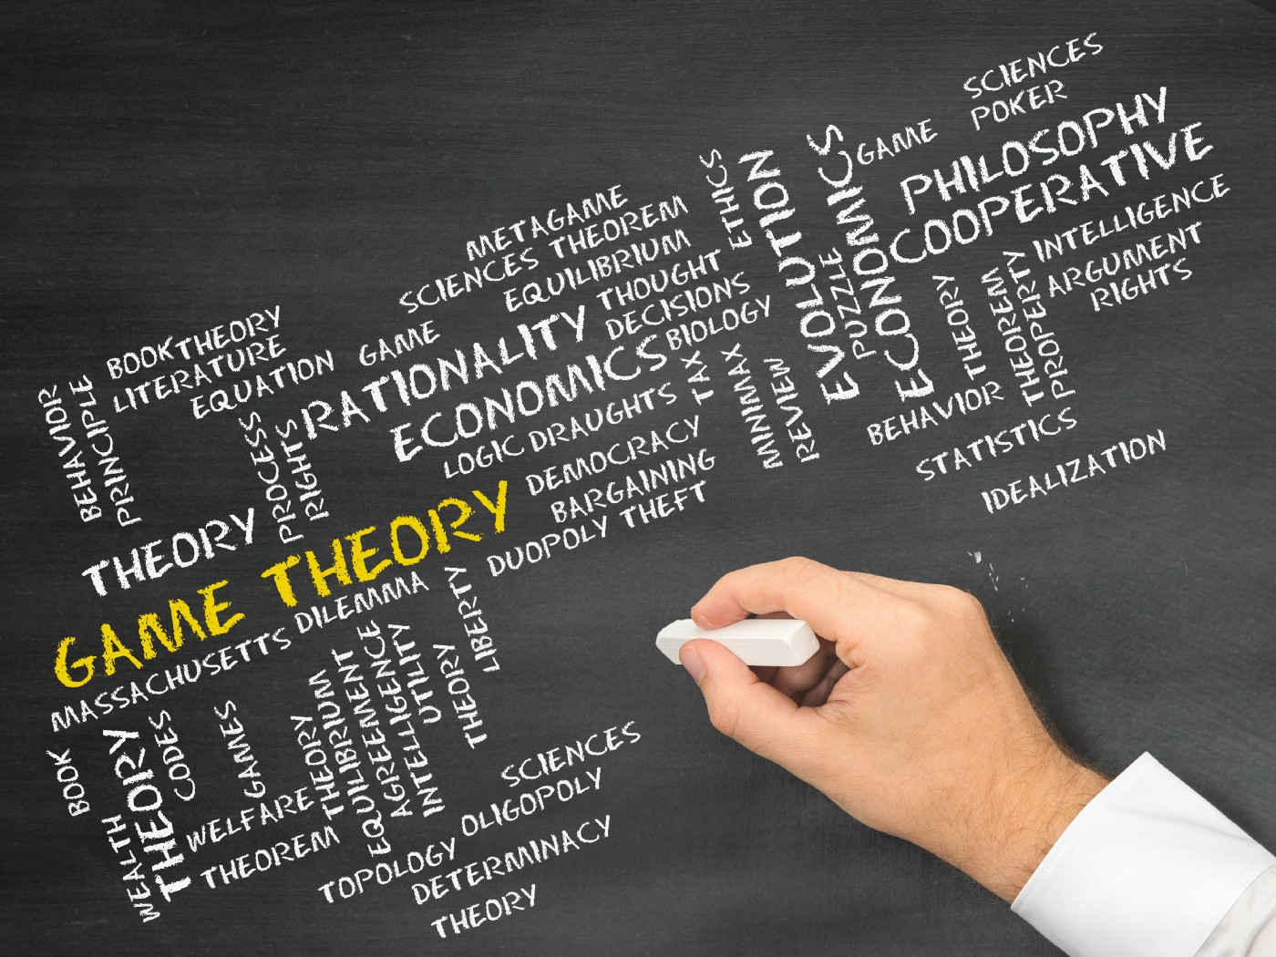
1. What is Game Theory?
Game theory is the process of modeling the strategic interaction between two or more players in a situation containing set rules and outcomes.
While used in a number of disciplines, game theory is most notably used as a tool within the study of economics. The economic application of game theory can be a valuable tool to aid in the fundamental analysis of industries, sectors, and any strategic interaction between two or more firms.

Slide 4
Game Theory Definitions
Game:
Any set of circumstances that has a result dependent on the actions of two of more decision-makers (players).
Players:
A strategic decision-maker within the context of the game.
A complete plan of action a player will take given the set of circumstances that might arise within the game.
Strategy:
The payout a player receives from arriving at a particular outcome. The payout can be in any quantifiable form, from dollars to utility.
Payoff:
The information available at a given point in the game. The term information set is most usually applied when the game has a sequential component.
Information set:
Equilibrium:
The point in a game where both players have made their decisions and an outcome is reached.

Slide 5
To simulate (solve) an antagonistic
game means that for each player to specify strategies that satisfy the condition of optimality.
Player A must receive the maximum guaranteed winnings, no matter what strategy is adhered to by player B, and player B must receive a minimum loss, no matter what strategy player
A adheres to.
Models
A game is called a doubles game if it involves two players, and a multiple if the number of players is greater than two. We will consider only doubles games. Players are denoted by A and B.
A game is called antagonistic (zero-sum) game if one player's win equals the other's loss.
Double and Multiple Game
Antagonistic (zero-sum) Game

Slide 6
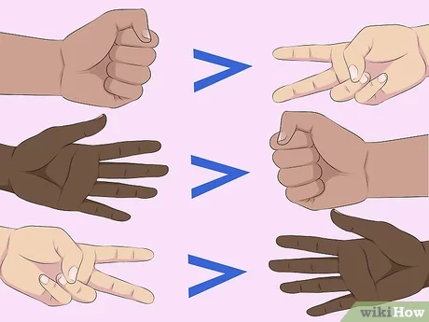

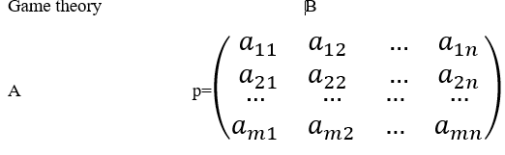
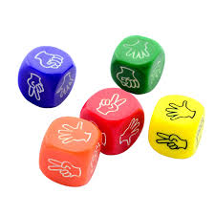
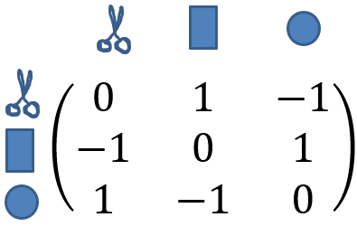

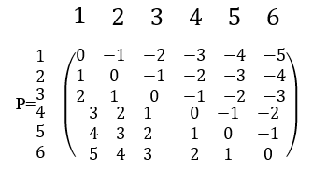
2. Solving Games

Slide 7
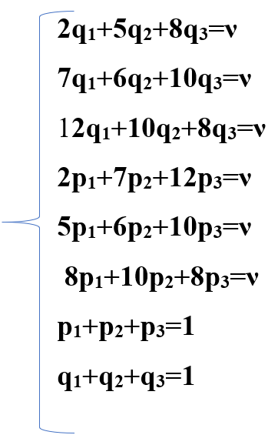
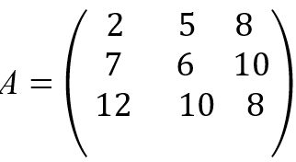
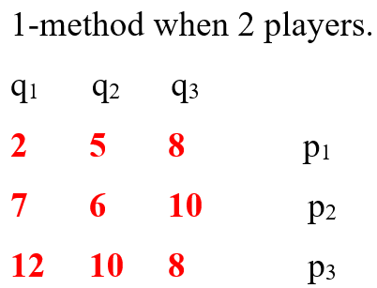
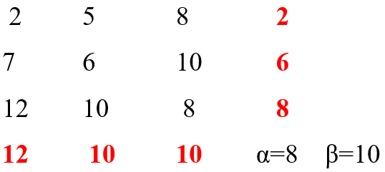
Finding optimal solution for the Game
Calculation
α=maxmin β=minmax
! it is difficult to solve this system of equations

Slide 8
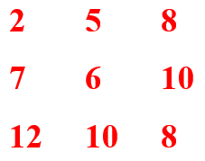
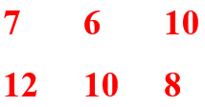
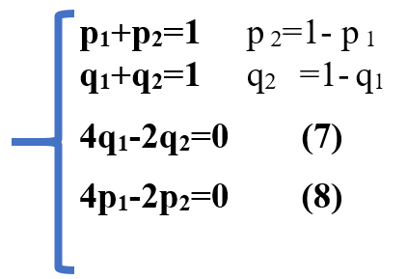
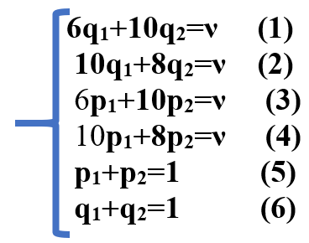
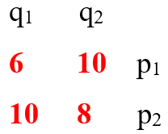
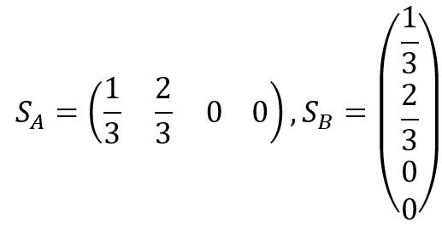
Finding optimal solution for the Game
Since the 1-row elements are less than corresponding items of the 2-row, we may remove the 1-row
Since the 1-column elements are greater than corresponding items of the 2-column, we may remove the 1-column.
Now we have a new matrix
S_{A}(p₁, p₂) S_{B}(q₁, q₂)
let’s subtract (1) from (2),
(3) from (4)
Answer!

Slide 9
3. Importance of Game Theory
Game theory can help players reach optimal decision-making when confronted by independent and competing actors in a strategic setting.
A common "game" form that appears in economic and business situations is the prisoner's dilemma, where individual decisionmakers always have an incentive to choose in a way that creates a less than optimal outcome for the individuals as a group.
Game theory is a framework for understanding choice in situations among competing players.
01
02
04
03
Several other forms of game exist. The practical application of these games can be a valuable tool to aid in the analysis of industries, sectors, markets, and any strategic interaction between two or more actors.

Slide 10
THANK YOU

