Slide 1

A National Rental Car Company, Lariat’s Profitability Model
Prepared for Lariat Executives
Presented by: Haftom Abrha
April 2023

Slide 2
Goals of this presentation
Review the current business performance and identify strategies that minimize cost and maximize profit of the rental car company
Compare the strategies and baseline options to each other to help in decision making process

Slide 3
Review of the current business situation Baseline
2018 Gross metrics
Total number of rentals | Total revenue | Total cost | Total profit
81318 | $ 52,830,207.0 | $ 30,320,297.9 | $ 22,509,909.1

Slide 4
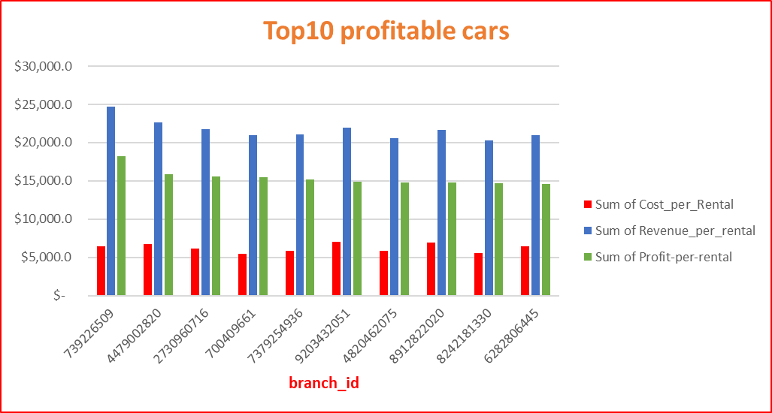
Top10 profit_generating cars

Slide 5
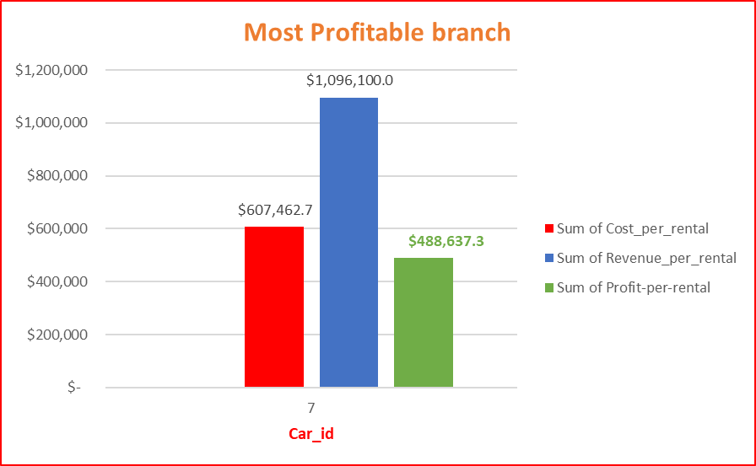
Most profit_generating location(branch)

Slide 6
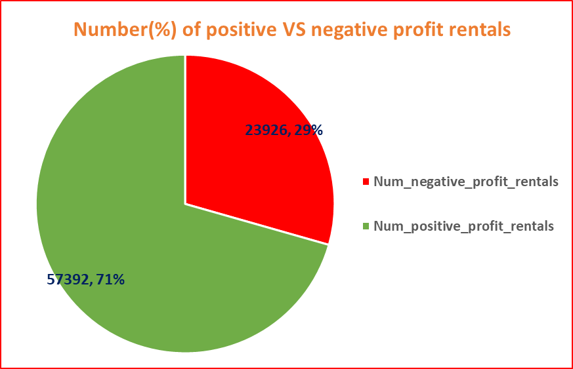
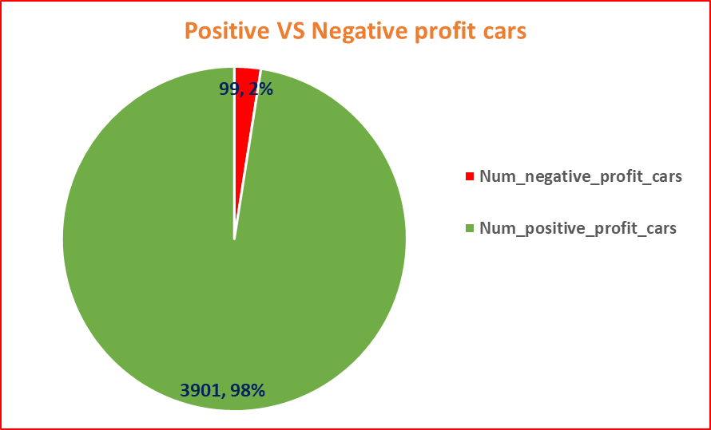
Cars and rentals that generate negative VS positive profits NB. 99 cars are generating losses

Slide 7
Review of strategies to maximize profit and reduce cost
Strategy1: Lariat, should get rid of those cars with negative profit from the fleet to reduce cost and maximize profit.
strategy 2: Buy the top10 profitable car types, and replace the 99 negative profit cars. # of rentals for the top10 are 270 and ( 5*270) --> almost replaces the negative profit car rentals.
Strategy 3. Add more cars in the top1 profitable location, branch_id of 7(Denver, CO) to the fleet. Those cars approximately replaces the negative profit generating cars.

Slide 8
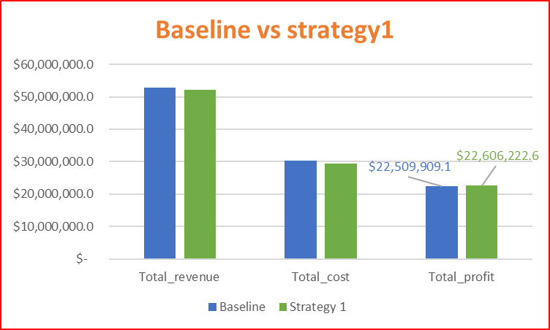
… continued Review of strategies Strategy1 vs Baseline

Slide 9

… continued Review of strategies Strategy2 vs Baseline

Slide 10

… continued Review of strategies Strategy3 vs Baseline

Slide 11
Recommendations & Call to action
Lariat should take advantage of the 3 strategies to maximize profit and reduce cost than sticking to the current business(baseline)
Among these, buying more of the top10 profitable cars(strategy2), best strategy, can result a net profit difference of close to $1M.
If action is not taken accordingly, Lariat won’t get the amount mentioned above, or at least $96,313.50(strategy1) that should’ve profited

