Slide 1

Lesson - 11
Sensors

Slide 2
Agenda
Introduction
Sensor Type
Sensor Framework
Sensor Implementation Structure
Hands on Example 1 – Retrieve Device Sensor List
Hands on Example 2 - TYPE_ACCELEROMETER
Hands on Example 3 & 4 - TYPE_LIGHT

Slide 3
Android and Sensors
Sensors can discover user action and respond
Device contents rotate as needed
Walking adjusts position on map
Tilting steers a virtual car or controls a physical toy
Moving too fast disables game interactions

Slide 4
Introduction
Most of the Android powered devices come with the default sensors such as:
Motion Sensors: These sensors measure acceleration forces along the three axis. This includes accelerometers, gravity sensors, rotation vector, and gyroscopes(movements).
An example of an app that uses these types of sensors is a fitness tracker app that keeps track of the steps taken throughout the day or your general activity level.
Environmental Sensors: These sensors can measure characteristics of the device environment, such as ambient air temperature and pressure, illumination, and humidity. This category includes barometers, photometers, and thermometers.3
An example of an app that uses these sensors may be a hiking app that displays temperature, and air pressure information.
Position Sensors: These sensors measure the physical position of the device which includes orientation changes and magnetometers.

Slide 5
Sensor types supported by the Android platform
Sensor | Description | Common Uses
TYPE_ACCELEROMETER | Measures the acceleration force in m/s2 that is applied to a device on all three physical axes (x, y, and z), including the force of gravity. | Motion detection (shake, tilt, etc.).
TYPE_LIGHT | Measures the ambient light level (illumination) in lx. | Controlling screen brightness.
TYPE_ORIENTATION | Measures degrees of rotation that a device makes around all three physical axes (x, y, z). | Determining device position.
Refer for more sensors https://developer.android.com/guide/topics/sensors/sensors_overview.html

Slide 6
Sensor Framework
You can access sensors and acquire raw sensor data by using the Android sensor framework. The sensor framework is part of the android.hardware package and includes the following classes and interfaces:
SensorManager
The SensorManager class handles the usage of sensors and can be invoked by the method, Context.getSystemService().
Sensor
This class is used to retrieve a list of Sensors available in the devices.
SensorEvent
This class stores information about the sensor type, sensor data, and so on.
SensorEventListener
you acquired a sensor, you can register a SensorEventListener object on it. This listener will get informed, if the sensor data changes.
To avoid the unnecessary usage of battery register your listener in the onResume() method and unregister it in the onPause() method.

Slide 7
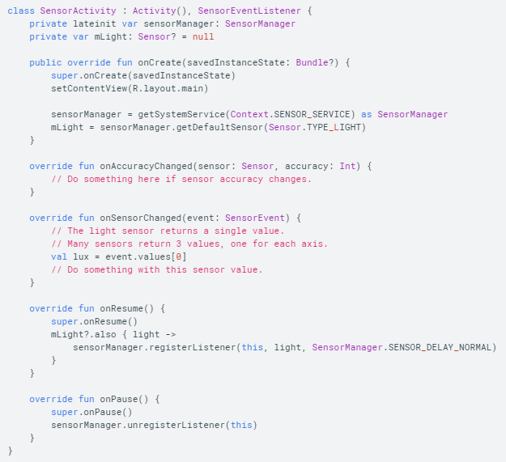
Sensor Implementation Template

Slide 8
Steps to work with Sensor
Implementing the SensorEventListener Interface in your Activity
class SensorActivity : AppCompatActivity(), SensorEventListener
Get a reference to the SensorManager to work on Sersor service
var mySensorManager = getSystemService(Context.SENSOR_SERVICE) as SensorManager;
To determine if the sensor we are trying to use is available on the
device model the app is running on, we need to try to get the sensor
reference and check if it is null:
var tempSensor = mySensorManager.getDefaultSensor(Sensor.TYPE_AMBIENT_TEMPERATURE);
if (tempSensor != null) {
// The sensor exists
} else {
// The sensor does not exist
}

Slide 9
Steps to work with Sensor
4. Registering a listener to receive sensor data by overriding onResume().
mySensorManager.registerListener(this, mSensors, SensorManager.SENSOR_DELAY_NORMAL)
Arguments
arg1 → SensorEventListener listener
arg2→ Sensor sensor
arg3→ int samplingPeriodUs
Values for the arg3 are
SENSOR_DELAY_FASTEST ( default int value 0 - get sensor data as fast as possible )
SENSOR_DELAY_GAME (default int value 1 - rate suitable for games )
SENSOR_DELAY_UI (default int value 2-rate suitable for the user interface like rotating the screen orientation)
SENSOR_DELAY_NORMAL (default int value 3 - rate (default) suitable for screen orientation changes )
5. Unregistering the sensor by Overriding onPause() – Needed to save your battery life
mySensorManager.unregisterListener(this)
Notes:
The default data delay (SENSOR_DELAY_NORMAL) is suitable for monitoring typical screen orientation changes and uses a delay of 200,000 microseconds (0.2 seconds). You can specify other data delays, such as SENSOR_DELAY_GAME (20,000 microseconds or 20 milliseconds), SENSOR_DELAY_UI (60,000 microseconds or 60 milliseconds), or SENSOR_DELAY_FASTEST (no delay, as fast as possible).

Slide 10
Steps to work with Sensor
6. To monitor raw sensor data you need to implement two callback methods that are exposed through the
SensorEventListener interface: The Android system calls these methods whenever the following occurs:
override fun onAccuracyChanged(sensor: Sensor, accuracy: Int) {
// Do something here if sensor accuracy changes.
}
override fun onSensorChanged(event: SensorEvent) {
/* Do something with this sensor event - object contains information about the sensor data*/
}

Slide 11
Steps to work with Sensor
Usage of onAcuuracyChanged() code
@Override
public void onAccuracyChanged(Sensor sensor, int accuracy){
switch(accuracy){
case SensorManager.SENSOR_STATUS_ACCURACY_HIGH:
this.accuracy.setText("SENSOR_STATUS_ACCURACY_HIGH");
break;
case SensorManager.SENSOR_STATUS_ACCURACY_MEDIUM:
this.accuracy.setText("SENSOR_STATUS_ACCURACY_MEDIUM");
break;
case SensorManager.SENSOR_STATUS_ACCURACY_LOW:
this.accuracy.setText("SENSOR_STATUS_ACCURACY_LOW");
break;
case SensorManager.SENSOR_STATUS_UNRELIABLE:
this.accuracy.setText("SENSOR_STATUS_UNRELIABLE");
break; }}

Slide 12
Hands on Example – 1- Sensor List
Problem Requirement
To get the list of sensors from your device and display in the ListView.
Create an xml file with one ListView component and configure id .
Write your logic to retrieve the list of available sensors in MainActivity.kt

Slide 13
MainActivity.kt
import android.content.Context
import android.hardware.Sensor
import android.hardware.SensorManager
import androidx.appcompat.app.AppCompatActivity
import android.os.Bundle
import android.widget.ArrayAdapter
import android.widget.ListView
class MainActivity : AppCompatActivity() {
lateinit var listView: ListView
lateinit var sensorManager: SensorManager
lateinit var listsensor:List<Sensor>
lateinit var liststring:ArrayList<String>
lateinit var adapter: ArrayAdapter<String>

Slide 14
MainActivity.kt
override fun onCreate(savedInstanceState: Bundle?) {
super.onCreate(savedInstanceState)
setContentView(R.layout.activity_main)
listView = findViewById<ListView>(R.id.lv1)
liststring = ArrayList()
sensorManager = getSystemService(Context.SENSOR_SERVICE) as SensorManager
listsensor = sensorManager.getSensorList(Sensor.TYPE_ALL)
for (i in listsensor.indices) {
liststring.add(listsensor[i].name)
}
adapter = ArrayAdapter(this@MainActivity,
android.R.layout.simple_list_item_1, liststring
)
listView.adapter = adapter
}
}

Slide 15
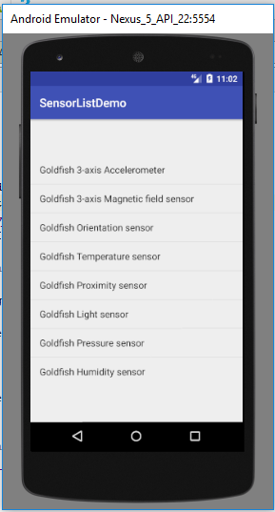
Hands on Example – 1- Sensor List
Sample Output
This code is run through Emulator. ListView shows the available sensors from the Emulator. You can run this using your real device.
Refer : ShowSensorsList

Slide 16
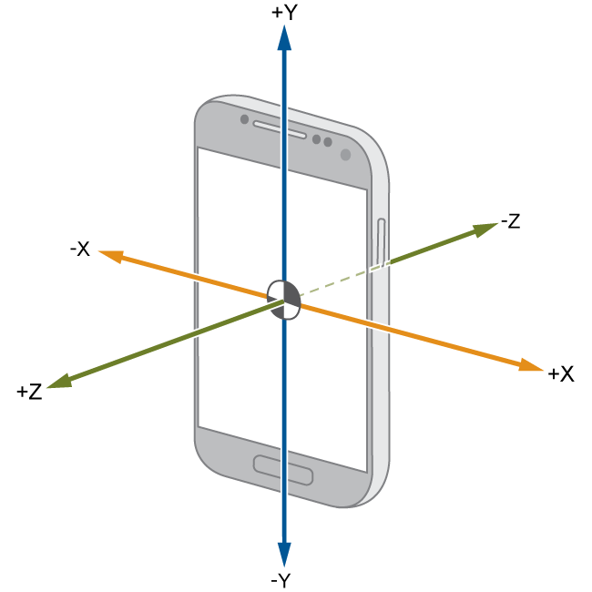
Hands on Example 2 - TYPE_ACCELEROMETER
This example illustrates to know the x, y, z axis position on movements and if you shake your device fast, will play a sound.
Create an xml file with one TextView component and configure id .
Write your logic in MainActivity.java to play music and display the Coordinate position in the TextView.
Refer : Accelerometer

Slide 17
MainActivity.kt
class MainActivity : AppCompatActivity(), SensorEventListener {
lateinit var sensor:Sensor
//help us manage sensor components
lateinit var sm:SensorManager
lateinit var displayReading:TextView
lateinit var mPlayer:MediaPlayer
override fun onCreate(savedInstanceState: Bundle?) {
super.onCreate(savedInstanceState)
setContentView(R.layout.activity_main)
sm = getSystemService(SENSOR_SERVICE) as SensorManager
//select the sensor we wish to use
sensor = sm.getDefaultSensor(Sensor.TYPE_ACCELEROMETER)
displayReading = findViewById(R.id.display_reading) as TextView
mPlayer = MediaPlayer.create(this, R.raw.iphone)
}

Slide 18
MainActivity.kt
// Register your Sensor Manager
override fun onResume() {
super.onResume()
sm.registerListener(this, sensor, SensorManager.SENSOR_DELAY_NORMAL)
}
// Unregister your Sensor Manager
override fun onPause() {
super.onPause()
sm.unregisterListener(this) }
override fun onSensorChanged(event:SensorEvent) {
displayReading.setText("X" + event.values[0] + "\nY" + event.values[1] + "\nZ"
+ event.values[2])
if (event.values[0] > 10){
mPlayer.start()
} }
// Called when the accuracy of a sensor has changed. We are not going to make use of this.
override fun onAccuracyChanged(arg0:Sensor, arg1:Int) {
}
}

Slide 19
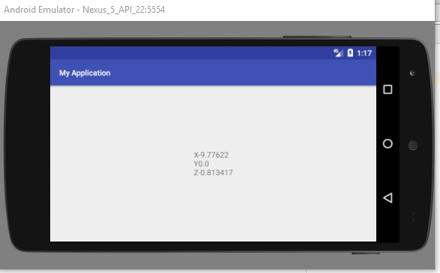
Sample Output

Slide 20
Hands on Example 3 - TYPE_LIGHT
Measures the ambient light level (illumination) in lx.
lx stands for lux.
Useful for controlling screen brightness.
Many mobile having Auto brightness mode function, this function work on light sensor that will adjust screen brightness as per light intensity.
In this example we are reading light intensity value and display with progress bar.
If you take your device from light to dark or dark to light, able to see the changes on Progress Bar.

Slide 21
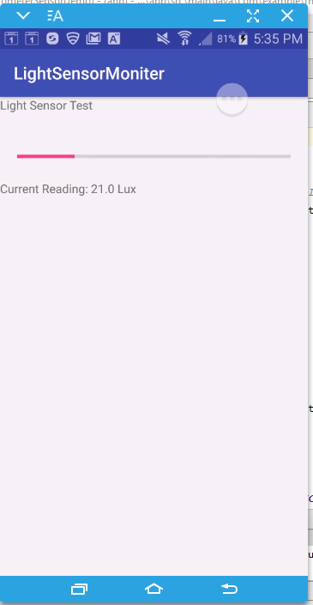
Problem Requirement
Design your layout with two TextView components and Progress Bar.
Your MainActivity.kt needs to deal with TYPE_LIGHT sensor, and show the updated lx value in the Progress bar and in TextView.
Refer : LightLuxSensor

Slide 22
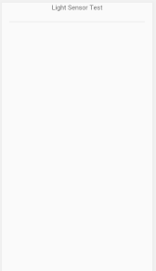
ProgressBar UI
ProgressBar UI
<ProgressBar
android:id="@+id/lightmeter" style="?android:attr/progressBarStyleHorizontal"
android:layout_width="fill_parent"
android:layout_height="wrap_content"
android:max="100"
android:padding="20dp"
android:progress="0" />
android:progress : determine the amount of progress. This example set it as 0.
android:max : Progress bar get full once it reaches to 100.

Slide 23
MainActivity.kt
class MainActivity : AppCompatActivity(), SensorEventListener {
private var sensorManager: SensorManager? = null
private var lightSensor: Sensor?=null
override fun onCreate(savedInstanceState: Bundle?) {
super.onCreate(savedInstanceState)
setContentView(R.layout.activity_main)
// implement sensor manager
sensorManager = getSystemService(Context.SENSOR_SERVICE) as
SensorManager?
lightSensor = sensorManager!!.getDefaultSensor(Sensor.TYPE_LIGHT)
}
// Register your Sensor Manager
override fun onResume() {
super.onResume()
sensorManager!!.registerListener(this, lightSensor, SensorManager.SENSOR_DELAY_NORMAL)
}

Slide 24
MainActivity.kt
// Unregister your Sensor Manager
override fun onPause() {
super.onPause()
sensorManager!!.unregisterListener(this)
}
// get sensor update and reading
override fun onSensorChanged(event: SensorEvent) {
val ac = event.accuracy
if (event.sensor.type == Sensor.TYPE_LIGHT){
val currentReading = event.values[0]
lightmeter.progress = currentReading.toInt()
reading.text = ("Current Reading: "
+ (currentReading).toString() + " Lux")
} }
override fun onAccuracyChanged(sensor:Sensor, i:Int) {
}}

Slide 25
Hands on Example 4 - TYPE_LIGHT
Problem Requirement
If your device gets darkness, play music automatically.
If your device gets light stop music.
Refer :LightOnOffMusic

Slide 26
MainActivity.kt
class MainActivity : AppCompatActivity(),SensorEventListener {
// Declare Sensor object to select particular sensor
private var sensor:Sensor? = null
// To manage Sensor components declare SensorManager Object
private var sm:SensorManager? = null
// Declare MediaPlayer object to play music
lateinit var mp:MediaPlayer
var cuttentLux = 0
// Declare the boolean flag to know the player is running or not
var flag = false
override fun onCreate(savedInstanceState: Bundle?) {
super.onCreate(savedInstanceState)
setContentView(R.layout.activity_main)
// Initialize object for Sensor service using getSystemService()
sm = getSystemService(Context.SENSOR_SERVICE) as SensorManager?
// Initialize Sensor object for the Type light using getDefaultSensor() from SensorManager object
sensor = sm!!.getDefaultSensor(Sensor.TYPE_LIGHT)
// Check device has the requested Sensor or not
if(sensor==null){
Toast.makeText(this,"Your device has no Sensor.TYPE_LIGHT",Toast.LENGTH_LONG).show()
}
}

Slide 27
MainActivity.kt
// Register your Sensor Manager
override fun onResume() {
super.onResume()
sm!!.registerListener(this, sensor, SensorManager.SENSOR_DELAY_NORMAL)
}
// Unregister your Sensor Manager
override fun onPause() {
super.onPause()
sm!!.unregisterListener(this)
}
override fun onAccuracyChanged(sensor: Sensor?, accuracy: Int) {
// Nothing
}

Slide 28
MainActivity.kt
override fun onSensorChanged(event: SensorEvent?) {
if (event!!.values!![0] < 10 && !flag)
{ // < 10 use for dark. > 40 to run in light
flag = true
// mp = new MediaPlayer();
try
{
// mp.setDataSource("http://www.tamilmp3plus.com/837/vijay-prakash-hits/");
// mp.prepare();
mp = MediaPlayer.create(applicationContext, R.raw.iphone)
mp.start()
}
catch (e:Exception) {
e.printStackTrace()
}
}
}
}

