Slide 1

BALA template #10
CS 473 – MDP
Mobile Device Programming
© 2020 Maharishi International University
All course materials are copyright protected by international copyright laws and remain the property of the Maharishi International University. The materials are accessible only for the personal use of students enrolled in this course and only for the duration of the course. Any copying and distributing are not allowed and subject to legal action.
Maharishi International
University

Slide 2
BALA template #10
CS 473 – MDP
Mobile Device Programming
MS.CS Program
Department of Computer Science
Renuka Mohanraj, Ph.D.,
Maharishi International
University

Slide 3
BALA template #10
CS 473 – MDP
Mobile Device Programming
Lesson 3
Creating First App
Maharishi International
University

Slide 4
Wholeness
In this lecture we examine fundamental building blocks of Android apps including the manifest, the activity, and views. We also explore the useful files in your project explorer. Lastly, we create an Android app from these basic elements and run through Emulators. The most fundamental knowledge is the most important knowledge, since everything else is built upon it. The reason TM can provide such a wide range of benefits to life in general is because it works at such a truly fundamental level.

Slide 5
Agenda
Introduction to Android Studio
Creation of HelloWorld app
Android Project Structure and Folders
AVD Manager
Styles
Event Handling

Slide 6
Introduction to Android Studio
Android Studio is the new foundation of Google’s efforts to give Android developers top-notch development tools.
Android Studio is a special version of IntelliJ IDEA(leading Java IDE) that interfaces with the Android Software Development Kit (SDK) and the gradle build system.
Gradle is the native build system for Android Studio. Hence, if you are using that IDE, you should get a build.gradle file automatically. Will discuss about this in later chapters.

Slide 7
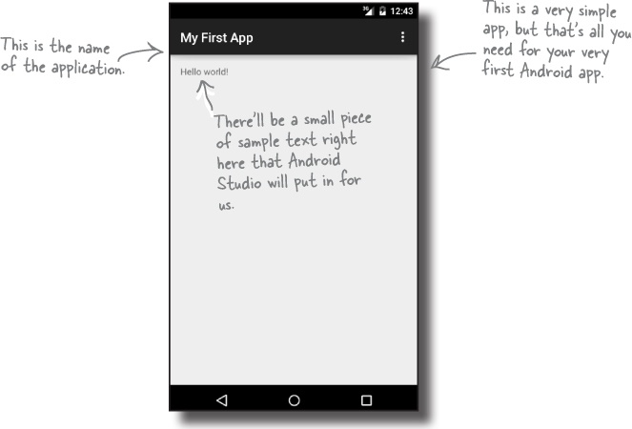
Initial HelloWorld App Example
Now that you’ve set up your development environment, you’re ready to create your first Android app. Here’s what the app will look like:

Slide 8
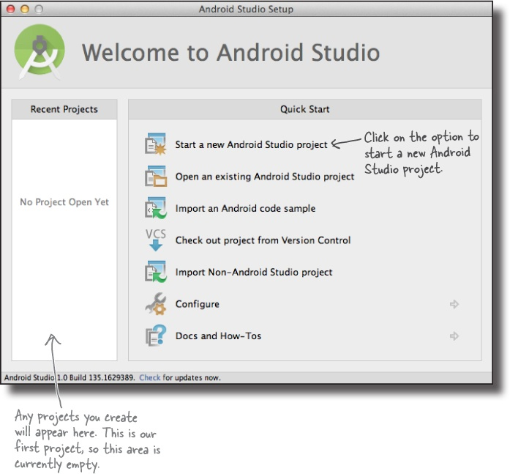
1. Create a new project
The Android Studio welcome screen gives you a number of options for what you want to do. We want to create a new project, so click on the option for “Start a new Android Studio project”. (or) File -> New->New Project

Slide 9
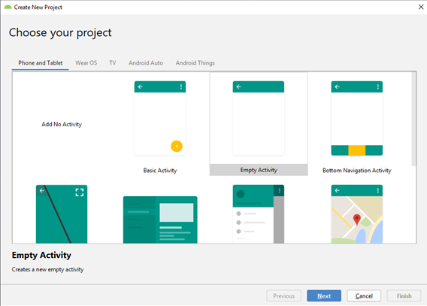
Choose Phone and Tablets then select Empty Activity and click Next to proceed.
Notes:
Android: Minimum supported version is now Android 4.1 Jelly Bean

Slide 10
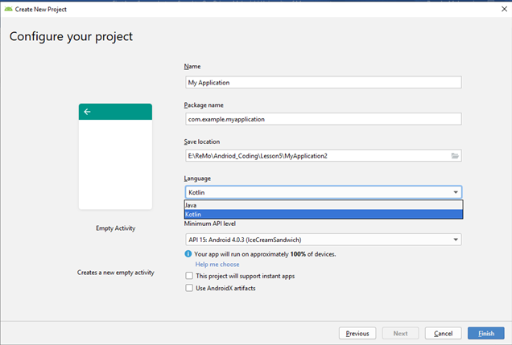
Create a new project
Name of your Application shown in Google play store and other places.
Forms the package name by combining application name and company name
All of your files for your project will be stored here.
Choose the language for Implementation
Choose Minimum API support of SDK
Click Finish
Notes:
A Google Android instant app is a small software program that enables end users to test out a portion of a native Android app without installing it on a device.
Android users can also find the instant app through the Google Play store. Android users must download Android 6.0 to take advantage of instant apps.
androidx artifacts – Android JetPack support, Jetpack is a suite of libraries, tools, and guidance to help developers write high-quality apps easier.

Slide 11
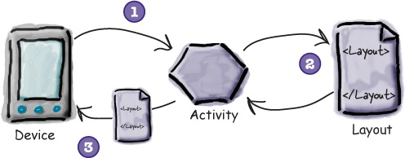
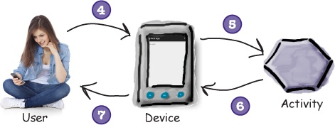
Activity
Every Android app is a collection of screens, and each screen is comprised of an activity and a layout.
An activity is a single, defined thing that your user can do. You might have an activity to compose an email, take a photo, or find a contact. Activities are usually associated with one screen, and they’re written in Java/Kotlin.
A layout describes the appearance of the screen. Layouts are written as XML files and they tell Android how the different screen elements are arranged.
Notes:
Layouts define how the user interface is presented.
Activities define actions.
The device launches your app and creates an activity object.
The activity object specifies a layout.
The activity tells Android to display the layout on screen.
The user interacts with the layout that’s displayed on the device.
The activity responds to these interactions by running application code.
The activity updates the display...
...which the user sees on the device.

Slide 12
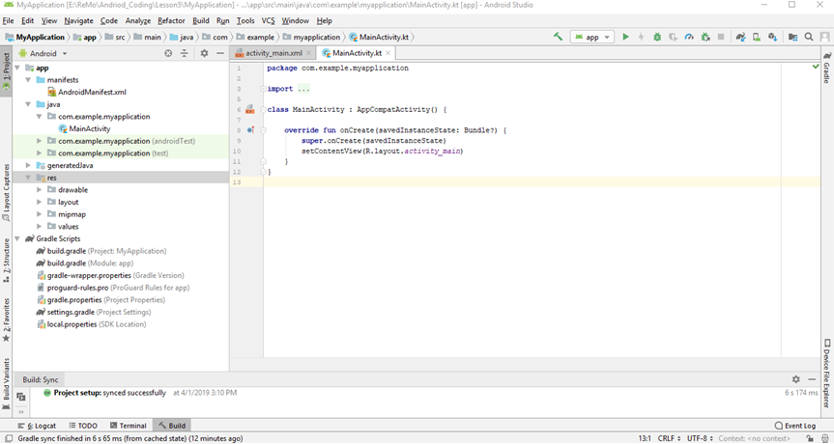
Creation of HelloWorldApp
Here’s what our project looks like (don’t worry if it looks complicated right now, we’ll break it down over the next few slides):
Refer : https://kotlinlang.org/docs/tutorials/kotlin-android.html

Slide 13
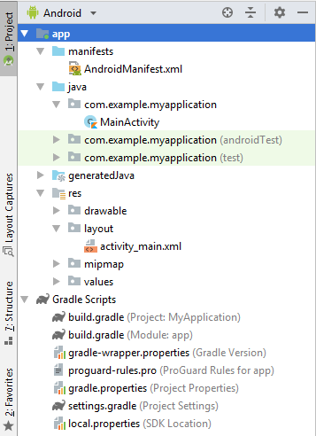
Project folders
1
manifests—This folder contains AndroidManifest.xml. This file describes all the components of your Android app and is read by the Android runtime system when your app is executed.
java—All your Kotlin and Java language files are organized here.
res—This folder contains all the resources for your app, including images, layout files, strings, icons, and styling.
Gradle Scripts - Shows all the project's build-related configuration files.
2
3
4
Notes:
In the Project > Android view you see three top-level folders below your app folder: manifests, java, and res.
1. Expand the manifests folder. This folder contains AndroidManifest.xml. This file describes all the components of your Android app and is read by the Android runtime system when your app is executed.
2. Expand the java folder. All your Kotlin and Java language files are organized here. The java folder contains three subfolders: com.example.android.myapplication (or the domain name you have specified): This folder contains the Kotlin and Java source code files for your app. com.example.android. myapplication (androidTest): This folder is where you would put your instrumented tests. It starts out with a skeleton test file. com.example.android. myapplication(test): This folder is where you would put your unit tests. It starts out with a skeleton unit test file.
3. Expand the res folder. This folder contains all the resources for your app, including images, layout files, strings, icons, and styling. It includes these subfolders: drawable: All your app's images will be stored in this folder. layout: This folder contains the layout files for your activities. Currently your app has one activity that has a layout file called activity_main.xml. mipmap: This folder contains the launcher icons for your app. values: Contains resources, such as strings and colors, used in your app.

Slide 14
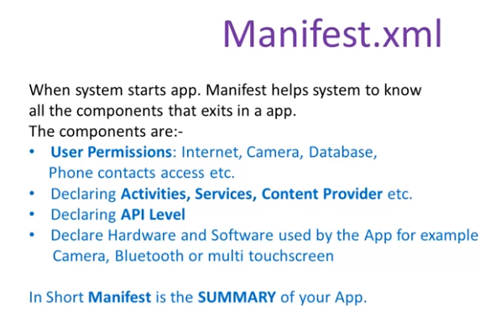

Slide 15
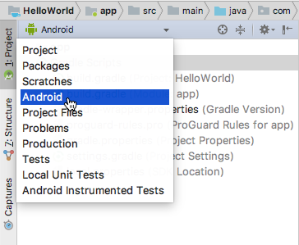
Explorer Views
Explore the Project -> Android pane
If not already selected, click the Project tab in the vertical tab column on the left side of the Android Studio window. The Project pane appears.
To view the project in the standard Android project hierarchy, choose Android from the popup menu at the top of the Project pane, as shown below. [ Default View for the App Development]

Slide 16
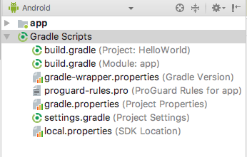
Gradle build system
The Gradle build system in Android Studio makes it easy to include external library modules to your build as dependencies.
Three build.gradle:
project
module
settings
Learn more about gradle at https://gradle.org/
Every Android project needs a gradle for generating an apk from the .kt and .xml files in the project. Simply put, a gradle takes all the source files (kt and XML) and apply appropriate tools, e.g., converts the java files into dex files and compresses all of them into a single file known as apk that is actually used.

Slide 17
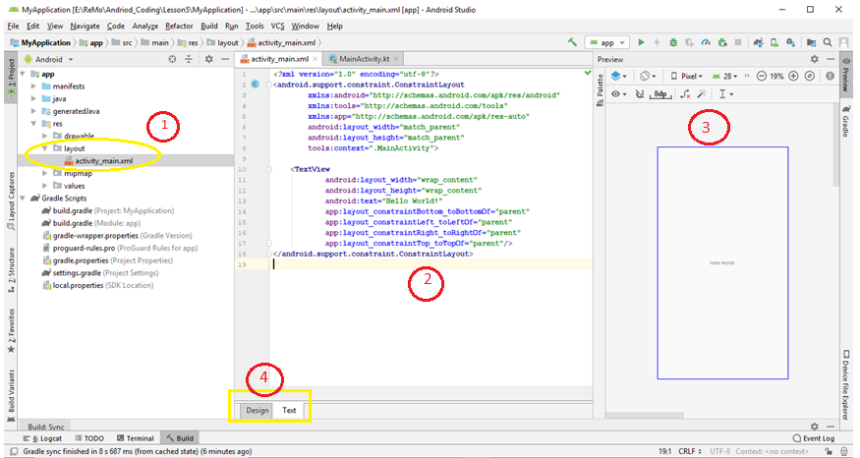
Code Editor - activity_main.xml
Click actitvity_main.xml to view the code editor and preview of Activity
XML editing panel -Type xml code to design activity
Preview panel and shows the current visual state of the layout
By clicking Design and Text button to switch between Design Editor and Code Editor

Slide 18
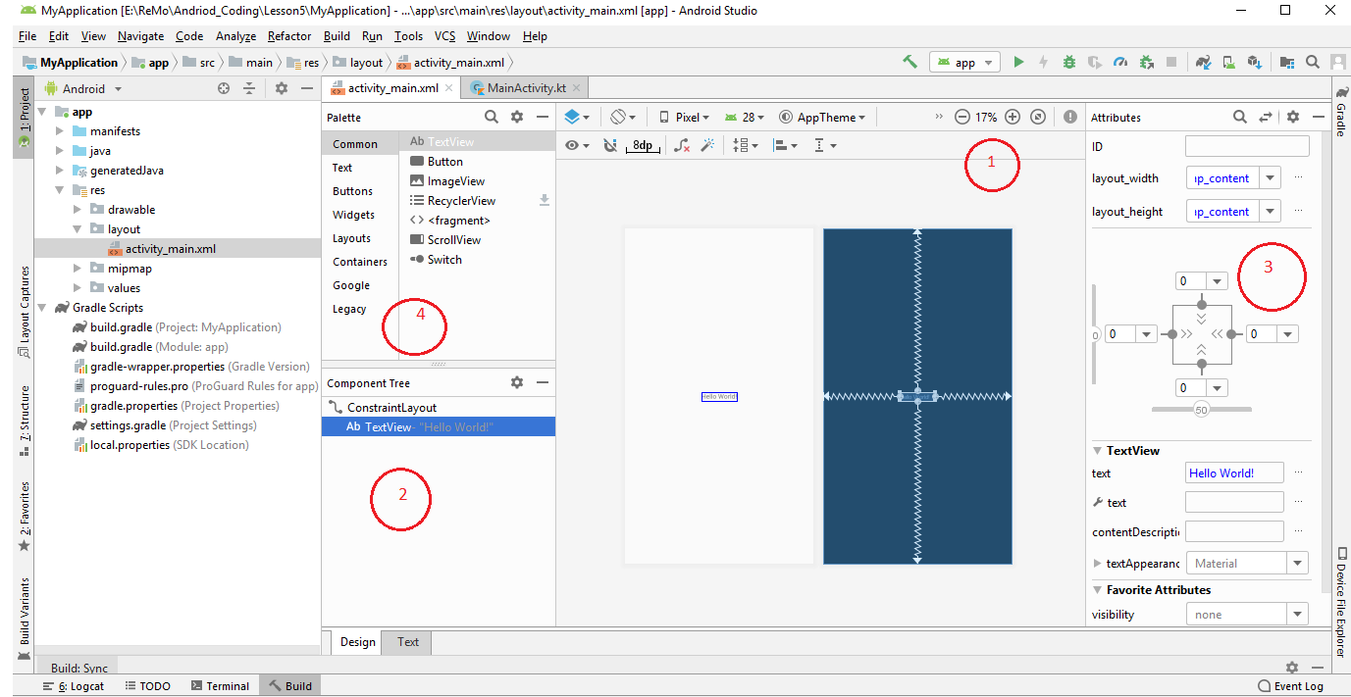
Design Editor - activity_main.xml
In the XML code, notice that the root element is <android.support.constraint.ConstraintLayout>. The root element contains a single <TextView> element.
+ and - buttons for zooming in and out, or click the Zoom to Fit Screen button (right of the zoom buttons) so that both panels fit reasonably on your screen.
Component Tree - This panel shows the hierarchy of views in your layout.
Properties Panel - This panel displays the attributes assigned to the currently selected component in the layout.
The Palette panel – It consists of two columns with the left-hand column containing a list of view component categories. The right-hand column lists the components contained within the currently selected category.

Slide 19
activity_main.xml
<?xml version="1.0" encoding="utf-8"?> <android.support.constraint.ConstraintLayout xmlns:android="http://schemas.android.com/apk/res/android" xmlns:tools="http://schemas.android.com/tools" xmlns:app="http://schemas.android.com/apk/res-auto" android:layout_width="match_parent" android:layout_height="match_parent" tools:context=".MainActivity"> <TextView android:layout_width="wrap_content" android:layout_height="wrap_content" android:text="Hello World!" app:layout_constraintBottom_toBottomOf="parent" app:layout_constraintLeft_toLeftOf="parent" app:layout_constraintRight_toRightOf="parent" app:layout_constraintTop_toTopOf="parent"/> </android.support.constraint.ConstraintLayout>
In the XML code, notice that the root element is
<android.support.constraint.ConstraintLayout>.
The root element contains a single <TextView> element.
We will discuss about Layout and changing properties in the next lesson.
Notes:
Activity_main.xml is a layout file.
XML is used to transfer data between multiple technologies.
The first line with url says that every xml file need to follow the XSD(XML Schema Definition)
Layout helps to organize the UI components.
Every UI component need to specify width and height
To Specify Width and Height use five parameters
match_parent - occupy the complete screen
Wrap_content - occupy the screen up to the content
Pixels –Specify in pixels
dps – It is the best choice it adjust according to the screen resolution
References
Taken in part or whole from http://developer.android.com/guide/components/activities.html

Slide 20
MainActivity.kt
package com.example.myapplication // Package name
// Need to import necessary libraries import android.support.v7.app.AppCompatActivity import android.os.Bundle
// Every Kotlin Activity extends from AppCompatActivity class class MainActivity : AppCompatActivity() {
// Must Override onCreate override fun onCreate(savedInstanceState: Bundle?) { super.onCreate(savedInstanceState) setContentView(R.layout.activity_main) } }
Notes:
An activity is a single screen in an application with some UI components. It is a Java File.
To create an Activity follow these steps
Create a class which extends Activity ( which import from andriod.app.Activity )
Usually in Java execution starts with main method() but in Android execution starts with onCreate(), so provide implementation for onCreate() method
By using setContentView() specify the XML file R.layout.activity_main.
References
Taken in part or whole from http://developer.android.com/guide/components/activities.html
By default if you create a new project MainActivity extends AppCompatActivity
AppCompatActivity is a class from v7 appcompat library. This is a compatibility library that back ports some features of recent versions of Android to older devices.

Slide 21
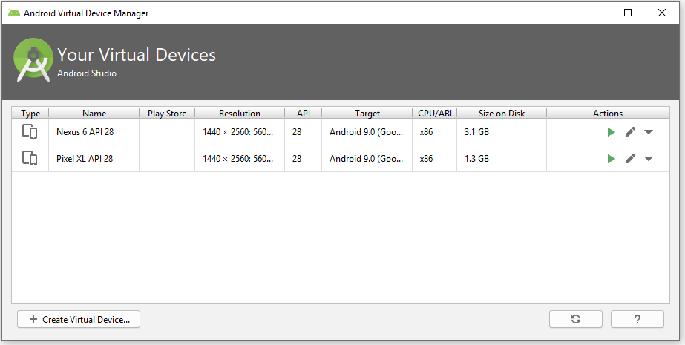
Open the Android Virtual Device Manager
The AVD Manager allows you to set up new AVDs, and view and edit ones you’ve already created.
Open it by selecting Tools menu and choosing AVD Manager.
To add an additional AVD, begin by clicking on the Create Virtual Device button in order to invoke the Virtual Device Configuration dialog as shown in next slide
Notes:
An Android Virtual Device (AVD) is a device configuration that is run with the Android emulator. It works with the emulator to provide a virtual device-specific environment in which to install and run Android apps.

Slide 22
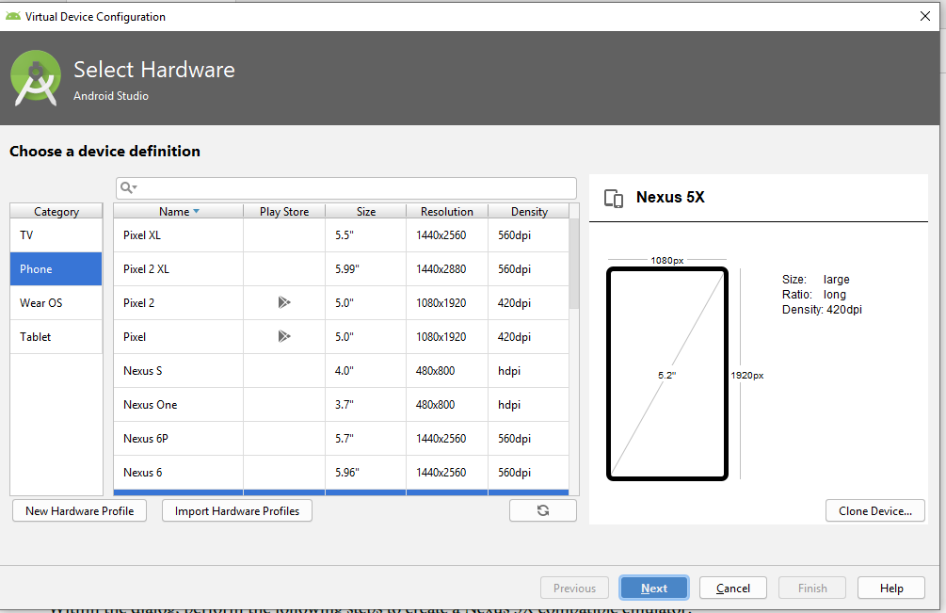
Open the Android Virtual Device Manager
Select the Device for Running App and click Next.
On the System Image screen, select the latest version of Android.
Click Next to proceed and enter a descriptive name (for example Nexus 5X API 26) into the name field or simply accept the default name.
Click Finish to create the AVD.
Notes:
An Android Virtual Device (AVD) is a device configuration that is run with the Android emulator. It works with the emulator to provide a virtual device-specific environment in which to install and run Android apps.

Slide 23
Running your App
You can now run the app on a real device or on an emulator.
Run on a Real Device, Set up your device as follows:
Connect your device to your development machine with a USB cable. If you're developing on Windows, you might need to install the appropriate USB driver for your device. For help installing drivers, see the https://developer.android.com/training/basics/firstapp/running-app.html#RealDevice
Enable USB debugging on your device by going to Settings > Developer options. Note: On Android 4.2 and newer, Developer options is hidden by default. To make it available, go to Settings > About phone/Tablet/Device and tap Build number seven times. Return to the previous screen to find Developer options.
Enable USB Debugging.
Run the app from Android Studio as follows:
In Android Studio, select your project and click Run from the toolbar.
In the Select Deployment Target window, select your device, and click OK.
Android Studio installs the app on your connected device and starts it.

Slide 24
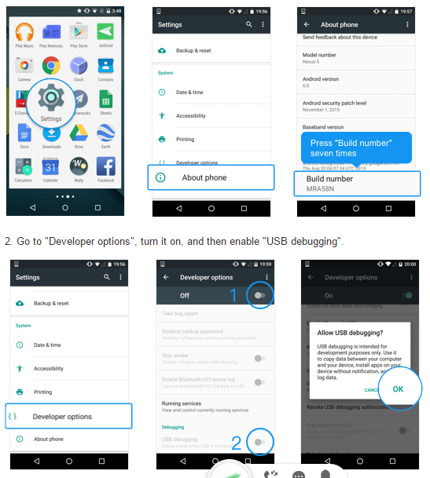
Running your App on Real Device Setup Screenshots

Slide 25
Running and Deploy your App
Choosing the Run option doesn’t just run your app. It also deals with all the preliminary tasks that are needed for the app to run:
Once you run your app an Android Application Package, or APK file, gets created. (Which is the installation file in Android for the OS)
The file includes the compiled Kotlin files, along with any libraries and resources needed by your app.
Once the emulator has been launched and the AVD is active, the APK file is uploaded to the AVD and installed.
The AVD starts the main activity associated with the app.
Notes:
The Kotlin source files get compiled to byte code.
An Android Application Package, or APK file, gets created. (Which is the installation file is Android for the OS)
The file includes the compiled Kotlin files, along with any libraries and resources needed by your app.
Assuming there’s not one already running, the emulator gets launched with the AVD.
Once the emulator has been launched and the AVD is active, the APK file is uploaded to the AVD and installed.
The AVD starts the main activity associated with the app.
Your app gets displayed on the AVD screen, and it’s all ready for you to test out.

Slide 26
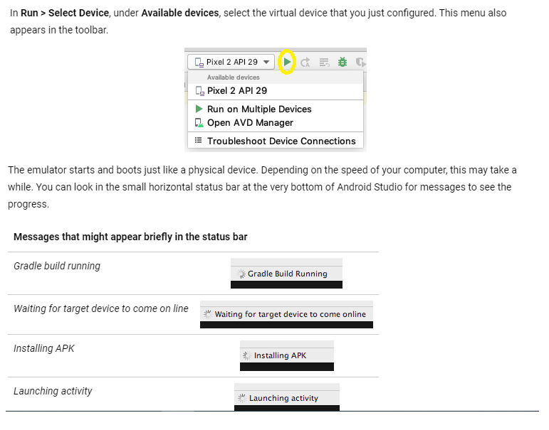
Running and Deploy App

Slide 27
Main Point 1
Learning Android programming is further growth in your programming knowledge to get a new experience of mobile programming. Science of Consciousness: Similarly experience is the practical basis of knowledge. With growth of experience, the abstraction of TC becomes more concrete.

Slide 28
Styles
A style is a collection of attributes that specify the look and format for a View or window.
A style can specify attributes such as height, padding, font color, font size, background color, and much more.
To create a set of styles, use style.xml file in the res/values/ directory of your project.
The root node of the XML file must be <resources>.
For each style you want to create, complete the following series of steps:
Add a <style> element to the file, with a name that uniquely identifies the style.
For each attribute of that style, add an <item> element, with a name that declares the style attribute. The order of these elements doesn't matter.
Add an appropriate value to each <item> element.

Slide 29
Example
<resources>
<!-- Base application theme. -->
<style name="AppTheme" parent="Theme.AppCompat.Light.DarkActionBar">
<!-- Customize your theme here. -->
<item name="colorPrimary">@color/colorPrimary</item>
<item name="colorPrimaryDark">@color/colorPrimaryDark</item>
<item name="colorAccent">@color/colorAccent</item>
</style>
<!-- Customized My Style-->
<style name="MyStyle">
<item name="android:layout_height"> wrap_content</item>
<item name="android:layout_width">match_parent</item>
<item name="android:textSize">30sp</item>
<item name="android:textColor">#673AB7</item>
<item name="android:background">#F5C4D6</item>
</style>
</resources>
Notes:
SP stands for scale-independent pixels, Use sp for text size, because it is scaled by the user’s font size preference.
dp or dip stands for density-independent pixels, use dp for everything else other than text size.

Slide 30
Styles reference in activity_main.xml
<Button
android:text=" My Style Button"
style="@style/MyStyle">
</Button>
<TextView
android:text="Empty"
style="@style/MyStyle">
</TextView>

Slide 31
Example of Styles.xml
<resources> <!-- Base application theme. --> <style name="AppTheme" parent="Theme.AppCompat.Light"> <!-- Customize your theme here. --> <item name="colorPrimary">@color/colorPrimary</item> <item name="colorPrimaryDark">@color/colorPrimaryDark</item> <item name="colorAccent">@color/colorAccent</item> </style> </resources>
To Change the Theme of your Layout
<style name="AppTheme" parent="Theme.Material">

Slide 32
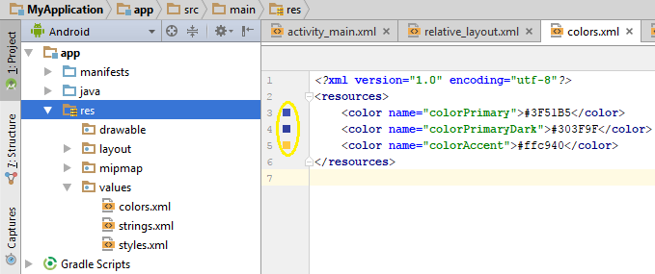
colors.xml
Android uses standard RGB (red, green and blue) color model. Each primary color value is usually represented by hexadecimal number.
At the beginning of such a color definition you must put a pound character (#).
Color used in the layout xml file is maintained in the color.xml
Example
To change the assigned color click the Squared colors

Slide 33
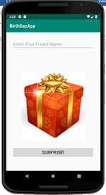
Hands on Example - BirthdayWishApp
BirthDayWishApp contains
LinearLayout – To organize the components
EditText – To enter to whom you want wish
TextView – To show the Birthday wish Message
ImageView – To show the Giftbox
Button – Once the user click the SURPRISE button, you will get the Birthday Message with the given friend name appeared on the TextView and the giftbox will show the gift.
Space – To provide space between components
This app will explain how to handle the click events.

Slide 34
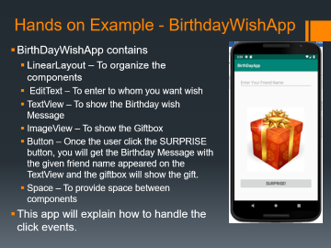

Event Handlers
Methods that do something in response to a click
A method, called an event handler, is triggered by a specific event and does something in response to the event
Handle the Click event in two ways
In XML way
In Java way
XML Way
Configure the following attribute to the UI component
android:onClick=“method_name”
android:id="@+id/idname"
If you click the button, it will invoke the specified method from Kotlin code. You have to specify your action in code by creating inside MainActiviity.kt
fun method_name(view : View) {//Implementation}
If the method is not available, it will throw java.lang.IllegalStateException: Could not find method
View is the parent class for all UI Group and components, by using this object you can call objects from xml.

Slide 35
activity_main.xml
<?xml version="1.0" encoding="utf-8"?>
<LinearLayout
xmlns:android="http://schemas.android.com/apk/res/android"
xmlns:tools="http://schemas.android.com/tools"
xmlns:app="http://schemas.android.com/apk/res-auto"
android:layout_width="match_parent"
android:layout_height="match_parent"
android:orientation="vertical"
android:layout_margin="8dp"
android:padding="20dp"
tools:context=".MainActivity">
<EditText
android:id="@+id/name"
android:layout_width="match_parent"
android:layout_height="wrap_content"
android:textSize="20sp"
android:hint="Enter Your Friend Name"/>
<Space android:layout_width="match_parent"
android:layout_height="30dp"/>

Slide 36
activity_main.xml
<TextView
android:id="@+id/msg"
android:textSize="25sp"
android:layout_width="match_parent"
android:layout_height="wrap_content"/>
<Space android:layout_width="match_parent"
android:layout_height="30dp"/>
<ImageView
android:id="@+id/image"
android:layout_width="300dp"
android:layout_height="300dp"
android:src="@drawable/giftbox"
android:layout_gravity="center" />
<Space android:layout_width="match_parent"
android:layout_height="30dp"/>
<Button
android:id="@+id/button"
android:text="Surprise!"
android:textSize="20sp"
android:onClick="click"
android:layout_width="match_parent"
android:layout_height="wrap_content"/>
</LinearLayout>
Note : The highlighted id can refer directly in Kotlin code by importing import kotlinx.android.synthetic.main.activity_main.* in your activity

Slide 37
Handling Event XML Way - MainActivity.kt
class MainActivity : AppCompatActivity() {
override fun onCreate(savedInstanceState: Bundle?) {
super.onCreate(savedInstanceState)
setContentView(R.layout.activity_main)
}
/* Button click event implementation - XML Way
android:onClick="click“. It is the function name should use in Kotlin
code to perform event click*/
fun click(view : View){
// Change the Label Text
msg.text = "Happy BirthDay Dear ${name.text}!"
// Change the ImageView dynamically
image.setImageResource(R.drawable.gift)
}
}

Slide 38
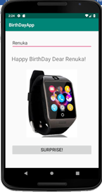
Running the App
Before Clicking After Clicking
SURPRICE Button. SURPRICE Button.
Type your Friend Name

Slide 39
findViewById
findViewById(int id) is very useful function to access or update properties of Views. Views are LinearLayout, TextView, Button, EditText, ImageView etc. To find a view programmatically, should have been set with an id in the layout xml file
<ImageView
android:id="@+id/image"
android:layout_width="300dp"
android:layout_height="300dp"
android:src="@drawable/giftbox"
android:layout_gravity="center" />
Inside your Kotlin code
var image = findViewById<ImageView>(R.id.image)
image.setImageResource(R.drawable.gift)
In Kotlin you may skip and not use the findViewById( ) and still be able to refer to UI components defined in XML Layout file by Import the data binding library into the Kotlin file (import kotlinx.android.synthetic.main.activity_main.* in your activity)
Get the reference to the view and use that reference to access its properties

Slide 40
Handling Event Kotlin Way - MainActivity.kt
class MainActivity : AppCompatActivity() {
override fun onCreate(savedInstanceState: Bundle?) {
super.onCreate(savedInstanceState)
setContentView(R.layout.activity_main)
// Set a Click Listener for the button
button.setOnClickListener {
// Change the Label Text
msg.text = "Happy BirthDay Dear ${name.text}!"
// Change the ImageView dynamically
image.setImageResource(R.drawable.gift)
}
}
}

Slide 41
Summary Points
A typical Android app is comprised of activities, layouts, and resource files.
Layouts describe what your app looks like. They’re held in the app/src/main/res/layout folder.
Activities describe what your app does, and how it interacts with the user. The activities you write are held in the app/src/main/java folder.
strings.xml contains string name/value pairs. It’s used to separate out text values from the layouts and activities and supports localization.
AndroidManifest.xml contains information about the app itself. It lives in the app/src/main folder.
An AVD is an Android Virtual Device. It runs in the Android emulator and mimics a physical Android device.
An APK is an Android application package. It’s like a JAR file for Android apps, and contains your app bytecode, libraries, and resources. You install an app on a device by installing the APK.
Android apps run in separate processes using the Android runtime (ART).
RelativeLayout is used to place GUI components in relative positions in a layout.
The TextView element is used for displaying text.

Slide 42
Main Point 2
XML in Android allows developers to create user interface that are rich in content and functionality with the help of styles, colors and event handling. The ultimate provider of tools for the creation of beautiful and functional content in manifest existence is pure intelligence itself; all creativity arises from this field’s self-interacting dynamics.

