Slide 1


MAJOR’S HUMAN RESOURCE MANAGEMENT SYSTEM
Supervisor: Lai Duc Hung

Slide 2
Team member
1. Ho Truc Mai (Leader)
2. Tang Nguyen Thanh Gia
3. Do Luong Tai

Slide 3
Outline
1. Introduction
2. Our Approach
3. Outcome

Slide 4
1. INTRODUCTION

Slide 5


Business
1. Introduction

Slide 6




Business
Receive CVs
Filter CVs
Interview
Track recruitment progress
1. Introduction

Slide 7



Business
Native teacher
Quality Supervisor
AC
1. Introduction

Slide 8
Problem

Slide 9


Problem
1. Introduction

Slide 10


Problem
Time consuming
Error
1. Introduction

Slide 11
Solution

Slide 12


Generality
Manage recruitment
MHRM System
Manage quality
1. Introduction

Slide 13




Supportive Feature
Sort CV
Send mail
Manage recruitment progress
Sum up AC Evaluation
1. Introduction

Slide 14
Role
No. | Role
1 | HR Supervisor
2 | Quality Supervisor
3 | Recruitment Consultant
4 | Compliance Officer
5 | Teacher
6 | AC
7 | Recruiting Teacher
8 | Admin
1. Introduction

Slide 15












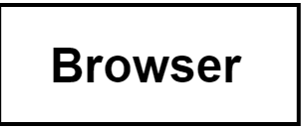





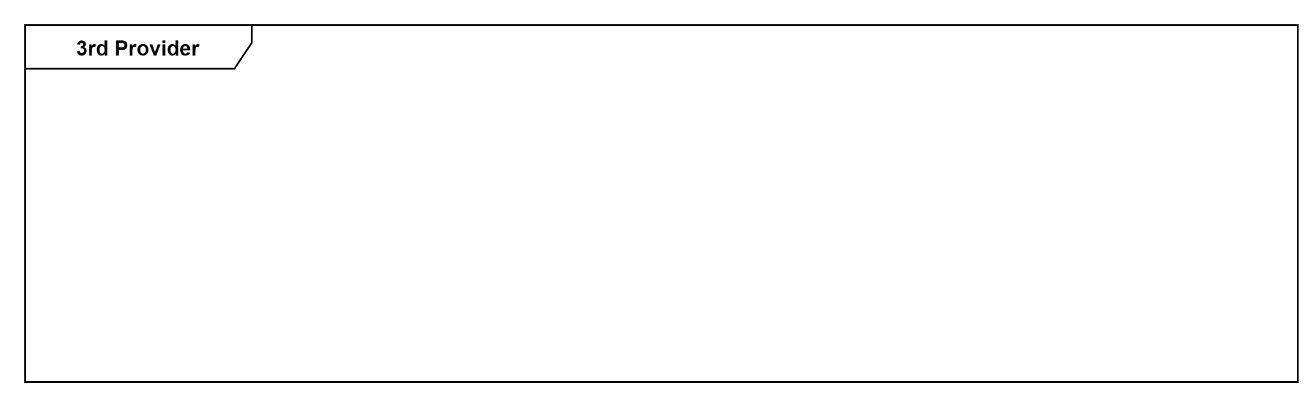



Architecture
Click URL
1. Introduction

Slide 16
2. OUR APPROACHES

Slide 17
Manage Recruitment

Slide 18




Supportive flow – Send mail
Firebase Storage
Email
Send button
Login button
Login Form
2. Our Approach

Slide 19




Main flow – Create CV
(If any)
Create CV
Submit button
Firebase Storage
Successful message
File’s URL
Database
2. Our Approach

Slide 20



Main flow – Accept new CV
Submit button
Profile
Accept button
Interview info
(Option)
Successful message
Send mail flow
2. Our Approach

Slide 21


Main flow – Approve waiting CV
Submit button
Profile
Approve button
Deadline info
Successful message
Send mail flow
Account
2. Our Approach

Slide 22

Main flow – Deny waiting CV
Profile
Deny button
Send mail flow
Successful message
2. Our Approach

Slide 23


Main flow – Update recruitment progress
Progress form
Update button
Successful message
2. Our Approach

Slide 24


Main flow – Update progress image
Image
Submit button
Firebase Storage
Successful message
Database
File’s URL
2. Our Approach

Slide 25
Main flow – Create expense
(If any)
Expense Info
Submit button
Firebase Storage
Database
File’s URL
Successful message
2. Our Approach

Slide 26
Demo
2. Our Approach

Slide 27
Manage Quality

Slide 28

AC’s Evaluation
22th per month
12 days
Evaluation Form
Quality Supervisor
Evaluation Form
AC
Native teacher
2. Our Approach

Slide 29
Main flow – Teacher Submit Evaluation
Evaluation Form
Submit button
Successful message
2. Our Approach

Slide 30
Main flow – QS Submit Evaluation
Evaluation Form
Submit button
Email
Successful message
2. Our Approach

Slide 31
Teacher’s KPI
Quality Supervisor
KPI Form
Native teacher
2. Our Approach

Slide 32
Main flow – Update KPI
KPI Form
Update button
Successful message
2. Our Approach

Slide 33
Main flow – Submit KPI
KPI Form
Submit button
Email
Successful message
2. Our Approach

Slide 34
Demo
2. Our Approach

Slide 35
3. OUTCOME

Slide 36


Limit
1 image/time
1 image/expense (progress)
Reminder function
3. Outcome

Slide 37


Future Plans
Mobile app
Multiple images
3. Outcome

Slide 38
Q&A

