Slide 1
OpenAI Build Week · Demo
SingLink
Project & code
hachi-mori
A word becomes a song.
Notes:
日本語には、きらきらのような音を表す言葉がたくさんあります。便利で楽しい言葉ですが、単語の一覧だけでは覚えにくいことがあります。
Narration: Japanese has many sound words, such as kira-kira for sparkling. They are useful and fun, but they can be hard to remember from a list.

Slide 2
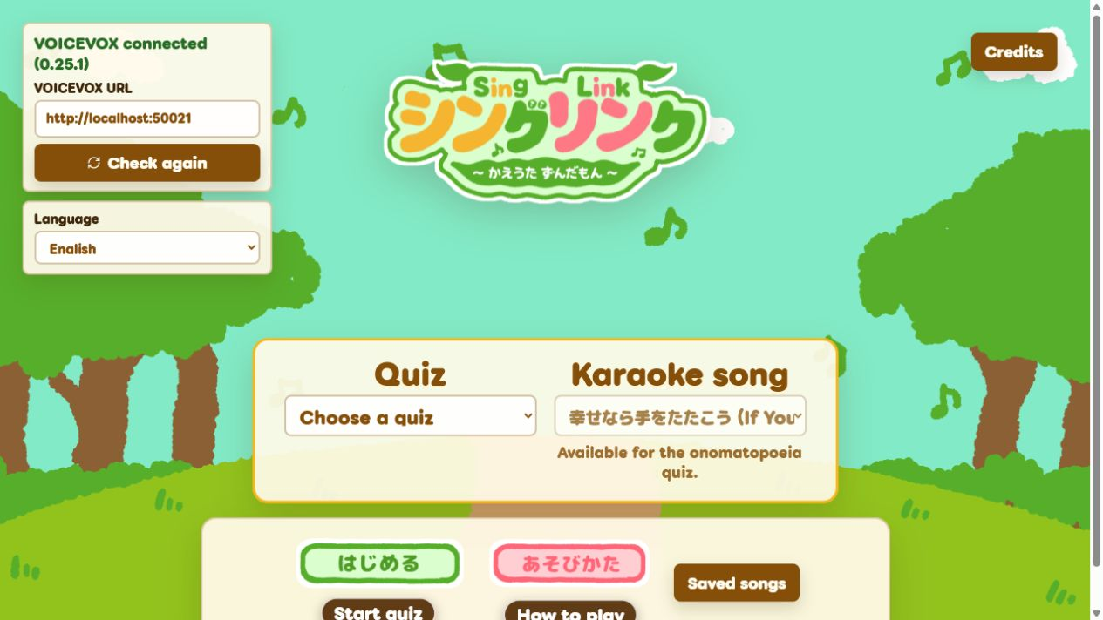
Quiz first. Sing next.
1 Choose one of five melodies
2 Answer four short questions
3 Hear the correct sentences as karaoke
Notes:
SingLinkは、日本語の音を表す言葉を短いクイズとカラオケ体験に変えます。5曲から選び、4問に答えます。
Narration: SingLink turns these words into a short quiz and karaoke experience. First, you choose one of five familiar melodies. Then you answer four Japanese questions.

Slide 3
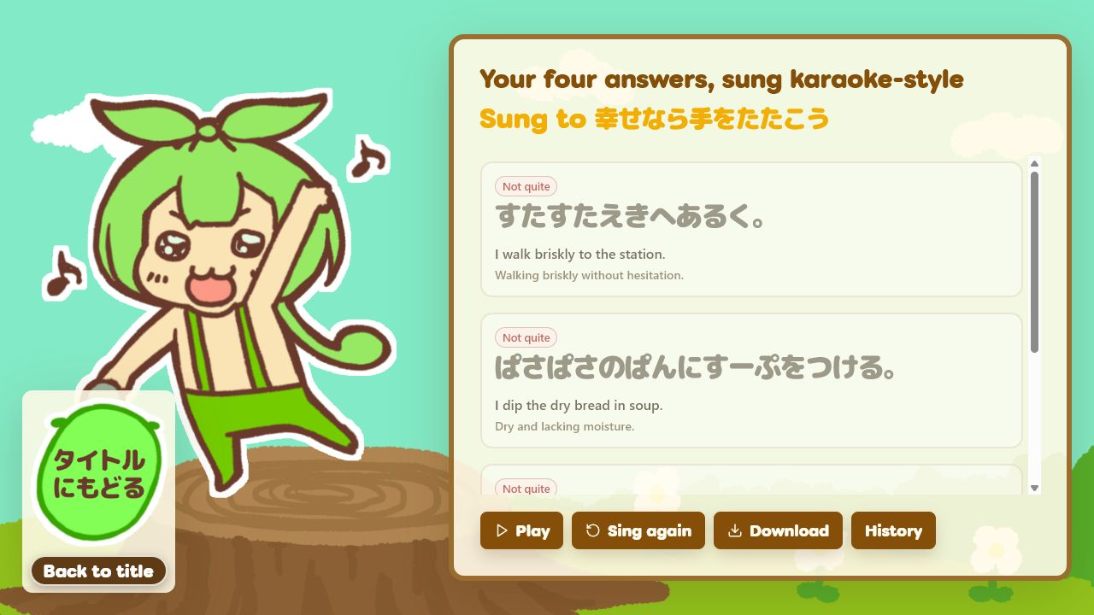
Learn by singing.
Japanese lyrics light up with each note.
Lyrics
Four correct sentences become one short song.
English meaning
stays visible.
Karaoke result
Meaning
Notes:
クイズの後、ずんだもんが4つの正しい文を歌います。日本語の歌詞がメロディーに合わせて光り、英語字幕が意味を説明します。
Narration: After the quiz, Zundamon sings the four correct sentences. The Japanese lyrics light up with the melody, and English subtitles explain the meaning.

Slide 4
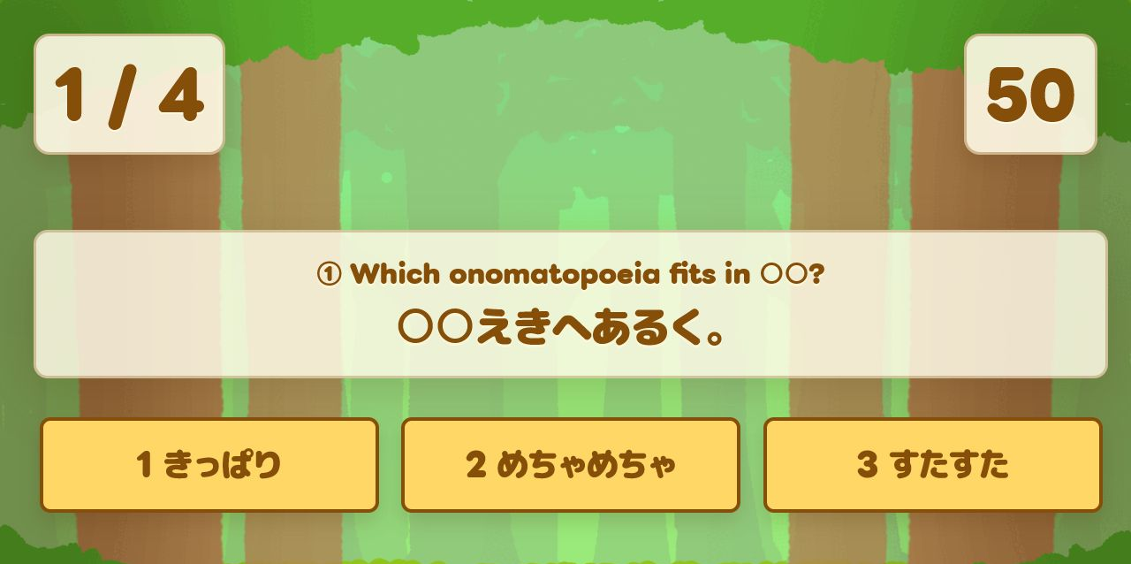
Built during OpenAI Build Week
New Web learning features, tested during Build Week
335 learning records
Original examples and meanings
Singing readings
English interface and subtitles
Five melody choices
Score-note timing for karaoke
Notes:
Build Week中に、335件の学習データ、英語UIと字幕、5曲、Scoreの音符に基づく同期処理をWebへ実装しました。
Narration: During OpenAI Build Week, I rebuilt important parts for the Web. I prepared 335 learning records with original examples, meanings, singing readings, and English support. I also added a responsive English interface, five melody choices, and timing based on the notes in the score.

Slide 5
A demo with no setup
PUBLIC DEMO
Fixed four questions
Pre-generated singing
Works on GitHub Pages
NORMAL MODE
Four random questions
Creates a song from the correct sentences
Windows + VOICEVOX
Notes:
公開デモは固定4問と事前生成音声を使い、準備なしで試せます。通常モードはローカルWindowsとVOICEVOXを使って新しい歌を生成します。
Narration: Judges can open a fixed demo on GitHub Pages with no setup. It uses four fixed questions and one pre-generated singing sample. Normal mode is different. It creates a new song from random quiz answers on a local Windows computer with VOICEVOX.

Slide 6
How Codex helped
Study the earlier app
Move score logic to the Web
Check 335 learning records
Build the English experience
Test timing, layout, and demo flow
Final learning, design, and publishing decisions: hachi-mori
Notes:
CodexとGPT-5.6は、旧アプリ調査、Web移植、データ確認、英語機能、テストを支援しました。最終判断はhachi-moriが行いました。
Narration: I used Codex and GPT-5.6 to study the old app, move the score logic to the Web, check the learning data, build the English features, and test the result. I made the final learning, design, and publishing decisions.

Slide 7
Try SingLink
Words + sound + meaning, connected by karaoke.
Public fixed demo
hachi-mori.github.io/
SingLink-Parody-Song-Maker/
openai-build-week/?demo=1
VOICEVOX:ずんだもん | Art: Ryotsu
Project, score & accompaniment: hachi-mori
Font: Futehodo Maru Gothic (SIL OFL 1.1)
Notes:
SingLinkは、カラオケを通じて日本語の言葉、音、意味をつなぎます。画面のリンクから公開デモを試せます。
Narration: SingLink connects Japanese words, sound, and meaning through karaoke. It gives learners one more way to repeat and remember. You can try the public demo from the link on screen.

