Slide 1

Project Title -
SEASONAL AGRICULTURE PERFORMANCE ANALYSIS
Chinmai H A
Jawaharlal Nehru National College Of Engineering
STU696848f0938c91768442096

Slide 2

PROBLEM STATEMENT
Agricultural performance varies across seasons due to differences in:
Environmental conditions
Farming practices
Resource availability
Agricultural activities
Market conditions
However, raw agricultural data does not clearly reveal these seasonal patterns.

Slide 3
Project Description
This project analyses agricultural data across Kharif, Rabi and Zaid seasons to understand differences in agricultural performance.
The analysis focuses on:
Crop yield and production
Water usage and water efficiency
Revenue and profit
Environmental conditions
Disease and pest risk
Regional and crop-level variations
Python-based data analytics techniques were used for data cleaning, exploratory analysis, visualization, correlation analysis and seasonal comparison.

Slide 4

WHO ARE THE END USERS?
Farmers-
To understand seasonal performance and resource usage.
Agricultural Departments-
To support seasonal planning and resource management.
Agricultural Researchers-
To identify patterns and relationships in agricultural data.
Data Analysts-
Analyse agricultural trends and performance indicators.
Agricultural Planners-
To support evidence-based seasonal decision-making.

Slide 5

Technology Used
Technology | Purpose
🐍 Python | Data analysis
🐼 Pandas | Data manipulation
🔢 NumPy | Numerical operations
📊 Matplotlib | Visualization
📈 Seaborn | Statistical visualization
📐 SciPy | Statistical analysis
📓 Google Collab / Jupyter | Notebook-based analysis
💻 GitHub | Project and notebook storage

Slide 6
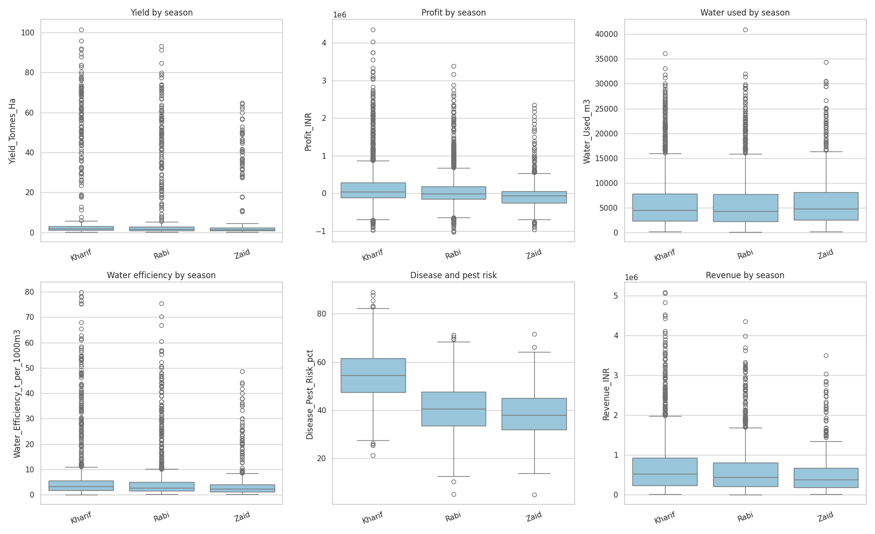
RESULTS: Overall Seasonal Performance

Slide 7
RESULTS-Seasonal Performance Comparison
Key Observations
Yield: Kharif shows a higher central tendency than Rabi and Zaid.
Profit: Kharif generally shows stronger profit performance, while Rabi and Zaid have lower central values.
Water Usage: Water consumption varies across seasons, with substantial variation and many high-value observations.
Water Efficiency: Seasonal distributions are similar at the central level but contain several high-efficiency observations.
Disease & Pest Risk: Kharif has the highest central risk level among the three seasons.
Revenue: Kharif shows the highest central revenue, with considerable variation across observations.

Slide 8
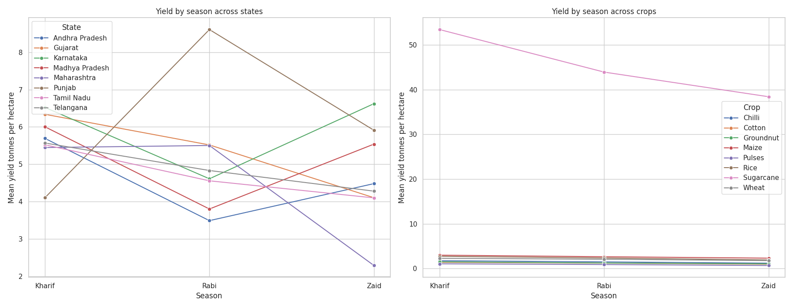
RESULTS-Regional Analysis

Slide 9
RESULTS-Regional Yield Variation (Left Graph)
Key observations:
Seasonal performance is not consistent across all states.
Some states show increased yield during Rabi.
Some states perform better during Zaid.
Punjab shows a strong increase in Rabi yield.
Karnataka shows a notable increase in Zaid yield.
Maharashtra shows a substantial decline in Zaid yield.
This indicates that seasonal performance depends on regional conditions.

Slide 10
RESULTS-Crop-wise Yield Comparison(Right Graph)
Key observations:
Sugarcane has substantially higher mean yield than the other crops.
Most other crops show relatively smaller seasonal variations.
Crop performance differs across Kharif, Rabi and Zaid.
Some crops show a gradual decline across seasons.
Seasonal patterns are therefore crop-dependent.

Slide 11
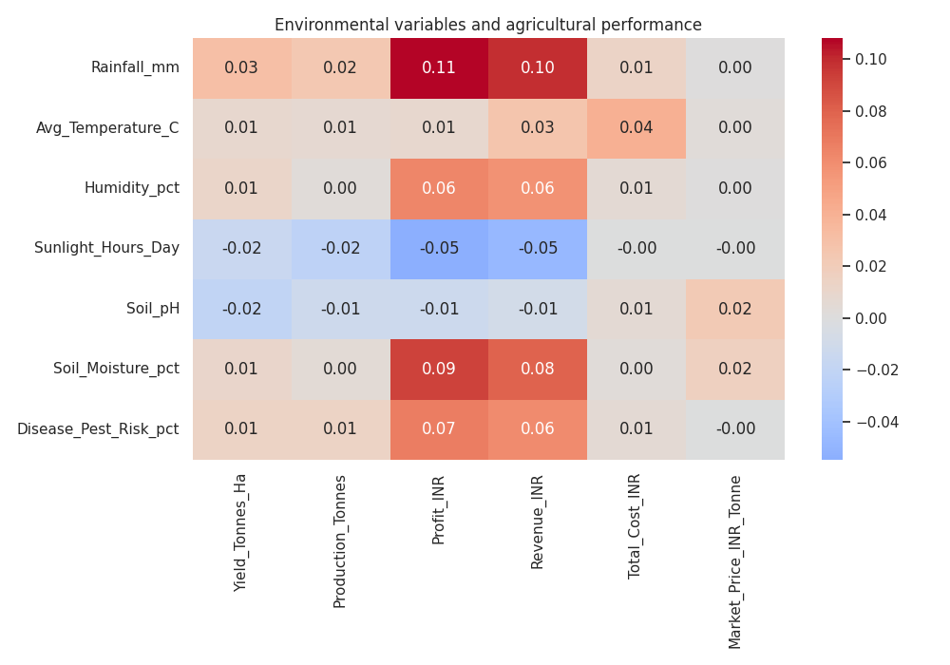
RESULTS-Environmental Factors

Slide 12
RESULTS-Environmental Factors & Agricultural Performance
Correlation analysis was used to examine relationships between environmental variables and agricultural outcomes.
Important observations:
Rainfall shows a positive but weak relationship with profit and revenue.
Soil moisture shows a positive relationship with profit and revenue.
Disease and pest risk shows a weak positive relationship with profit and revenue.
Sunlight hours show a weak negative relationship with yield and production.
Most environmental variables have weak correlations with agricultural performance.
Correlation indicates association, not causation.

Slide 13
Future scope
Develop machine learning models to predict crop yield.
Incorporate detailed weather and climate data.
Develop models for optimizing water usage.
Perform more detailed district-level analysis.
Build interactive dashboards for agricultural monitoring.
Develop models for predicting revenue and profitability.
Develop early-warning systems for disease and pest risks.
Create farmer-friendly decision-support applications.

Slide 14
GitHub Link
hachinmai25-dot/seasonal-agriculture-performance

Slide 15
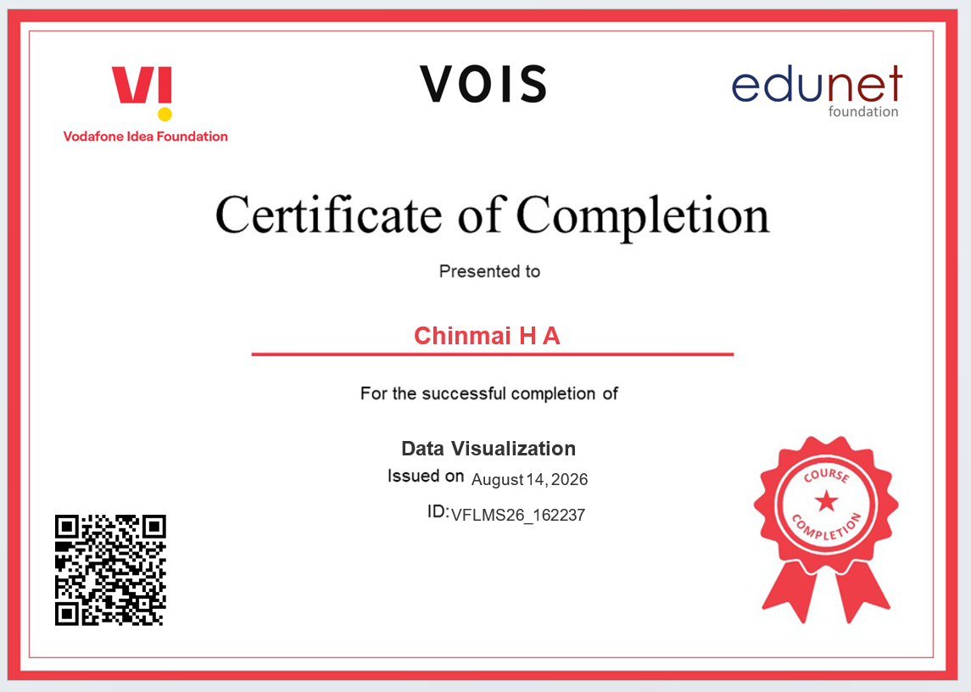
VOIS Course completion certificate - Course name- Data Visualization

Slide 16
Thank you
.
.

