Slide 1
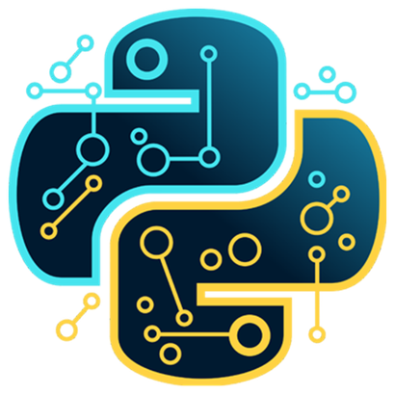

Data Science
with Python
Course Curriculum
Module 1: Introduction to Data Science & Python
What is Data Science and its business applications
Data Science lifecycle and workflow
Introduction to Python programming
Setting up Python environment (Anaconda, Jupyter Notebook)
Python basics: Variables, Data Types, Operators
Control Statements and Loops
Module 2: Python for Data Handling
Functions and Moduls
Lists, Tuples, Sets, Dictionaries
File Handling in Python
Exception Handling
Introduction to NumPy
Array operations and mathematical functions
Module 3: Data Manipulation with Pandas
Introduction to Pandas DataFrames
Data Loading (CSV, Excel, JSON)
Data Cleaning and Preprocessing
Handling Missing Values
Filtering, Grouping, and Aggregation
Data Transformation Techniques

Slide 2
Data Science
with Python
Module 4: Data Visualization & Exploratory Data Analysis (EDA)
Introduction to EDA
Data Visualization using Matplotlib
Visualization with Seaborn
Univariate and Bivariate Analysis
Correlation and Pattern Identification
Business Insight Generation
Module 5: Statistics for Data Science
Descriptive Statistics
Probability Concepts
Probability Distributions
Hypothesis Testing
Correlation and Regression Basics
Module 6: Machine Learning – Supervised Learning
Introduction to Machine Learning
Regression (Linear & Multiple Regression)
Classification (Logistic Regression, KNN, Decision Trees)
Model Evaluation Metrics
Overfitting & Underfitting
Cross-Validation Techniques

Slide 3
Data Science
with Python
Module 7: Machine Learning – Unsupervised Learning
Clustering (K-Means, Hierarchical Clustering)
Dimensionality Reduction (PCA)
Association Rule Mining
Real-world Use Cases
Module 8: Advanced Machine Learning Concepts
Feature Engineering
Hyperparameter Tuning
Ensemble Methods (Random Forest, Gradient Boosting)
Model Optimization Techniques
Module 9: Model Deployment & Real-Time Applications
Introduction to Model Deployment
Saving and Loading Models (Pickle/Joblib)
Building Simple Web App with Flask/Streamlit
GitHub Project Deployment
End-to-End Project Workflow
Module 10: Live Projects – Real-Time Industry Use Cases
Sales Prediction Model
Customer Churn Prediction
Credit Risk Analysis
Sentiment Analysis Project
Business Dashboard Creation

