Slide 1
From Invenio 1 to Invenio 2
Case Study
of
BibKnowledge
Created by Leonardo Rossi (@hachreak)

Slide 2
From Invenio 1 to Invenio 2
Summary
Introduction
Use the “Divide et impera” concept
how to split the module in all its aspects:
From SQL to Model
Upgrade's recipes
Refactoring API
REST API
Forms
Admin interface
User's web interface
Documentation
Test the new code

Slide 3
Introduction
Invenio
access
authorlist
circulation
converter
access
deposit
encoder
messages
pages
redirector
statistics
scheduler
access
authorlist
circulation
converter
access
knowledge
upgrader
accounts
author
profiles
classifier
dashboard
webhooks
exporter
jsonalchemy
multimedia
pdfchecker
refextract
pidstore
submit
uploader
…
alerts
authors
cloud
connector
baskets

Slide 4
Introduction
Invenio
access
authorlist
circulation
converter
access
deposit
encoder
messages
pages
redirector
statistics
scheduler
access
authorlist
circulation
converter
access
knowledge
upgrader
accounts
author
profiles
classifier
dashboard
webhooks
exporter
jsonalchemy
multimedia
pdfchecker
refextract
pidstore
submit
uploader
…
alerts
authors
cloud
connector
baskets

Slide 5
From Legacy to Module v2.0
“In the beginning was the legacy code”
invenio/legacy/bibknowledge/
100%
invenio/module/knowledge/
0%
Conceptually the process is like “communicating vessels”....

Slide 6
From Legacy to Module v2.0
Then, Legacy transition to “module v2.0”
invenio/legacy/bibknowledge/
70%
adminlib.py
admin.py
webinterface.py
Functionality
invenio/module/knowledge/
30%

Slide 7
From Legacy to Module v2.0
Then, Legacy transition to “module v2.0”
invenio/legacy/bibknowledge/
30%
Note: the legacy code
use our new module.
adminlib.py
admin.py
webinterface.py
invenio/module/knowledge/
70%

Slide 8
From Legacy to Module v2.0
In the end, only “module v2.0” survive
invenio/legacy/bibknowledge/
0%
invenio/module/knowledge/
100%

Slide 9
Stack
Visual representation of a module
REST API
Admin
Views
Docs
Tests
Forms
API
Model
Upgrade recipes

Slide 10
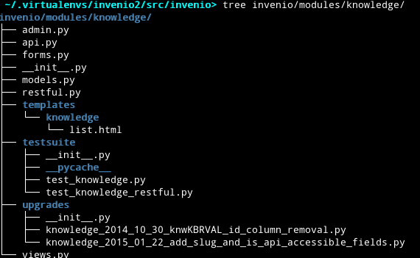
From Legacy to Module v2.0
How a module is composed?
Admin UI with Flask-Admin
API accessible from outside
All your defined WTForms
SQLALchemy models
REST API implementation
Jinja2 templates
Testsuites
Upgrade recipes
User Interface

Slide 11
Stack
Visual representation of a module
REST API
Admin
Views
Docs
Tests
Forms
API
Model
Upgrade recipes

Slide 12
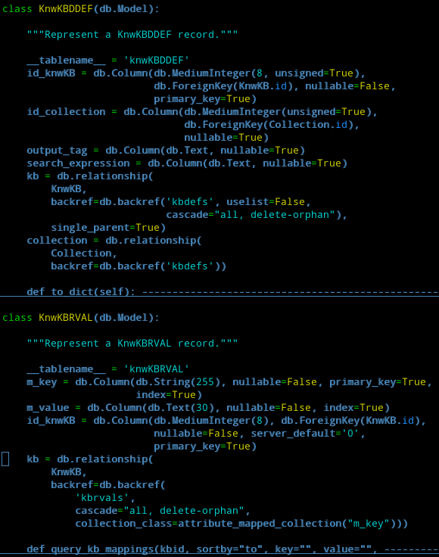
From RAW SQL to SQLAlchemy
From
run_sql()
To
models.py
Why?
Independence from the DB server.
More easy to develop and maintain.
How?
Generating the model (Alembic can help you) and refine it.
For any SQL, we need to replace it with SQLAlchemy ORM equivalente.

Slide 13
Stack
Visual representation of a module
REST API
Admin
Views
Docs
Tests
Forms
API
Model
Upgrade recipes

Slide 14
How to write upgrade's recipes
Old data model vs New model
how to upgrade your database in production environment without break it?
- old Database
+ new Model
-----------------------
= upgrade recipe
Alembic is a database migrations tool
It helps you to write python code to upgrade the database.

Slide 15
Stack
Visual representation of a module
REST API
Admin
Views
Docs
Tests
Forms
API
Model
Upgrade recipes

Slide 16
Refactoring API: re-implement and deprecate.
What we want?
Each request have to pass from the api (no direct access to models).
Respect the old API (backward compatibility)
Meanwhile refactoring: deprecate not useful code and implement a new cool API.
API
Models
Input
Output
Black Box

Slide 17

Refactoring API: re-implement and deprecate.
What we want?
Each request have to pass from the api (no direct access to models).
Respect the old API (backward compatibility)
Meanwhile refactoring: deprecate not useful code and implement a new cool API.
API
Models
Input
Output
Black Box

Slide 18
Refactoring API: re-implement and deprecate.
What we want?
Each request have to pass from the api (no direct access to models).
Respect the old API (backward compatibility)
Meanwhile refactoring: deprecate not useful code and implement a new cool API.
API
Models
Input
How?
Output
Black Box

Slide 19
Refactoring API: re-implement and deprecate.
What we want?
Each request have to pass from the api (no direct access to models).
Respect the old API (backward compatibility)
Meanwhile refactoring: deprecate not useful code and implement a new cool API.
API
Models
Input
How?
Output
TEST, TEST ,TEST
Black Box

Slide 20
Stack
Visual representation of a module
REST API
Admin
Views
Docs
Tests
Forms
API
Model
Upgrade recipes

Slide 21
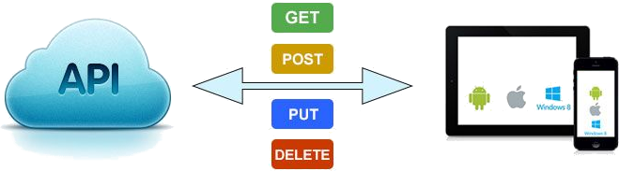
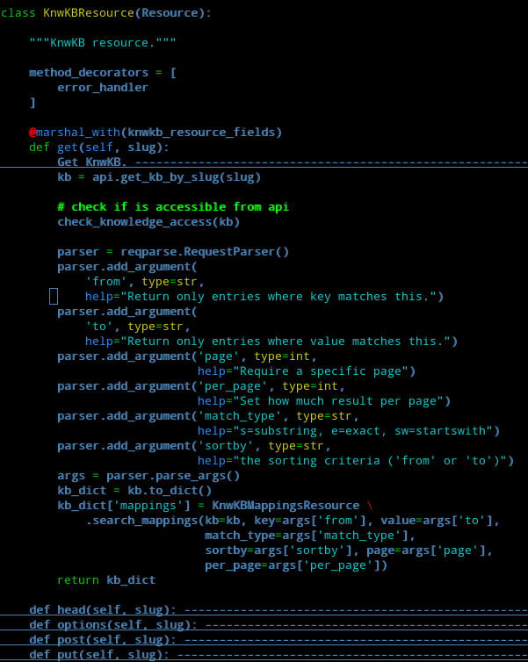
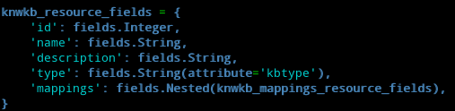
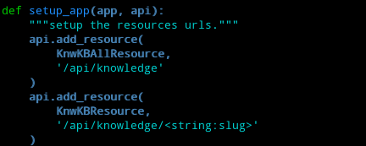
Write REST API
Define a resource
Define the object structure
Define the endpoints

Slide 22
Stack
Visual representation of a module
REST API
Admin
Views
Docs
Tests
Forms
API
Model
Upgrade recipes

Slide 23
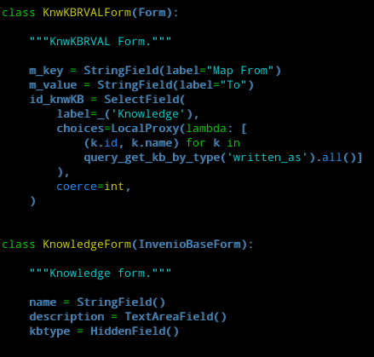
Write forms with WTForms
WTForms
A flexible forms validation and rendering library for Python

Slide 24
Stack
Visual representation of a module
REST API
Admin
Views
Docs
Tests
Forms
API
Model
Upgrade recipes

Slide 25
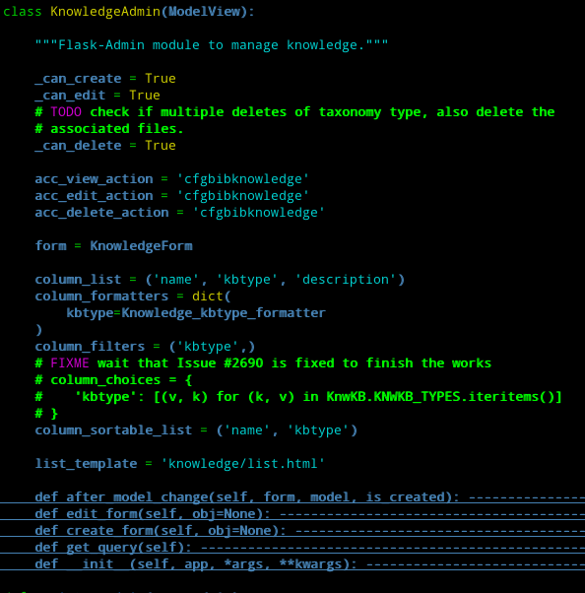
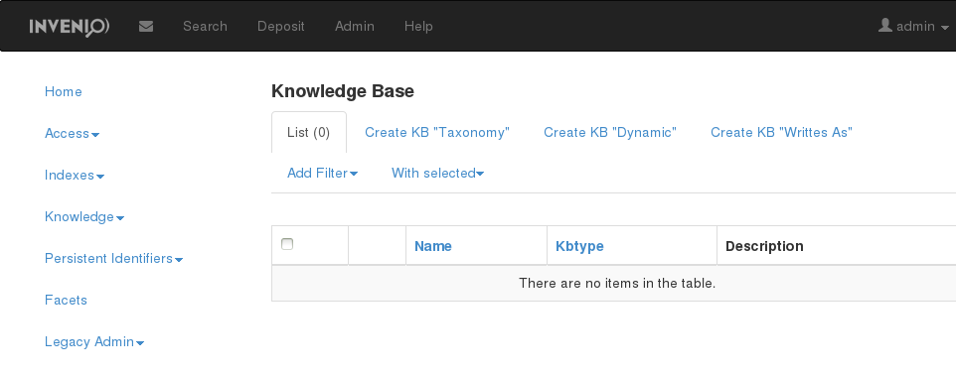
The Admin interface with Flask-Admin
Easy to extend admin interface through “hooks”.
Admin interface for Knowledge

Slide 26
Stack
Visual representation of a module
REST API
Admin
Views
Docs
Tests
Forms
API
Model
Upgrade recipes

Slide 27
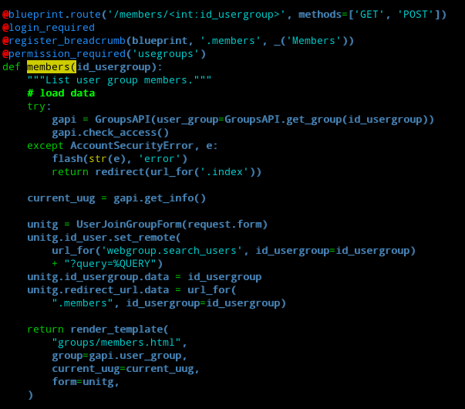
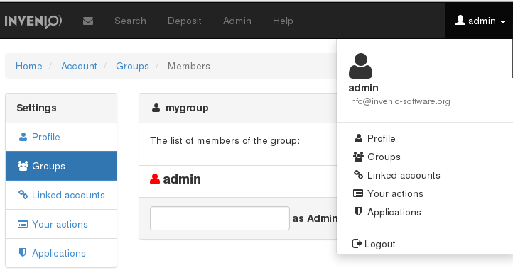
User's web interface with Jinja templates
.. but, if you need also a “normal” web interface?
Endpoint & params
Your template
The objects passed to the template

Slide 28
Stack
Visual representation of a module
REST API
Admin
Views
Docs
Tests
Forms
API
Model
Upgrade recipes

Slide 29
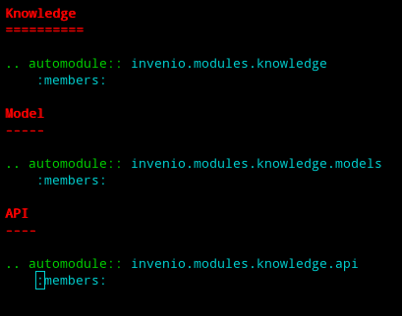
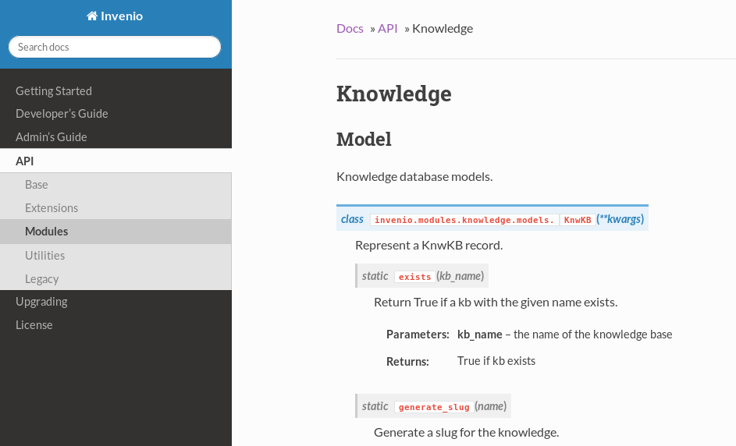
Write documentation
“Write as much documentation as possible!”
Why?
To refactoring the code, you need to know what the code does..

Slide 30
Stack
Visual representation of a module
REST API
Admin
Views
Docs
Tests
Forms
API
Model
Upgrade recipes

Slide 31
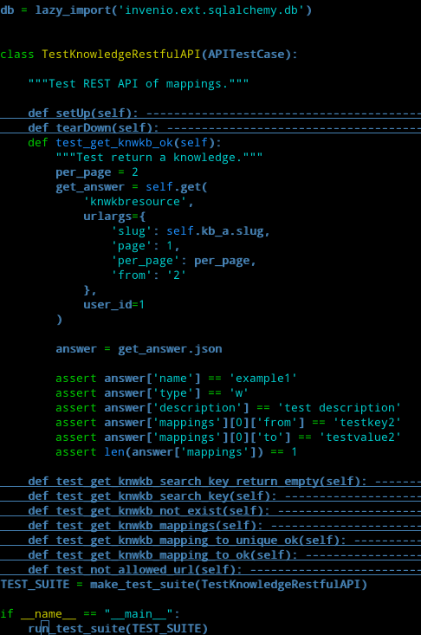
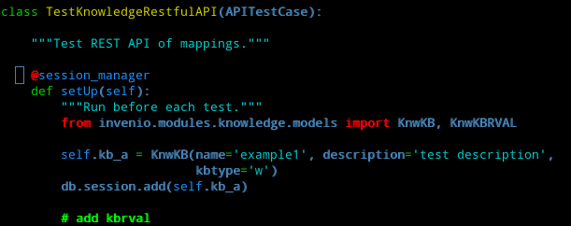
Test the new code
“Test Driven philosophy
is your best friend”
Start your test:
$> cd invenio/modules/knowledge/testsuite
$> py.test test_knowledge_restful.py

Slide 32

The End
Thank you for your attention

