Slide 1
From Invenio 1 to Invenio 2
Case Study of BibKnowledge
From Legacy to Module v2.0
From SQL to SQLAlchemy Model.
How to write upgrade's recipes.
Refactoring API: re-implement and deprecate.
Write REST API.
Write forms with WTForms.
The Admin interface with Flask-Admin.
User's web interface with Jinja templates.
Write documentations.
Test the new code.
Tips & Tricks

Slide 2
From Legacy to Module v2.0
In the beginning was the legacy code
invenio/legacy/bibknowledge/

Slide 3
From Legacy to Module v2.0
Then, Legacy transition to “module v2.0”
invenio/legacy/bibknowledge/
Note: the legacy code
use our new module.
adminlib.py
admin.py
citation_indexer.py
invenio/module/knowledge/

Slide 4
From Legacy to Module v2.0
In the end, only “module v2.0” survive
invenio/legacy/bibknowledge/
invenio/module/knowledge/

Slide 5
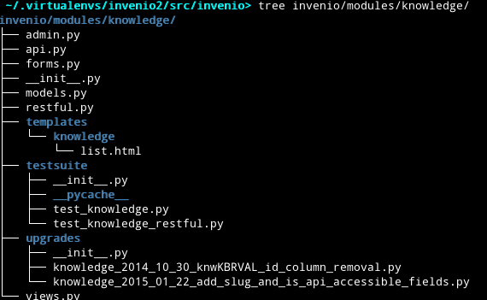
From Legacy to Module v2.0
How a module is composed?
Admin UI with Flask-Admin
API accessible from outside
All your defined WTForms
SQLALchemy models
REST API implementation
Jinja2 templates
Testsuites
Upgrade recipes
User UI

Slide 6
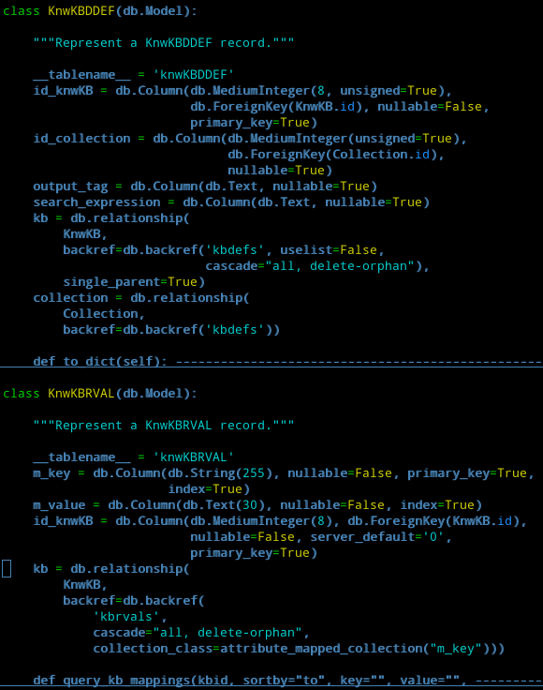
From SQL to SQLAlchemy Model
From
run_sql()
To
models.py
Where in legacy code is used run_sql(),
now it'll be replaced with the usage of SQLAlachemy (better if incapsulate the use of the model inside your api)

Slide 7
How to write upgrade's recipes (1/2)
Old data model vs New data model:
how to upgrade your database in production environment without break all?
# Use the old Database
$> git checkout pu
$> inveniomanage database recreate –yes-i-know
# With the new Codebase
$> git checkout mybranch
$> inveniomanage upgrader create recipe -a -p invenio.modules.knowledge
# Finish to prepare your recipe
$> vim invenio/modules/knowledge/upgrades/knowledge_2015_02_16_rename_me.py

Slide 8
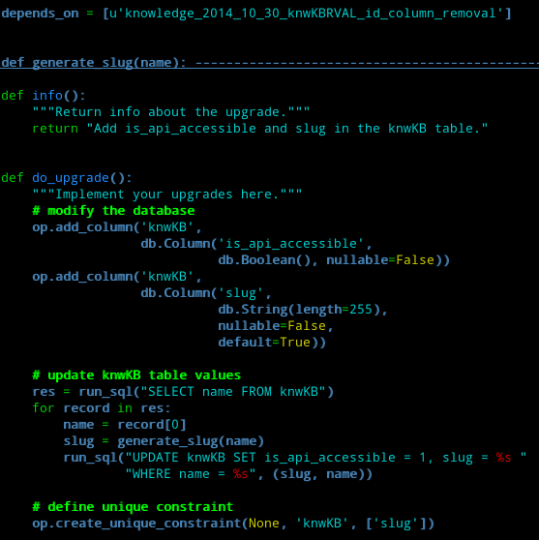
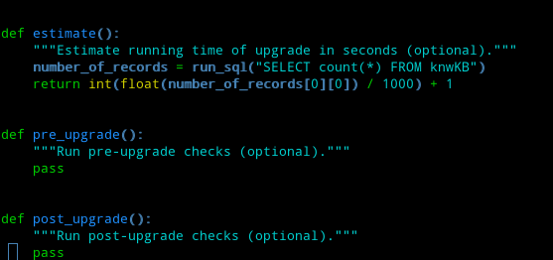
How to write upgrade's recipes (2/2)
Alembic is a database migrations tool written
It help you to write python code to upgrade the database

Slide 9
Refactoring API: re-implement and deprecate.
Each request have to pass from api (no direct access to models).
Respect the old API (backward compatibility), meanwhile deprecate not useful code and implement a new cool API.
API
Models
Input
Output
Black Box

Slide 10
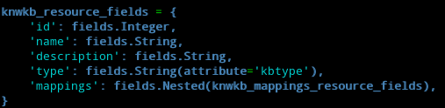
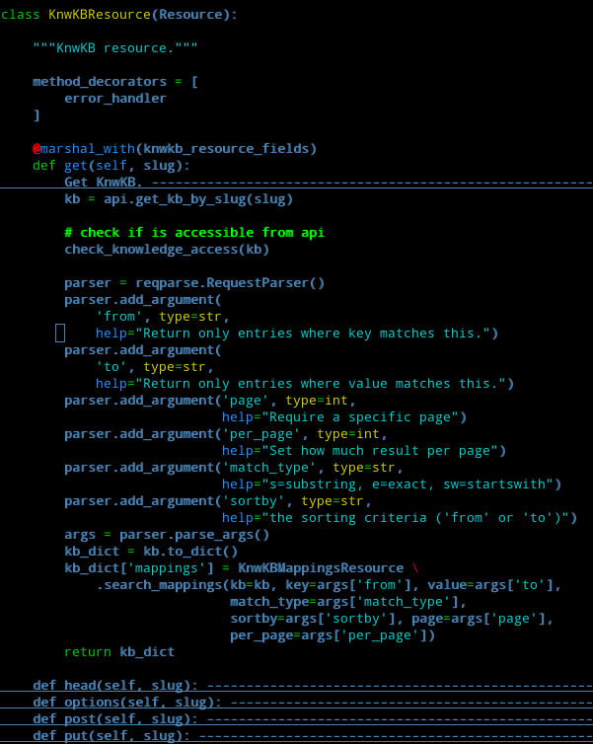
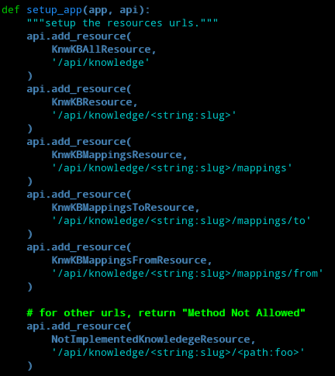
Write REST API
Define the object structure
Define a resource
Define the endpoints

Slide 11
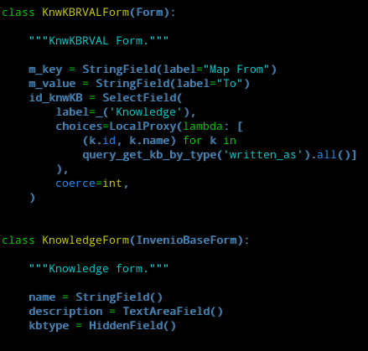
Write forms with WTForms

Slide 12
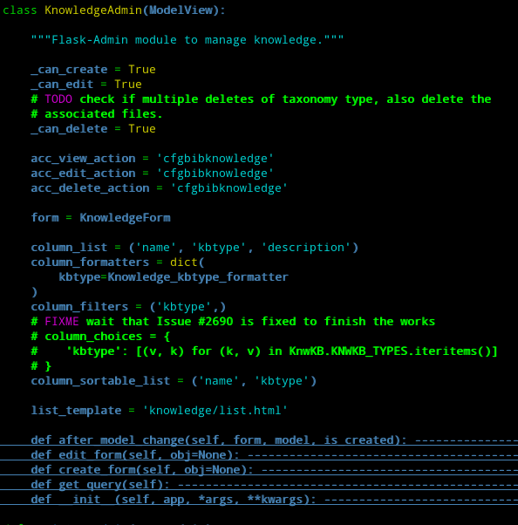
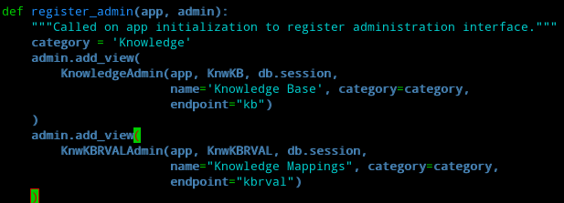
The Admin interface with Flask-Admin
Admin interface for Knowledge
Define endpoints

Slide 13
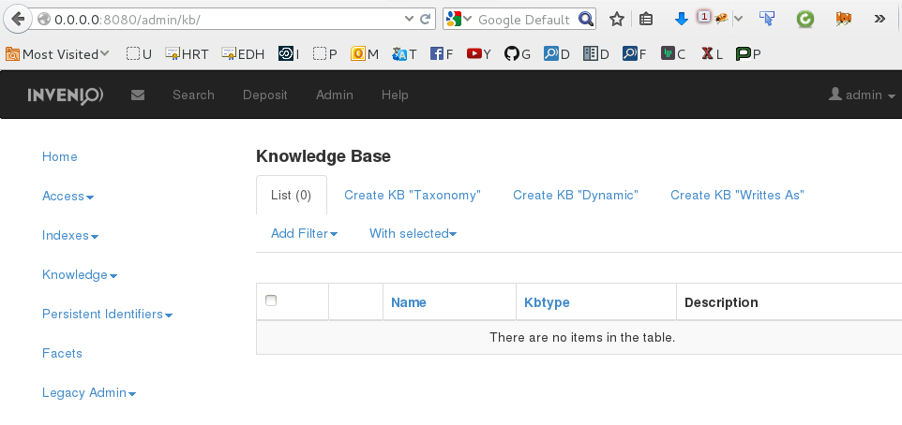
The Admin interface with Flask-Admin

Slide 14

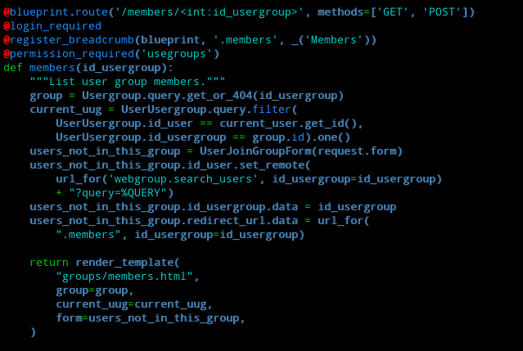
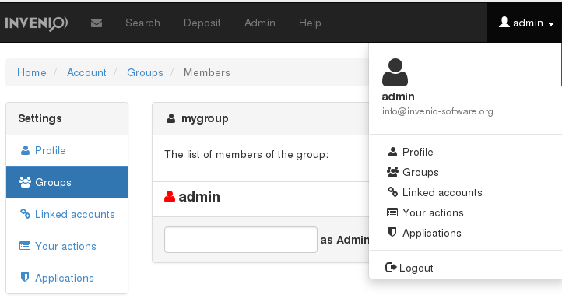
User's web interface with Jinja templates
Define where load the templates
(in this case invenio/modules/groups/templates)
Your template
The objects passed to the template

Slide 15
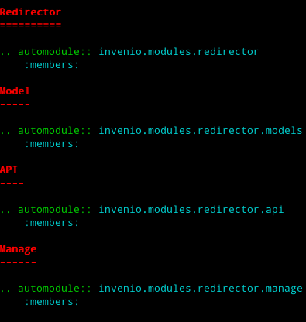
Write documentations
E.g. docs/modules/redirector.rst
Generate documentation
$> sphinx-build -qnNW docs docs/_build/html
E.g: Define where find the documentation for the section “Model”

Slide 16
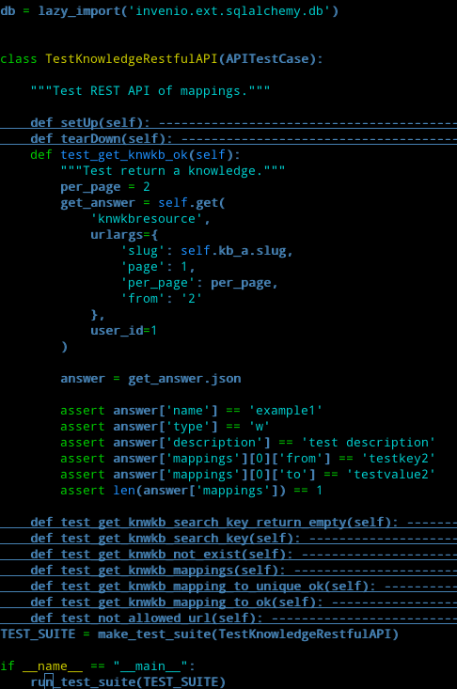
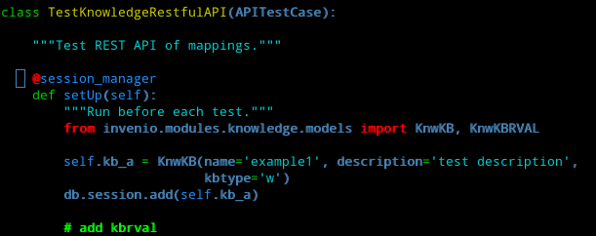
Test the new code
Load db interface
Start your test:
$> cd invenio/modules/knowledge/testsuite
$> py.test test_knowledge_restful.py
Note: import only when you need it (inside the function
where you use it).

Slide 17
Tips & Tricks
Debugging configuration:
SQLALCHEMY_ECHO=True
ASSETS_DEBUG = True
DEBUG = True
TESTING = True
Configuration file:
cdvirtualenv var/invenio.base-instance/
vim invenio.cfg
Jasmine tests:
http://0.0.0.0:8080/jasmine/specrunner
Python tests:
python setup.py test
Use devscrips to install invenio2:
https://github.com/tiborsimko/invenio-devscripts
Database create/drop:
inveniomanage database create
inveniomanage database drop –yes-i-know
inveniomanage database recreate –yes-i-know
Start server:
inveniomanage runserver
Install all dependency:
pip install -e . --process-dependency-links
Install Kwalitee:
pip install kwalitee
kwalitee githooks install

