Slide 1

Hachy
Your Eggspedient Candler

Slide 2
Hachy 101

Slide 3
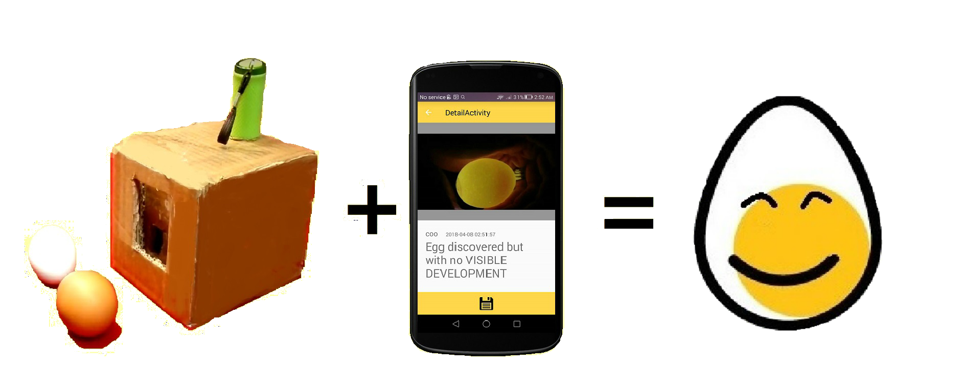
What is Hachy
Hachy uses machine learning to candle eggs with a phone and a Hachy Box:

Slide 4
How it Works
Drop, Snap – have your Egg back!
Insert Egg into Hachy Box
Mount Device onto Hachy Box
Snap a shot of on device
Observe the result of egg status
Track history of past egg result
Notes:
Todo: insert image here of 5 steps here

Slide 5

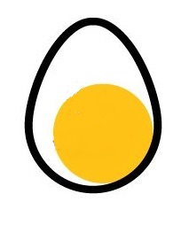


Stage of Eggs
Five Stages of Eggs
Easy and Intuitive
Notes:
Todo: insert image here of 5 steps here

Slide 6
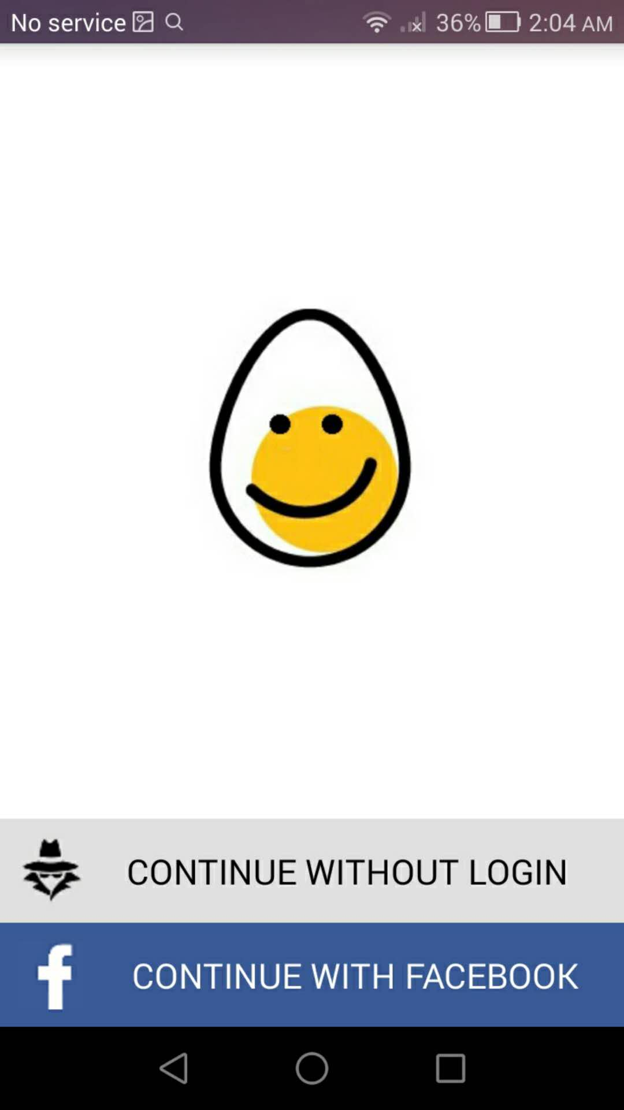
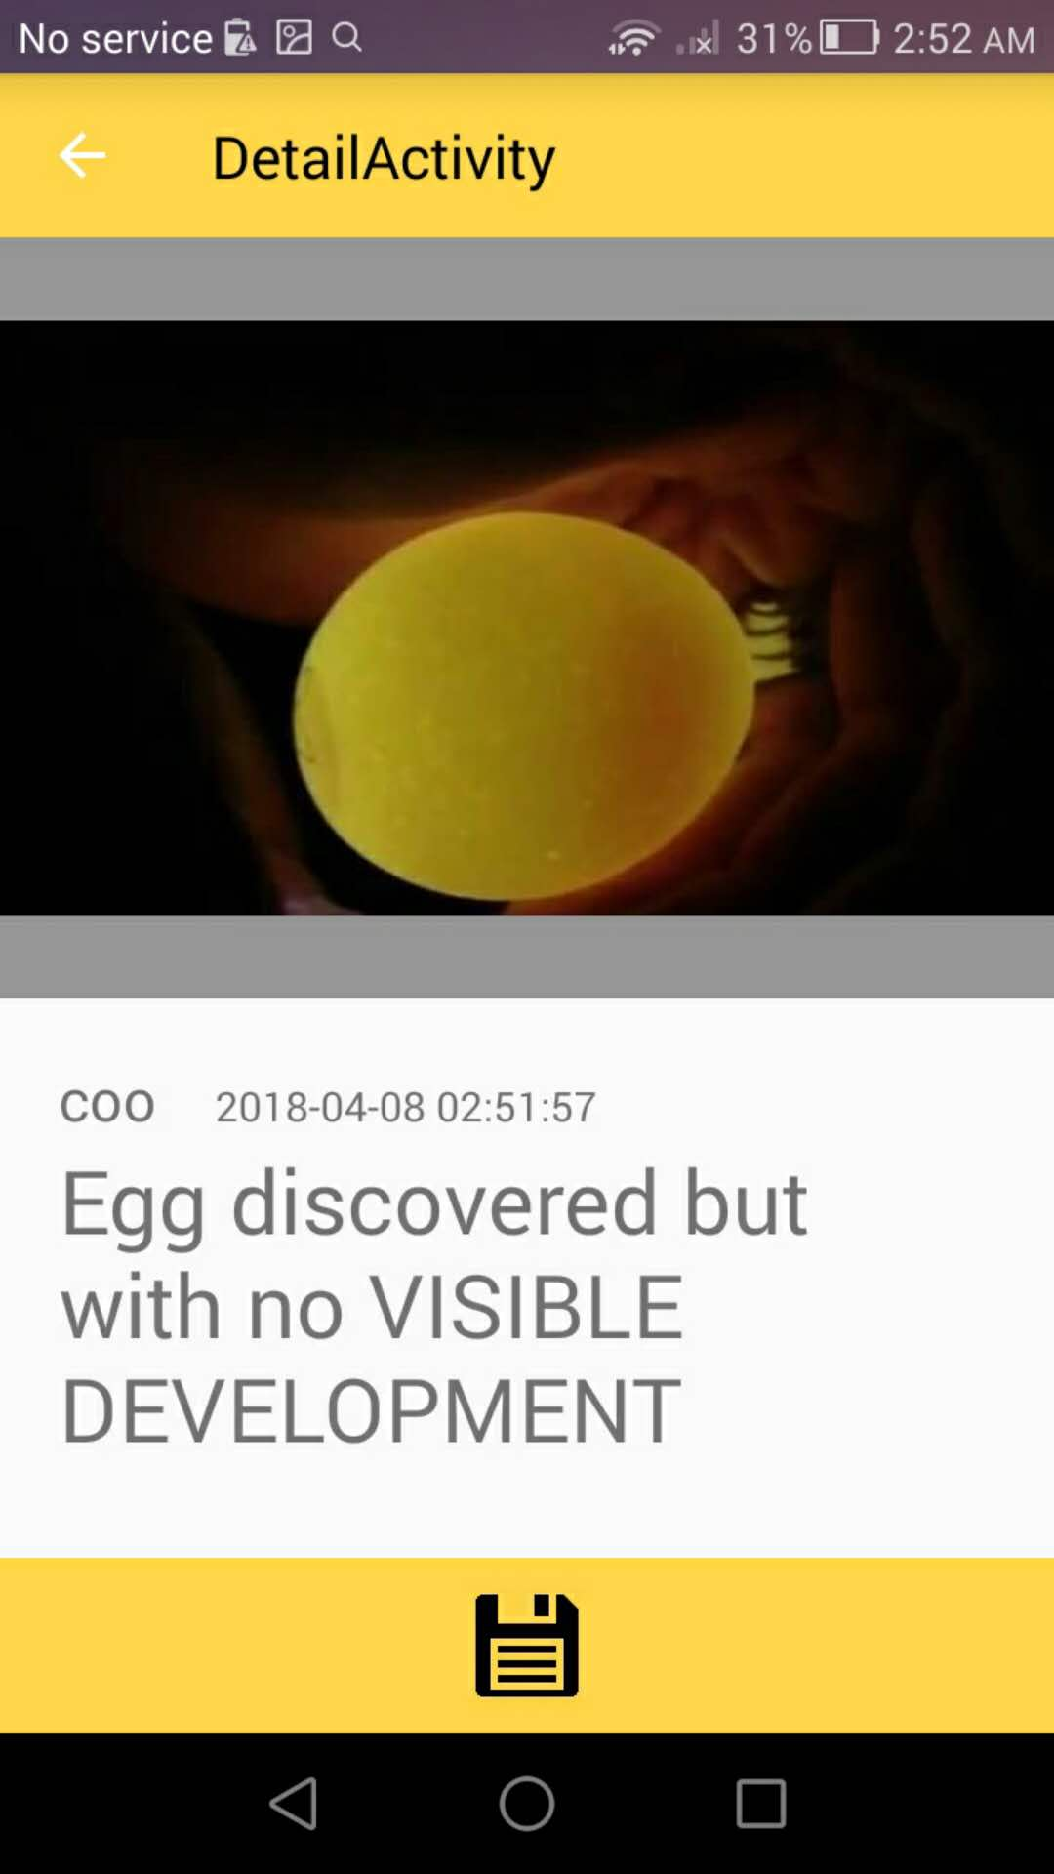
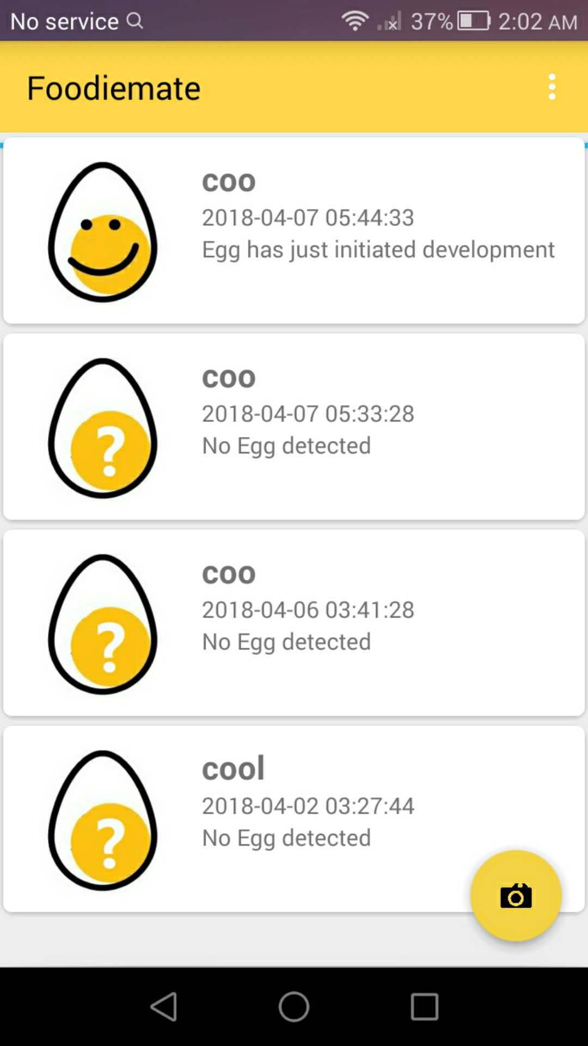
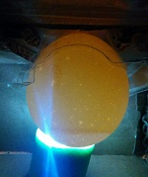
Catalogue
Notes:
Todo: insert image here of 5 steps here

Slide 7

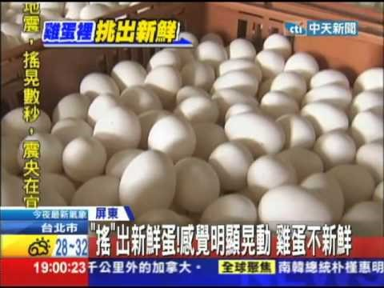
Use Cases
Hachy will facilitate Egg Candling for
Cath(farmer) Wancai(consumer)
Notes:
Todo: insert image here of 5 steps here

Slide 8
Design

Slide 9

Logo
Our logo consists of an logomark and a watermark. They can be used together or separately depending on the situation. If used together the watermark and logo shall have consistent color. And most preferably the brand color (see next slide)
Hachy
Hachy
Brand Main: #ffd966
Brand Dark: #ffc315
Brand Frame: #000000
Brand Text: #707070
Brand empty: #ffffff
Notes:
Todo: insert image here of 5 steps here

Slide 10
Color
We have a main brand color that we try to incorporate anytime we create something in the name of Hachy. There are additional secondary and tertiary colors as well. Different shades with different opacity of each color can be also used . We also have a gradient that we use sparingly (to be determined, right now refer to primary color)
Primary
Brand Main: #ffd966
Brand Dark: #ffc315
Brand Frame: #000000
Brand Text: #707070
Brand empty: #ffffff
Secondary
Close to text color but with diff transparency and intensity
Tertiary
Close to brand color with different transparency and intensity
Gradient
Secondary + tertiary
Notes:
Todo: insert image here of 5 steps here

Slide 11
Typography
Our Ui font for IOS is Gotham, and for Android it’s Roboto. For title or header, we use Arial Rounded MT Bold
Gotham
Regular
Medium
Bold
Roboto
Regular
Medium
Bold
Arial Rounded MT Bold
Regular
Medium
Bold
Notes:
Todo: insert image here of 5 steps here

Slide 12
Dev

Slide 13
Client side Development Overview
Android:
Kotlin 1.3.0—Android framework
Java 8+ for Heavy Lifting Algorithm
C++ for TensorFlow core (not implemented)
MVP Architecture
Dalvik Testing Framework
IOS
Swift 4.1
MVC
Fastline.io Testing Framework
Web
Angular2 → 4
DRY!
Notes:
Todo: insert image here of 5 steps here

Slide 14
Server side Development and Git
Backend
Abstracted Backend Development
Currently hosted on Google Firebase
To be adapt on MS Azure/AWS/GCE
Coded in Node-ExpressJS/Java-SpringMVC
Firebase(development server)
Database:
SQL relational Database for log
Blob Storage for Image and files
Git:
Format: VueJS format (non-binding, we are chill)
Create a branch for feature implementation: eg. feat-mainview
No need to create branch for addons and fixes
Currently work off master, may divert to dev branch in future
Notes:
Todo: insert image here of 5 steps here

Slide 15
Modals
Modal
Egg
Eggs
EggPrediction
EggStatus
User
Notes:
Todo: insert image here of 5 steps here

Slide 16
Marketing

Slide 17
Tell us what you think here

