Slide 1

Hachy
Your Eggspedient Candler

Slide 2
Hachy 101

Slide 3
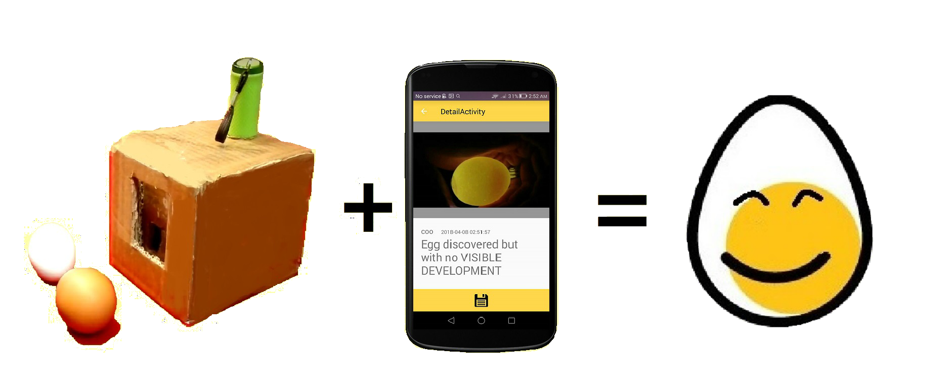
What is Hachy
Hachy uses machine learning to candle eggs with a phone and a Hachy Box:

Slide 4
How it Works
Drop, Snap – have your Egg back!
Insert Egg into Hachy Box
Mount Device onto Hachy Box
Snap a shot of on device
Observe the result of egg status
Track history of past egg result
Notes:
Todo: insert image here of 5 steps here

Slide 5

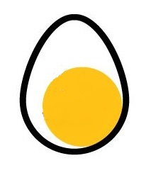


Stage of Eggs
Five Stages of Eggs
Easy and Intuitive
Notes:
Todo: insert image here of 5 steps here

Slide 6

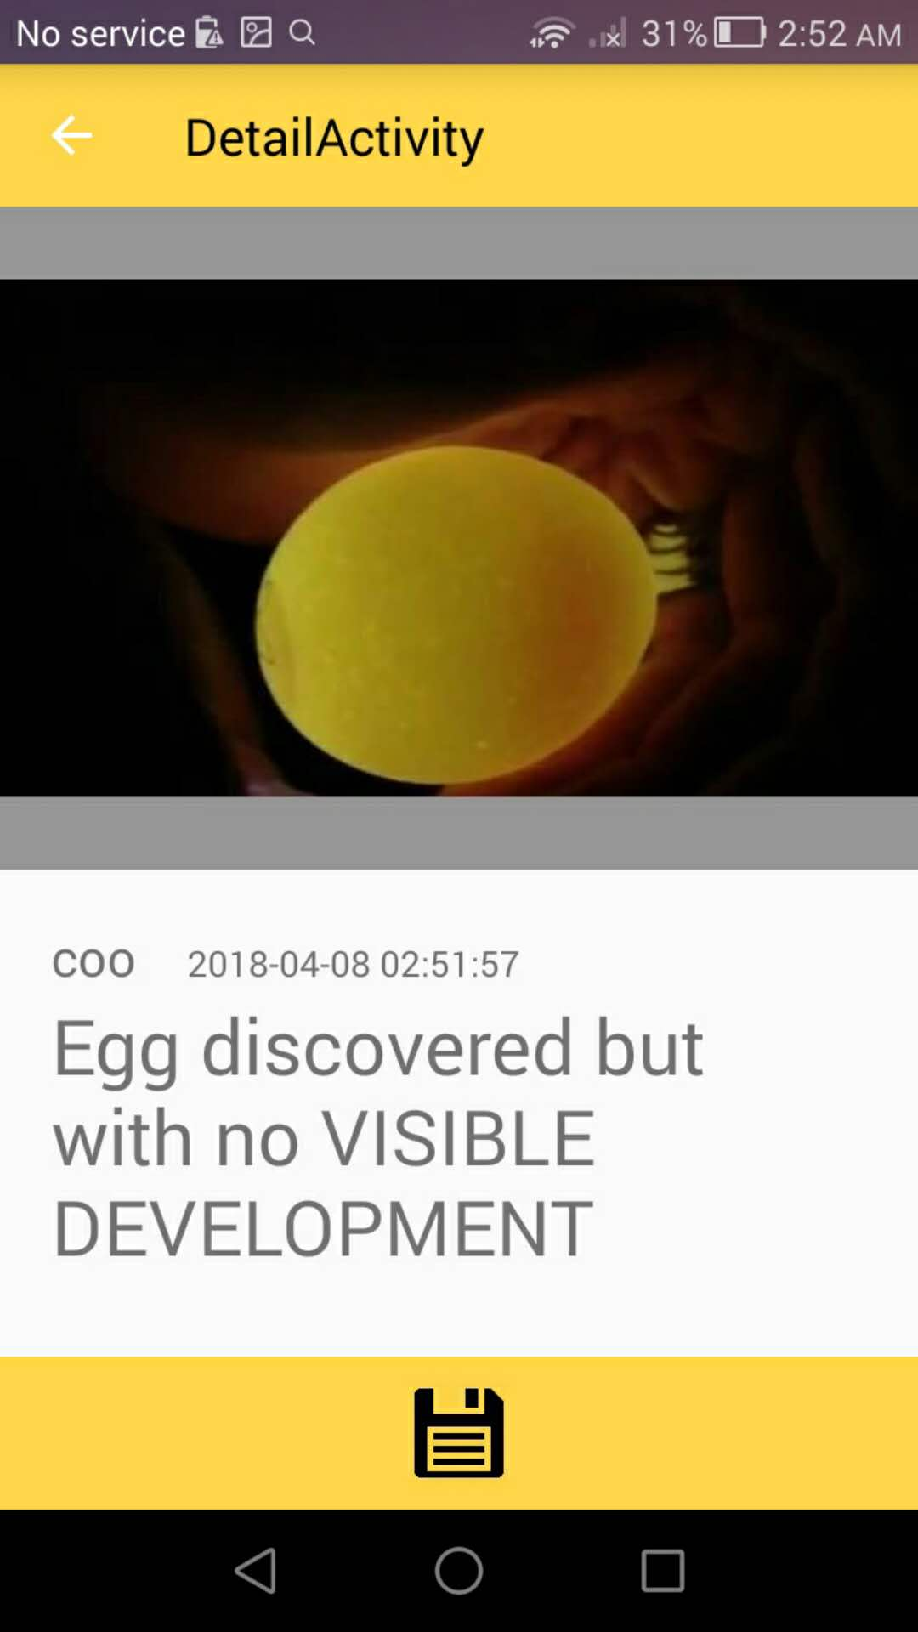
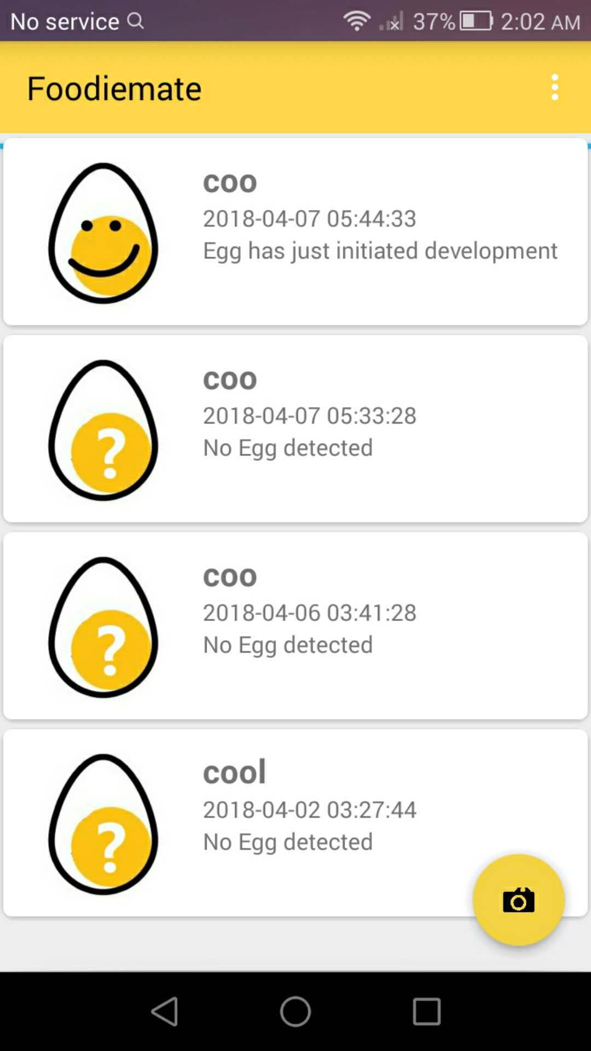
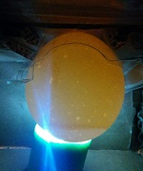
Catalogue
Notes:
Todo: insert image here of 5 steps here

Slide 7

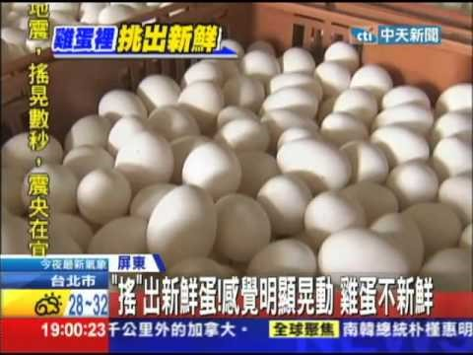
Use Cases
Hachy will facilitate Egg Candling for
Cath(Italy) Wancai(Taiwan)
Notes:
Todo: insert image here of 5 steps here

Slide 8
Design

Slide 9

Logo
Our logo consists of an logomark and a watermark. They can be used together or separately depending on the situation. If used together the watermark and logo shall have consistent color. And most preferably the brand color (see next slide)
Hachy
Hachy
Notes:
Todo: insert image here of 5 steps here

Slide 10
Dev

Slide 11
Hachy Development Overview
Android:
Kotlin 1.3.0—beta framework
Java 8+ for Heavy Lifting Algorithm
C++ for Tensorflow core (not impl)
MVP Architecture
Dalvik Testing Framework
IOS
Swift 4.1
MVC
Fastline.io Testing Framework
Web
Angular2 → 4
Backend
Abstracted Backend Development
Currently hosted on Google Firebase
To be adapt on MS Azure/AWS/GCE
Coded in NodeJS/Express/Java
Database:
SQL relational Database for log
Blob Storage for Image and files
Git:
Format: VueJS format (non-binding, we are chill)
Create a branch for feature implementation: eg. feat-mainview
No need to create branch for addons and fixes
Currently work off master, may divert to dev branch in future
Notes:
Todo: insert image here of 5 steps here

Slide 12
Marketing

Slide 13
Dev

