Slide 1

Mini Project Unit Calculator
By- Priyanshu Kumar

Slide 2
I am Priyanshu Kumar a student of BE-CSE in Chandigarh University. I wants to express my special thanks to all my Instructor who had helped me to learn this course and I had made this project gaining knowledge from it. I would also like to extend my gratitude to my University who have given chance to learn this course. Priyanshu Kumar 21BCS2798
Acknowledgement

Slide 3
Abstraction
I have made this Unit Calculator with very user-friendly interface which converts Kilometers to meters, feet's ,inches and miles.
I have made this with all my basic knowledge giving it my full efforts.
With the change of technology and modern world every thing have become so easy. Analyzing theses I have made this Android App.

Slide 4

Software Used
ANDROID STUDIO
This is a wonderful software to make Android App easy to make UI interface. It provides best environment to do Android development.

Slide 5
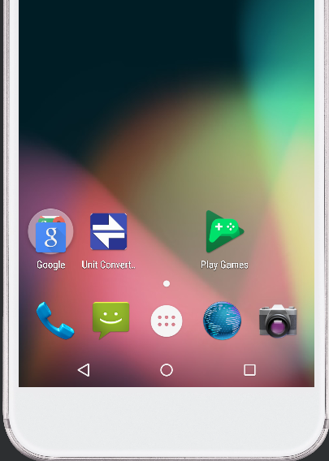

This is Icon and View in mobile phone of Unit Calculator.

Slide 6
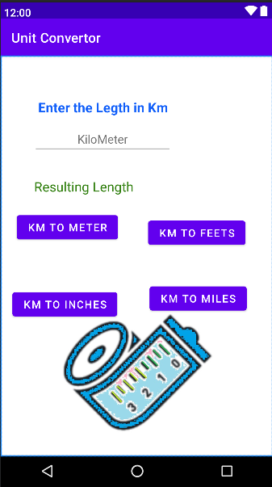
User Interface
This is the friendly interface made for users to interact with application easily.

Slide 7
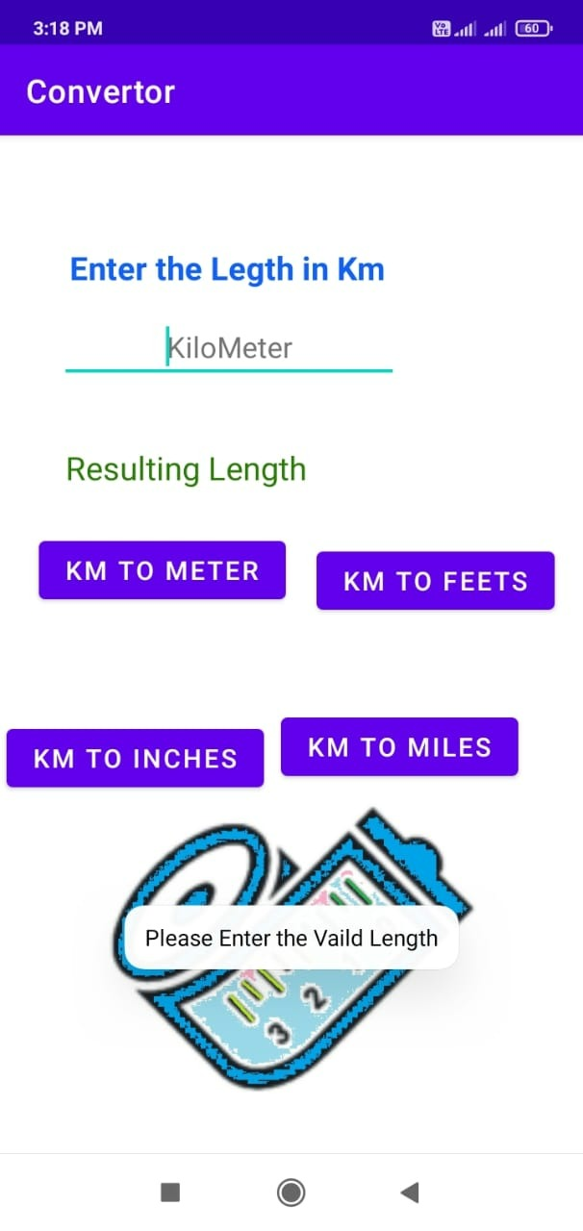
Working
User will enter the length value here
Result will appears here
If user try to process the conversion without it will show the warning
User can process the calculation with the help of these buttons.

Slide 8
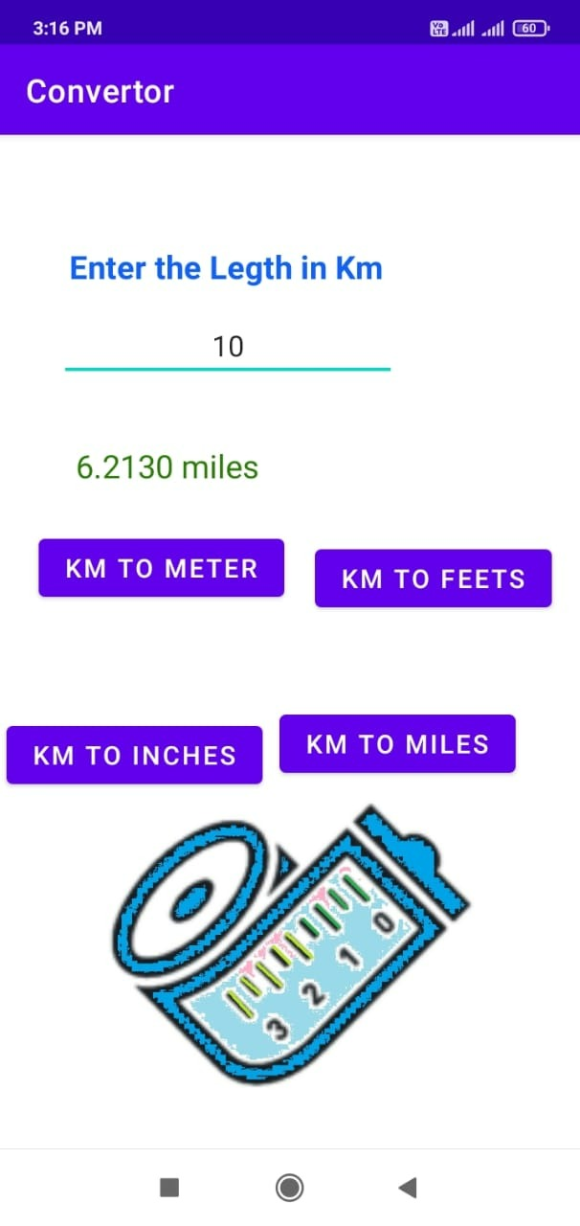
Using Trail
Shown each of conversions with example in the following figures .

Slide 9
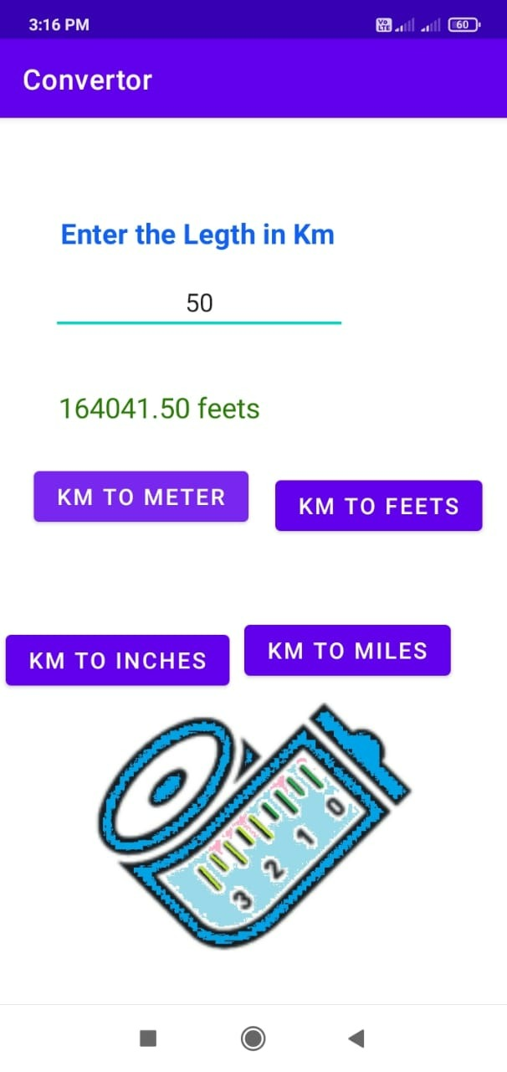

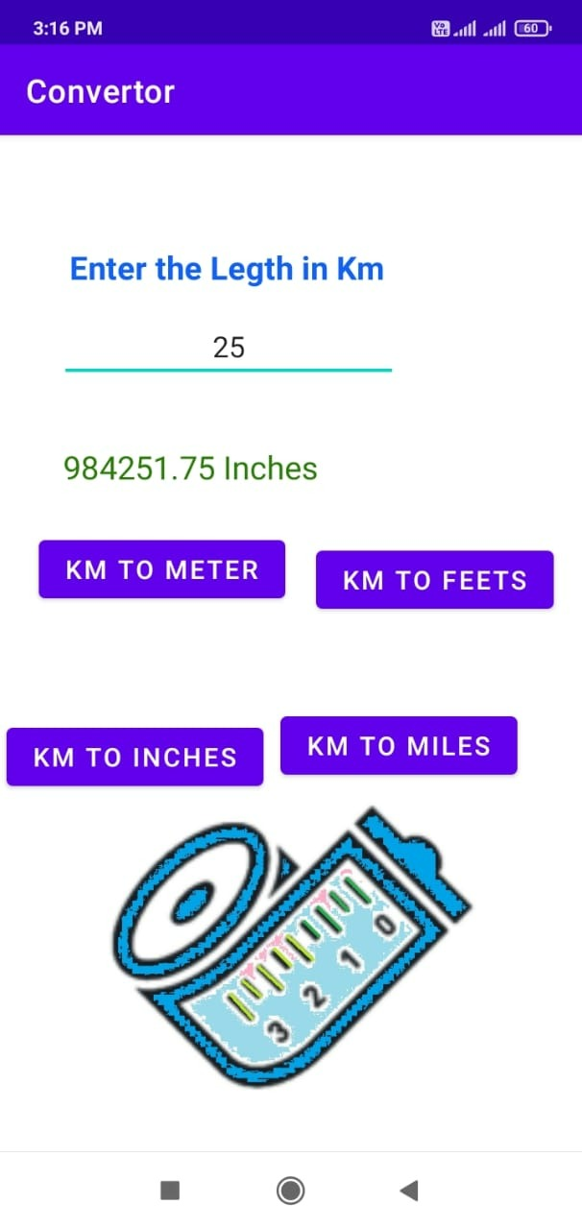
Input in Km
Result is there according to input

Slide 10


Advantage
Easy to use
Avoids errors
Future proof
Saves time

Slide 11

THANK YOU

