Slide 1

Bug Slayers
AICB1-CC01

Slide 2
Project Title
Attendance System Using Cloud Computing

Slide 3
Agenda
Attendance is very important in every student’s life, a single absent is big difference in performance in the academics. Attendance is the basic and the most important criteria needed in all the education system. Attendance is used as a record to assess student consistency in the class. Therefore, student is required to attend all teaching activities held by the institutions. Currently, schools and colleges are still practicing old method to take the student attendance which is by giving out attendance sheet to be sign by student. This impractical method leads to fraud on number of absentees by students. Besides, this method also easily allow for impersonation as some student may purposely sign on another student’s name. Besides, lecturer needs to analyse manually every attendance sheet to identify the number of absentees for both lecture and lab classes correspond to subject. Then, lecturer needs to count and calculate percentage of present of all the students manually to identify when warning letter need to be given to the student depend on his or her number of absents without providing any medical certificate or notice. As a result, it is time consuming, increases work of the lecturer and prone to human error as it is difficult to know whether the calculation made was correct. As a result, there is a need to find new and modern ways to track and manage student attendance records at higher academic learning institutions more efficiently and effectively. Therefore, it is very important to develop an assistance system that is equipped with an online database, especially to prevent data loss, as well as to promote ecological and paperless and ecological technology campaigns. In addition, this application will help reduce time wasted, which will lead to greater learning productivity in the classroom.

Slide 4
Problem Statement
Attendance Management System is software developed for daily student attendance in schools, colleges and institutes. It facilitates to access the attendance information of a particular student in a particular class. This system will also help in evaluating attendance eligibility criteria of a student. By just a click on the mouse, the system will be able to produce the students' attendance report thus reducing the need for manual labour which is prone to human errors and time consuming. This application is built for automating the processing of attendance. It also enhances the speed of performing attendance task easily. The Student Attendance will be based on the department and section. According to the department wise and section wise the attendance will be marked for the students. It includes present, absent and leave column for each student so that they would mark the attendance like period wise. By just a click on the mouse, the system will be able to produce the students' attendance report thus reducing the need for manual labour which is prone to human errors. The student can only view the attendance record on weekly, monthly, and whole semester basis

Slide 5
Project Overview
It has been proven that the form of a manual method for bringing student attendance is difficult and time-consuming to verify each student. Without control, whether confirmed students respond or not, consolidated attendance calculations are another important task that can cause manual errors. The conventional method by having manually signed the attendance in a sheet of paper then passed around the classroom while lecturer conducts the teaching in the classroom is wide implements nowadays. This method could undoubtedly allow the students to do cheating about their attendance in the classroom, where a student may sign for an absent student. In addition, the help form can easily be lost or lost during circulation. A more rigorous approach, especially to prevent students from cheating on their attendance, is also boring, where a teacher tells each student’s name based on a list of student names and validates each student’s attendance. It is very important to develop an assistance system that is equipped with an online database, especially to prevent data loss and to reduce human errors as well as to promote ecological and paperless and ecological technology campaigns. In addition, this application will help reduce time wasted, which will lead to greater learning productivity in the classroom. With that in mind, our goal is to overcome this problem by having a system with minimum hardware requirements and, at the same time, enhancing the mobility aspects of the existing support system.

Slide 6
Who are the End Users?
In our System, our End Users are Teachers and Students , User / Customer is the person who uses the software or the product that is designed by us to get fruitful results. Attendance Monitoring System using Cloud Computing can be used in Educational Institutions. In educational institutions students and teachers are the end user. By using it we can monitor the presence and absence of students in class, by using this, students will be reporting on correct time, their leaves can also be managed in an efficient manners and teachers can have complete accessibility of it.

Slide 7
Our Solution and Its Value Proposition
Our proposed system covers the problem of using the manual system such as an unsecured record of attendance, lots of paper works, and inaccuracy of the data inputs. This proposed system will benefit the school for its development and improvement by using a new technology and improved system for the day-to-day process of attendance. The system is developed to provide automation for the daily attendance of the students and teachers. The purpose of this system is to improve the attendance monitoring system for students and teachers. With the system created with a user-friendly environment, the school staff would find their work easy and efficient. The system will also help the school administrators to evaluate the attendance performance of the students and teachers with ease. This will help the school a lot for its development and performance in terms of attendance monitoring. The system will automatically determine and reflected if a student did not attend his classes. By using databases, the data is more organized

Slide 8
Value Proposition
A value proposition is a simple statement that summarizes why a customer would choose our product or services. The Value proposition of our Attendance System are as follows –
Reduces the amount of paperwork involved in a manual time tracking system
Significantly cut down on errors and processing time.
Remote management - They can be accessed from anywhere on any device
Improved security - With cloud-based attendance systems comes added layers of security.
Labour and budget management - cloud-based systems have built-in tools to help you better manage your labor costs and budget

Slide 9
The WOW in our Solution
Manually taking attendance and registering it in file unnecessarily consumes time, to overcome the inefficient work process there are various software systems available to speed up the attendance process and reduce the manual work. Additionally it helps to maintain accurate records and generate summarised student attendance reports. In modern attendance monitoring system inconsistency in data entry and generation of errors can be reduced. An automatic attendance system is an educational ERP system that records the students Attendance in an institution. Unlike the conventional attendance system, the automatic attendance software enables the faculty to record, store and monitor students’ attendance history and manage the classroom efficiently. The database will be stored in the cloud which will form a dedicated connection between application and cloud server via internet with the in-time and out-time data stored in cloud.

Slide 10
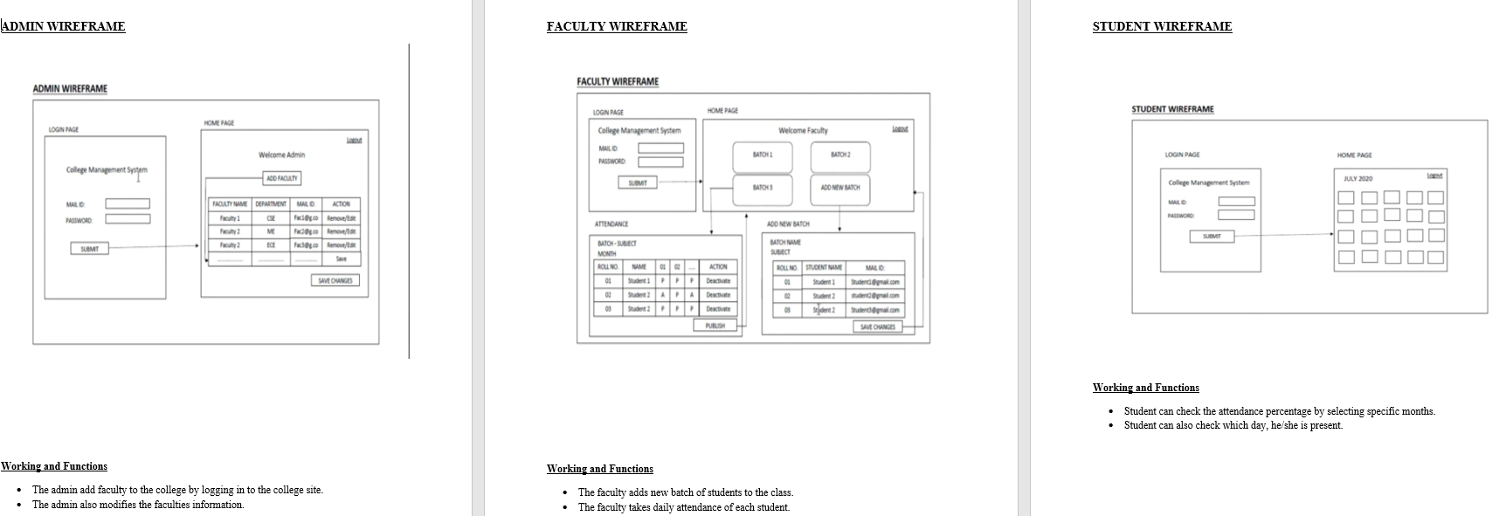
Modelling of our System

Slide 11
Results
Our Attendance Management System is deployed on Microsoft Azure cloud Platform and here are the results -
The admin of the system manages the Users (Teachers / Students) and Add Users , They Manage the attendance as well as check their attendance report.
Teachers are only allowed to add Students , Mark their attendance and check the attendance report of students.
The Student is only allowed to check his/her attendance
The System has following features - Increased accuracy, Remote working , Improved security , Scalability , Cost and time savings etc

Slide 12
Meet Our Team
Daksh Raj Singh (Leader)
Roshan Bawne
Abhishek Adari
Kamisetty Kalyani
Tamilarasi

