Slide 1
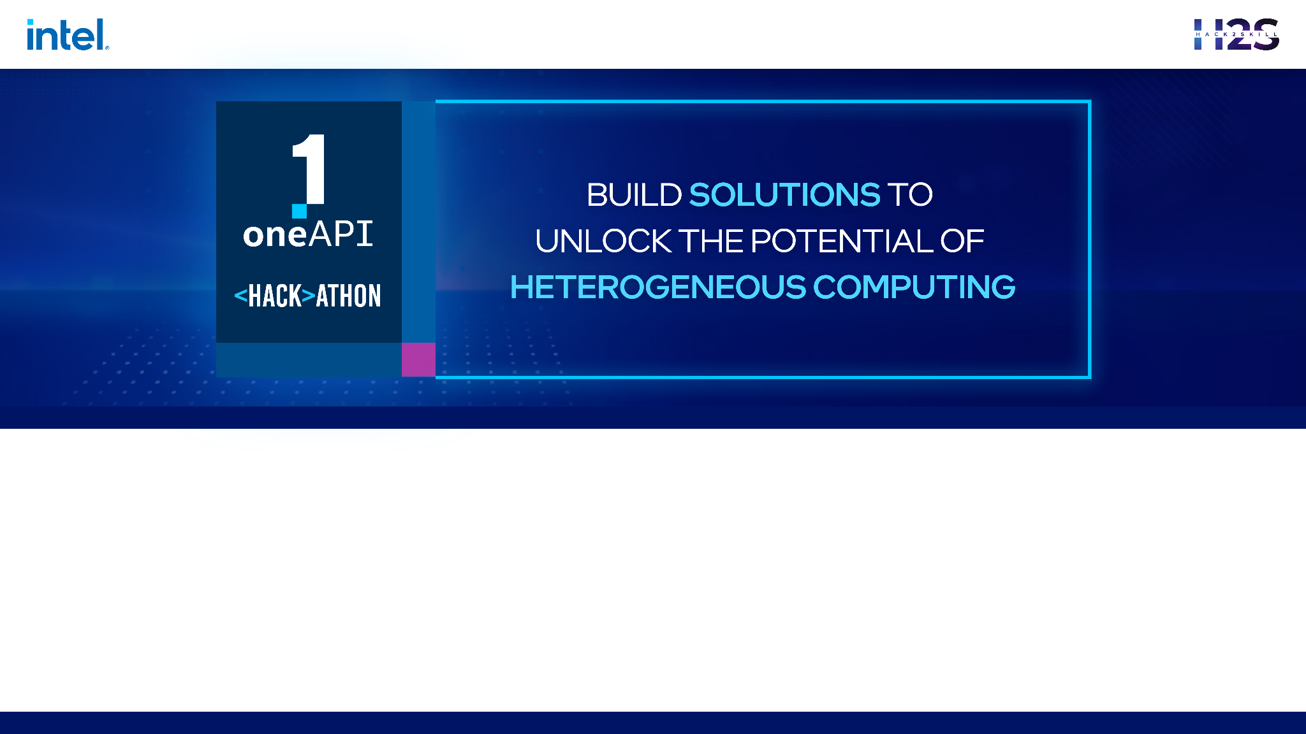
Project Name - Medical Image Processing
oneAPI or SYCL mention - SYCL
Team Name - Mind Crusaders
Team Member - Kaamal VN, Harshitaa M S, Abbi Jannanee M, Vishal M

Slide 2
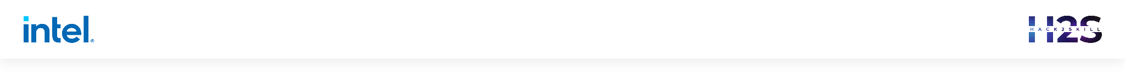
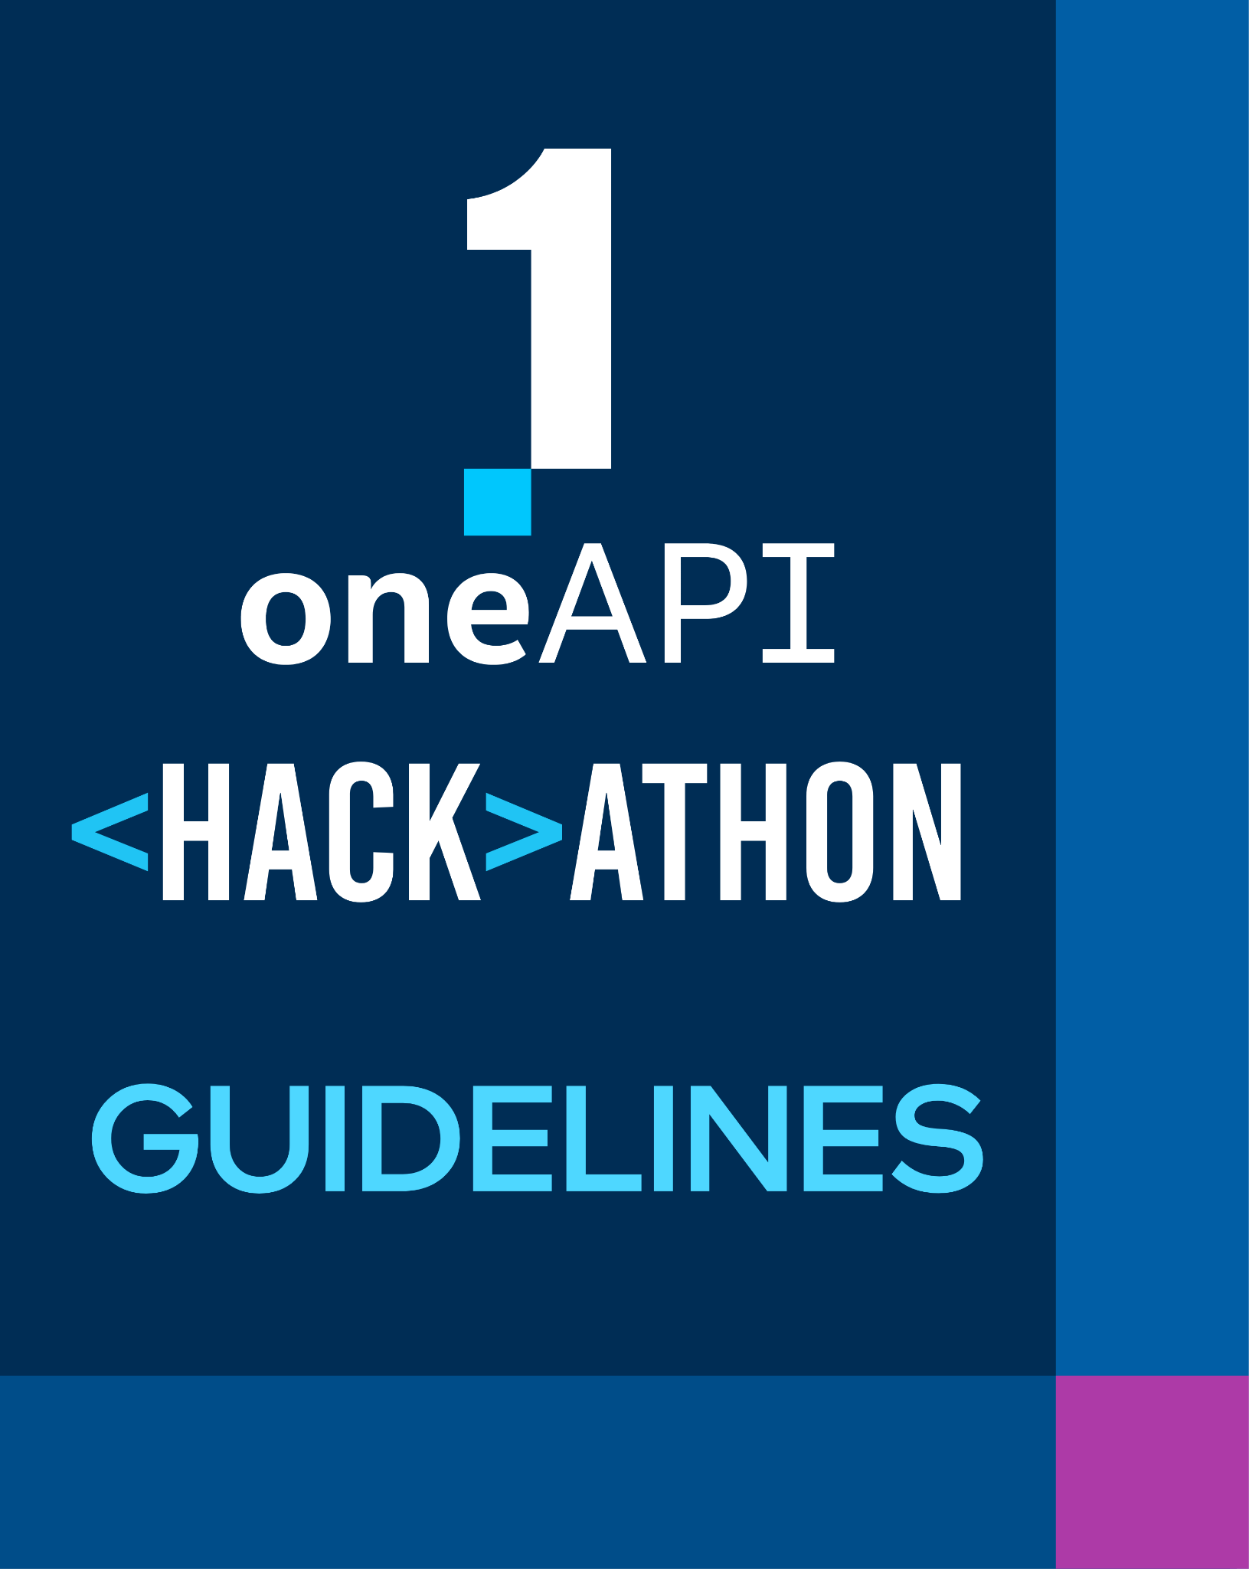
Your pitch time is for 15 Mins.
This included 10 mins of presentation and 5 mins of Q&A.
The presentation will be in person
Keep it crisp, clear and concise.
Core components of oneAPI/SYCL used
Demo is mandatory. (Video or Live demo)
Highlight oneAPI AI Toolkit & its Libraries /SYCL usage with Stats.
After pitch, there will be questions from Jury.

Slide 3
Problem Statement
Medical Image Processing - Pneumonia classification
According to WHO, the world pneumonia killed more than 80800 children under the age of 5 in 2017 accounting for 15% all deaths under 5years while India contributes about 23% of global pneumonia burden.
Pneumonia is a prevalent respiratory infection that requires accurate and timely diagnosis for effective treatment.
In our project, we utilized SYCL, a programming model based on standard C++, for the classification of pneumonia in medical image processing.
SYCL served as the foundation for our pneumonia classification project, leveraging the power of heterogeneous hardware architectures, such as CPUs, GPUs, and FPGAs.
With SYCL, we optimized our classification algorithms for parallel processing, enabling faster and more accurate diagnosis.

Slide 4
Architecture – Impact of oneAPI AI Toolkit & its Libraries /SYCL (How oneAPI /SYCL helped you?)
Performance Optimization: Harness the power of parallel programming with fine-grained control over performance which ensures faster and more efficient diagnosis.
Portability: Develop code once and seamlessly execute it on various hardware platforms which supports SYCL standards which is useful when using multiple GPUs.
Resource Utilization: Efficiently utilize CPUs, GPUs, and FPGAs to distribute the workload, optimizing resource utilization and enhancing pneumonia classification algorithms.
Streamlined Development: Leverage SYCL's unified programming model, incorporating pre-implemented functions and algorithmic optimizations to streamline development, deploy models faster, and achieve accurate pneumonia classification.
Debugging and Profiling: We utilized the debugging and profiling capabilities offered by the SYCL framework to analyze the performance of our code.- These tools allowed us to identify bottlenecks, optimize our pneumonia classification algorithms, and improve accuracy and speed.
SYCL served as the foundation for our pneumonia classification project, providing a robust programming model for heterogeneous computation resources.

Slide 5
Core components of oneAPI AI Toolkit & its Libraries /SYCL used in the project
Intel® oneAPI Base Toolkit – it provides the environment for compiling for DPC++/ SYCL libraries
SYCL – it provides process parallelism which makes the diagnosis efficient and effective
oneDNN – Neural Network Classifier for pneumonia prediction
Opencv - it is used for data preprocessing

Slide 6
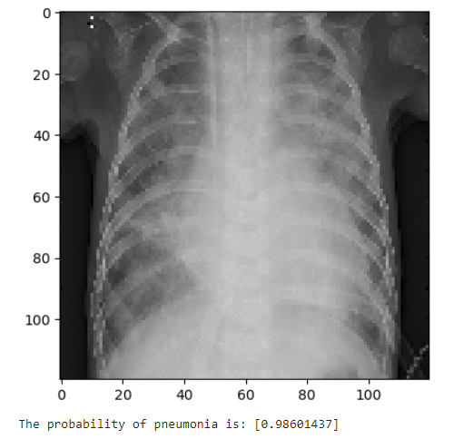
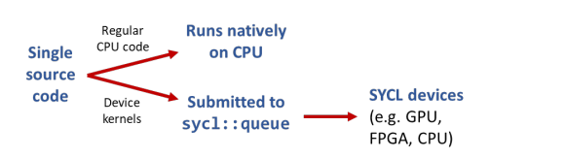
Demo Video/Live Demo
Please elaborate oneAPI AI Toolkit & its Libraries /SYCL usage

Slide 7
GitHub Link (Codes should be public
and available after hackathon also)
MEDICAL IMAGE PROCESSING – PNEUMONIA CLASSIFICATION
https://github.com/KaamalVN/intel-oneAPI

Slide 8
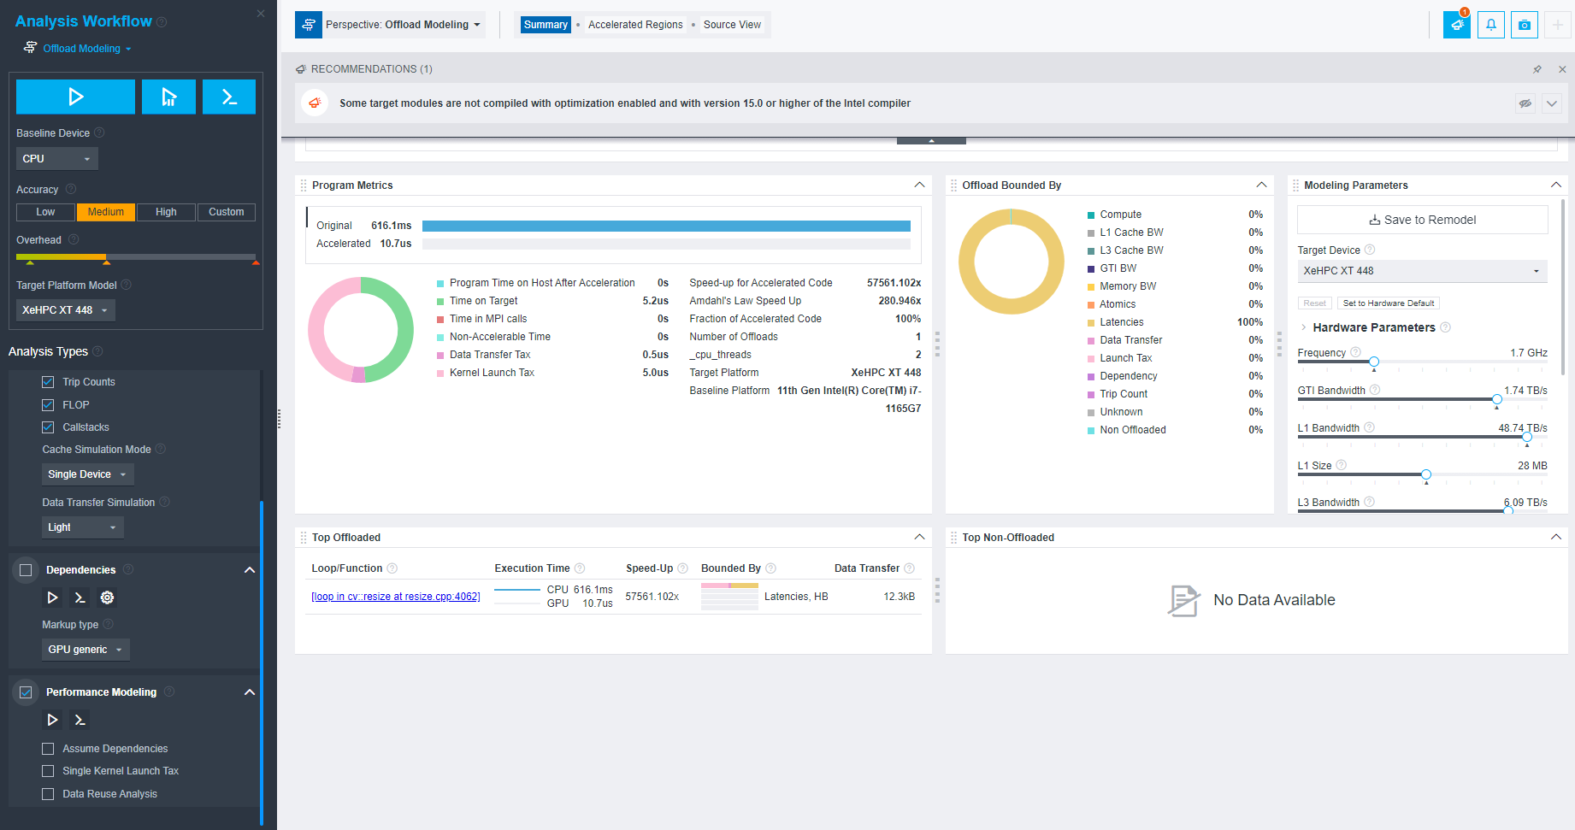
Results Summary (focus on unique aspects of oneAPI AI Toolkit & its Libraries /SYCL that you have used)

Slide 9
