Slide 1
Mindbody
Automation HW exercise

Slide 2
Background
MINDBODY offers multiple web applications that allow businesses around the world to easily access its services. These services allow business owners to keep track of their entire organization through one website. That is to say, clients are able to offer classes, appointments, workshops, or even sell online products through MINDBODY’s online software. Due to this, it is crucial that the software is kept fully operational. Automated testing through browser automation enables to check if the software is working correctly from a front-end perspective.

Slide 3
The Task
Create a series of automated tests using the Selenium framework and the C# programming language. These tests are designed to create coverage around an online parking calculator. Listed below are the test cases we would like coverage for. In addition to the cases below, write out and automate 5 more test cases for any scenarios you feel would benefit the testing effort of this tool. You are welcome to use the browser of your choice for these utomated tests.

Slide 4

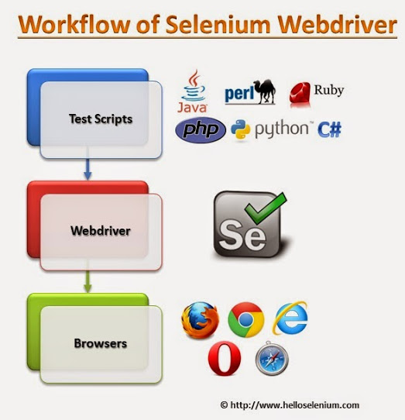
Automation Framework
Microsoft Visual Studio Community 2015
Version 14.0.25425.01 Update 3
Microsoft .NET Framework
Version 4.6.01055
Programming Languague: C#
.Testing Framework
MS Test
Selenium WebDriver for C#
Design Patterns: POM

Slide 5
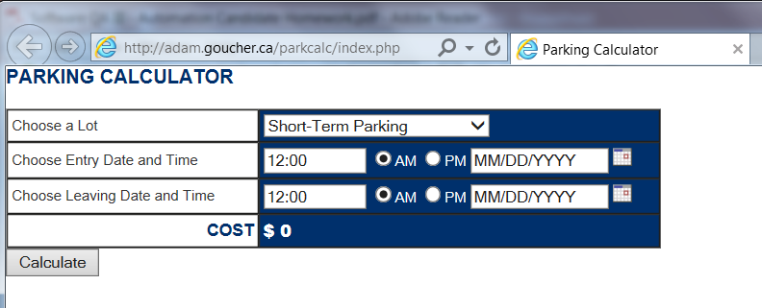
The System Under Test (SUT)
Parking Calculator

Slide 6
Architecture
The web application is the SUT.
The Automation Framework is directly tied to Selenium and implements Page Object Model (operations and flows in the UI).
Test cases could use any testing framework (e.g.: Nunit, MSTest, xUnit .Net) for verification.
Web Application
Automation
Framework
Selenium
Tests

Slide 7
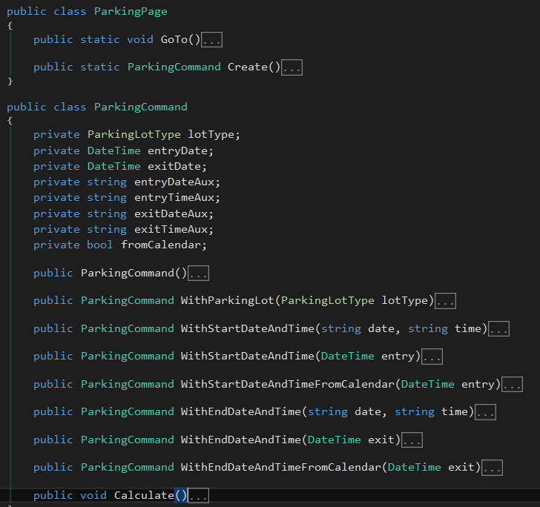
Page Object Model (POM)
It helps to make code more readable, maintainable, and reusable.
POM recommends to create a page class for each web page in our web application. This page class will find the WebElements in the web page and will perform operations on those WebElements.

Slide 8
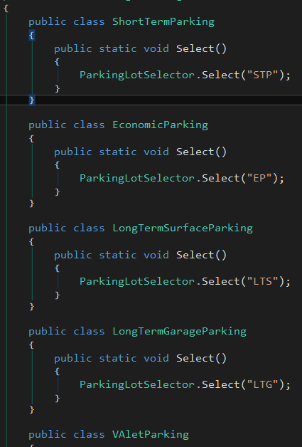
Page Object Model (POM)
One of the biggest advantages is that if the element change in the web page, we only need to make a change in a single place. For example, if the value for Short-Term Parking change in the future, we’ll need to update only in one place.

Slide 9
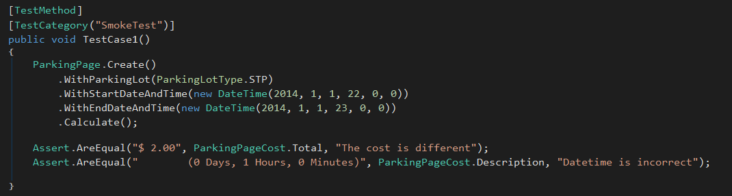
Advantages of POM
Page Object Patten says operations and flows in the UI should be separated from verification. This concept makes our code cleaner and easy to understand.
Code becomes less and optimized because of the reusable page methods in the POM classes
Verification is made at test level

Slide 10
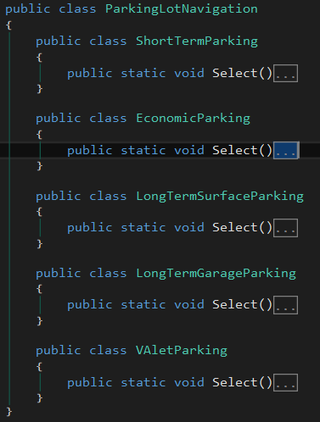
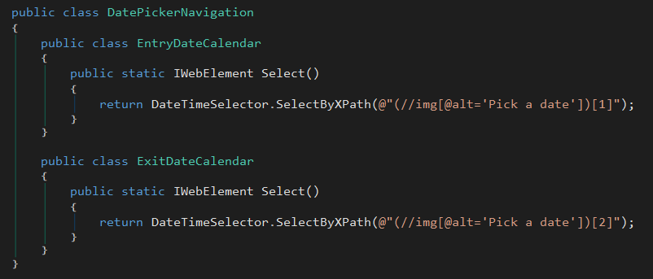
Advantages of POM
Methods get more realistic names which can be easily mapped with the operation happening in UI. i.e.: The method for select short-term parking will be ParkingLotNavigation.ShortTermParking.Select();

Slide 11
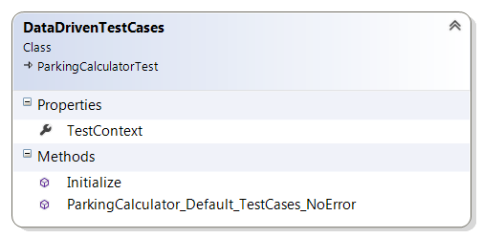
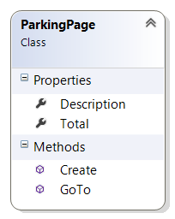
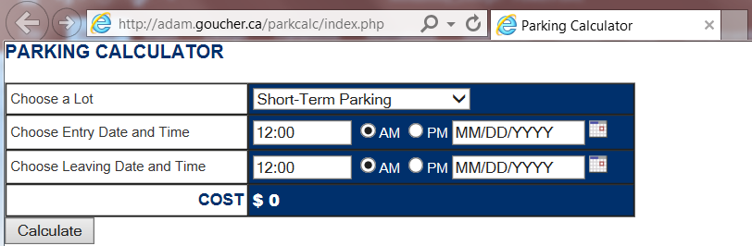
The Page Pattern
Operations and flows in UI are managed here
Verification is managed here (Tests)
SUT

Slide 12
Future Work or Nice to Have
Automation Framework independent of Selenium.
Integrate Specflow to define, manage and automatically execute human-readable acceptance tests.

