Slide 1
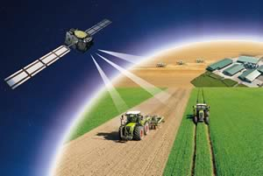
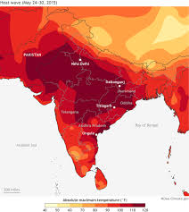
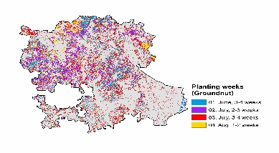
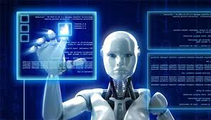
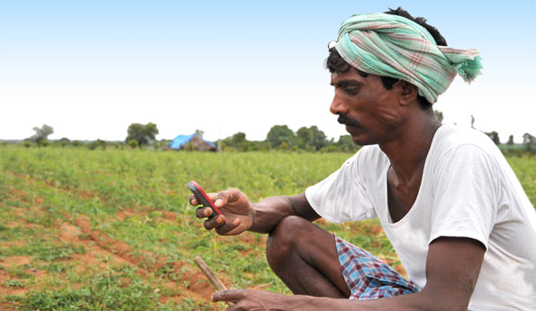
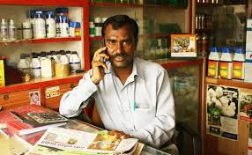
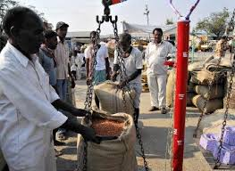
AgNi Artificial Intelligence System for next generation Agriculture .

Slide 2
Power of Contextual Content
Increased yield
Quality
Cost reduction
More profits
Agricultural Ecosystem Players
Agri Input Companies
Agri Output Companies
Agricultural Universities &
Research Organizations
Relevant, Recent and Micro
level information

Slide 3
Model
Content Enrichment
Content Users
Agricultural Universities & Research Organizations
Agri Input Companies
Agri Output Companies
Other Stakeholders
User Feedback
AgNi
Farmers
Agri Input Companies
Extension Officers
Agri Output Companies
Artificial Intelligence System for next generation Agriculture

Slide 4
Solution & Demo

Slide 5
Team AgNi members
Anjaneyulu SVS (anjaneyulu.svs@i2vworld.com)
DakshinaMurthy Kadiyala (D.Kadiyala@cgiar.org)
Dukhishyam (dukhishyam@farmfocus.in)
Hari Krishnan (Krishna.hari@gmail.com)
Patan Elias Khan (P.Eliaskhan@cgiar.org)
Priyanka Pathak (priyanp@microsoft.com)

