Slide 1



Great opportunity
Low income of small holder farmers
Poor market integration
Climate variability and change
Poor access to information technology
Location specific climate information/ forecast
Access to near-by technology institutions: SAUs, KVKs, Research institutes and extension agencies
Connecting large number of small holders, producers and buyers (e-mandis, market aggregation)
Information is power

Slide 2
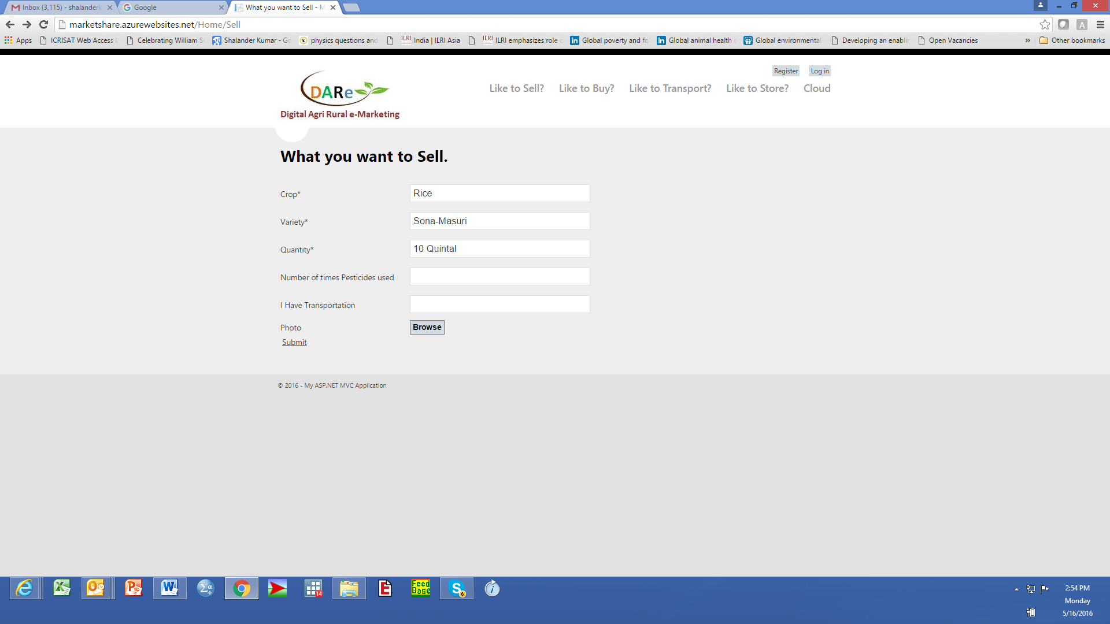

Slide 3
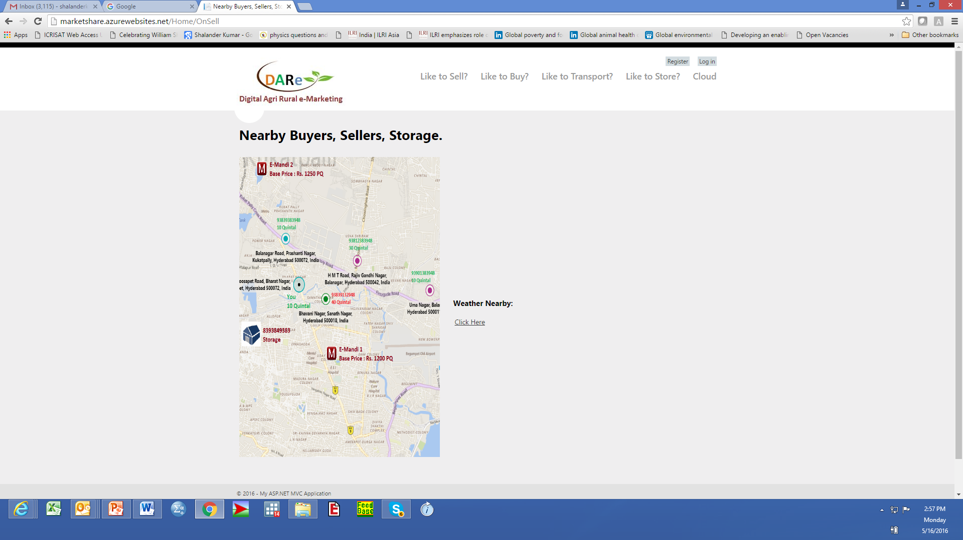

Slide 4
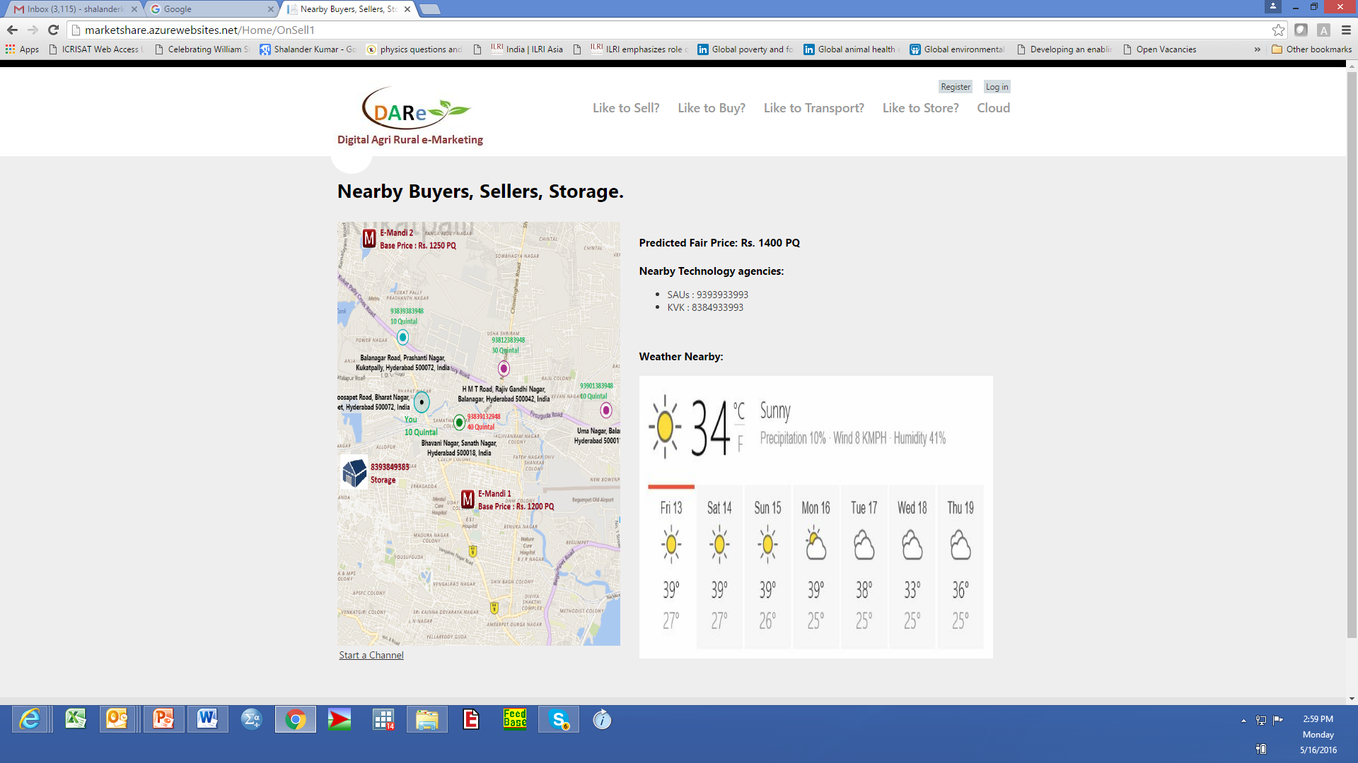

Slide 5
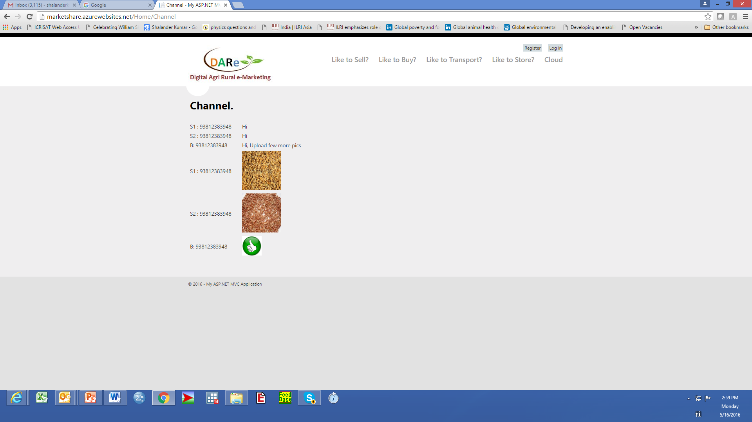

Slide 6
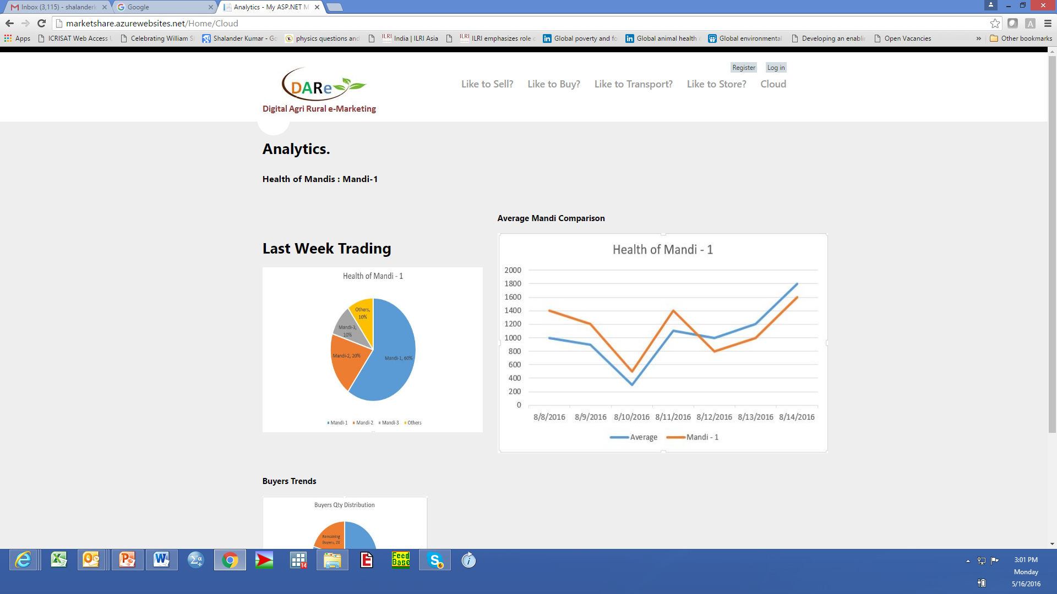

Slide 7
Increased price realization for small holder farmers
Multiple options for buyers and processors
Farmers use location specific climate information/forecast for climate risk management
Real time data accessibility for market monitoring and future planning

