Slide 1
Elixr
To feed the world's rapidly-expanding population in
coming decades, agriculture must produce more. Our
Big data holds one of the keys for farmers.
1

Slide 2
A farmer knows his every acre. Each inch the crop grows. Each species of bug that may destroy it. The wind, the rain, the heat, the dust. He knows the effects of it all. But he is limited
Trust is a currency in this world. Farmers need people they trust to inform the many decisions they make every year. The agricultural world has evolved to rely so much on seed sellers, fertilizer sellers, and local traders. Trust is broken, they need an alternative.
With our predictive analytics, the data is combined with real-time market information, farmers can mitigate price fluctuations better. The volatility on the market of crops can be substantial. Speculations can increase the price of crops or bring it down.
Using our predictive analytics the price of a certain crop can be determined upfront in a certain location. This will help the farmer to get the right price for the right crop at the right moment in time at the right location.
1

Slide 3
We have derived a model that suggests farmers on when to Sell and where to sell and at what prices after analyzing huge amounts of data, trends and patterns.
We look forward to more data-driven diagnostics, marketing plans, and predictive analytics to determine the best selling plans more scientifically.
And we will see a new era of marketing and sale of agricultural commodities , where data about an individual crop– ranging from weather data to farming practices – becomes data to help algorithmically determine a better strategy for marketing and sale.
Future Prices Predictions info from institutions like Commodity Exchange
Funding against warehouse storage receipt, Facilitating Banks and other financial institutions
2

Slide 4

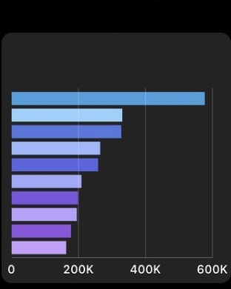
App Tentative Demo
Predictive Market Prices
Mobile App
3

Slide 5
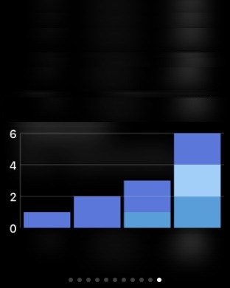
App Demo
Increase in Returns
Mobile App
Crafter © 2016
4

Slide 6
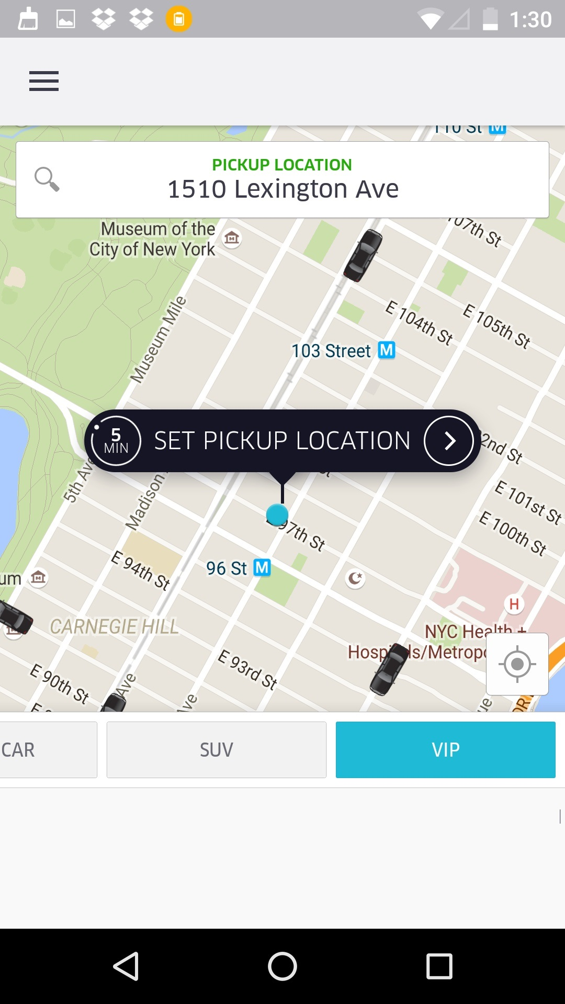
App Demo
Book a Truck
Mobile App
Crafter © 2016
5

Slide 7
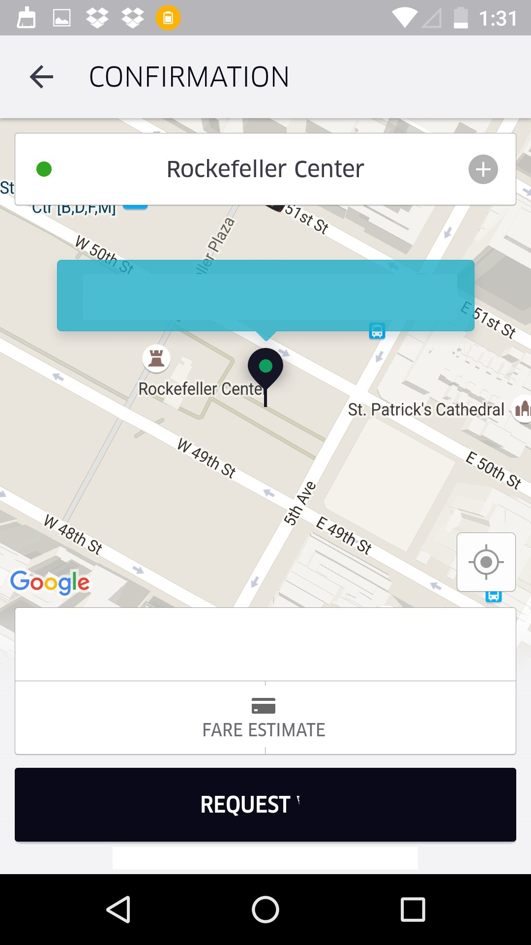
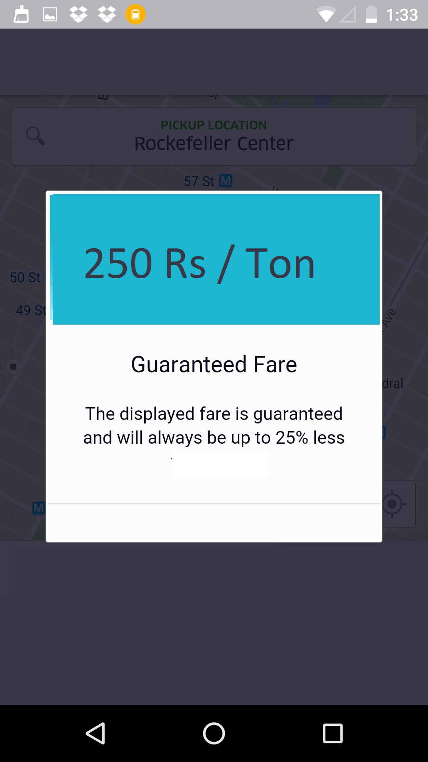
App Demo
Storage /Warehouses
Mobile App
Crafter © 2016
6

Slide 8
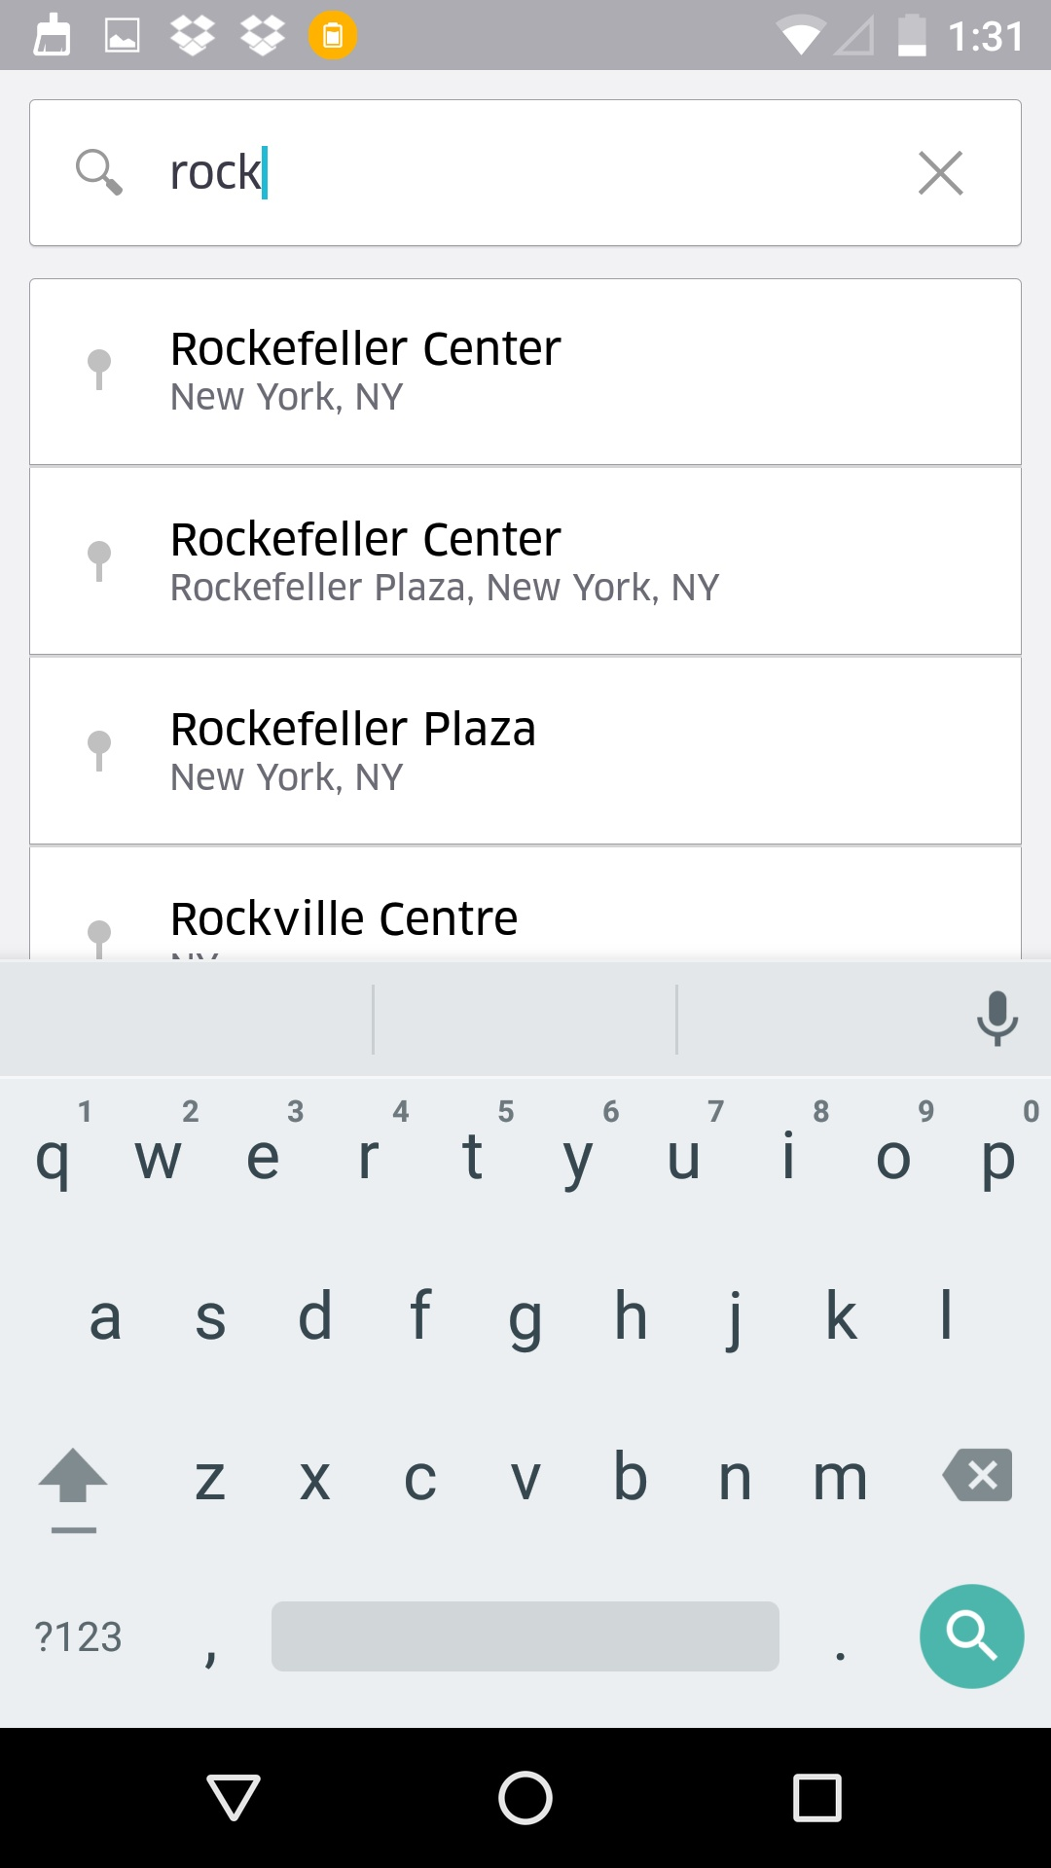
App Demo
Find Storage manually
Mobile App
7

Slide 9
Navatej Kumar
Prakhar Bansal
Dr. Sreenivas Rao
Purushotham
Mahender Kola
Team 9
Thank You
8

