Slide 1
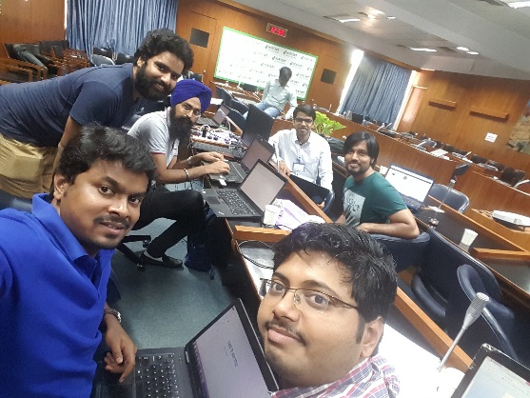
FarmWell Google For farmers
Team 1: Gaurav, Navpreet, Chanchal, Prateek, Pankaj & Sampath

Slide 2
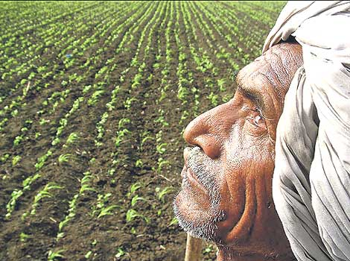
Farmer’s words – Before Cultivation
Crop decision
Current high value crop
Labor
Follow routine crop rotation
Availability of Finance
Follow co-farmer
Financial source
Co-farmer
Own saving
Money lender
Loan against Jewel in private money lenders
Income Planning?
Why not loan?
Crop Protection
Not aware unless bankers stress farmers while availing loan

Slide 3
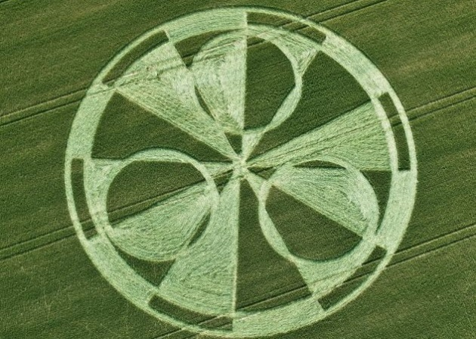
Farmer’s words – During & After Cultivation
No Support on weather changes
Agri Input Purchase
Own Saving
Traders for Seeds
Agri Input Shops (Not compelled to pay immediately)
Traders
Nearby local market
Cost: Commission, Packaging, Wastage and logistics
Support on Cultivation practices

Slide 4
Objective
To develop a system which allows for informed decisions about farming leading to
Optimal Yield
Optimal Use of Water & Fertilizers
Avoid Crop Loss
Know the market

Slide 5
Opportunities
Right Crop
Know the risks (Climate, Soil, Water, Pest/Disease)
Right Market
FarmWell

Slide 6
Solution Overview
Weather
Soil
Irrigation Requirement
Historical Info
Market
Crop Decision
Maize
Paddy
Variety
Cultivation Protocol
Risks Info: Weather, Pest & Disease & Water
Market Info
Wheat
Precision
Sensors
UAVs
API
Satellite Images
Insurer
Weather Risk
Crop Health indexes
Yield Info
Market

Slide 7
Technology Framework
Acquire
Models
Analyze
App
Gateway
API
S1
S2
S3
Application
Soil test results
F1
F2
F3
Nutrient recommendation
M1
M3
Application Control
Soil health Monitoring
M2

Slide 8
Solution Network
FarmWell
Sense Data (M1)
IoT Suit (Gateway & Cloud)
Application (M2 & M3)
Experts
Partners
Buyers
Growers / Grower Communities
Government bodies (KVKs, Extension Department)
Enterprises

Slide 9
Business Models
“Google for Farmers”
Market Makers / Ecosystems:
Service providers for machine-related activities
Service providers for Seed-related activities
Service providers for business intelligence
FarmWell
1
2
3
4
5
..

Slide 10
Thank you

