Slide 1

iFarm –
“Transforming lives, one farmer and one farm at a time”

Slide 2
Outline:
1
Background
2
iFarm
3
Demo

Slide 3
Background:
Today’s agriculture is very rain reliant
Farmer is working against the climate unintentionally
Research data exists in multiple places, isolated in multiple formats
Information gap exists between farmers and science
Need to bridge the information gap between the useful agri-data and the farmers whose livelihood can be transformed with that data

Slide 4
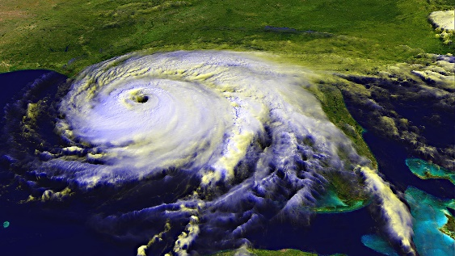
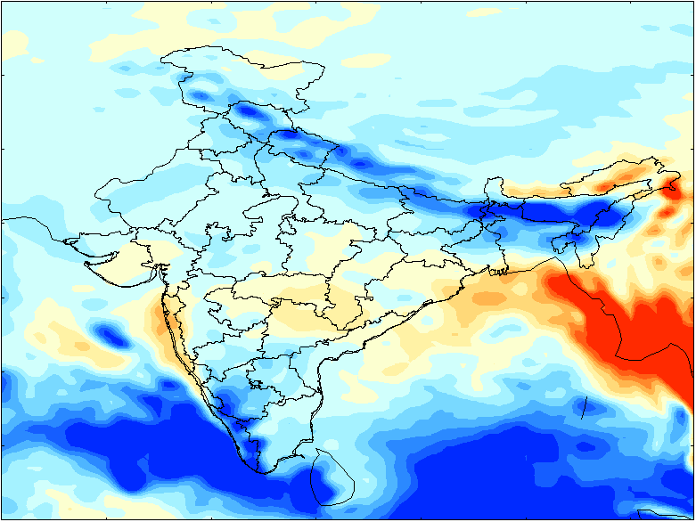
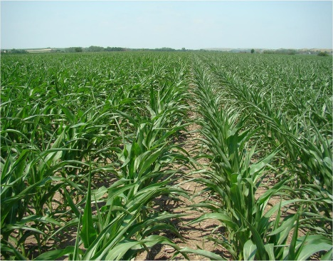
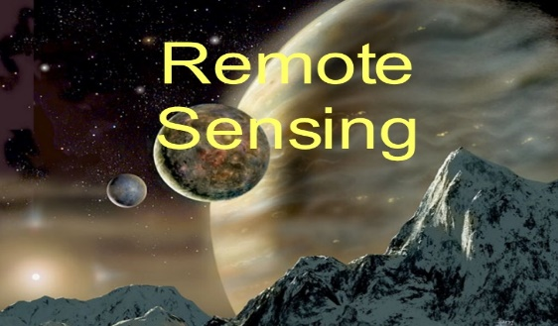

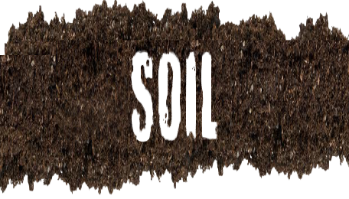
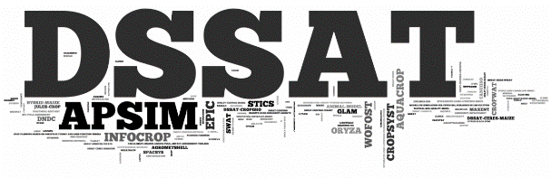


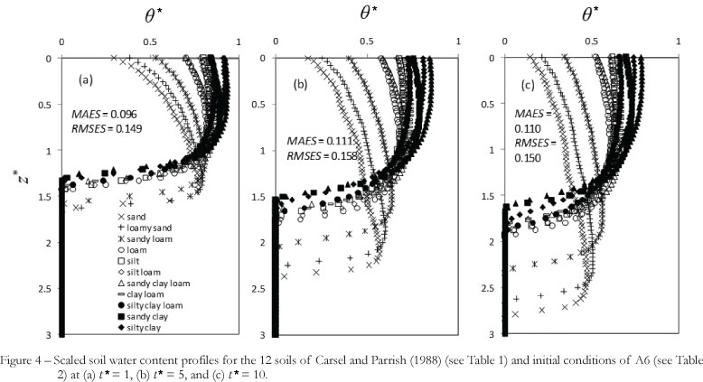
iFarm
Seasonal Climate information
Agronomy
Climate
Interventions

Slide 5
DEMO

Slide 6
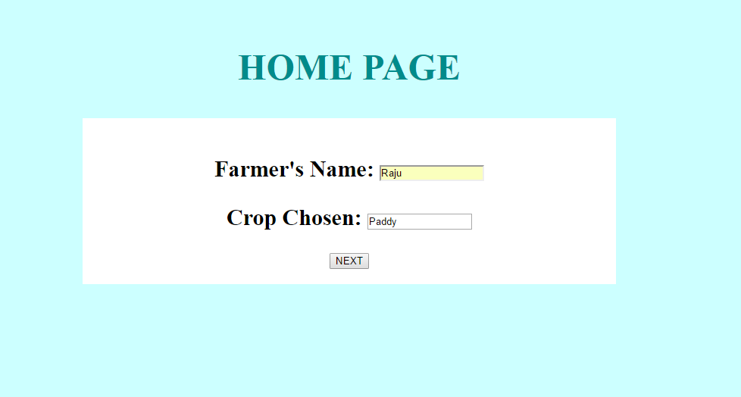

Slide 7
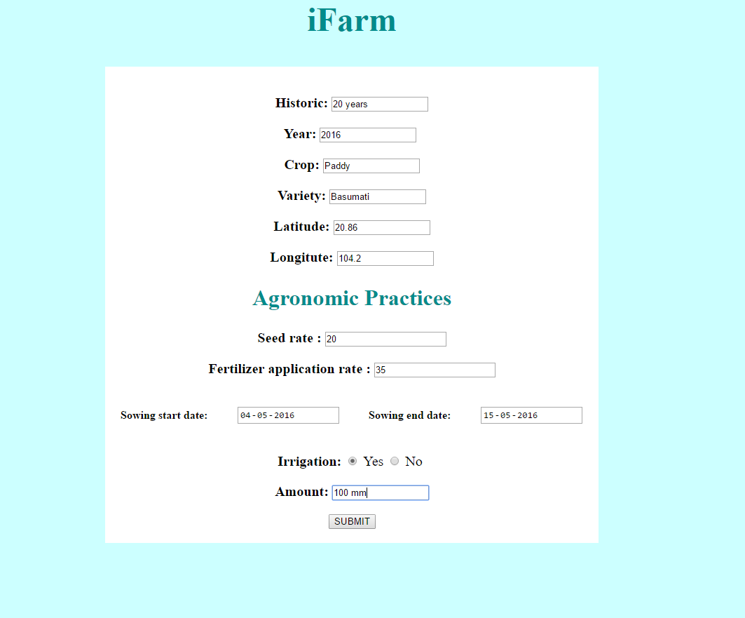

Slide 8
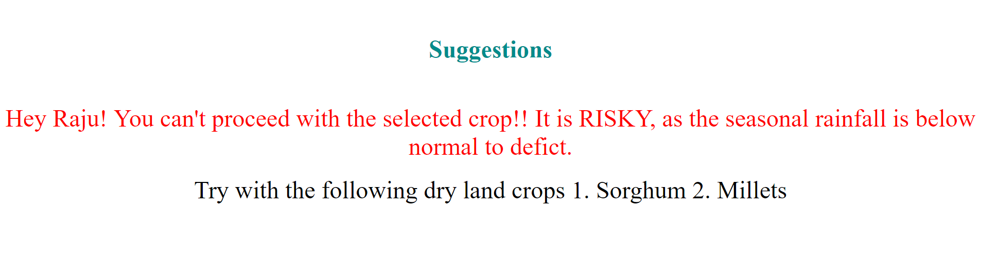

Slide 9
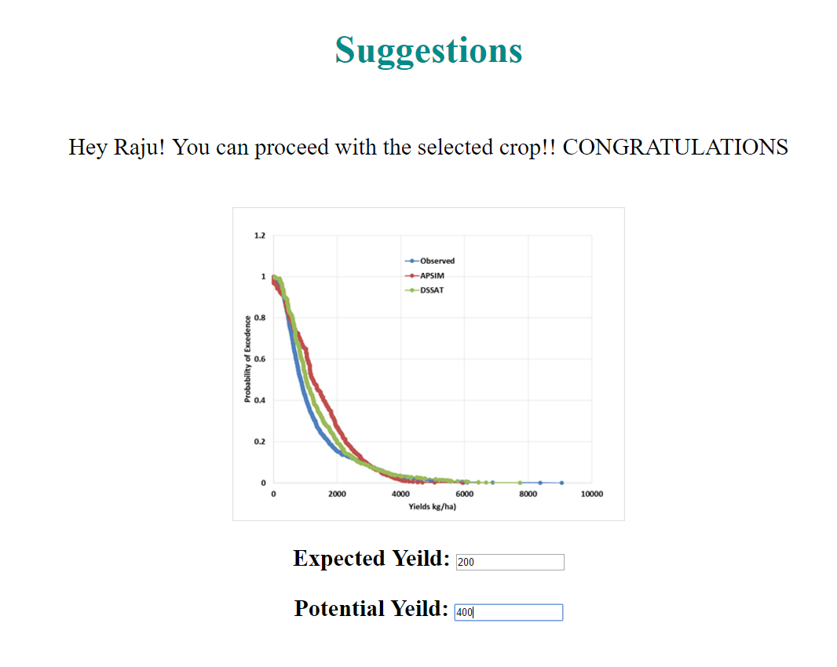

Slide 10


Let’s transform lives, one farmer and one farm at a time!
Thank you!
Thank you!
ICRISAT is a member of the CGIAR Consortium

