Slide 1
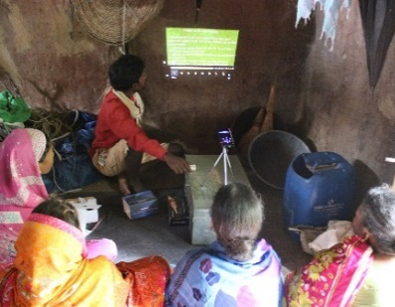

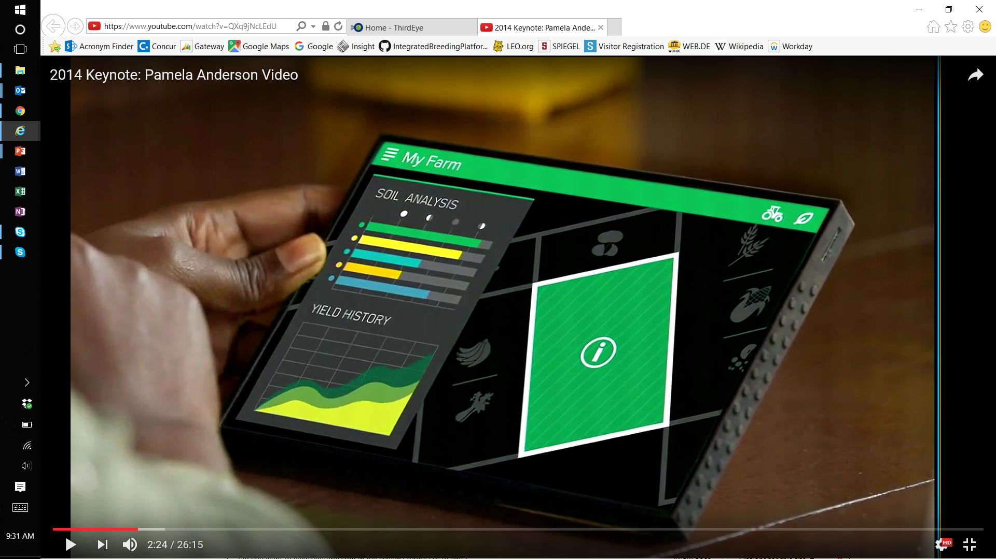
1
INVEST IN DISRUPTIVE ICT4AG MODELS
THREE INVESTMENT OPPORTUNITIES WILL UNLOCK FARMER PRODUCTIVITY AND INCOME
PARTICIPATORY AND CUSTOMIZED RAS
ICT-ENABLED MARKET LINKAGES
SELF-SERVICE FARM
MANAGEMENT SOLUTIONS
… to link farmers to the knowledge necessary to drive productivity gains
… to translate productivity gains into increased famer incomes
… to boost farm profitability and empower farmers to transition from smallholders to small businesses
2
3
4
2
3
4
2
3
4
Ag Transf. focus:
0
1
Ag Transf. focus:
0
1
Ag Transf. focus:
0
1
Across these investment opportunities we will fund high risk innovations with potential for transformative shifts in farmer productivity and income, and build the evidence base to understand and demonstrate the value of ICT solutions
RAS photo courtesy of Digital Green.

Slide 2













1
INVEST IN DISRUPTIVE ICT4AG MODELS - RURAL ADVISORY SERVICES
ICT-enabled RAS drives greater productivity gains than traditional methods
By linking farmers to the knowledge needed to access and adopt high quality, effective, low costs product services and practices, successful ICT-enabled RAS could drive:
RATIONALE FOR INVESTMENT AND IMPACT DIMENSIONS
Primary - global goods, by developing new digital RAS solutions
Secondary – farmer impact, by increasing awareness of improved products/services/ practices, increasing diversity in cropping and livestock systems, increasing resilience and women’s decision making.
30-40%
20-25%
30-45x
increase in yields
increase in
farmer income
return in farmer income / dollar invested
GRANT EXAMPLES
Ag system surveillance utilizing Remote Sensing
HIGH POTENTIAL INVESTMENT OPPORTUNITIES
Test and expand participatory and multichannel models
Support bundled RAS and market linkage models
Experiment with “precision” models
Facilitate extension system performance
Digital Soil Maps
Radio extension & feedback
Community Knowledge Worker Program
Critical gender dimension
Critical nutrition dimension
Video extension
Weather data
Yield, income, ROI and cost targets are aspirational targets estimated for RAS investments based on evidence from existing models and dimensions of BMGF proposed investment. See annex for detailed data and methodology on impact and cost-effectiveness of RAS models.
2

Slide 3
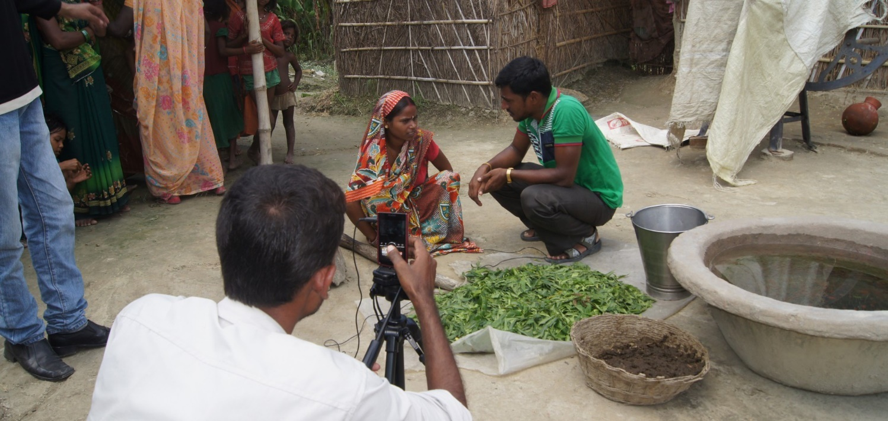







1
INVEST IN DISRUPTIVE ICT4AG MODELS - RURAL ADVISORY SERVICES
New models have the opportunity to multiply productivity gains vis a vis traditional extension
Test & expand participatory and multichannel models
Support bundled RAS and market linkage models
Experiment with “precision” models
Facilitate extension
system performance
Proven potential for high (20-50%) productivity gains
More experimentation needed to include women and determine optimal level of human mediation for cost-effective impact
Connecting to input and/or offtake markets allows farmers to translate knowledge into productivity and income
Some models have shown >50% income increases
Customized, farmer-data driven models delivering plot-specific advice represent next frontier in RAS
Given risk appetite, BMGF well poised to drive this innovation
Low cost data system to track service delivery and outcomes
Incentive based workforce management
Improve targeted outreach to underserved groups
Critical gender dimension
Critical nutrition dimension
3

Slide 4





1
INVEST IN DISRUPTIVE ICT4AG MODELS
INVEST IN DISRUPTIVE ICT4AG MODELS – MARKET LINKAGES
BETTER MARKET LINKAGES WILL TRANSLATE PRODUCTIVITY GAINS INTO INCREASED FARMER INCOME
By enabling farmers to act on the information they receive to purchase quality inputs and connect to markets to sell their produce at better prices, digital market access models could drive:
RATIONALE FOR INVESTMENT AND IMPACT DIMENSIONS
Primary - global goods, by developing new digital market linkages solutions
Secondary - farmer impact, by improving market knowledge and access, reducing women time burdens, and increasing women control over income
50-60%
8-10x
increase in
farmer income
return in farmer income
per dollar invested
GRANT EXAMPLES
HIGH POTENTIAL INVESTMENT OPPORTUNITIES
2KUZE
Drive input linkages to financial sustainability
Experiment with output linkages in loose value chains
Integrate market linkages and farm management solutions
Integrate market and financial services solutions
SHF finance & e-trading
SHF e-trading,
track & trace
Virtual aggregation
Critical gender dimension
Income, ROI and cost targets are aspirational targets for market linkages investments estimated based on evidence from existing models and dimensions of BMGF proposed investment. See annex for detailed data and methodology on impact and cost-effectiveness of RAS models.
4

Slide 5




1
INVEST IN DISRUPTIVE ICT4AG MODELS
INVEST IN DISRUPTIVE ICT4AG MODELS – MARKET LINKAGES
experiments are happening on both input and output market linkages, giving us an opportunity to support innovation
Drive input linkage models to financial sustainability
Experiment with output linkages in loose value chains
Integrate market linkage and farm mgmt solutions
Integrate market linkage and financial service solutions
Platforms connecting farmers to high quality, low cost inputs have shown high income gains [>20%]
More experimentation needed on aggregation and achieving financial sustainability
Models that combine aggregation, market transparency, and human-intermediated logistics promise strong returns (~$3 income/$1 invested)
Limited private engagement opens clear role for BMGF
Partnerships between market access/farm mgmt innovators could unlock exponential impact (60-400% income increases) by empowering farmers as entrepreneurs
Both require localized, context-specific solutions
In collaboration with FSP, AgDev can develop human-centered, integrated finance, market, and payment solutions
Critical gender dimension
5

Slide 6






1
INVEST IN DISRUPTIVE ICT4AG MODELS
INVEST IN DISRUPTIVE ICT4AG MODELS – FARM MANAGEMENT
OUR MOONSHOT: ENABLING THE TRANSITION FROM SMALL FARMERS TO SMALL BUSINESSES VIA FARM MANAGEMENT SOLUTIONS
By empowering farmers the tools to become entrepreneurs, farmer self-service solutions can boost profitability and transform the livelihoods of rural communities
RATIONALE FOR INVESTMENT AND IMPACT DIMENSIONS
Primary - global goods, by developing new digital farm mgmt. tools
Secondary - farmer impact, by increasing efficiency of input use, increasing cropping diversity and resilience, and increasing women decision making and access to productive assets
40-60%
60-80%
2-15x
increase in yields
increase in
farmer income
return in farmer income / dollar invested
EXAMPLES OF INNOVATORS
HIGH POTENTIAL INVESTMENT OPPORTUNITIES
Invest in agent-facilitated farm management tools
Create PPPs to expand self-service models to loose value chains
Experiment with digitally-enabled asset sharing models
Digitalization of land records, land tenure management
Farmer Business Schools
Farmer Business Books
Mechanization sharing
Disease detection & treatment
Critical gender dimension
Critical nutrition dimension
Note: Impact metrics are anecdotal high-level, long term estimates of what may be possible with our farm management investments based on limited, anecdotal evidence. See annex for detailed data and methodology on impact and cost-effectiveness of farm management platforms
6

Slide 7



1
INVEST IN DISRUPTIVE ICT4AG MODELS
INVEST IN DISRUPTIVE ICT4AG MODELS – FARM MANAGEMENT
investment opportunities today are very early stage and private-sector led
Invest in agent-facilitated farm management tools
PPPs to expand self-service models to loose value chains
Experiment with digitally-enabled asset sharing models
Digitalization of land records, land tenure management
Agent-mediated farm management models emerge as the priority investment for near term impact, given low smartphone penetration and digital literacy, particularly in loose value chains
Several private players have already developed robust, commercial self-service farm management products
BMGF can incentivize, facilitate, and test the expansion of these models for staple crops
ICT tools can enable farmers to share critical assets (e.g., tractors, laser leveling tools), improving their productivity while lowering costs
BMGF is well positioned to spur innovation in this relatively new, untested space
Digital documentation of land rights & usage
Geographical Information Systems utilizing open imagery & mapping tools
Data ownership – access rights management & self service sharing tools
Critical gender dimension
Critical nutrition dimension
7

