Slide 1


Slide 2

Problem
It is expensive for seed companies to reach small scale farmers.
It is expensive for seed companies to get reports on seed products.
Small scale farmers are scattered and technologically uneducated.

Slide 3
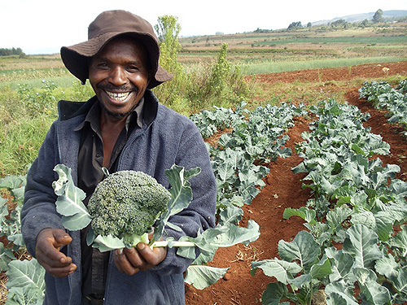
Solution
Seed companies recruit agents.
Agents manage demo plots, register farmers, hold field day events.
Agents submit reports through mbegubora.
Agents are rewarded with agro-trips, seeds, fertilizer.
Companies use reports for business intelligence.

Slide 4
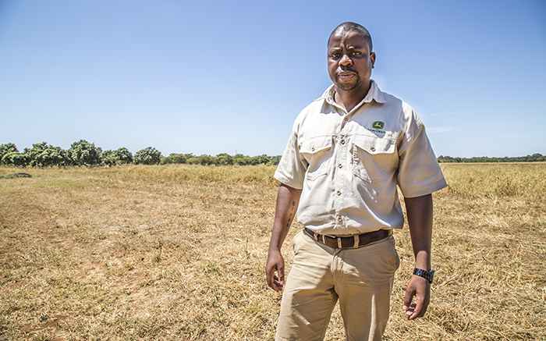




Screenshot
Agents
MbeguBora Platform
Farmers
Seed Companies

Slide 5
Business Model
Seed companies subscribe for their agents to use our platform to submit reports.
Value added charges on premium services.(aWhere, SMS)
Inviting farmer to field days through sms.
Field day promotions.

Slide 6
Competitive Advantage
Cost effective.
No technical expertise.
Easy to use.
Subscription based.
Challenges
Agent Data costs

Slide 7
Marketing
Direct Meetings with seed company .
Trade shows.
Agent training sessions.

Slide 8



Budget
Implementation costs.
Service providers cost (aWhere).
SMS providers(Africa’s talking).
Marketing cost.
IoT camera providers.
Cloud service providers.

Slide 9
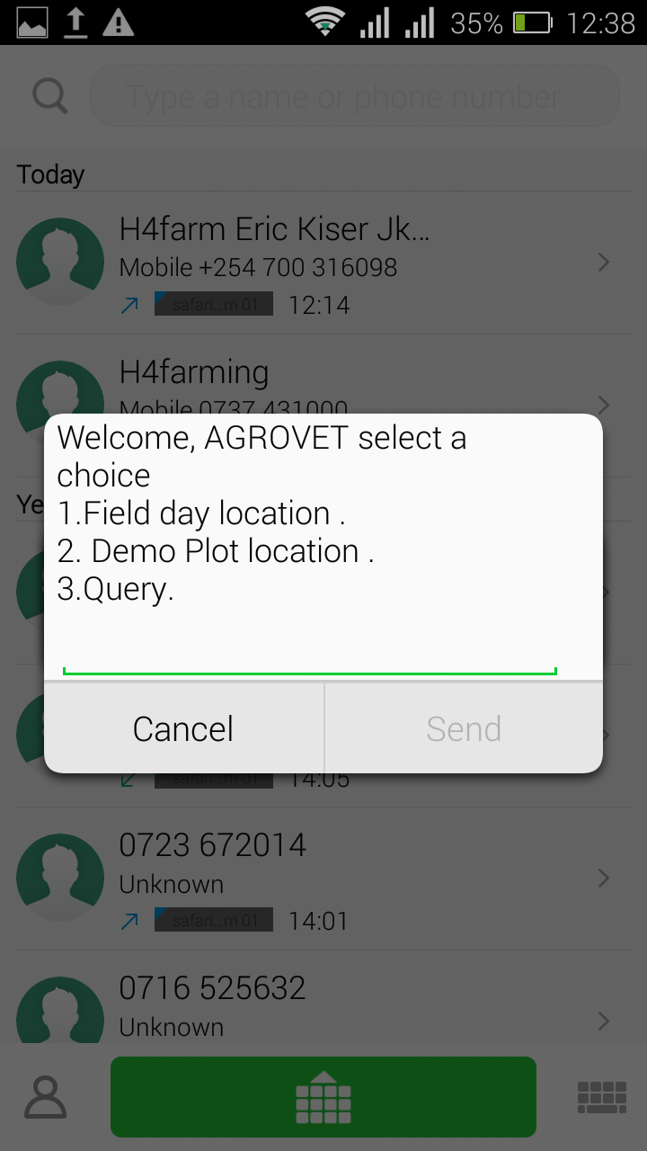
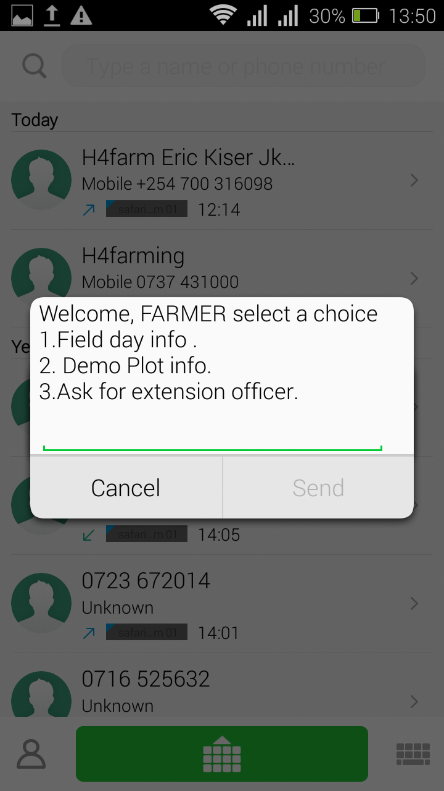
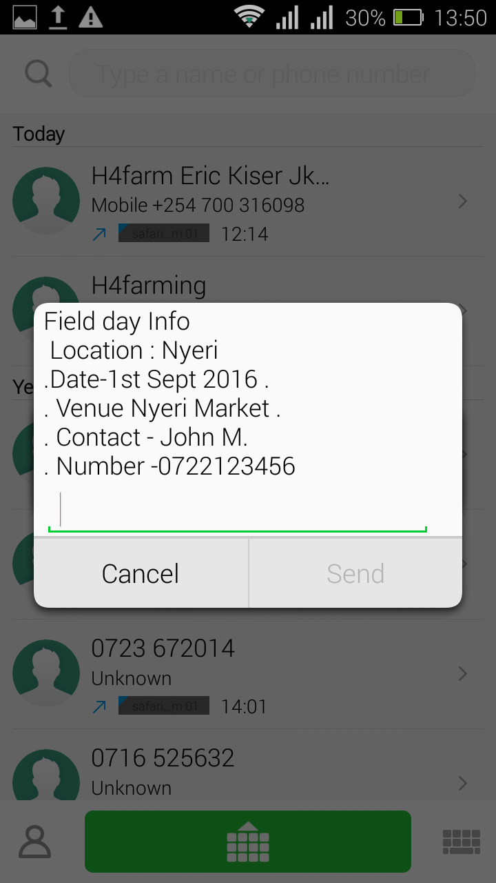

Screenshot(USSD *384*3679#)

Slide 10
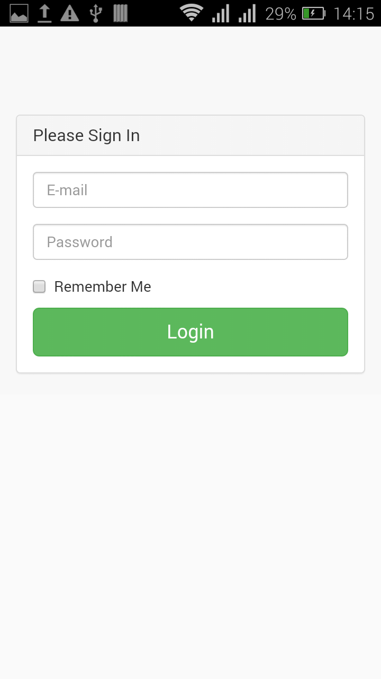
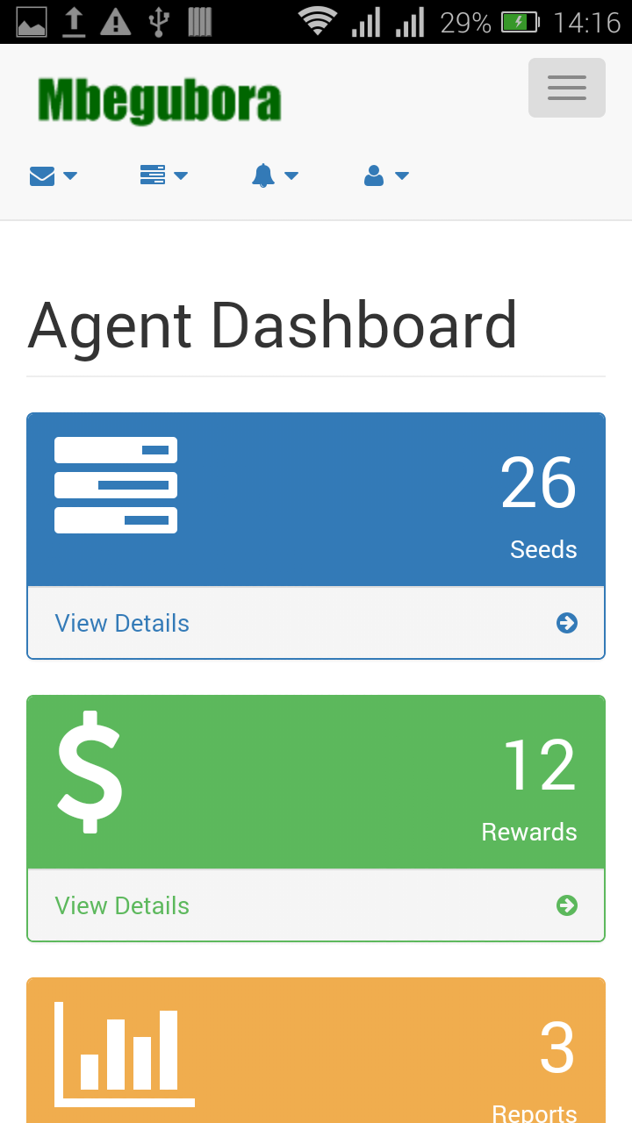
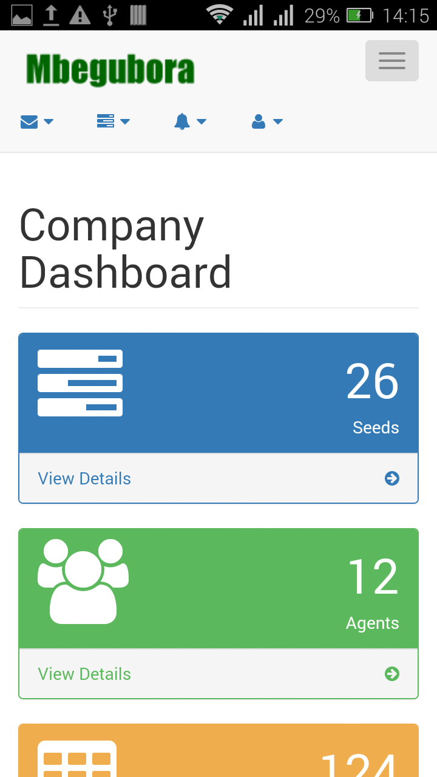
Screenshot

Slide 11
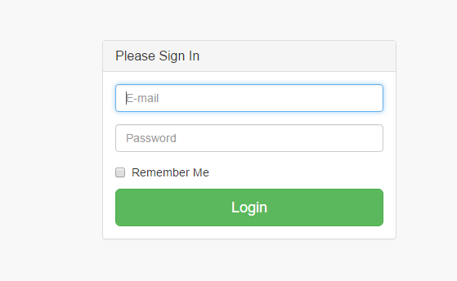
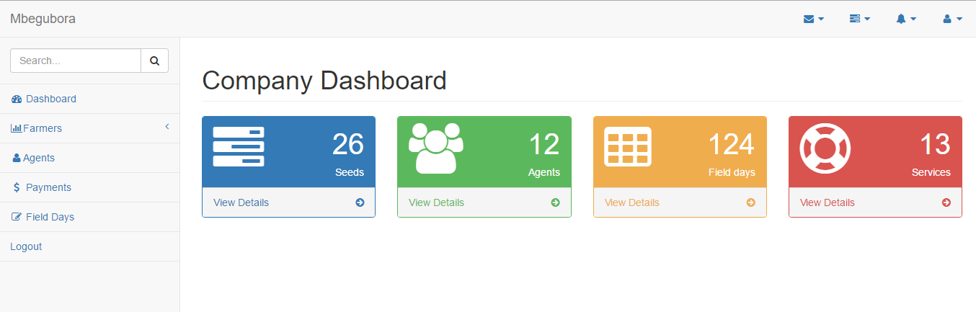
Screenshot

Slide 12
Thank You
Team Members
Name Email
Nathan Tonui tonui.nat13@gmail.com
Edwin Amakobe edwinamakobe10@gmail.com
Samuel Ouko oukosam@yahoo.com
Albert Muchisu amuchisu@gmail.com

