Slide 1
FARM REWARDS
Problem Statement
How seed companies can collect, access and visualize transactional data using cloud based data.

Slide 2
GOAL
Help seed companies, their partners (farmers, distributors, rural agents & agro-dealers) succeed & build relationships.
Gather customer data that will be used to identify sales trends, predict demand and targeted marketing.

Slide 3
Our Solution
To harness a farmers shopping list for better DATA driven business decision making and farming.

Slide 4
Process
1. Agrodealers/Distributors get POS systems running on nfc enabled tablets or mobile phones.They recieve bar codes of the product descriptions and location to stick on their products.
2. Farmers are registered as they buy the products and receive a nfc enabled loyalty card with information of what they bought.

Slide 5
Process ctn...
3.Farmers shopping history is received on cloud and segmented by location and products bought.
Ther data is analyzed send to the concerned seed companies.
Farmers will recieve farming tips information as per their purchase history.
The agrodealer owner will recieve updates on his stock flows.

Slide 6
Benefits
Maintain a clear, transparent pricing.
Promising targeted marketing.
Benchmark progress and those of peers and identify areas of improvement.
Build/Sustain credibility of seed company and trust among farmers via regular direct interaction with farmers.
View total weekly dealer sales.
View seed demand by region

Slide 7
POSSIBLE ANALYSIS BY SEED COMPANIES
Seed demand by region- depends on sales

Slide 8
POSSIBLE ANALYSIS BY SEED COMPANIES
Total Weekly Agro-dealer Sales

Slide 9
POSSIBLE ANALYSIS BY SEED COMPANIES
Weekly dealer Sales

Slide 10
POSSIBLE ANALYSIS BY SEED COMPANIES
Outgrower yields

Slide 11
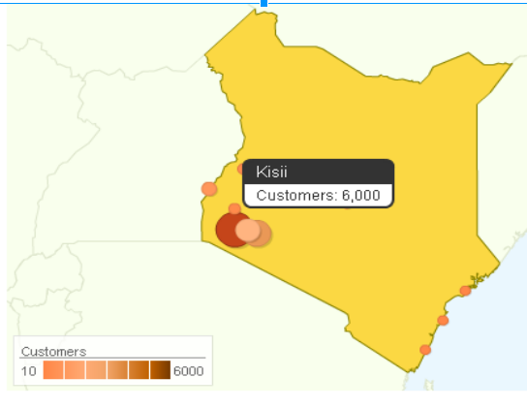
POSSIBLE ANALYSIS BY SEED COMPANIES
Customers-by region

Slide 12
Revenue Generation
Annual subscriptions by Seed companies.
Marketing revenue on cards.

Slide 13
Implementation Challenges
High cost of hardware.
Initial high cost of farmer acquisition.

Slide 14
FARM REWARDS
GROUP MEMBERS
Lydia Wambua
Mutano Munyao
Tekwane Mwendwa
Mugambi Mwalishi
Tallbert Maangi
Hezron Munyakin

